Slide 1

Various Stack Impementations

Slide 2
CONCURRENT STACK
IN THIS PRESENTATION WE ARE GOING TO TALK ABOUT IMPLEMENTATIONS OF VARIOUS STACKS THAT SUPPORT CONCURRENCY
WE ARE TO MEASURE THE TIME TO EXECUTE ITS PROGRAM AND COMPARE THEM
EACH PROGRAM EXECUTES 1.000.000 OPERATIONS

Slide 3
VERSION 1
Version 1 implements a concurrent stack.
The program uses a hashtable of 64 buckets, separated into 4 smaller hashtables of 16 buckets each.
These correspond to the 4 NUMA (Non-Uniform Memory Access) nodes of the system, with each NUMA node having its own memory.
Insertion, lookup, and deletion are based on two hash functions:
1. Hash function 1 determines the NUMA node.
2. Hash function 2 determines the index in the hashtable of the given NUMA node.
Threads operate on the hashtable based on their key value using these hash functions.

Slide 4
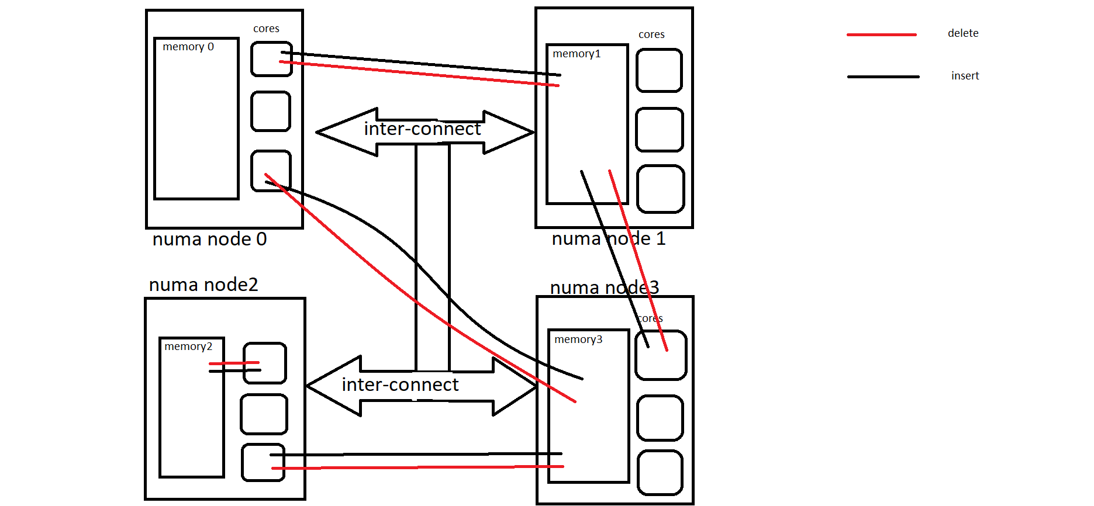

Slide 5
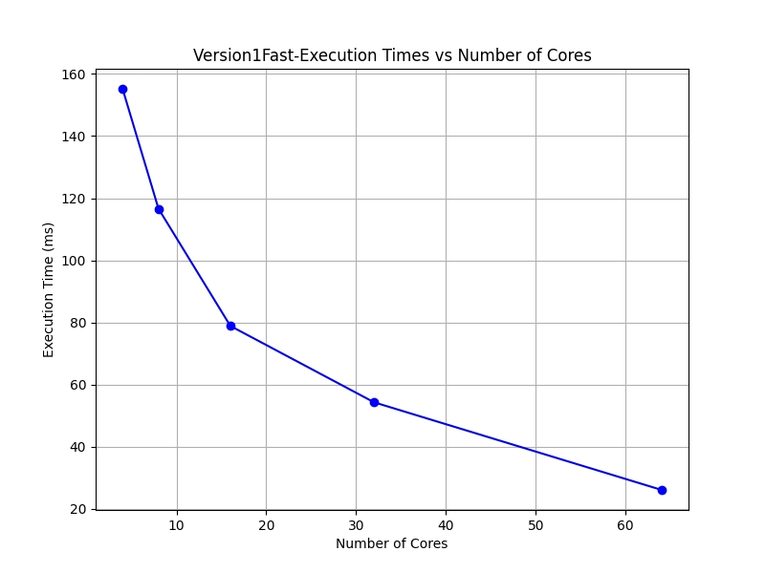

Slide 6
VERSION 2
Version 2 implements a concurrent stack.
The program uses a hashtable of 64 buckets, separated into 4 smaller hashtables of 16 buckets each.
These correspond to the 4 NUMA nodes of the system, with each NUMA node having its own memory.
Difference from Version 1:
Threads can only insert elements into their own hashtable.
For deletion, threads must search all 4 NUMA node hashtables to find the element to be deleted, as they do not know where each element is stored.

Slide 7
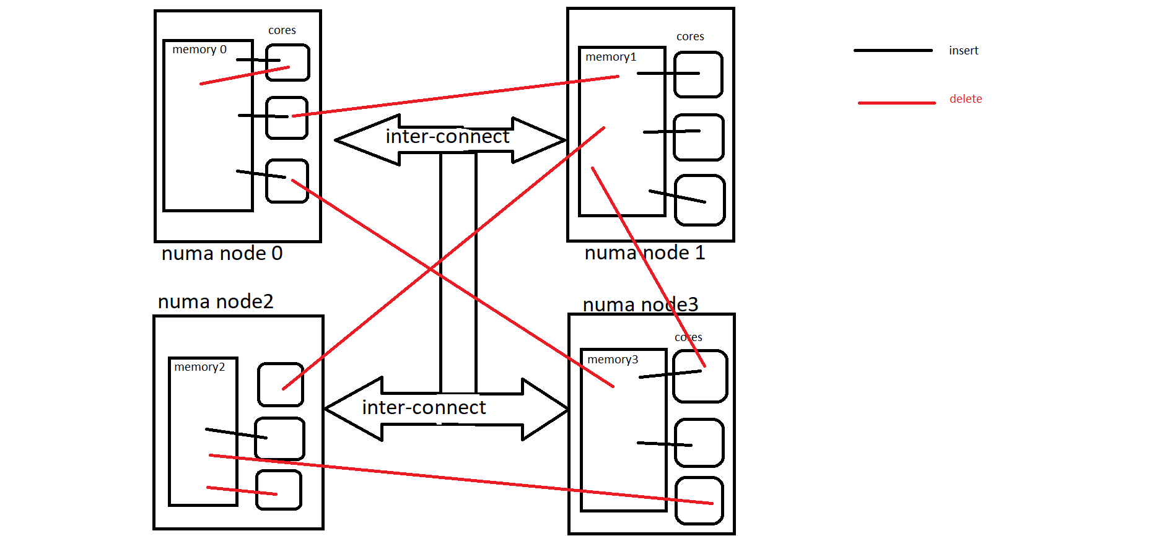
VERSION 2 –INSERT AND DELETE

Slide 8
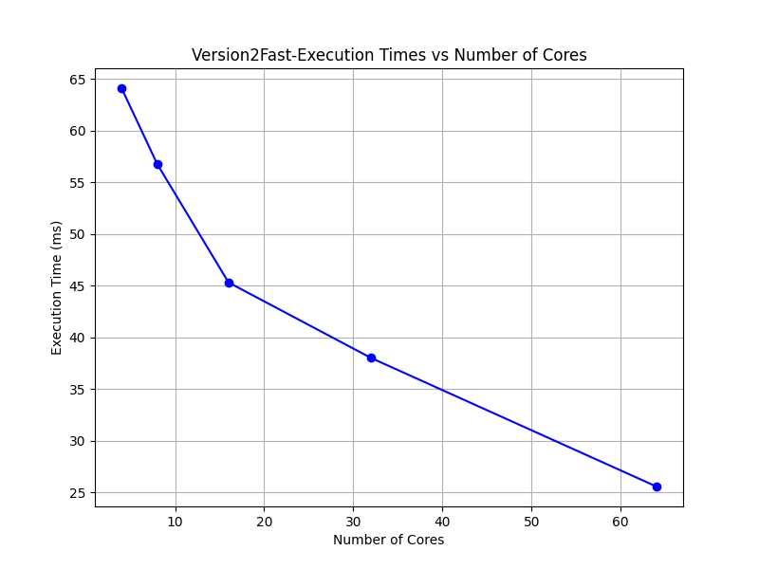

Slide 9
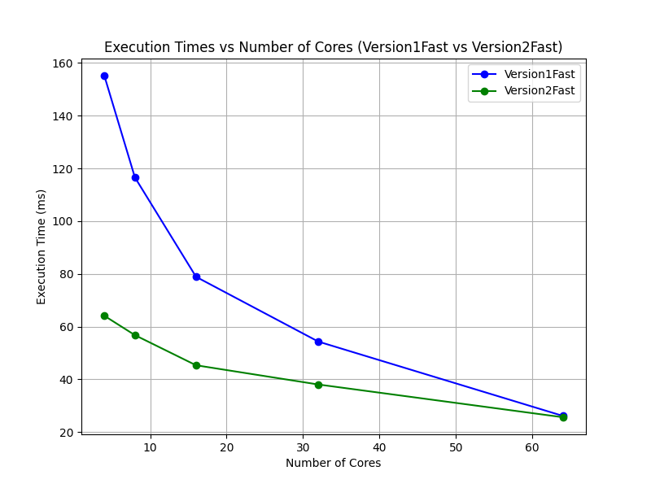
COMPARING VERSION 1VS2

Slide 10
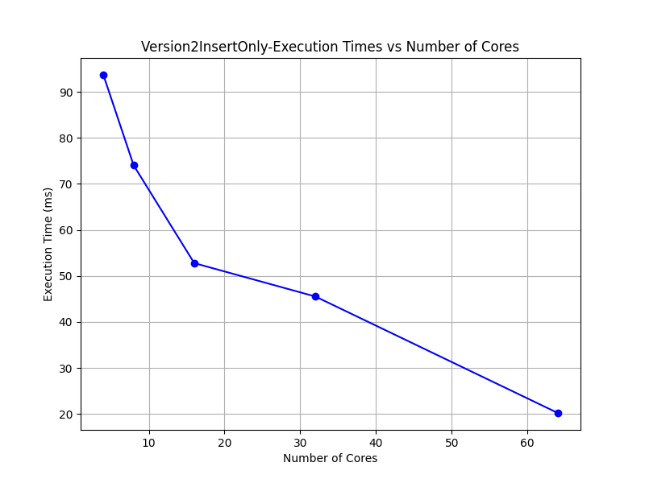
Another version is Version2 Insert Only

