Slide 1

Extracting Predictive Equity Features from Stock Options Financial Data Science | Dennis, Moritz, Niklas

Slide 2
Agenda
Motivation
Theoretical Background
From Option Prices to Moments
SPX vs. Stock A
Skewness Decomposing
Daily Skewness Market vs. Firm Effects
Index vs. Stock Skewness
Skewness Comparison SPX vs. Stocks
Economic Interpretation

Slide 3
Motivation
We extract the first four moments of the risk-neutral return distribution from option prices of:
SPX
all SP500 constituents
We also decompose skewness into systematic and idiosyncratic parts and compare Index and individual stocks skewness

Slide 4
Theoretical Background
We focus on four key statistical properties from option prices:
Mean: logarithmic expected change in price
Variance: expected volatility
Skewness: asymmetry – potential for large drops vs. gains
Kurtosis: fat tails – likelihood of extreme events

Slide 5
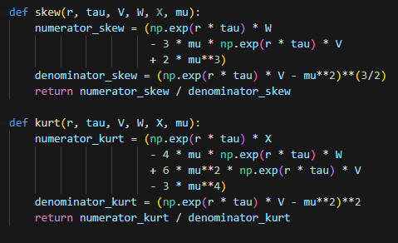


From Option Prices to Moments
Mu
Variance
Skewness
Kurtosis

Slide 6
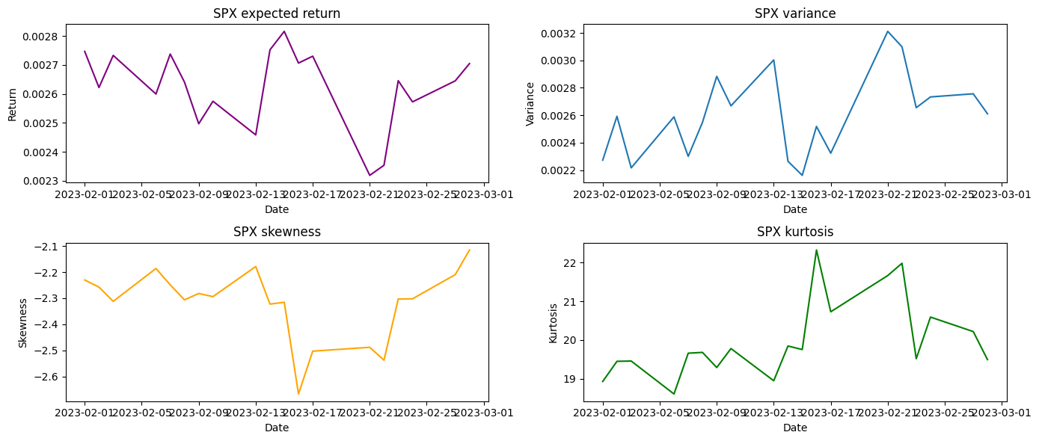
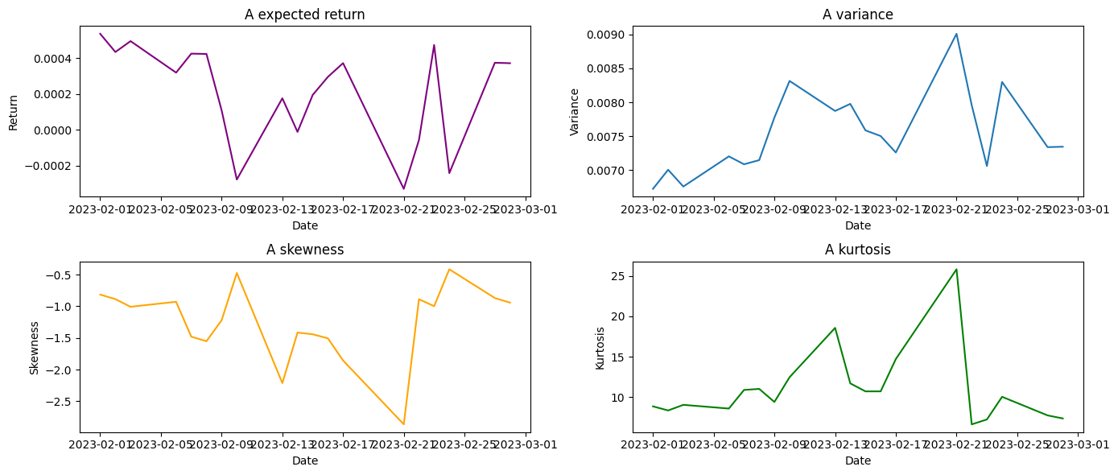
SPX vs. Stock A
SPX has strongly negative skew (−2.319) and high kurtosis (≈ 20)
Stock A shows higher skew and lower kurtosis
Indicates stronger downside risk priced in for the index

Slide 7
SPX vs. Stock A
SPX has strongly negative skew (−2.319) and high kurtosis (≈ 20)
Stock A shows higher skew and lower kurtosis
Indicates stronger downside risk priced in for the index

Slide 8
SPX vs. Stock A
SPX has strongly negative skew (−2.319) and high kurtosis (≈ 20)
Stock A shows higher skew and lower kurtosis
Indicates stronger downside risk priced in for the index

Slide 9
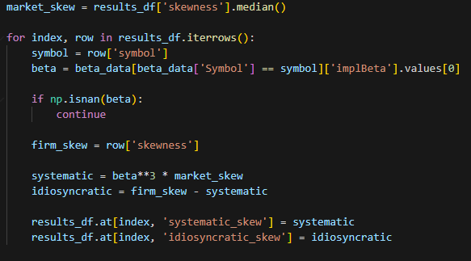
Skewness Decomposing
Systematic = market-driven
Idiosyncratic = firm-specific
Not all skew comes from market moves

Slide 10
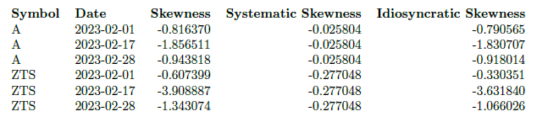
Skewness Decomposing in Practice
A and ZTS both show strong idiosyncratic skew
A and ZTS both show strong idiosyncratic skew
Market-driven skew is relatively minor
Firm-specific factors dominate asymmetry

Slide 11
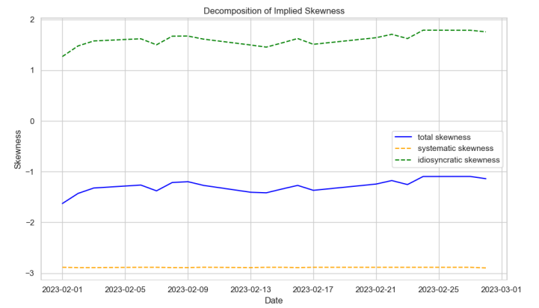
Daily Skewness Market vs. Firm Effects
Systematic skew remains stable and negative
Idiosyncratic skew is higher and fluctuates more
Total skew is a weighted blend of both

Slide 12
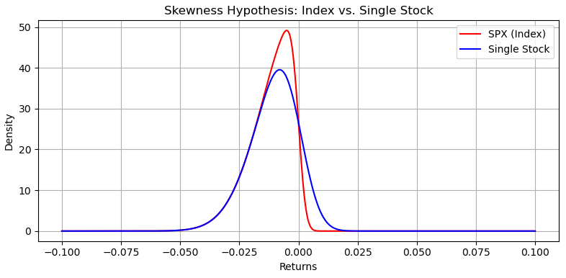
Index vs. Stock Skewness
Hypothesis: Index Skew < Stock Skew
Index reflects aggregated crash risk
Single stocks often have symmetric or even optimistic skew
Market-wide events drive stronger downside in indices

Slide 13
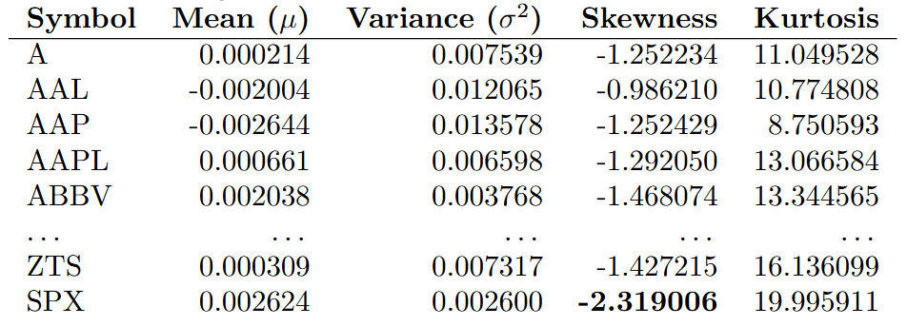
Skewness Comparison SPX vs. Stocks
SPX average skew = −2.319
Most stocks between −1.0 and −1.6 (mean -1.225)
Only ~3.8% of stocks more negatively skewed than SPX

Slide 14
Economic Interpretation
Why Is the Index More Skewed?
Risk aggregation amplifies downside
Index hedging demand > stock hedging
Optimism in stocks offsets market skew
Herding & panic act stronger on the index

Slide 15
Thank You

