Slide 1
Chapter 9
Action Bars (Also know as ”Hit your head on the wall for 4 hours”)

Slide 2
Purpose of chapter:
Understanding the idea of the Action Bar
Understanding Action Buttons versus ”overflow”
Finally understanding all our rendering problems caused by non-compatible themes!

Slide 3
Last thing’s first:
Pre-11: Android phones had an extra ”menu” button, making navigation a lot different from today.
Post-11 Holo themes are used. Action bars arrive.
Post-21 Material themes are used. More ”I-Phone”-like experience. (Same same, but better)

Slide 4
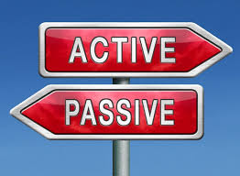
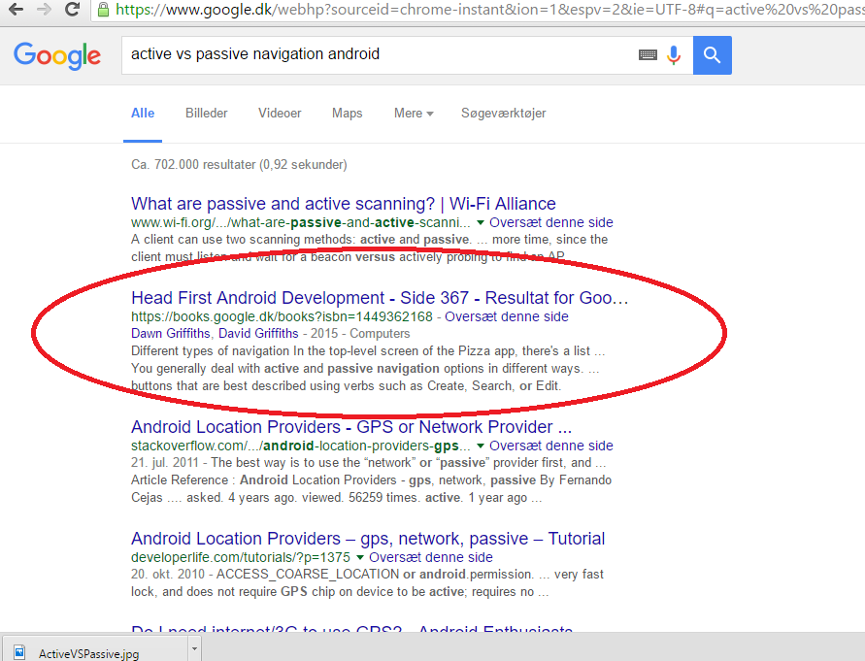
Active vs passive navigation:
Active: We change the scene – likely to something where we create something. Passive: We display information of subcategories
There must be a better explanation?
” active vs passive navigation android”

Slide 5
Android support libraries
To insure backwards compatability Android has libraries that makes it posible to use devices that are above the API treshhold we define when we make the app, but below the minimum API for some of the features we use. This will force us to keep in mind that our theme has to be usable in v7-10 if we are in a class that extends a support library
This project has minimum API of 17 set, so using Holo as theme is not an issue (17>11). The projcet uses Material for API of 21+ (note the +, the book is not clear on this!)

Slide 6
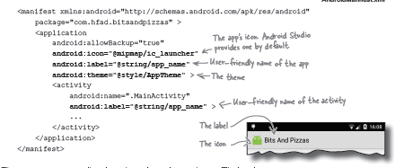
Manifest stuff!

Slide 7


Styles
Like We can specify different images for different screen sizes, can define different styles for different API versions. This comes in handy when we want our app to take advantage of the newest coolest look, but still be available on lower API’s

Slide 8
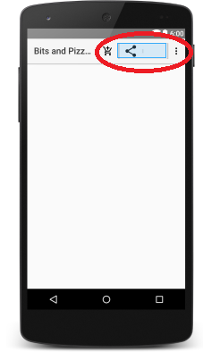
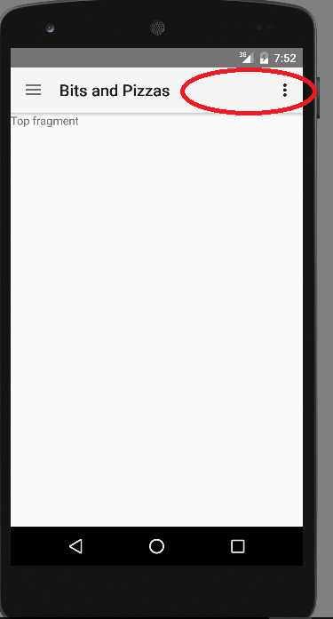
The Action Bar
Yep… An actionpacked place for our active navigation
It’s purpose is twofold: Showing us where we are Giving us a simple way of navigating
FIT
Frequent
Important
Typical

Slide 9
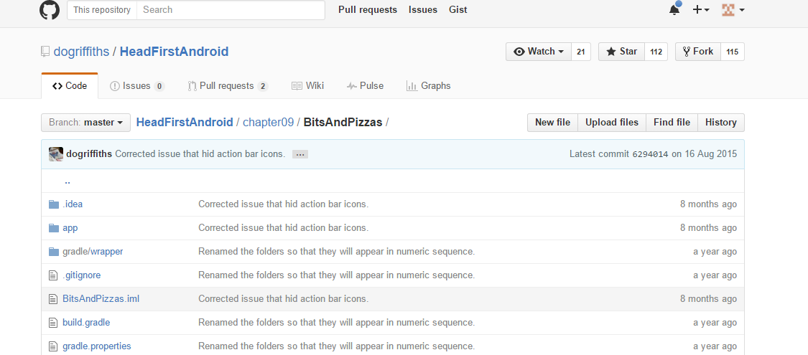
Mystery solved!

Slide 10
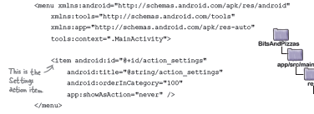

Menu settings

Slide 11

Throwing the stuff in the bar!

Slide 12
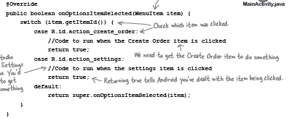

Slide 13

Last step!
We’ve seen all the rest, Intent -> Activity in other programs, been there got the T-shirt I have no great things to say about that!
Daniel out!

