Slide 1
Intro DB
Notes:
2016 - hau
Intro DB

Slide 2
Objectives
Obtain basic knowledge about database technology
Be able to
Run SQL statements and SQL scripts on a MySQL database server via an interactive front end tool
Write simple queries on one table
Use aggregate functions and sort the output
Know
Basic concepts concerning relational databases
The overall structure of a DBMS
Notes:
2016 - hau
Intro DB

Slide 3
Supplementary
SQL Tutorial
  http://www.tutorialspoint.com/sql/sql_tutorial.pdf
Online SQL Tutorial
  http://www.w3schools.com/sql/
MySQL 5.6 Reference Manual
  https://dev.mysql.com/doc/refman/5.7/en/
Animated DataBase Courseware
  http://adbc.kennesaw.edu/

Slide 4
EX: Emp_dept_DB
emp
dept
empno | ename | job | mgr | hiredate | sal | deptno
7369 | SMITH | CLERK | 7902 | 12/17/1980 | 800 | 20
7499 | ALLEN | SALESMAN | 7698 | 02/20/1981 | 1600 | 30
7521 | WARD | SALESMAN | 7698 | 02/22/1981 | 1250 | 30
7566 | JONES | MANAGER | 7839 | 04-02-1981 | 2975 | 20
7654 | MARTIN | SALESMAN | 7698 | 09/28/1981 | 1250 | 30
7698 | BLAKE | MANAGER | 7839 | 05-01-1981 | 2850 | 30
7782 | CLARK | MANAGER | 7839 | 06-09-1981 | 2450 | 10
7788 | SCOTT | ANALYST | 7566 | 04/19/1987 | 3000 | 20
7839 | KING | PRESIDENT |  | 11/17/1981 | 5000 | 10
7844 | TURNER | SALESMAN | 7698 | 09-08-1981 | 1500 | 30
7876 | ADAMS | CLERK | 7788 | 05/23/1987 | 1100 | 20
7900 | JAMES | CLERK | 7698 | 12-03-1981 | 950 | 30
7902 | FORD | ANALYST | 7566 | 12-03-1981 | 3000 | 20
7934 | MILLER | CLERK | 7782 | 01/23/1982 | 1300 | 10
deptno | dname | loc
10 | ACCOUNTING | NEW YORK
20 | RESEARCH | DALLAS
30 | SALES | CHICAGO
40 | OPERATIONS | BOSTON

Slide 5
SQL
Structured Query Language
Language for manipulating relational database management systems (RDBMS).
Characteristics:
  Relatively easy to learn;
  You state conditions for what you want, rather than how it is provided (non-procedural language);
  Use common words like SELECT, INSERT and UPDATE;

Slide 6
SQL
Data Definition (DDL)
CREATE
ALTER
DROP
Data Manipulation (DML)
SELECT (SQL)
INSERT
UPDATE
DELETE

Slide 7
SELECT interpretation
What is the output?
SELECT type
FROM room
WHERE price < 1000
Room
roomNo | hotelNo | type | price
100 | 1 | double | 600
200 | 1 | double | 700
300 | 1 | single | 500
100 | 2 | double | 800
200 | 2 | suite | 1200
200 | 3 | double | 900
2016 - hau

Slide 8
Ex: Hotel_DB /1
Hotel
hotelNo | hotelName | city
1 | SAS | London
2 | Hilton | Oslo
3 | Grand | Paris
4 | Palads | Odense
SELECT *
FROM room;
SELECT roomNo, price,
FROM room;
SELECT price
FROM room
WHERE roomNo = 200;
SELECT price
FROM room
WHERE type LIKE ‘%le’;
Room
roomNo | hotelNo | type | price
100 | 1 | double | 600
200 | 1 | double | 700
300 | 1 | single | 500
100 | 2 | double
200 | 2 | suite | 1200
200 | 3 | double | 900
2016 - hau

Slide 9
Ex: Hotel_DB /2
Hotel
hotelNo | hotelName | city
1 | SAS | London
2 | Hilton | Oslo
3 | Grand | Paris
4 | Palads | Odense
SELECT *
FROM room;
ORDER BY price;
SELECT roomNo, price,
FROM room
WHERE price BETWEEN 500 AND 700;
SELECT roomNo
FROM room
WHERE price IS NULL;
SELECT DISTINCT (type)
FROM Room;
Room
roomNo | hotelNo | type | price
100 | 1 | double | 600
200 | 1 | double | 700
300 | 1 | single | 500
100 | 2 | double
200 | 2 | suite | 1200
200 | 3 | double | 900
2016 - hau

Slide 10
SELECT syntax (simplified)
SELECT [DISTINCT | ALL] { * | [columnExpesession ] [,…] }
FROM tablename
[WHERE condition]
[GROUP BY columnList] [HAVING condition]
[ORDER BY columnList]
[ ] : optional
| : choice
{ } : required

Slide 11
Aggregate functions
count
sum
max
min
avg
2016 - hau

Slide 12
Select – aggregate functions
SELECT count (type) as t
FROM room
Room
roomNo | hotelNo | type | price
100 | 1 | double | 600
200 | 1 | double | 700
300 | 1 | single | 500
100 | 2 | double | 800
200 | 2 | suite | 1200
200 | 3 | double | 900
t
6
The question?
2016 - hau
Notes:
2016 - hau
Intro DB

Slide 13
Select – aggregate functions
SELECT count (distinct type) as t
FROM room
Room
roomNo | hotelNo | type | price
100 | 1 | double | 600
200 | 1 | double | 700
300 | 1 | single | 500
100 | 2 | double | 800
200 | 2 | suite | 1200
200 | 3 | double | 900
t
?
2016 - hau

Slide 14
Select – aggregate functions
SELECT sum (price) as p
FROM room
Room
roomNo | hotelNo | type | price
100 | 1 | double | 600
200 | 1 | double | 700
300 | 1 | single | 500
100 | 2 | double | 800
200 | 2 | suite | 1200
200 | 3 | double | 900
p
4700
The question?
2016 - hau

Slide 15
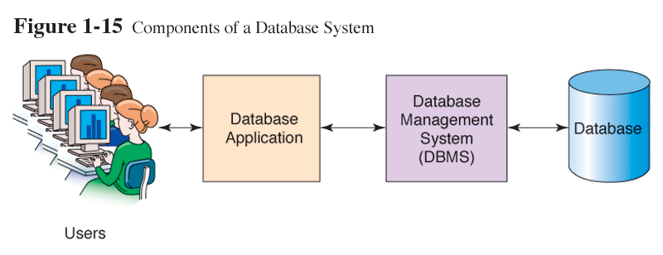
Database system
2016 - hau

Slide 16
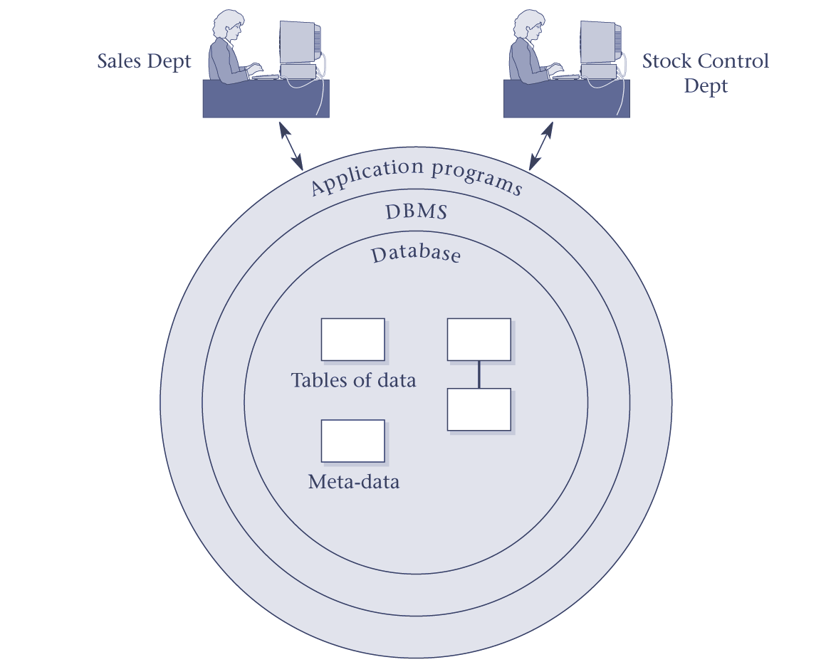
Database system

Slide 17
The Database
Shared collection of data – can be used simultaneously by many departments and users.
Logically related data - comprises the important objects and the relationships between these objects.
Description of the data – the system catalog (meta-data) provides description of data to enable data independence.
2016 - hau

Slide 18
The DBMS
A software system that enables users to define, create, and maintain the database and that provides controlled access to this database.
2016 - hau

Slide 19
The Application program
A software program that interacts with the DBMS
  issues appropriate requests - typically as SQL statement.
  Provides user interface
  May contain business and data processing logic
  communication with DBMS
2016 - hau

Slide 20
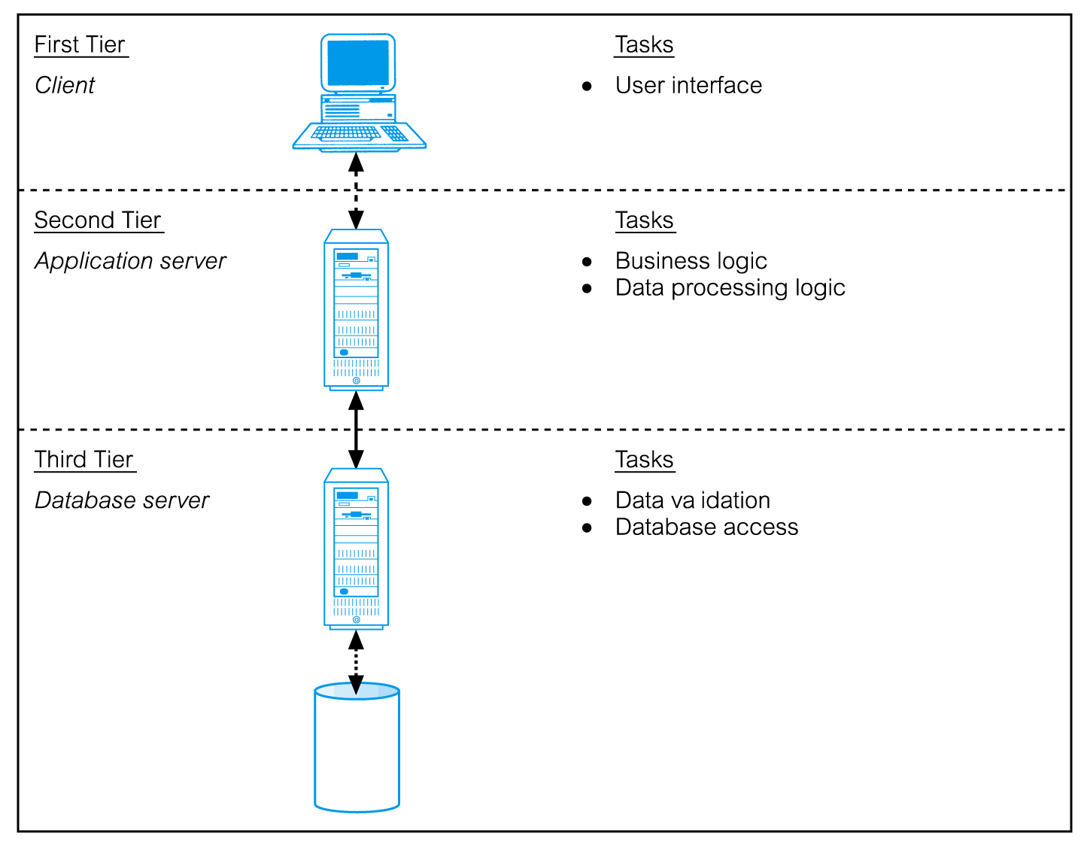
Three-Tier Client-Server
© Pearson Education Limited 1995, 2005

Slide 21
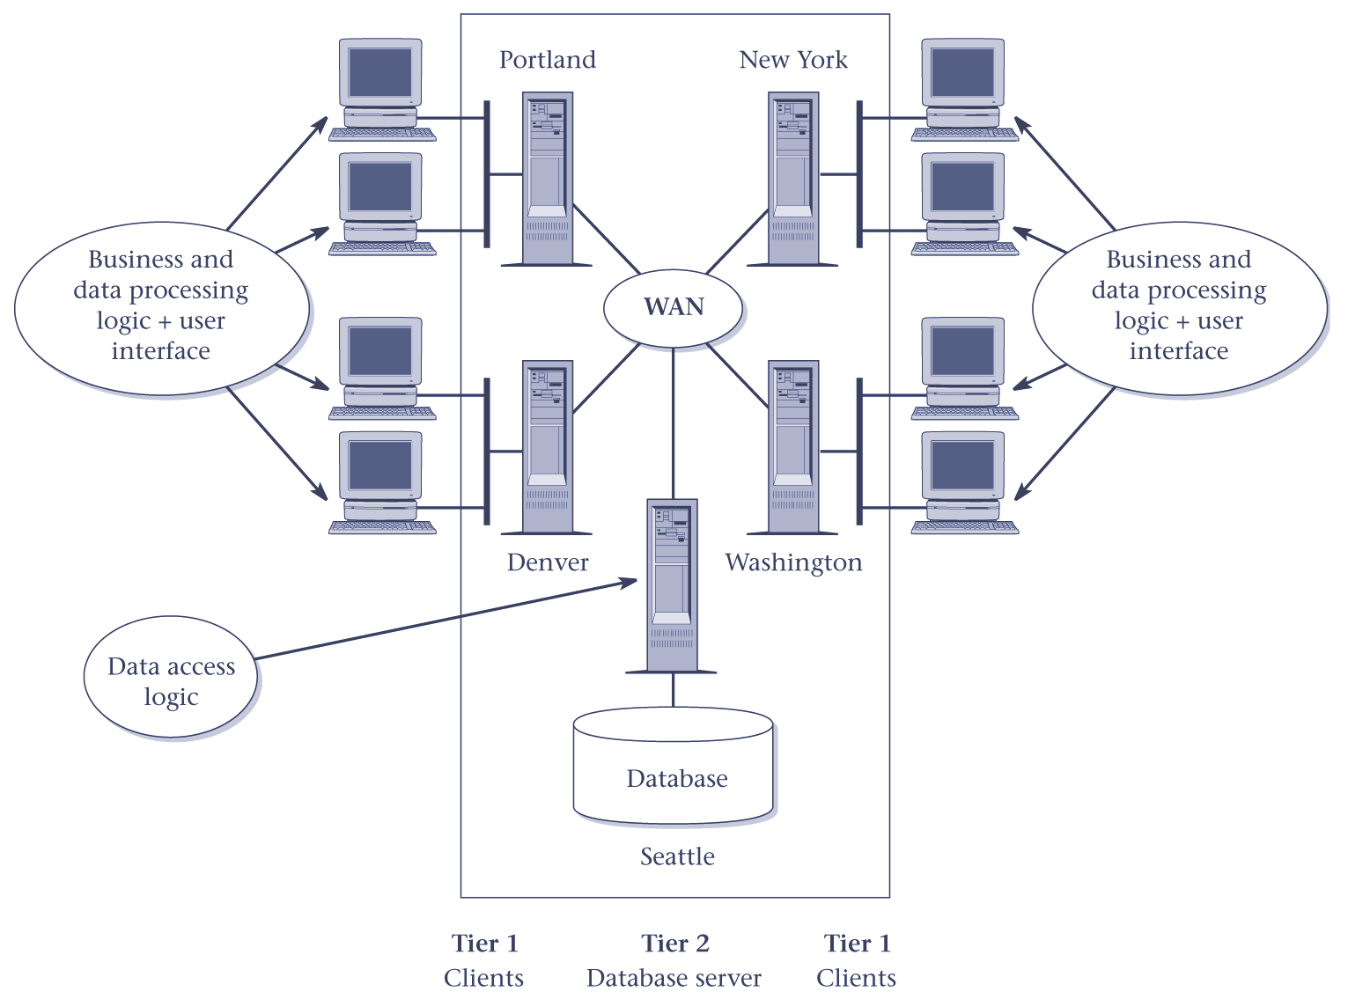
Two-Tier Client-Server
2016 - hau

Slide 22
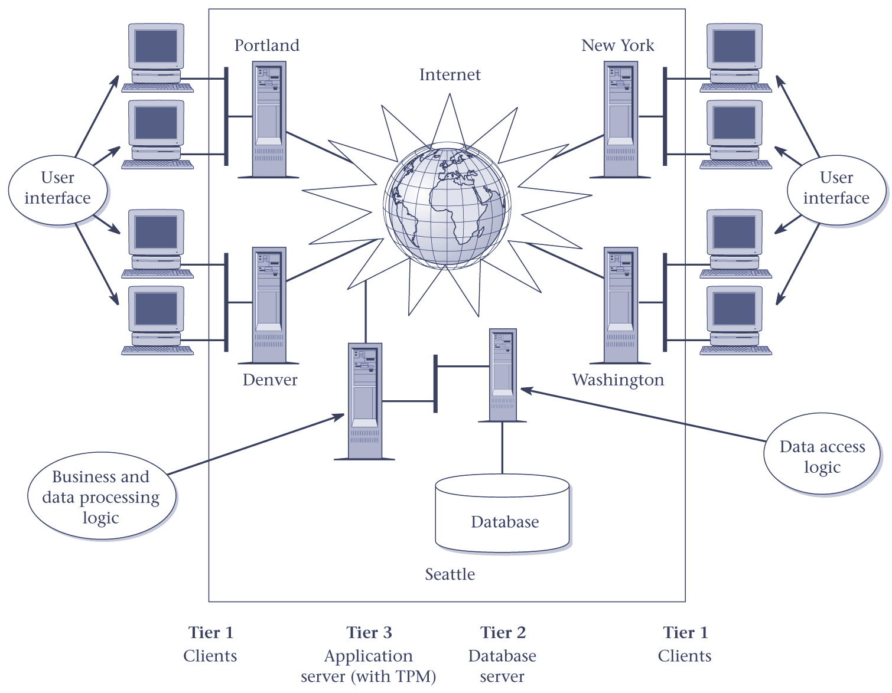
Three-Tier C-S Architecture
2016 - hau

Slide 23
Three-Tier C-S Architecture
Advantages:
  ‘Thin’ client, requiring less expensive hardware.
  Application maintenance centralized.
  Easier to modify or replace one tier without affecting others.
  Separating business logic from database functions makes it easier to implement load balancing.
  Maps quite naturally to Web environment.
2016 - hau

Slide 24
Functions of the DBMS
Data Storage, Retrieval, and Update.
User-Accessible Cataloque.
Transaction Support.
Concurrency Control Services.
Recovery Services.

Slide 25
Functions of the DBMS
Authorization Services.
Support for Data Communication.
Integrity Services.
Services to Promote Data Independence.
Utility Services.

