Slide 1
The Activity Lifecycle
-a tale of life and death!

Slide 2
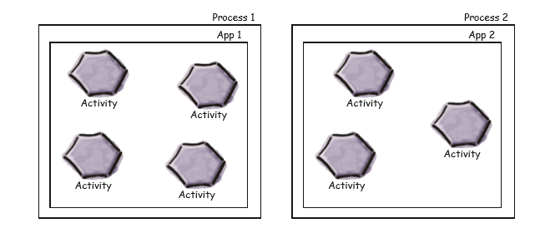
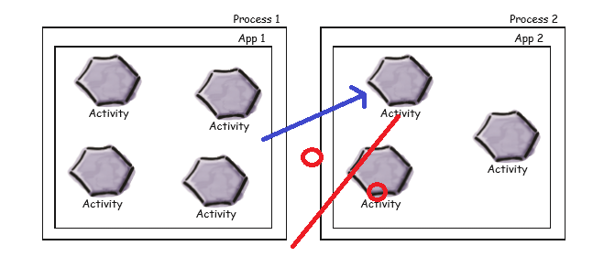
Your app lives in a process!
For security reasons the elements of an app are ”wrapped” in a process

Slide 3
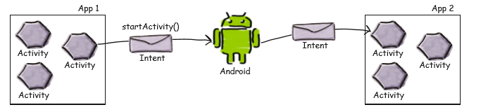
Intent to the rescue!

Slide 4
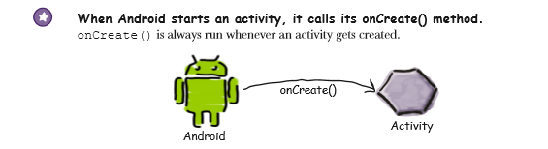
onCreate = constructor?
NO!

Slide 5
What did we learn from the first piece of code?
Handlers! – Wait what are those Runnables?
(Holy ****! It’s getting real now…)
In short: Coding in Java your program is singlethreaded per default*. We follow one route through the program and can only do one thing at a time. So what do we do when we need to do more than one thing at a time?!
We create a new Thread!
“The RUNNABLE interface should be implemented by any class whose instances are intended to be executed by a thread. The class must define a method of no arguments called RUN.”

Slide 6
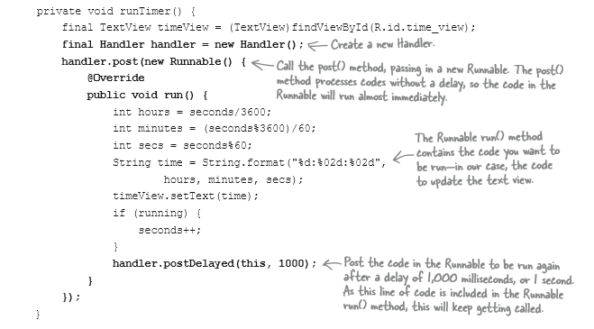
But where the Runnable CLASS go?

Slide 7
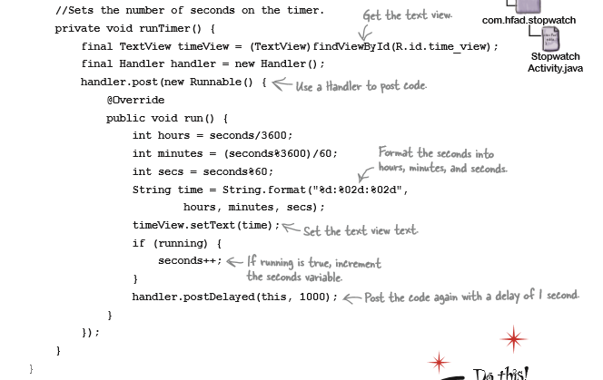
So where does that leave us?

Slide 8

So NOW we’ve learned the important parts of this chapter!
Just kidding. As you all know (at least if you’ve read todays chapter), this actually had very little to do with the overall purpose of the chapter!

Slide 9
Flip the screen -> The activity DIES!
It sounds dramatic but unless told otherwise Android will shut the activity down and start it up fresh again.
The reason is that rotating the screen could mean major changes to configuration, in terms of both layout and methods.
2 options: Explicitly tell Android NOT to restart Tell Android which attributes to save in a bundle

Slide 10
Option 2 is the way to go!
onSaveInstanceState() will be called before the activity is destroyed We add to a ”bundle” that functions a lot like requests/sessions in web
In the onCreate() we load the values stored to the bundle if !=null
This way we can maintain the state of the activity despite its destruction

Slide 11
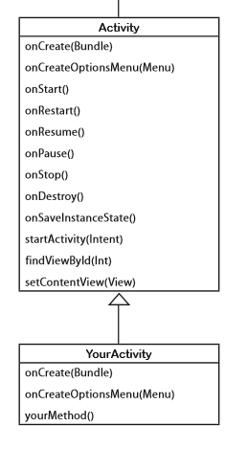
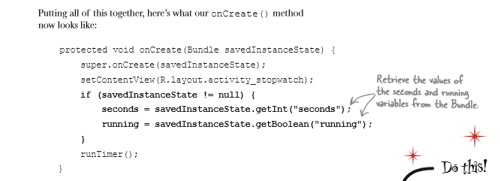

Slide 12
We can also have something in front
The onPause is called when something else hijacks the forground. This could be another app. This can be viewed as an onStop()-light

Slide 13
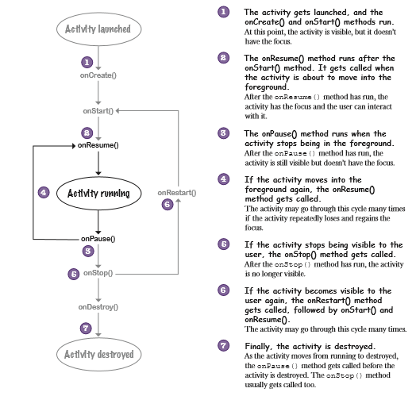
So how does it all look?

Slide 14
