Slide 1

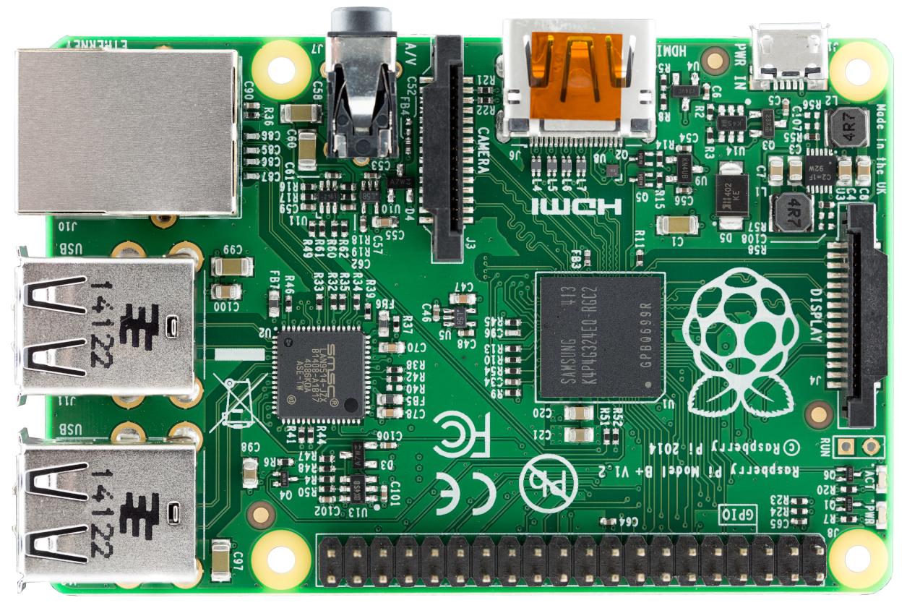
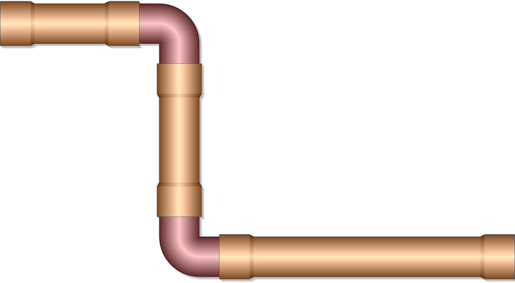
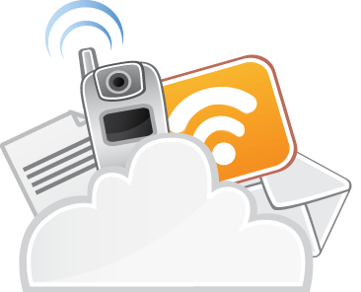

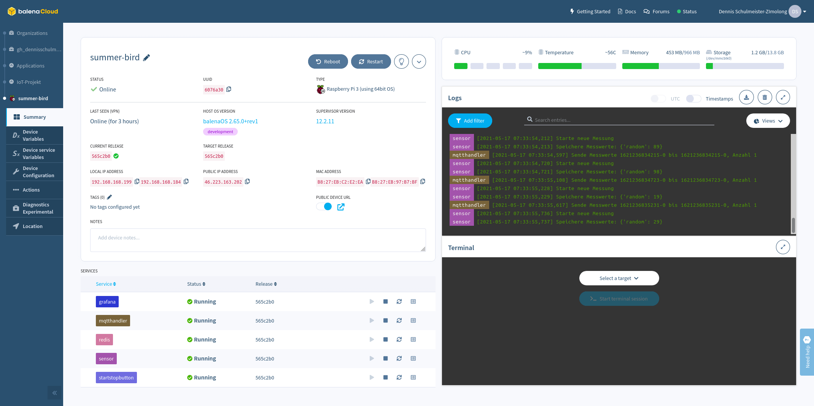

IoT-Device
Gesicherter
VPN-Tunnel
IoT-Device
Admin-Client
SSH-Zugang
Balena IoT-Cloud
IoT-Device

