Slide 1
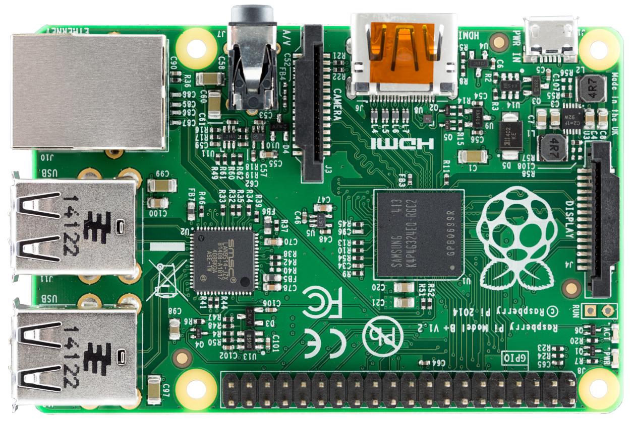





IoT-Device
[ sensordaten ]
[ sensordaten ]
[ sensordaten ]
{ kommandos }
{ kommandos }
IoT-Device
MQTT
Message Broker
Admin-Backend
Admin-Client
[ sensordaten ]
IoT-Device

