Slide 1




Controller
Model
Enterprise Java Beans
Persistence Entities
GetMeSomeDataBean
OverviewEntry
Servlet
HTTP-Anfrage
StartPageServlet
View
Java Server Pages
startpage.jsp

Slide 2
Controller
Model
Enterprise Java Beans
Persistence Entities
GetMeSomeDataBean
OverviewEntry
Servlet
Methodenaufruf
HTTP-Anfrage
StartPageServlet
View
Java Server Pages
startpage.jsp

Slide 3
Controller
Model
Enterprise Java Beans
Persistence Entities
GetMeSomeDataBean
Methodenaufruf
OverviewEntry
Servlet
Methodenaufruf
HTTP-Anfrage
StartPageServlet
View
Java Server Pages
startpage.jsp

Slide 4

Controller
Model
Enterprise Java Beans
Persistence Entities
GetMeSomeDataBean
OverviewEntry
Servlet
HTTP-Anfrage
StartPageServlet
View
Interne
Weiterleitung
Java Server Pages
startpage.jsp

Slide 5
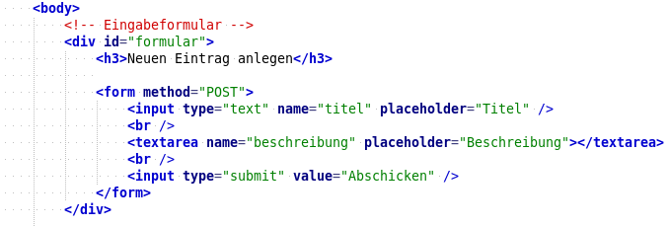
Controller
Model
Enterprise Java Beans
Persistence Entities
GetMeSomeDataBean
OverviewEntry
Servlet
HTTP-Anfrage
StartPageServlet
View
Interne
Weiterleitung
Java Server Pages
startpage.jsp

