Slide 1

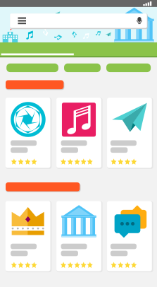


Spring MVC
REST Controller
Services / Beans
JDBC/JPA
Persistence Entities
Mobile App
Java-Backend
Datenbank

