Slide 1



Service
CustomerService
findCustomer(id)
createCustomer(…)
deleteCustomer(…)
ShoppingCart
addArticle (id, amount)
removeArticle(id, amount)

Slide 2
Webservice
GET /api/fernsehserie/42 HTTP/1.1
HTTP/1.1 200 Okay
content-type: application/json
{
"id": 42,
"name": "The X-Files"
}

Slide 3
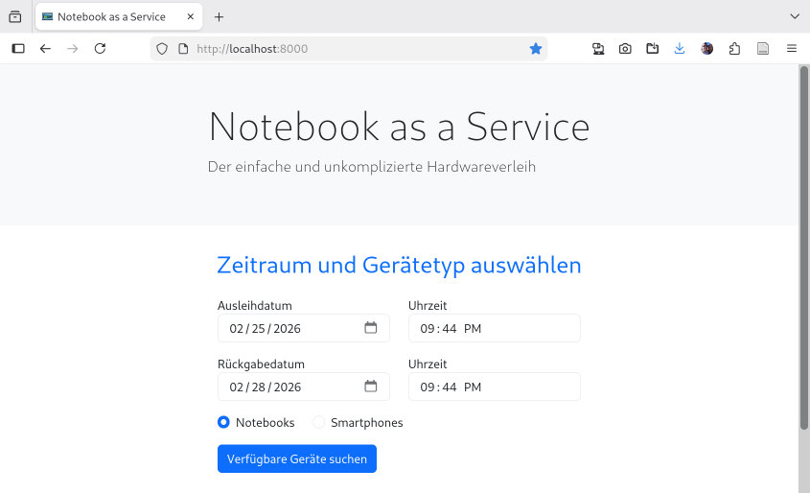
Webanwendung
GET … HTTP/1.1
HTTP/1.1 200 Ok
Content-Type:
text/html
<html>

Slide 4

Microservice

