Slide 1




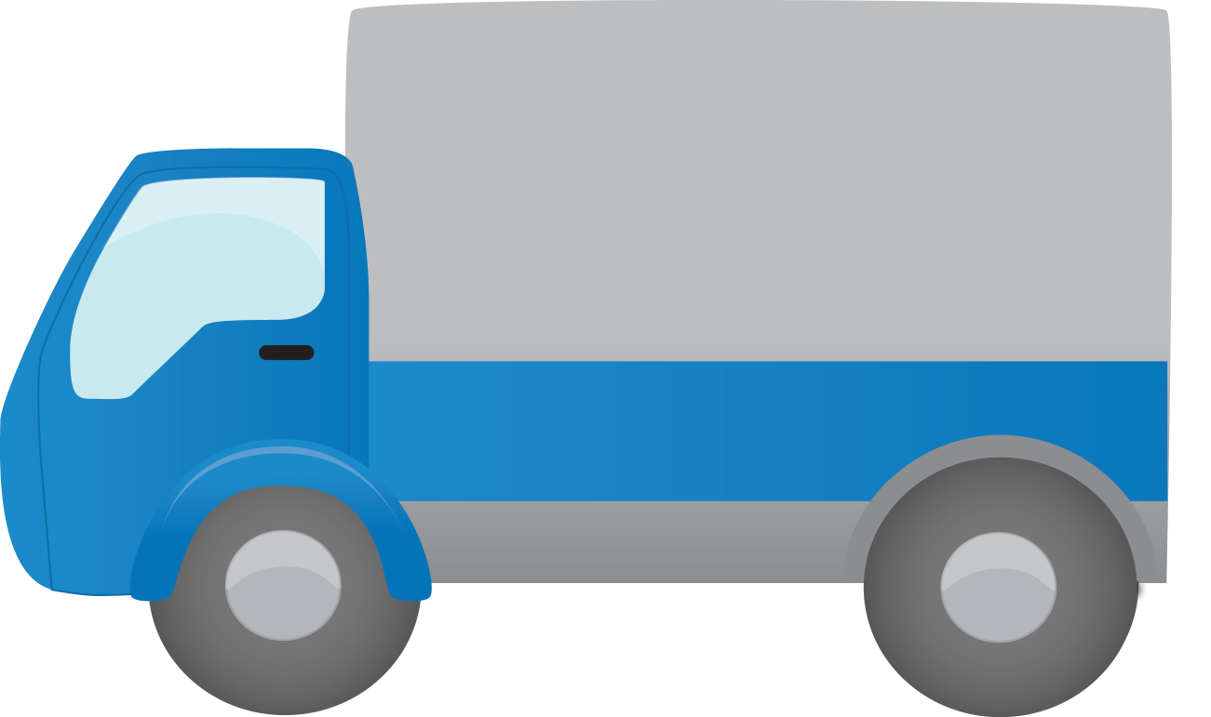


MQTT
AMQP
Kafka
...
Microservice
Microservice
REST-Webservices
Message Broker
IoT-Devices
API-Gateway
Microservice
Microservice
Frontend
Backend

