Slide 1

IRTM Practical Assignment
Extracting Game Strategies from Wiki pages
Dennis Soemers

Slide 2
Outline
Introduction
Corpus
Pre-processing
Strategy Extraction
Navigation & Visualization
Conclusions
Future Work

Slide 3
Introduction
Domain: StarCraft: Brood War
Goal: extract strategies from wiki pages for use in an intelligent game-playing agent
Martin’s request: extract and save to XML:
Build Order(s)
Countered By
Counter To
Strong/Weak Maps

Slide 4
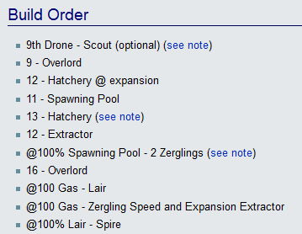
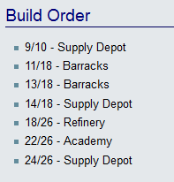
Introduction – Build Orders
List of instructions to execute in game
Sometimes very clean structure on wiki
Sometimes not

Slide 5
Corpus
181 strategy pages from http://wiki.teamliquid.net/starcraft
Some duplicate files
Some unused (no build orders)
Generally small size
Computational constraints not an issue
Can make use of HTML tags in addition to the text
No labelled/classified/annotated data available

Slide 6
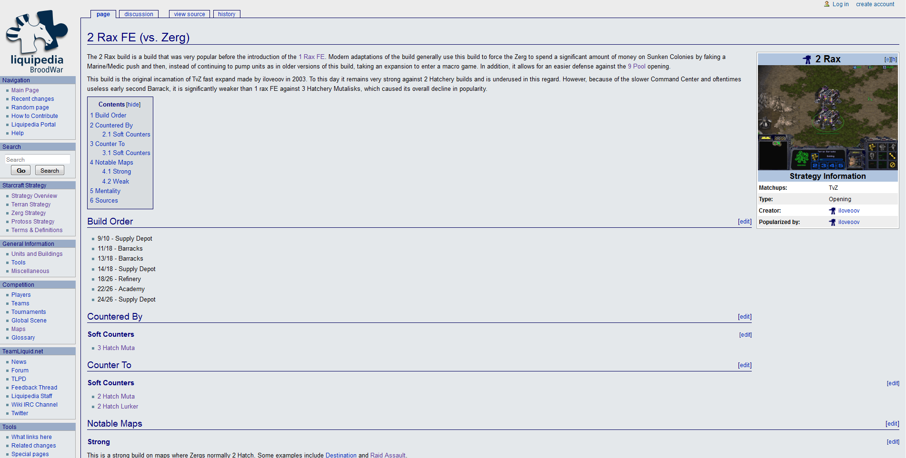
Corpus - Example

Slide 7
Pre-processing
Delete unnecessary/unused HTML
Use HTML to construct tree-based representation of document
Headers: interior nodes
Lists and plain text: leaf nodes
NLP Pre-processing
Tokenization, POS Tagging and Lemmatization extensively used
Not used on entire document, only on small parts of text when necessary

Slide 8
Strategy Extraction
Content type of lists and paragraphs classified using simple, hardcoded rules
For instance:
IF list AND a header contains the word “Build”
→ Build Order
IF some header contains “Map” AND some header contains “Strong”
→ Description of maps on which this strategy is strong

Slide 9
Build Order Extraction (1)
Given: list classified as Build Order
Every element of list is a small piece of text
Handcrafted rules to extract preconditions
Look for symbols such as “-”, “/” and “@”
Does not work for every wiki page: different writing styles
Match tokens with list of known verbs to find actions
POS Tagger and Lemmatization for finding root form of verbs
Manually constructed mapping from verbs to actions

Slide 10
Build Order Extraction (2)
Match tokens with list of known Unit and Building Types to find what to build
Manually constructed list of Unit and Building types
Manually constructed mapping from common abbreviations to Unit and Building types
Entire process requires a tokenizer and sentence splitter

Slide 11
Strategy Name Extraction (1)
Required to find counter-relations between strategies
Some examples of strategy names:
1 Rax FE
2 Gateway
2 Port Wraith
14 CC
Double Expand
Proxy 5 Rax

Slide 12
Strategy Name Extraction (2)
Attempted: Stanford CRF classifier with manually annotated data
Bad performance
Likely due to low amount of manually annotated data
Currently using: handcrafted heuristics
Allow numbers
Allow tokens starting with capitals
Remove single-token names that are known Unit/Building types

Slide 13
Map Extraction
Similar problem to Strategy Name Extraction
Luckily, exhaustive list of map names available
Can match tokens with manually created list of Map Names
Cannot detect descriptions of larger groups of maps

Slide 14
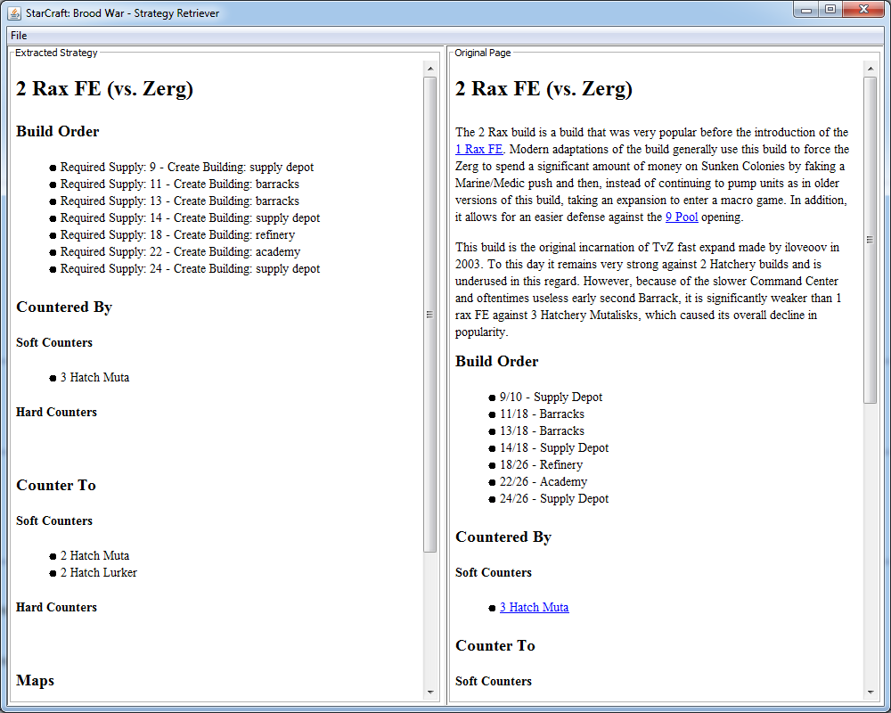
Navigation & Visualization (1)

Slide 15
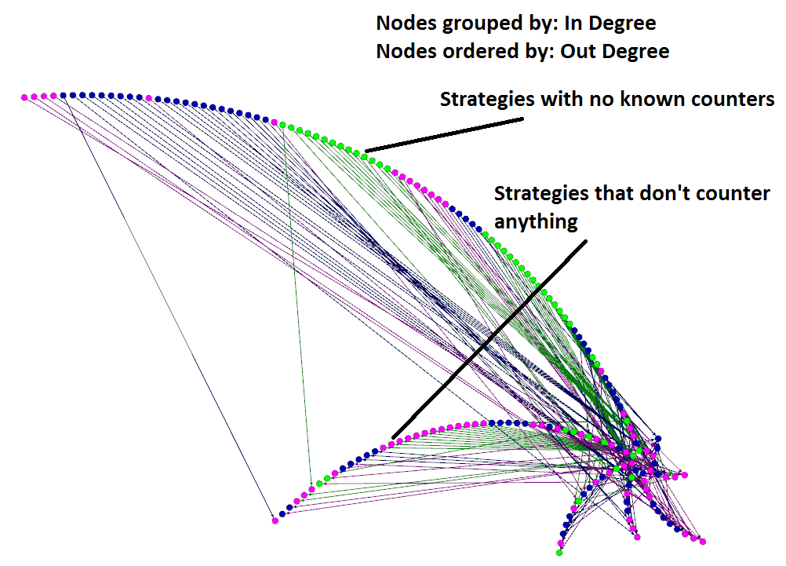
Navigation & Visualization (2)

Slide 16
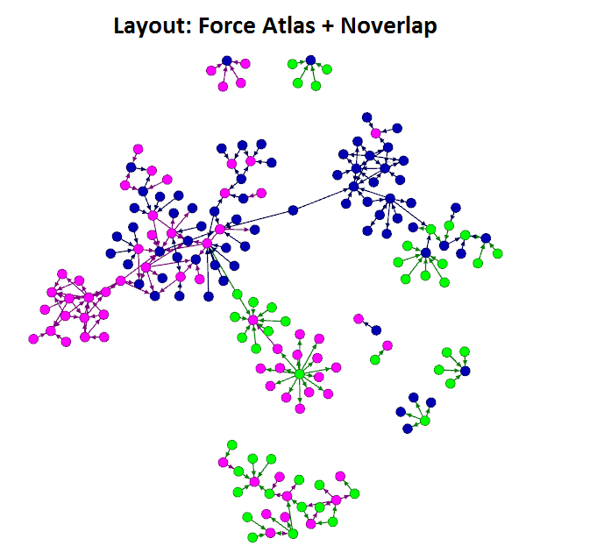
Navigation & Visualization (3)

Slide 17
Conclusions
Currently a heavy reliance on handcrafted and hardcoded rules / solutions
Difficult to get away from them without a large manually annotated corpus
Works surprisingly well in some cases
Fails horribly when a weird person wrote the wiki page
Can gain insight into strategies using Gephi
And especially gain insight into what we do not yet know about strategies

Slide 18
Future Work
Make use of text surrounding the currently used elements
Sentiment Mining
Manually annotate more data and replace handcrafted rules with Machine Learning algorithms
Play some StarCraft and learn more about strategies currently not connected in the graph

Slide 19
Thanks for your attention!
Libraries used:
Stanford CoreNLP (Tokenization, Sentence Splitting, POS Tagging, Lemmatization)
Jsoup (HTML parsing)
XOM (writing XML output)
Gexf4j (outputting graphs to Gephi)
Source of corpus:
http://wiki.teamliquid.net/starcraft

