Slide 1
My19
Arvind Sriram G

Slide 2
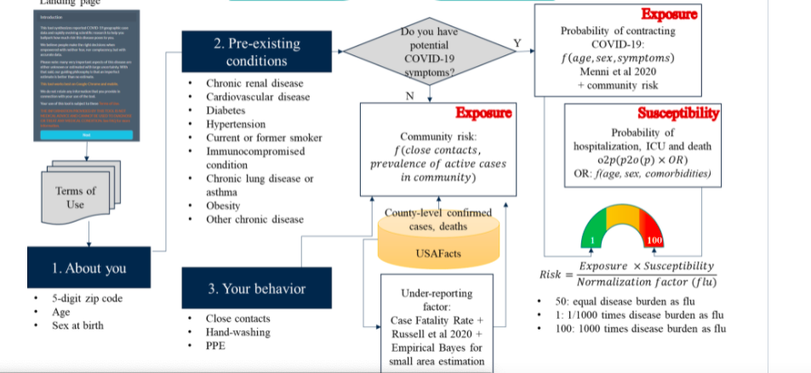
Working

