Slide 1
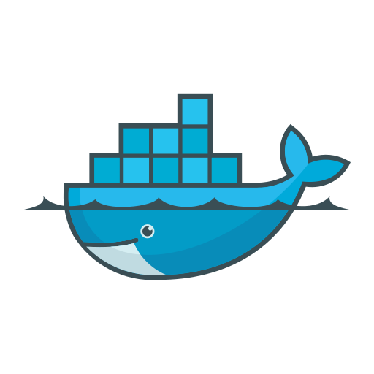

Docker course

Slide 2

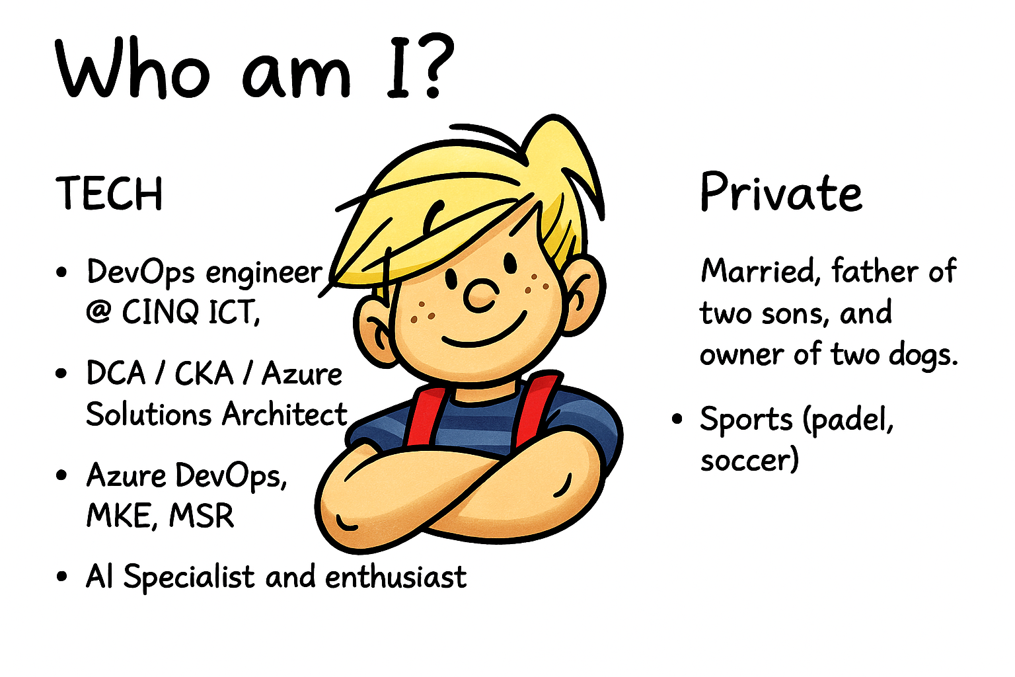


Slide 3
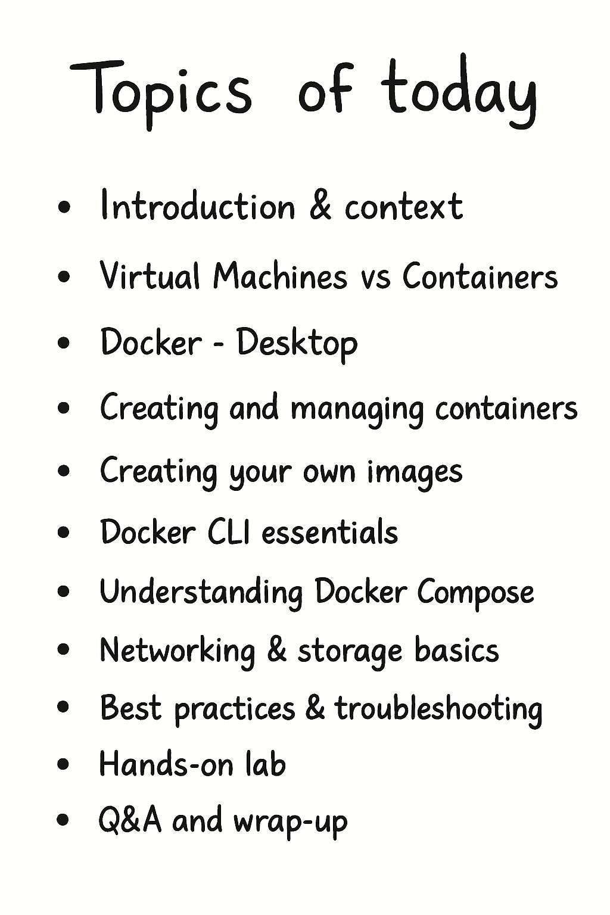


Slide 4
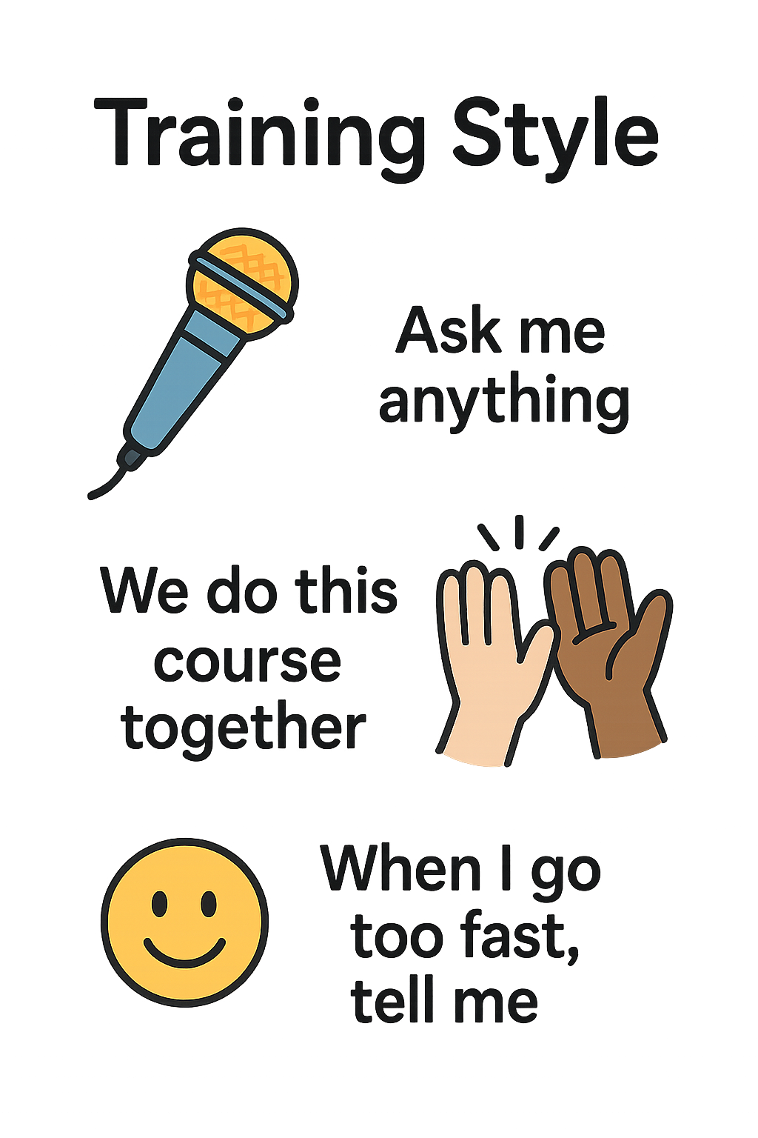
git clone https://github.com/DennisVermeulen/docker-course.git

Slide 5
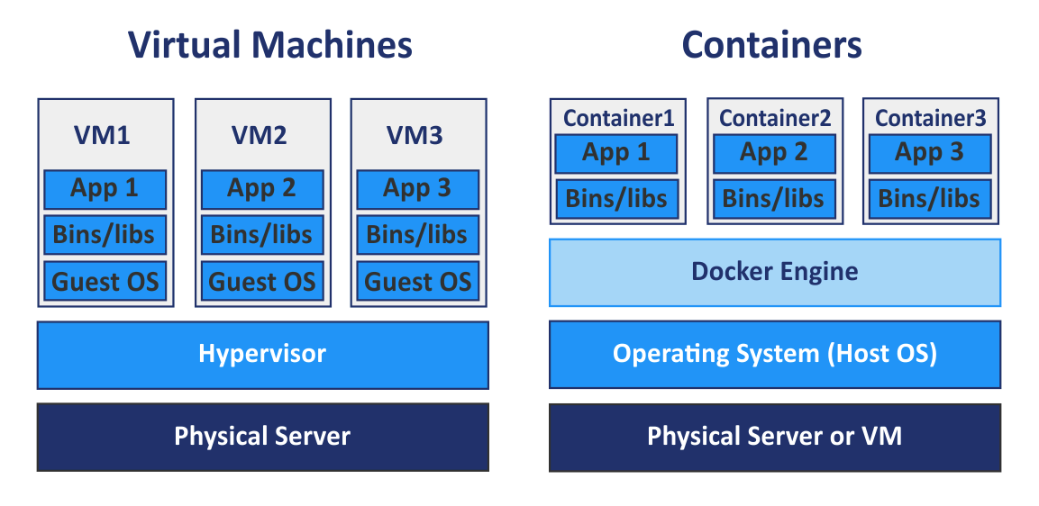
What is Docker Open-source project to run containers
github.com/moby/moby
Docker Engine / daemon
Manage: images, containers, networks, volumes
API on HTTP
Docker Client
CLI
Containers
Package of app + dependecies in a standaridzed unit
Share kernel of host OS
Isolation
    proces, network, filesystem
    memory, cpu

Slide 6
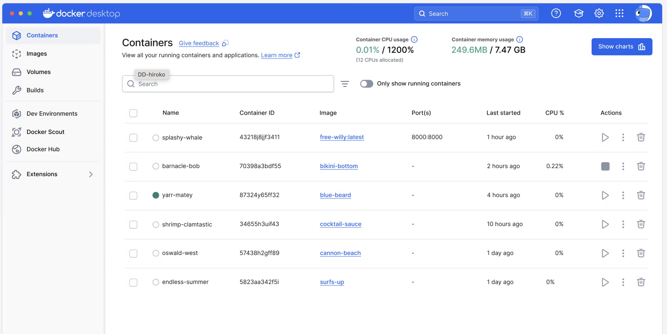
Play with docker-desktop

Slide 7
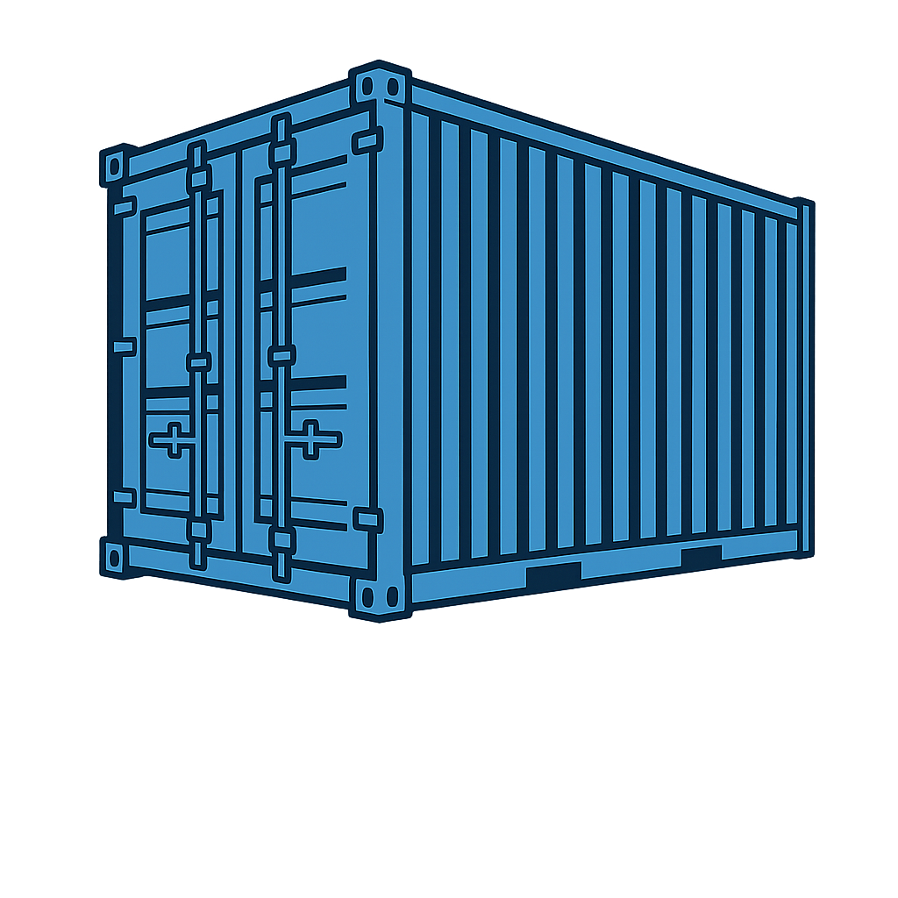
Docker - Why Containers
Standardized build/deployment
Independent of programming language
Run locally, on VM’s or in the cloud
Fast
Small images
Resources
Ship
Secure
Realtime scaling
Support Agile / DevOps
Build from code
Small increments
Micro services

Slide 8
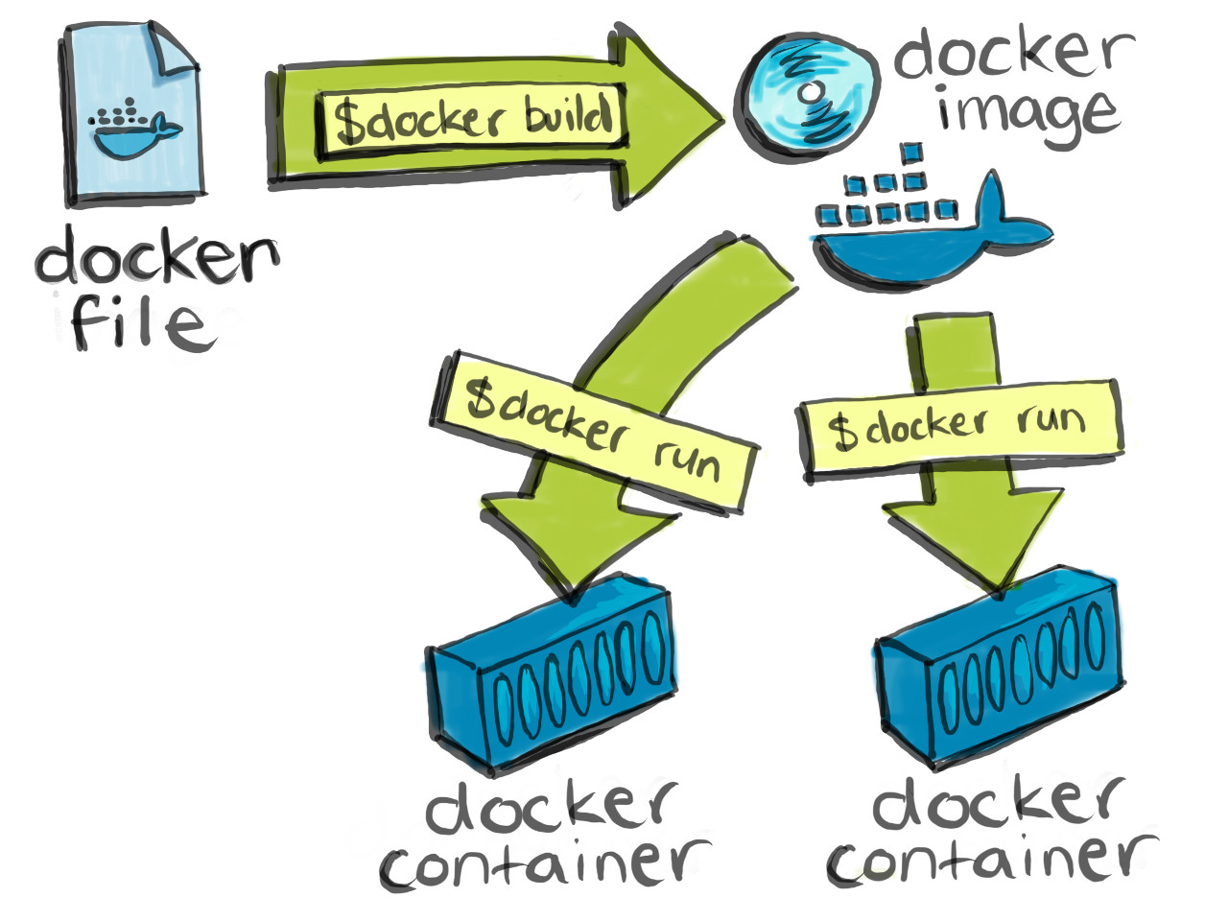
What are dockerfiles, images & containers
Dockerfile
Create image from code
Extends base image
Single file
Default name: Dockerfile
Image
Package app + dependencies
Read-only
Consist of layers
Used to create container
Container
Runnable instance of an image
Add writeable layer
Writeable layer in memory

Slide 9
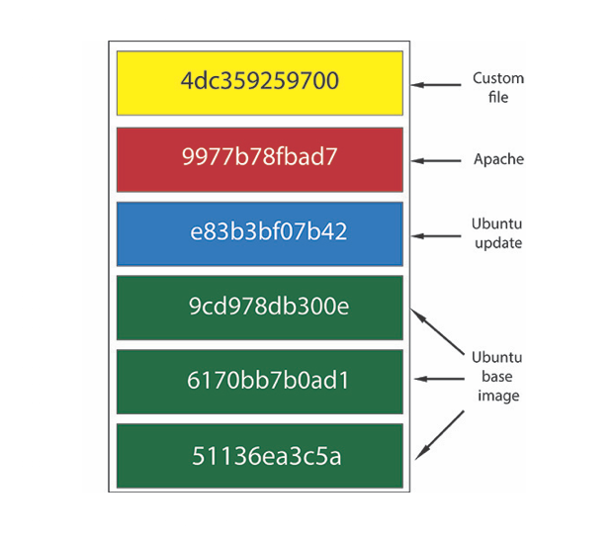
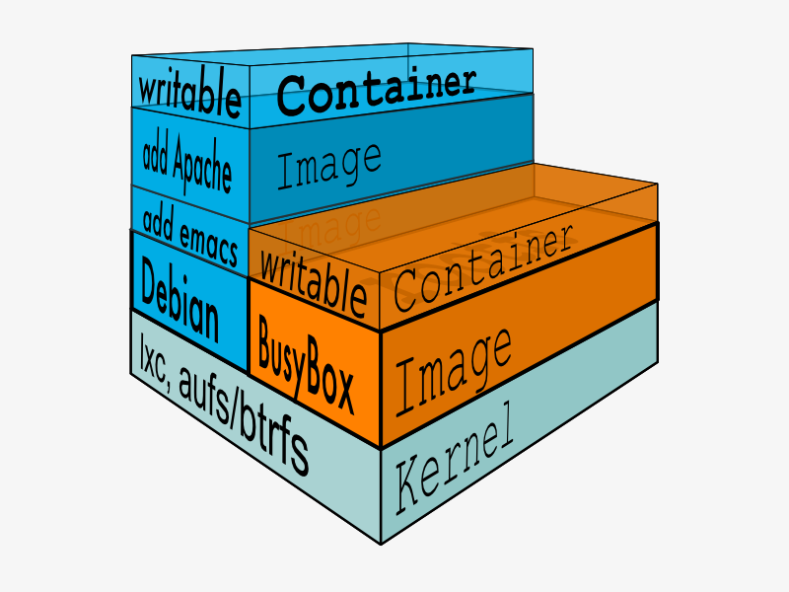
What are dockerfiles, images & containers
Dockerfile
Create image from code
Extends base image
Single file
Default name: Dockerfile
Image
Package app + dependencies
Read-only
Consist of layers
Used to create container
Container
Runnable instance of an image
Add writeable layer
Writeable layer in memory

Slide 10
What Are Docker Image Layers?
Each Docker image consists of layers stacked on top of each other. This concept originates from the Union File System.
How does it work?
Each instruction in a Dockerfile that results in a change (such as RUN, COPY, ADD) creates a new layer.
Layers are cached, so if nothing changes in a given layer, Docker can reuse the previously built layer.
Docker uses this caching mechanism to speed up builds.

Slide 11
⚡️ Best Practices for Fast Builds
1. Put Frequently Changing Instructions at the Bottom
Docker builds from top to bottom. If a layer near the top changes, all layers beneath it will be rebuilt.
✅ Good example:
COPY requirements.txt .
RUN pip install -r requirements.txt
COPY . .
❌ Bad example:
COPY . .
RUN pip install -r requirements.txt
Why?
In the bad example, any change in your code triggers a full rebuild, including reinstalling dependencies.
LAB 1.0

Slide 12
⚡️ Best Practices for Fast Builds
2. Combine RUN Instructions Where Possible
✅ Efficient:
RUN apt update && apt install -y curl && rm -rf /var/lib/apt/lists/*
❌ Inefficient:
RUN apt update
RUN apt install curl
Why?
Each RUN instruction creates a new layer.
LAB 1.1

Slide 13
⚡️ Best Practices for Fast Builds
3. Use .dockerignore
Avoid including unnecessary files in the build context (e.g., .git/, node_modules/, __pycache__/).
This speeds up builds and improves caching
Example .dockerignore:.
.git
__pycache__/
node_modules/
*.log

Slide 14
⚡️ Best Practices for Fast Builds
4. Use Lightweight Base Images
Choose smaller base images to reduce build time and image size.
✅ Examples:
python:3.12-slim instead of python:3.12

Slide 15
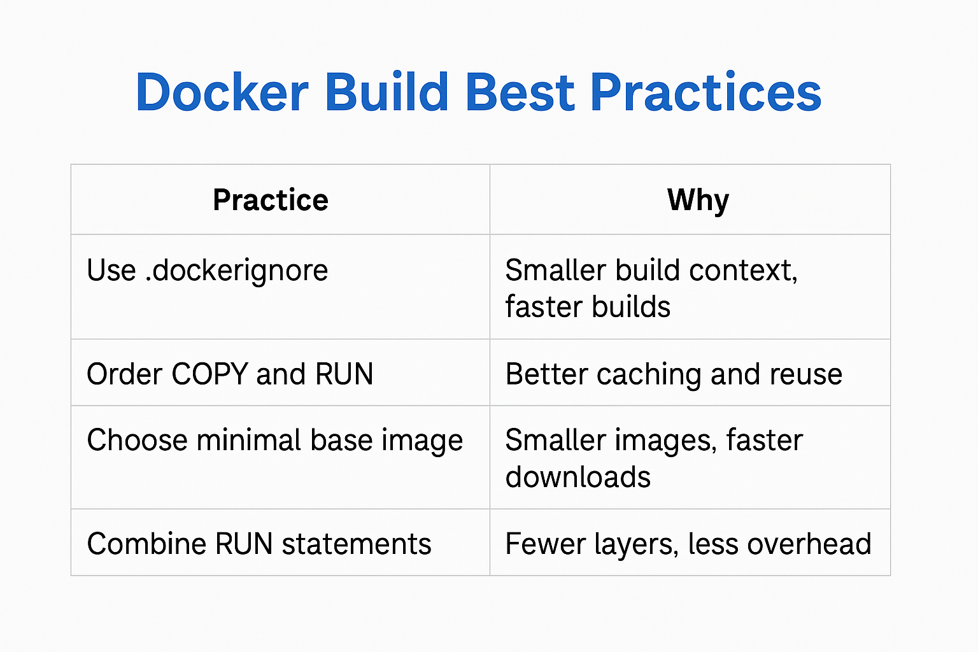

Slide 16
Why Dockerfiles
Image as code
Version control
One source of truth
Easy collaboration and sharing
Easy
Just the easiest way to build images

Slide 17
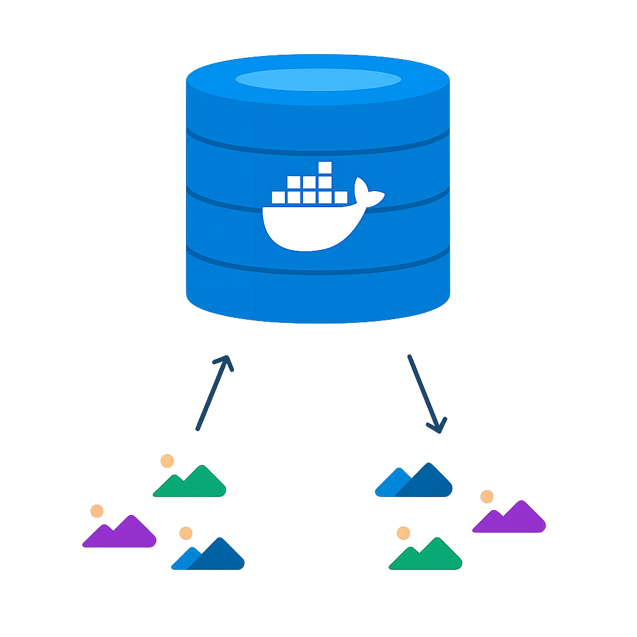
Why Registry
What
Store images
Central place
Why
Distribution
Traceability
Optional:
CI/CD,
Vulnerability scanning,
Notary (image trust),
Examples
Docker Hub (public)
On-premise registries
PaaS:
Azure Container Registry (ACR),
JFrog

Slide 18
docker-cli
-d (daemonize) = run the container in the background
-p = portforwarding into the host
$ docker ps (list running containers)
$ docker ps -a (list all containers, including stopped)
$ docker images (list images)
$ docker pull ubuntu (download ubuntu image)
LAB APP

Slide 19
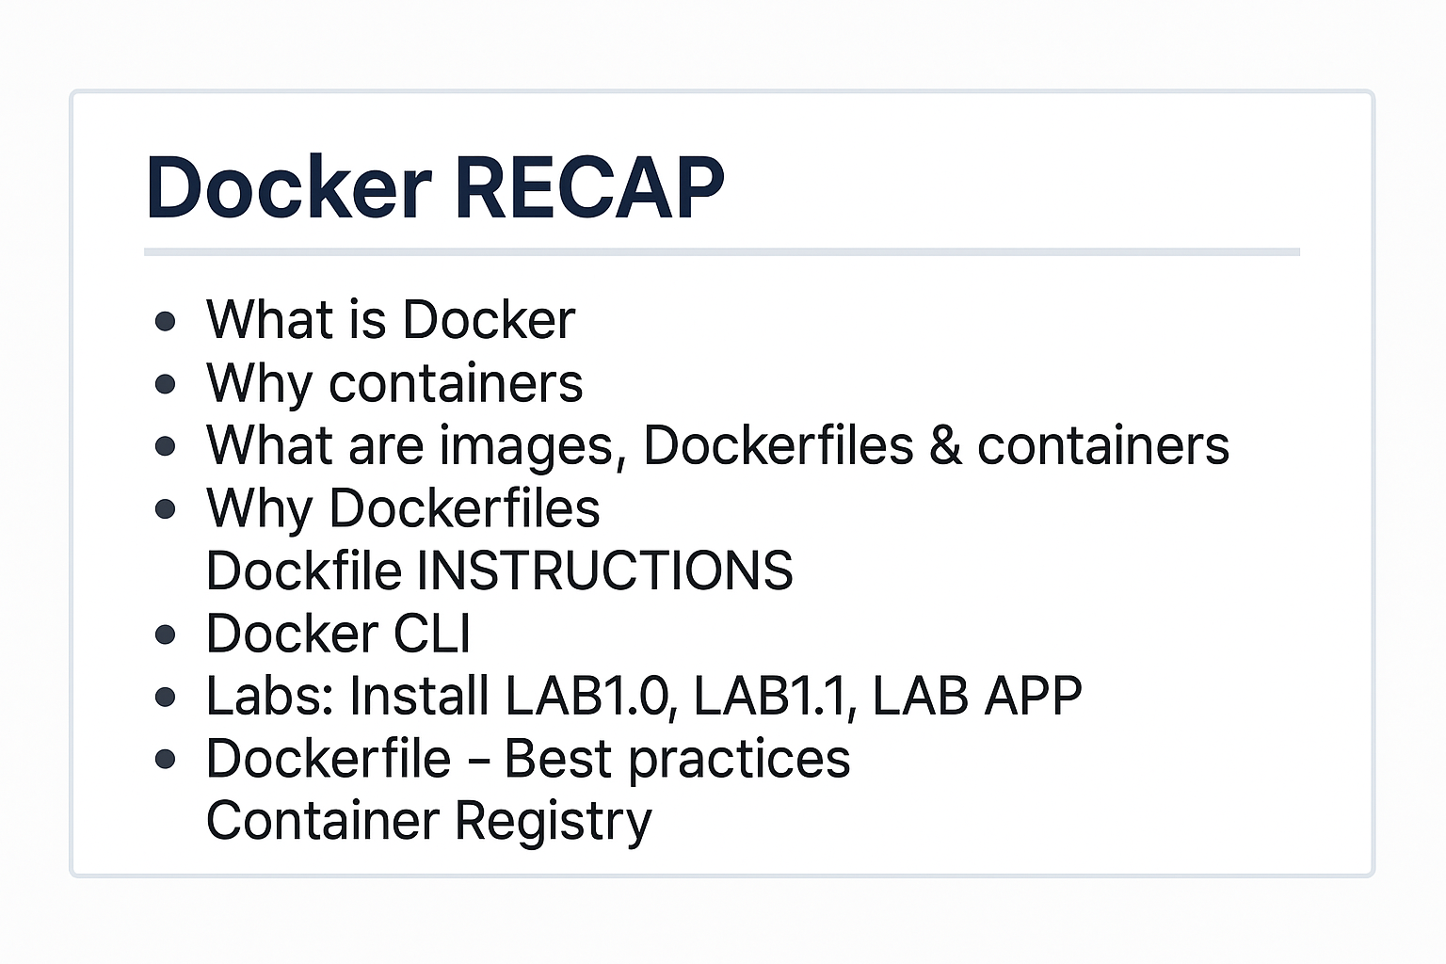

Slide 20
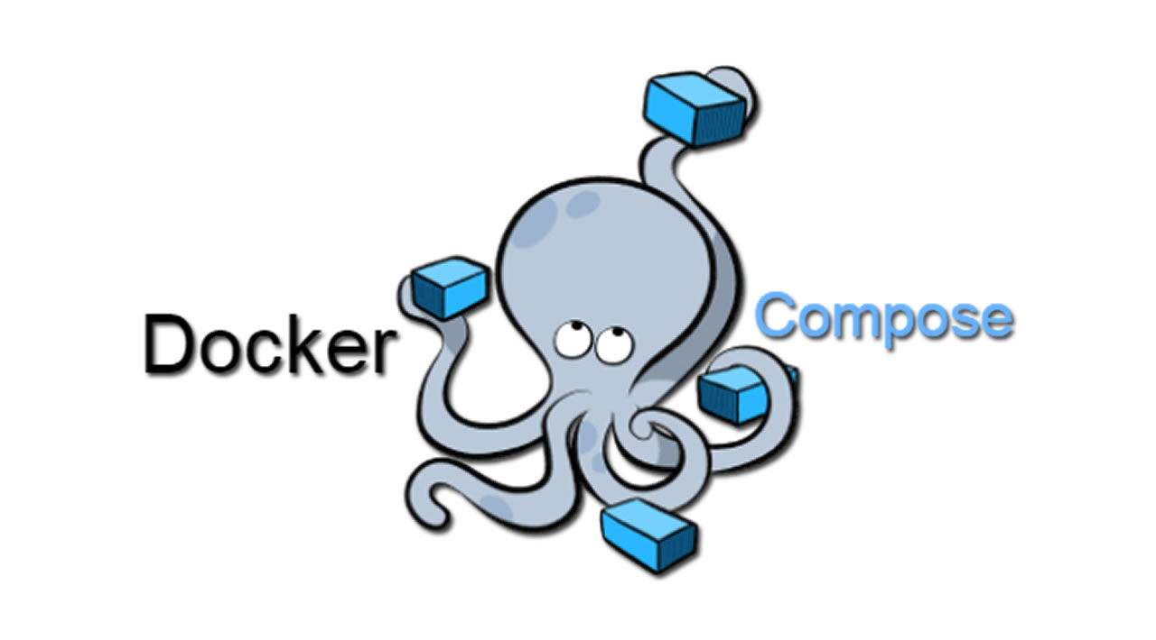

Slide 21
What is Docker-Compose
Docker Compose is a tool for defining and running multi-container Docker applications. With Docker Compose, you use a Compose file to configure the services of your application. Then, with a single command, you create and start all the services defined in the configuration.
By using Docker Compose, we can run each of these technologies in separate containers on the same host and enable them to communicate with one another. Each container will expose a port for communication with other containers.
The communication and uptime of these containers is managed by Docker Compose.

Slide 22
Three-Step Process
1. Define your app’s environment with a Dockerfile so it can be reproduced anywhere.
2. Define the services that make up your app in docker-compose.yml, so they can run together in an isolated environment.
3. Finally, run docker-compose up or docker-compose start to launch the entire application.

Slide 23
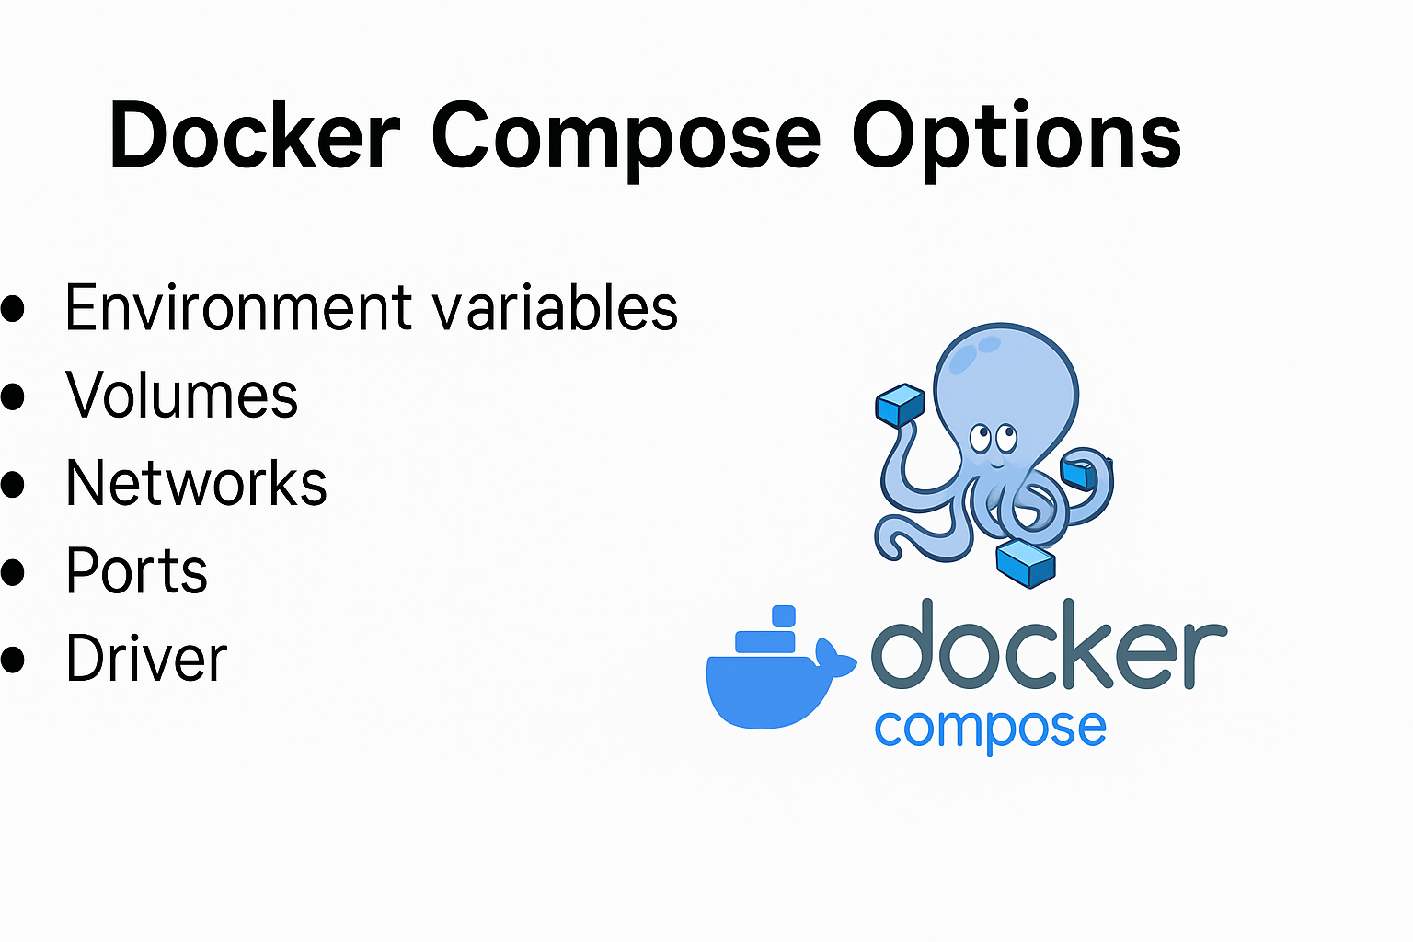

Slide 24
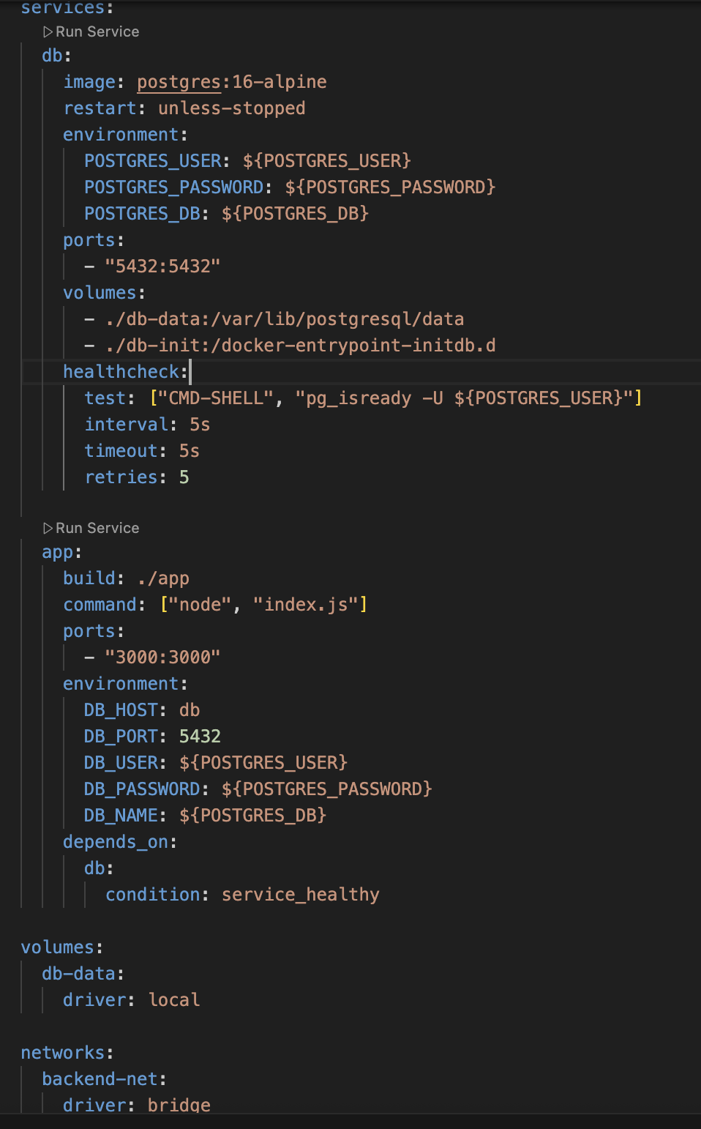
Make build with docker compose
LAB: mini-node-postgres-app

Slide 25
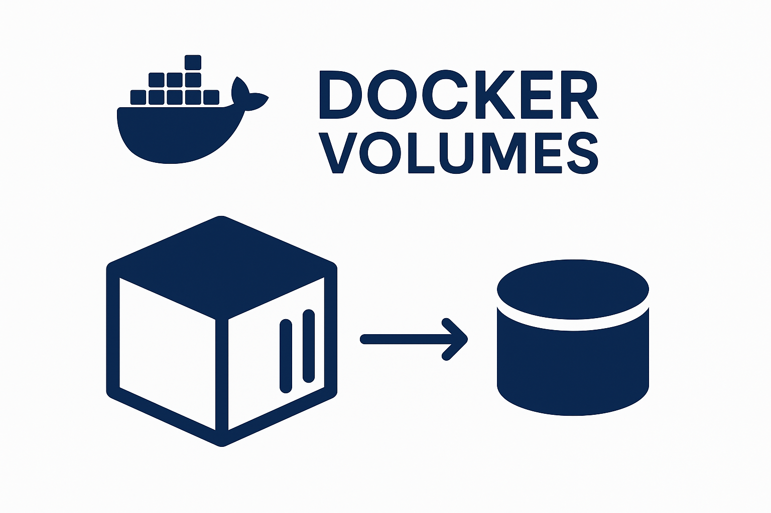

Slide 26
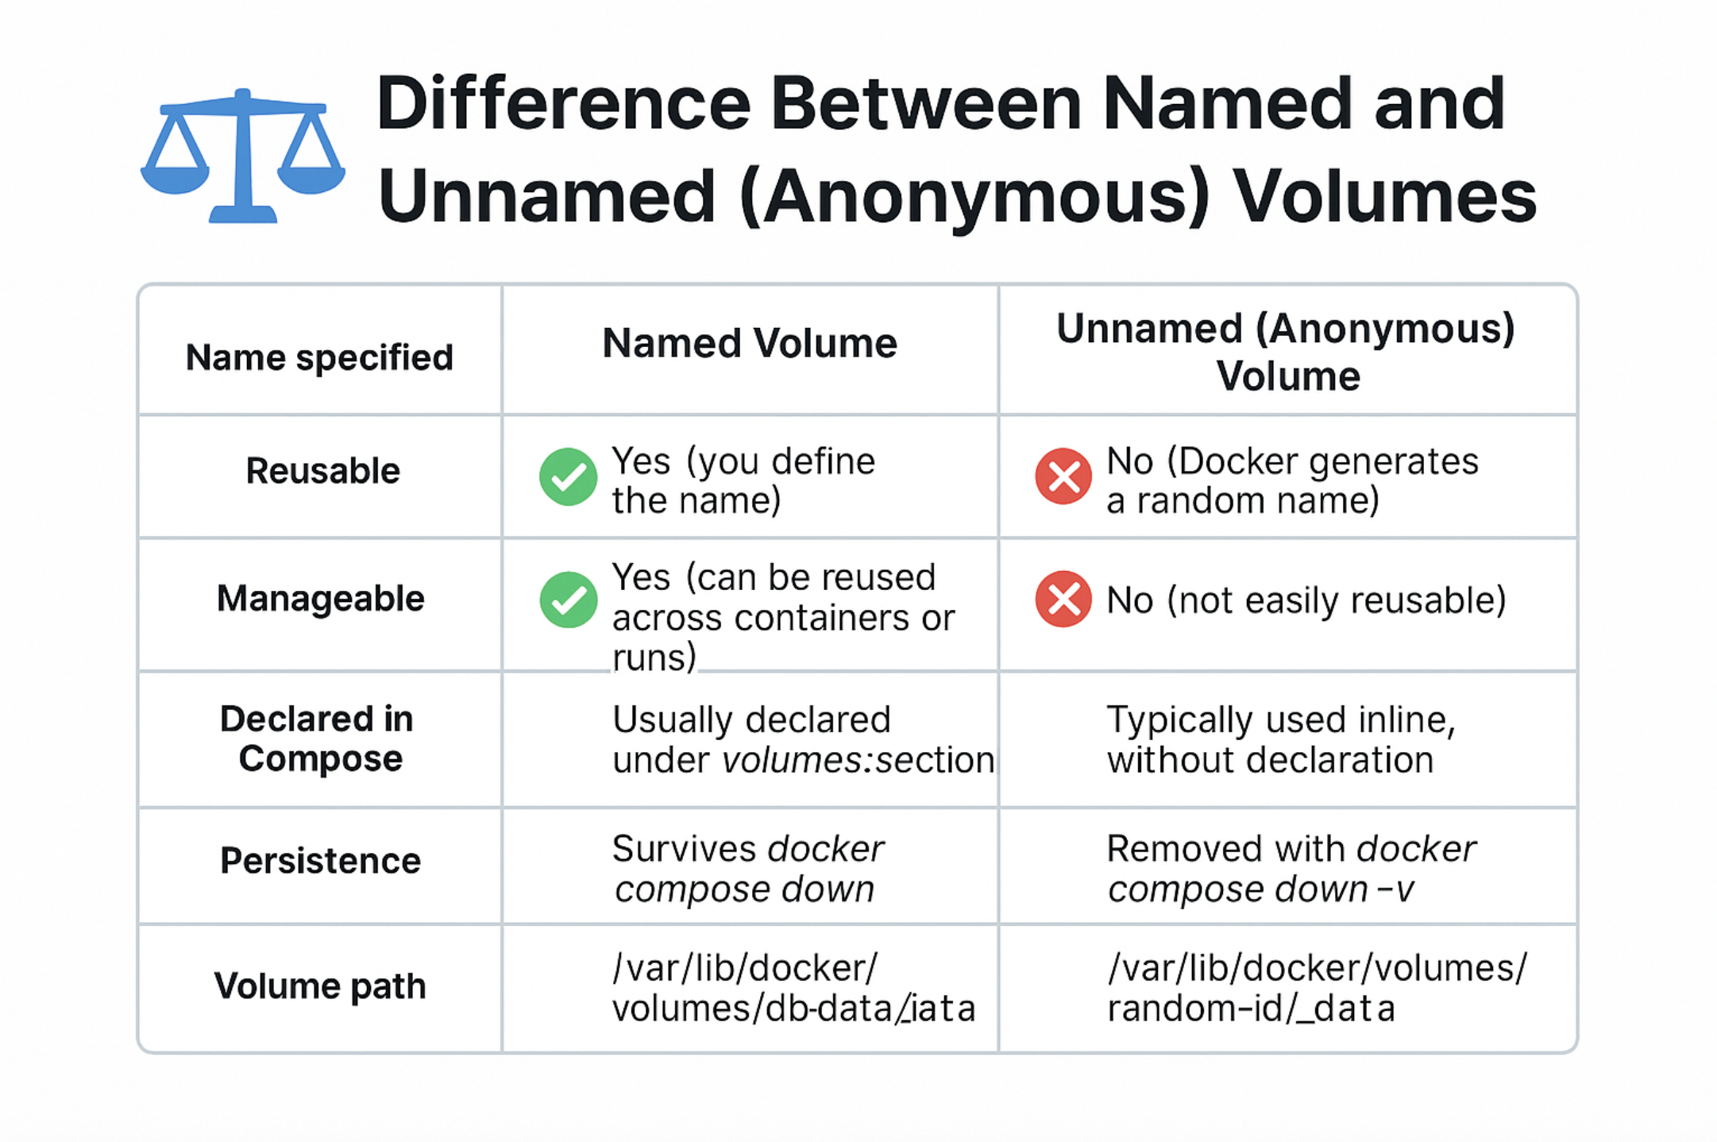
Volumes (named/unnamed), hun levenscyclus en gebruik

Slide 27
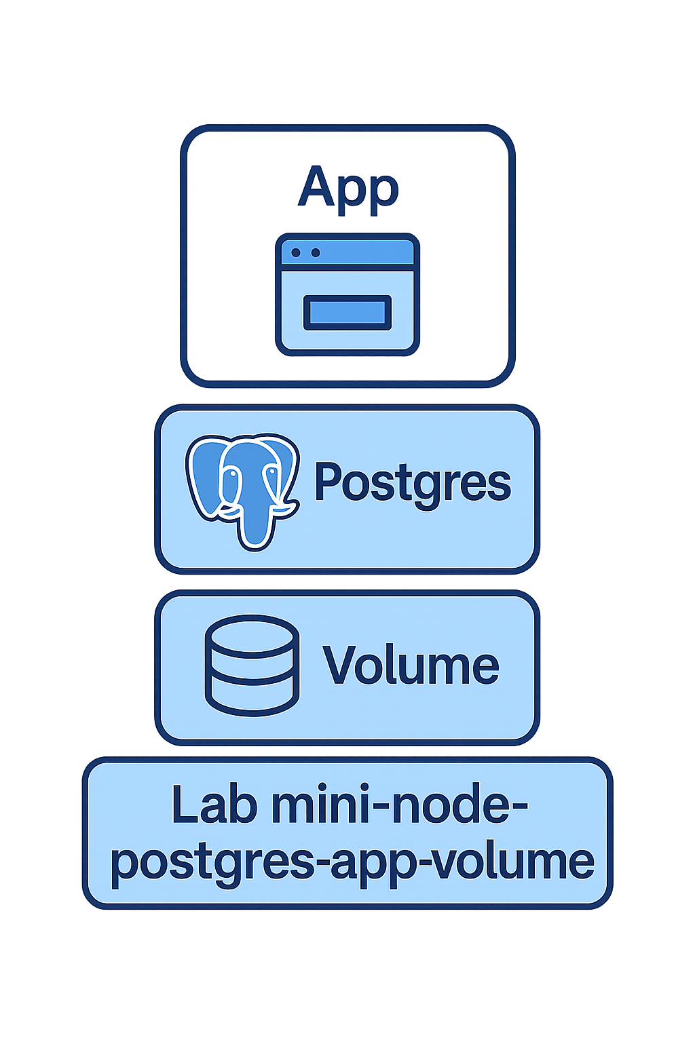

Slide 28
What is a Docker network?
In Docker, a network is a virtual channel that allows containers to communicate with each other, the host, and external systems. Every container you start is part of a network.

Slide 29
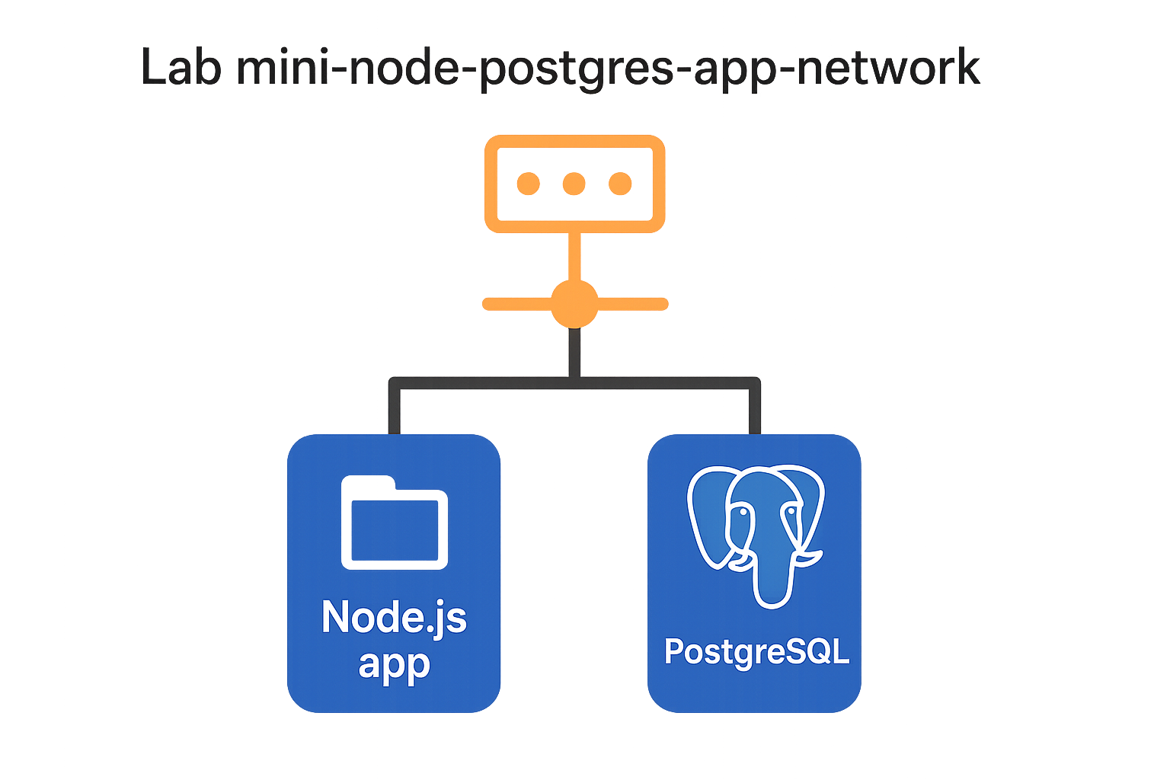

Slide 30
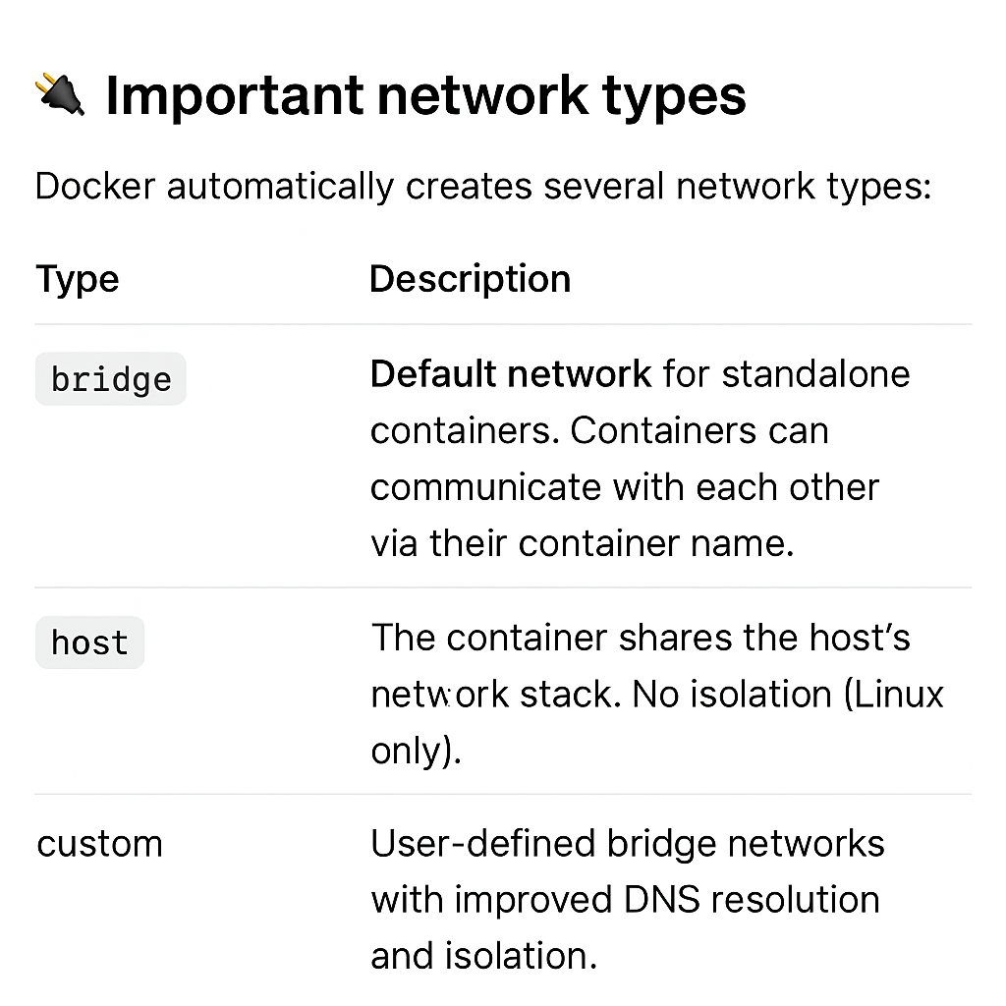

Slide 31
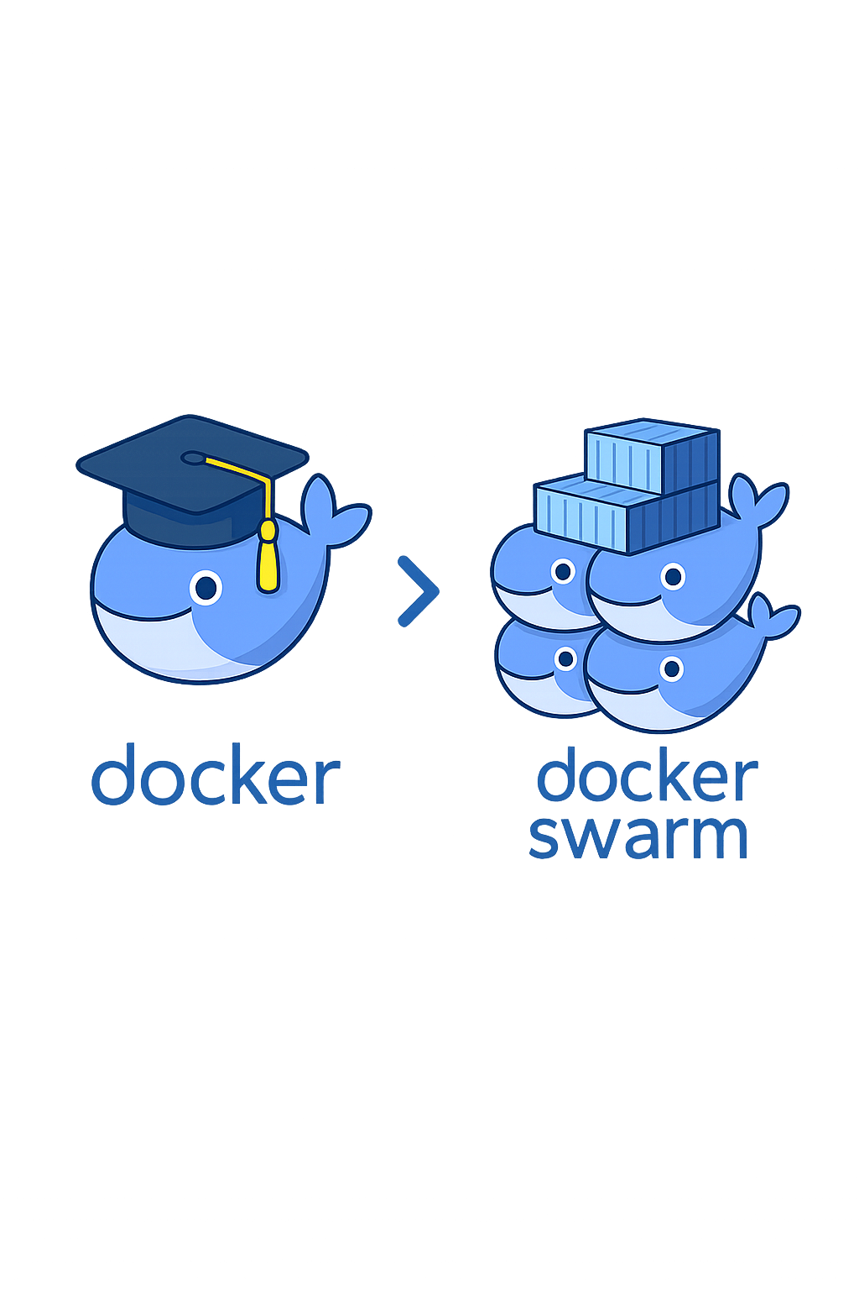

Slide 32
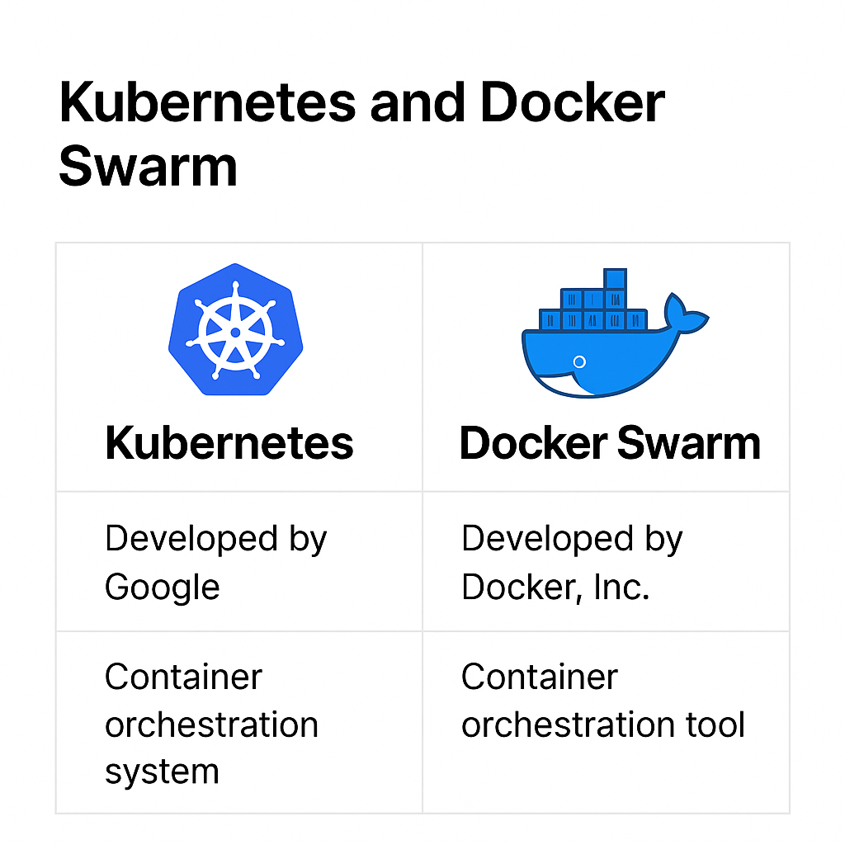
🐳 What is Docker Swarm?
Docker Swarm is Docker's native clustering and container orchestration tool. It allows you to group multiple Docker hosts (machines) into a single virtual cluster that you can deploy, manage, and scale containers on – as if they were running on one machine.

Slide 33


