Slide 1
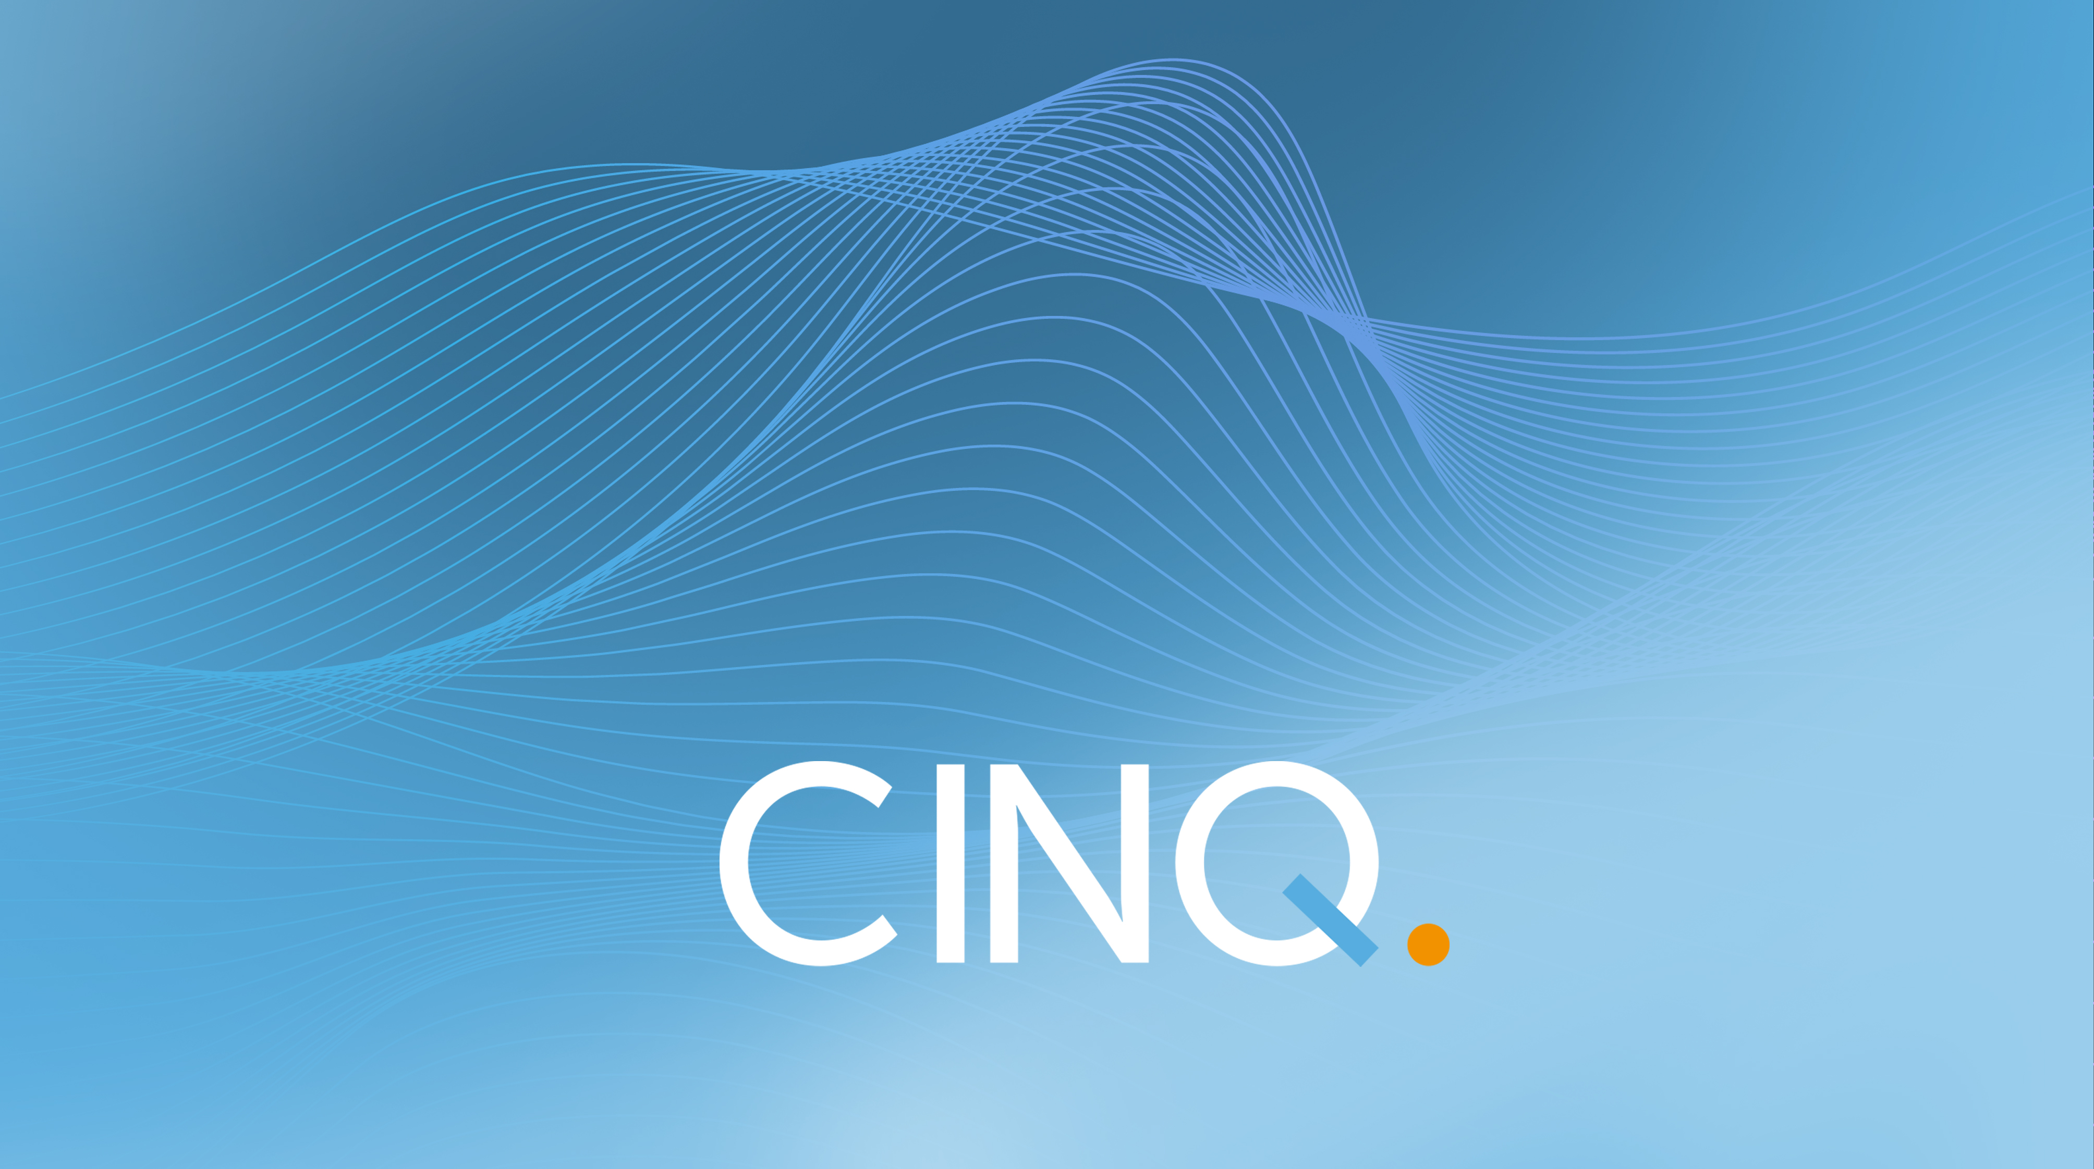
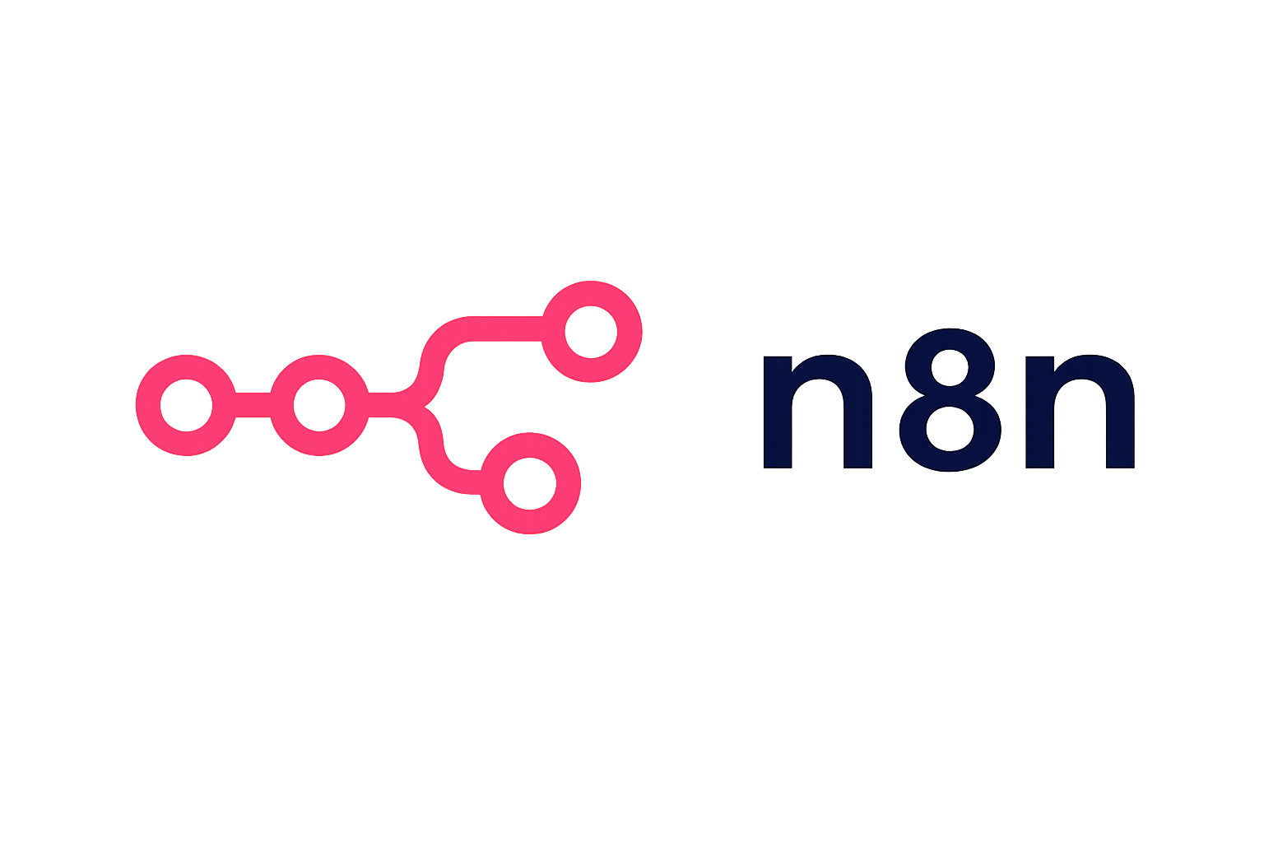
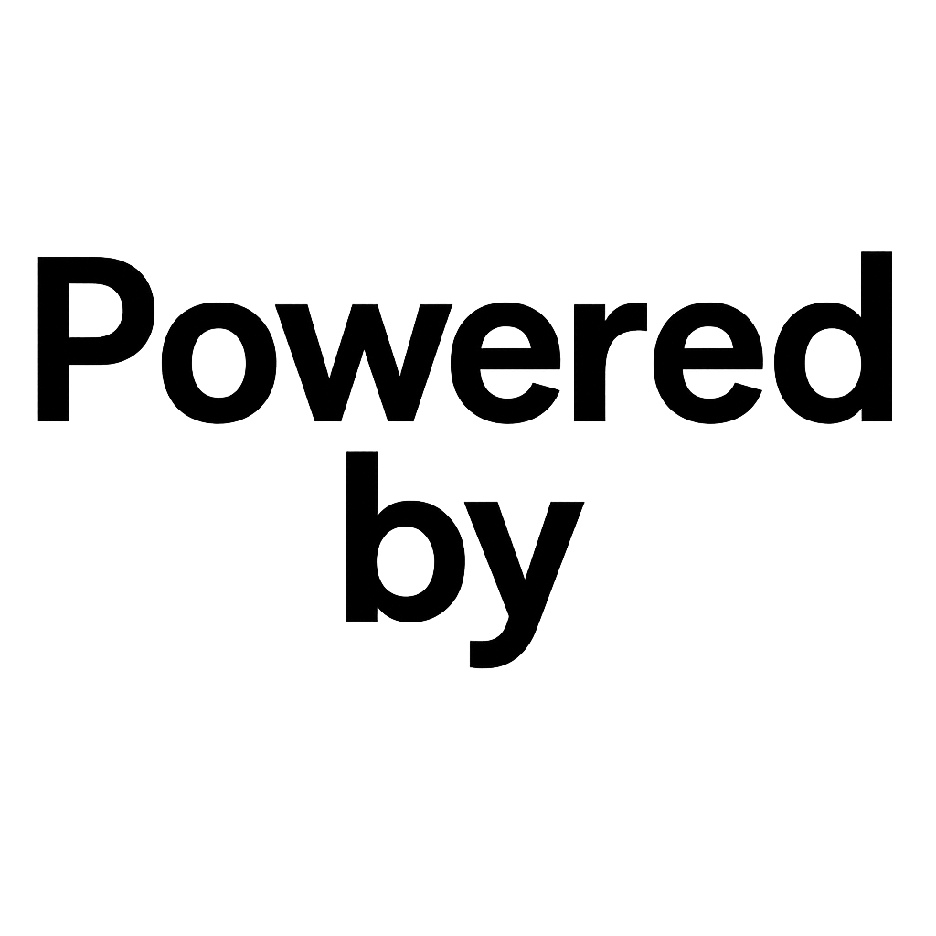

Slide 2

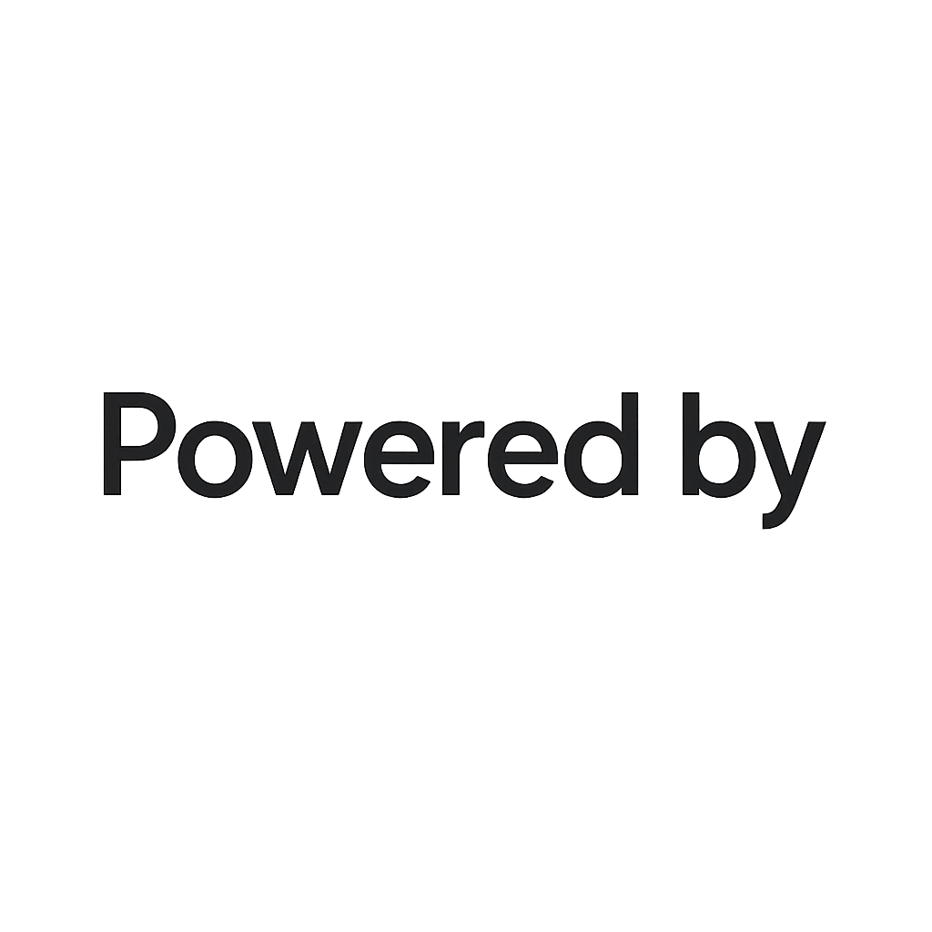
WHAT IS n8n AND WHY TO USE IT?
🤖 What is n8n?
n8n is a powerful open-source automation tool that lets you connect different apps and services- even if they don’t normally work together. With n8n, you can easily build automations that handle boring tasks for you, saving hours every week.
✅ Why choose n8n?
No coding needed: Anyone can use it! Just drag and drop to build workflows.
Open-source & free: Use n8n for personal or business projects, and even run it on your own computer or server to keep fullcontrol.
Super flexible: Connect hundreds of apps out of the box - and add your own if you want. Build anything from simple
automations to complex processes.
With n8n, you can automate your work, boost productivity, and connect all your favorite tools - without limits.

Slide 3
WHAT IS n8n AND WHY TO USE IT?
Simple Example
Imagine you get a new email with an attachment every day. n8n can automatically save that attachment to your Google
Drive and send you a message on Slack, without you doing anything.
Who Uses n8n?
Business owners looking to save time
Freelancers and agencies automating client tasks
Teams needing to connect different apps
Anyone wanting to learn automation skills - no matter their experience level
Why Learn n8n Now?
Learning n8n will help you work smarter, save time, and even create new job or business opportunities. It’s a top choice for
anyone who wants to get into automation without the headaches of coding or expensive software.

Slide 4
BENEFITS OF USING n8n
01 – Automate Anything, Anytime
Connect 350+ apps and services to automate endless tasks – from emails to data syncs, social media, business tools, and more.
02 – Open Source & Free to Start
Run n8n on your own computer or server for free, or choose cloud hosting for convenience. Your data stays private and secure.
03 – No-Code & Low-Code Friendly
Easily create powerful workflows with a visual editor. No programming skills needed, but you can use code for advanced solutions.
04 – Super Flexible & Customizable
Tweak every detail! Build custom triggers, set up complex logic, and adapt workflows to fit your business or personal needs.
05 – Saves Time & Reduces Errors
Let automations do the repetitive work, cut out mistakes, and focus on what really matters.
06 – Easy to Learn, Quick to Deploy
Intuitive drag-and-drop builder and plenty of tutorials, so anyone can get started and see results fast.
07 – Scale As You Grow
Whether you’re a solo creator or a big business, n8n can handle a few workflows — or thousands, as you expand.
08 – Active Community & Support
Get help, ideas, and inspiration from a huge global community, plus tons of ready-to-use workflow templates.

Slide 5

https://github.com/DennisVermeulen/n8ncinqworkshop

