Slide 1

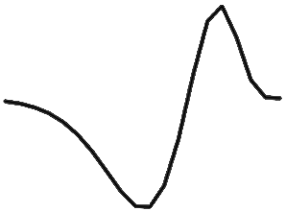
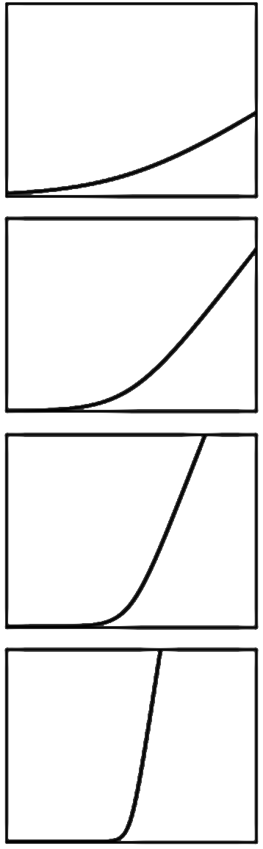

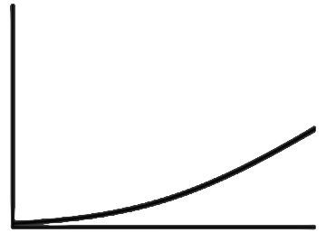

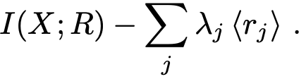
















Natural Image
Sensory degraded signal
Linear Nonlinear Encoder
$$w_{1}$$
$$φ_{1}$$
$$f_{1}$$
$$n_{out,1}$$
$$n_{in}$$
$$r_{1}$$
$$w_{2}$$
$$φ_{2}$$
$$f_{2}$$
$$n_{out,2}$$
$$r_{2}$$
$$w_{J}$$
$$φ_{J}$$
$$f_{J}$$
$$n_{out,J}$$
$$r_{J}$$
input x
neural response r
Maximize information transfer
subject to metabolic cost of firing spikes

