Slide 1
MONDE
Tap. Pay. Done.
Presentation by Denny Sepiso

Slide 2
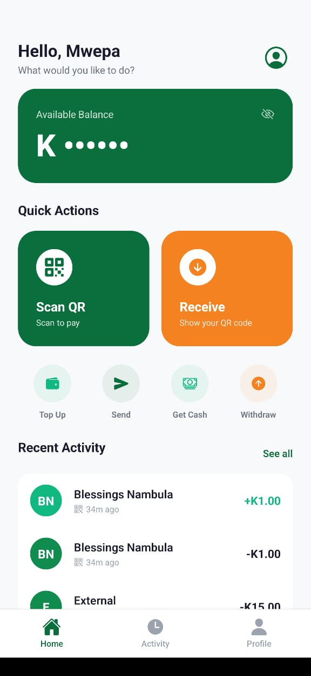
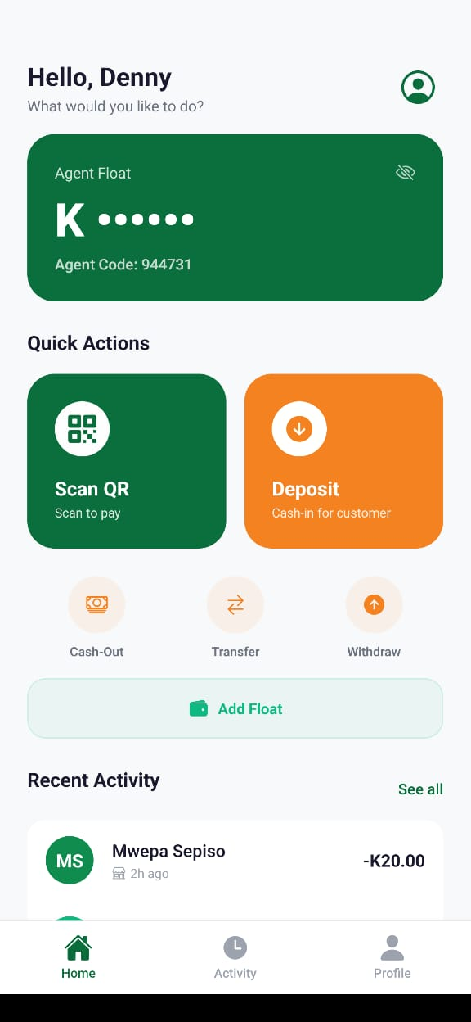
01 | EXECUTIVE SUMMARY
Monde at a Glance
Monde is a mobile payment application built for Zambia's financial ecosystem. Our platform enables instant, secure, and affordable person-to-person (P2P) payments using QR codes, and agent-assisted cash-in/cash-out services.
We are seeking designation as a Payment System Business to legally operate money transfer and transmission services across Zambia.
Monde is designed to be fully interoperable across all major Zambian payment providers :
Airtel Money
MTN MoMo
Zamtel Kwacha and
Visa/Mastercard

Slide 3
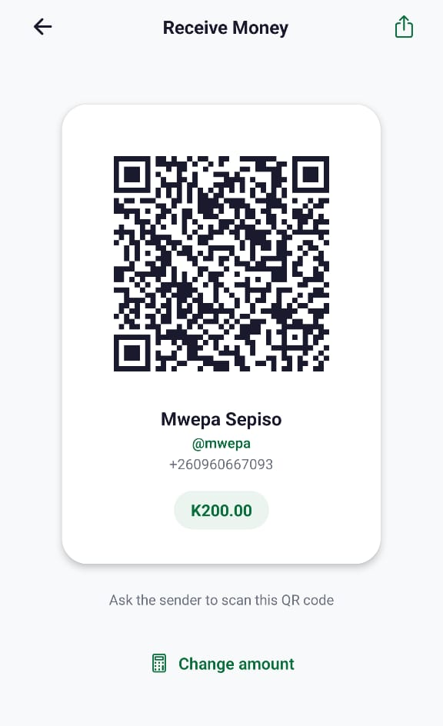
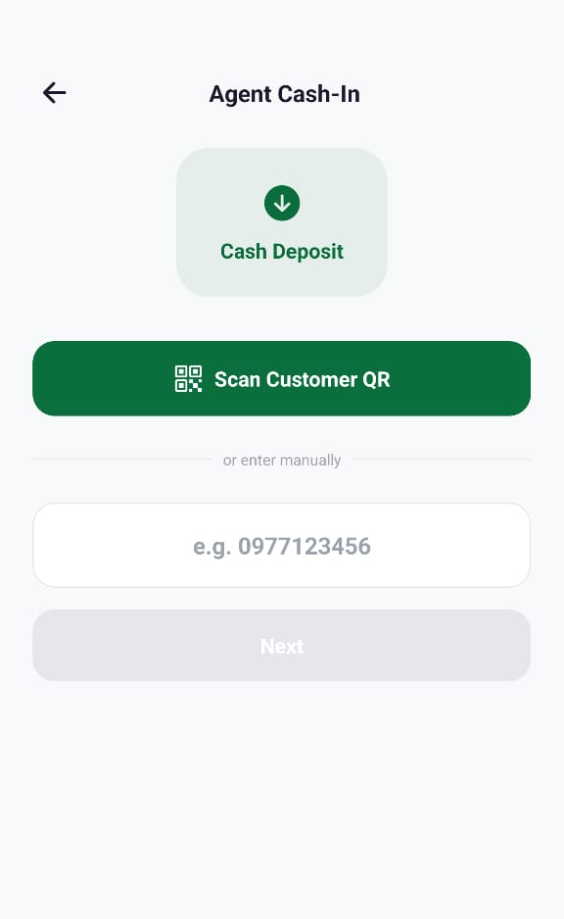
01 | EXECUTIVE SUMMARY
Monde at a Glance

Slide 4
02 | THE PROBLEM
Zambia's Payment Ecosystem Challenges
Fragmented Ecosystem
Low Interoperability
Multiple mobile money providers (Airtel, MTN, Zamtel) and banks (FNB, Zanaco, Absa) operate in silos. Sending money across providers is cumbersome, expensive, or impossible.
Despite BoZ's National Financial Switch (NFS) initiative, cross-platform P2P payments remain limited. Users are forced to maintain multiple accounts.
High Transaction Costs
Cash Dependency
Cross-provider transfers incur high fees that disproportionately burden low-income users. Small transactions become uneconomical.
Zambia remains heavily cash-dependent. The unbanked and underbanked need accessible digital onramps through agent networks and simple mobile interfaces.

Slide 5
03 | OUR SOLUTION
Monde
Every transaction completes in 3 taps or fewer. Interoperable across all Zambian providers.
QR
NFC
P2P
QR Code Payments
Tap to Pay
Send & Receive
Scan and pay instantly at merchants or between individuals. Dynamic and static QR codes supported.
Hold phones together to transfer money. Near-field communication for instant proximity payments.
Send money to any Zambian phone number across Airtel, MTN, Zamtel, FNB, Zanaco, Absa.
W
AG
TX
Digital Wallet
Agent Network
Transaction History
Top up from mobile money, manage balance, withdraw to any linked account. Real-time updates.
Cash-in/cash-out through designated agents. Commission-based model with anti-fraud controls.
Full audit trail with date grouping, filters, receipt generation, and share functionality.

Slide 6
04 | TECHNOLOGY & SECURITY
Enterprise-Grade Security Architecture
Technology Stack
React Native + Expo SDK 52 (cross-platform mobile)
TypeScript
Supabase (PostgreSQL) — auth, database, real-time.
MNO API: payment gateways for collections and disbursements
Row-Level Security (RLS) on all database tables
Edge Functions for server-side payment processing
Real-time balance and transaction updates via WebSockets
PIN Auth
Auto-Lock
4-digit PIN with secure hashing. No plain-text storage.
App locks after 2 minutes of inactivity. Full PIN re-entry.
Rate Limiting
Input Sanitization
5 login attempts max. 30-second lockout period.
All inputs sanitized against injection attacks.
Amount Controls
RLS Policies
Min K1, max K50,000. Balance validation pre-transaction.
Database row-level security. Users only access own data.

Slide 7
04B | DATA PROTECTION
Data Protection Act No. 3 of 2021 Compliance
Data Minimization
Confidential Transmission
Only essential user data collected: phone number, name, transaction records.
All API calls over HTTPS/TLS. Supabase enforces encrypted connections.
Secure Storage
Access Controls
All data stored in Supabase PostgreSQL with encryption at rest with Row-Level Security.
JWT-based authentication with session refresh.
Consent-Based Processing
Audit Trail
User data processed only with explicit consent at registration. Clear terms of service presented before account creation.
Complete transaction history maintained. All payment operations logged with timestamps, references, and status tracking.
Right to Access & Deletion
Data Retention
Users can view all their data through the app.
Account deletion procedures to be implemented.
Records maintained for minimum 6 years per NPSA Section 28. Electronic storage with integrity verification.

Slide 8
05 | AGENT NETWORK
Agent Cash-In / Cash-Out Model
Cash-In (Deposit)
0.5% commission to agent (Monde pays)
Agent accepts cash from customer, credits their Monde wallet
Cash-Out
Tiered fees: K2.50–K50 (70/30 agent/Monde split)
Customer generates 6-digit code, agent verifies and gives cash

Slide 9
05B | AGENT NETWORK
Agent Cash-In / Cash-Out Model
Agent Transfer
Free, K50,000 daily cap
Agent-to-agent float transfer for liquidity management
Float Top-Up
Agent loads wallet balance via mobile money
Standard top-up fees apply
Anti-Fraud
• Daily deposit limit — max 3 deposits per customer per day from any agent
• Agent transfer daily cap — K50,000/day per agent
• Self-service blocks — agents cannot deposit to self or cash-out own requests
• Admin-only agent designation — only admin can toggle agent status

Slide 10

06 | BUSINESS MODEL
Revenue Model & Fee Transparency
Service
Fee to Customer
Revenue
Provider Cost
P2P Send
Free
—
Included
Top-Up (MoMo)
2.5% collection fee
Margin on fee
2.5% (Lipila)
Withdrawal (MoMo)
1.5% disbursement fee
Margin on fee
1.5% (Lipila)
Cash-In (Agent)
Free to customer
Agent commission from Monde
0.5% to agent
Cash-Out (Agent)
K2.50 – K50 tiered
30% of fee | 70% to agent
---
Agent Transfer
Free
—
—
QR/NFC Payment
Free
---
Included
All fees are transparently disclosed to users before transaction confirmation. Fee schedules will be filed as required.
Monde collects all customer fees into a dedicated fee ledger account with full audit trail.
9 / 18

Slide 11
07 | REGULATORY COMPLIANCE
NPSA 2007 : Compliance Assessment
Monde's compliance status against key sections of the National Payment Systems Act No. 1 of 2007
Section 3 — Application
Monde operates as a payment system business; Act applies
Section 11 — BoZ Regulation
Seeking designation; prepared for BoZ oversight
Section 12 — Designation
Application in preparation; this presentation is part of the process
Section 13 — Restriction
Not yet designated; operating in pre-launch/sandbox mode
Section 27 — Returns
System capable of generating reports; formal reporting structure to be agreed with BoZ
Section 28 — Record Retention
All records stored electronically; 6+ year retention configured
Section 29 — Access to Information
Full database access; can provide information within 14-day requirement
Section 30 — Documents
Governance structure being formalized
Section 33 — Dishonoured Cheques
N/A
Section 43 — Rules & Guidelines
Ready to comply with any BoZ-prescribed rules, guidelines, or directives
Compliant / Ready
In Progress / Action Required

Slide 12
07B | COMPLIANCE DETAIL
What Monde Already Delivers
Technical Compliance
Operational Compliance
✓ Full transaction audit trail with timestamps and references
✓ KYC-ready architecture (phone-based identity verification)
✓ Real-time balance tracking with database-level integrity
✓ Transaction limits: min K1, max K50,000 per transaction
✓ Encrypted data transmission (HTTPS/TLS on all endpoints)
✓ Anti-fraud controls on agent operations
✓ Row-Level Security on all database tables
✓ Daily transaction caps and velocity checks
✓ JWT-based authentication with session management
✓ Admin dashboard for oversight and monitoring
✓ Input validation and sanitization on all user inputs
✓ Agent designation controlled by admin only
✓ Electronic record storage with 6+ year retention
✓ Real-time notifications for all transactions
✓ Separate fee ledger for revenue tracking and transparency
✓ Cross-provider fee transparency at point of transaction
11 / 18

Slide 13
08 | RISK MANAGEMENT
Risk Management & AML/CFT Framework
Operational Risk
Fraud Prevention
• Transaction amount limits (K1–K50,000) to contain exposure
• Circular transaction detection (agent cash-in/cash-out within 24h)
• Real-time balance validation
• Daily velocity limits per customer and per agent
• Atomic database transactions for consistency
• Agent-only operations segregated from customer operations
• Automated error handling with graceful degradation
• Self-service blocks
• Login rate limiting to prevent brute-force attacks
AML/CFT Readiness
Systemic Risk Mitigation
• Phone-based identity linked to MNO KYC records
• Funds held in regulated mobile money accounts (not pooled)
• Full transaction audit trail for suspicious activity monitoring
• Fee ledger separation ensures operational funds are distinct
• Planned: Formal MLRO appointment and STR filing procedures
• No credit extension — pure payment facilitation model
• Planned: Integration with FIC reporting requirements
• Settlement via existing regulated payment infrastructure
• Planned: Enhanced due diligence for high-value transactions
• Business continuity plan in development

Slide 14
9 | IMPLEMENTATION TIMELINE
Phased Rollout Plan
Q1–Q2 2026
Q3 2026
Q4 2026
2027+
Pre-Launch
Pilot
Controlled Launch
Scale & Expand
Notes:
Corporate Governance Commitments: • Board of Directors with independent members to be established • Annual external audits by a BoZ-approved auditor • Internal compliance reviews on a quarterly basis • Segregation of duties between operations, finance, and compliance • Formal whistleblower and grievance procedures per Section 43(3)(g) • Company registration with PACRA and tax compliance with ZRA

Slide 15
Thank You
Contact Information
Monde Payment Systems Denny Sepiso Dennysepiso@gmail.com
0970627630

