Slide 1
Team 5 – Car Store

Slide 2
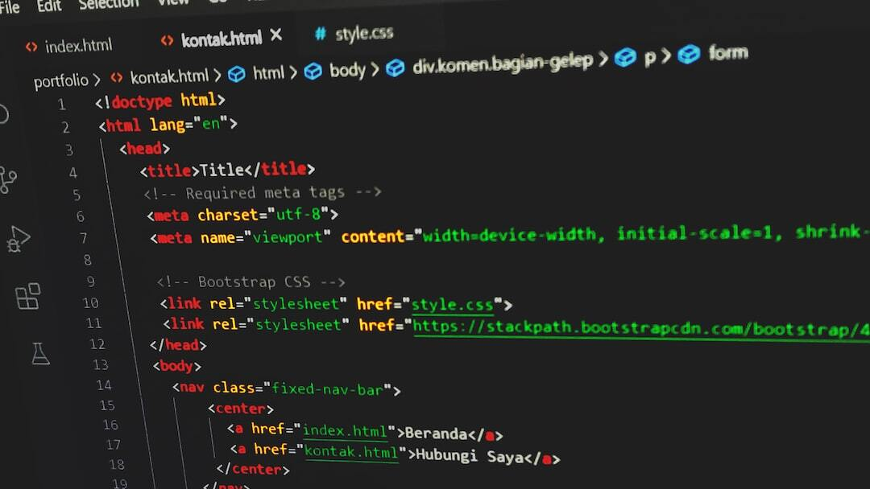
Car Store Project: Web Application
Overview: This presentation showcases a web application developed utilizing a modern tech stack consisting of React, Spring Boot, and MySQL.
Objectives: The primary goal was to create a responsive and scalable web application that allows users to go to an online car store and purchase a car.
Technology Stack: - React: Frontend web interface that provides flexibility. - Spring Boot: Robust backend framework simplifying overall development. - MySQL: Database management for reliable data storage and retrieval.

Slide 3

Frontend Development with React
React Features: Leveraged React for its virtual DOM and component-based architecture, enabling efficient updates and rendering of user interfaces.
Development Approach: Implemented reusable components to streamline the development process and maintain consistency across the application.
User Experience: Focused on creating a simplistic and responsive design to ensure a seamless interaction for end-users.

Slide 4
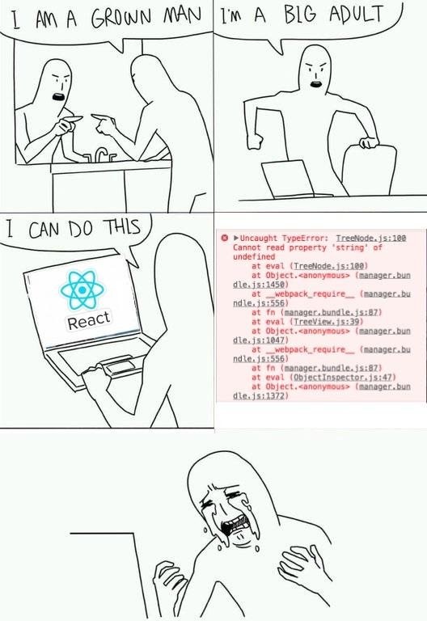

Slide 5

Backend Development with Spring Boot
Spring Boot Advantages: Chose Spring Boot because of multiple advantages it provides. Easy to set up, very scalable, removes a lot of boiler plate code, simplifies error handling and protects against SQL injections.
API Development: Developed RESTful APIs to handle requests and integrate seamlessly with the frontend, enhancing the application's scalability and manageability.
Security and Performance: Implemented Spring Security to ensure robust authentication and authorization. Optimized performance through efficient query management and server-side optimizations.

Slide 6
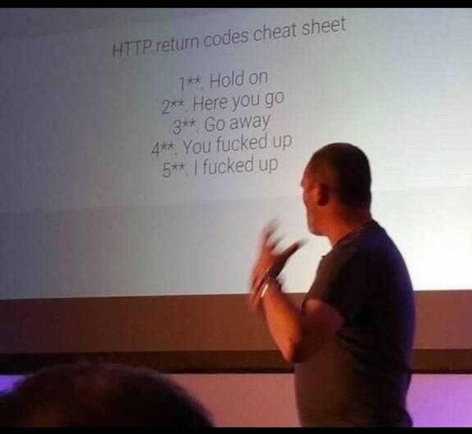

Slide 7

Database Development with MySQL
MySQL Advantages: Primary advantage of MySQL was familiarity. We have all worked with MySQL in previous classes, so this was the best fit for the team.
Database Development: The database schema had to be simple for the project. In a real world application there would be 2-3x the tables. However, the schema we created sufficed in complexity and performance.
Stateless application: By utilizing MySQL’s BLOB type, we have put all the pictures in the database as binary objects, creating a stateless application.

Slide 8
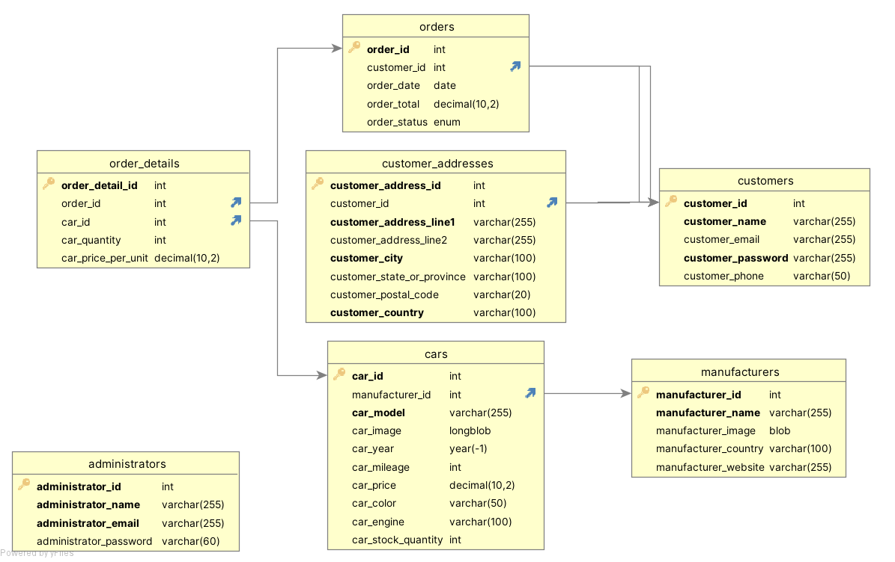

Slide 9
