Slide 1
Pitch
Deck
Creative
Presentation
https://v.youku.com/v_show/id_XNTg4OTcwMDM3Ng==.html

Slide 2
Page / 02
Introduction
Content
About Us
Our Plan
SWOT Analysis
Target Market
Meet the Team
Portfolio
PRESENTATION
FLOW

Slide 3

Page / 03
Great brands have the power to shape the world.

Slide 4

About Us
Presentations are communication tools that can be used as demonstrations, lectures, speeches, reports, and more. It is mostly presented before an audience. It serves a variety of purposes, making presentations powerful tools for convincing and teaching.
Page / 04

Slide 5
Our Plan
Vision
Mission
Presentations are communication tools that can be used as demonstrations, lectures, speeches, reports, and more. It is mostly presented before an audience. It serves a variety of purposes, making presentations powerful tools for convincing and teaching.
Presentations are communication tools that can be used as demonstrations, lectures, speeches, reports, and more. It is mostly presented before an audience. It serves a variety of purposes, making presentations powerful tools for convincing and teaching.
Page / 05

Slide 6
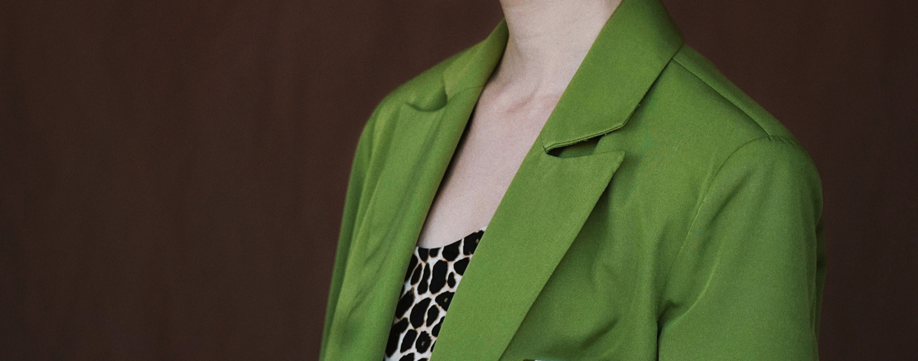

Rachelle Beaudry
Presentations are communication tools that can be used as demonstrations, lectures, speeches, reports, and more. It is mostly presented before an audience. It serves a variety of purposes, making presentations powerful tools for convincing and teaching.
FOUNDER / CEO
Page / 06

Slide 7

Presentations are communication tools that can be used as demonstrations, lectures, speeches, reports, and more. It is mostly presented before an audience.
To create a stunning presentation, it's best to simplify your thoughts. Start with an outline of topics and identify highlights, which can be applied to whatever subject you plan on discussing.
Our Journey
presentation.com
Page / 07

Slide 8


13/05/2021
Your Brand
in Our Hand
presentation.com
Page / 08

Slide 9



MEET
THE
TEAM
Avery Davis
Creative DIrector
Murad Naser
Product Designer
Soo Jin Ae
Director
Page / 09

Slide 10
SWOT ANALYSIS
STRENGTHS
OPPORTUNITIES
What advantages does your company have? What do you do better than anyone else? What are your unique selling points?
What changes in technology, policies, and social patterns
can be a growth opportunity for the company?
WEAKNESSES
THREATS
What areas can you improve on? What does your company lack? What things do your competitors do better than you?
What are the obstacles to your company’s growth? Who are your competitors? What changing factors can threaten your company's position?
Page / 10

Slide 11
OUR
PROCESS
STRATEGY
Strategy is how your methods, time, and resources come into play to fulfill your
company mission and vision.
TACTICS
Tactics are the specific methods, resources,
and techniques you will need to accomplish
your strategy.
EXECUTION
Execution is how you will employ the tactics you’ve chosen. It includes measurable outcomes, such as timelines and deliverables.
Page / 11

Slide 12


OUR
PROJECT
PROJECT . 01
Presentations are communication tools that can be used as demonstrations, lectures, speeches, reports, and more. It is mostly presented before an audience.
Page / 12

Slide 13


PROJECT . 02
Creative
Presentation
OUR PROJECT
Page / 13

Slide 14



Creative
Presentation
PORTFOLIO
presentation.com
Page / 14

Slide 15
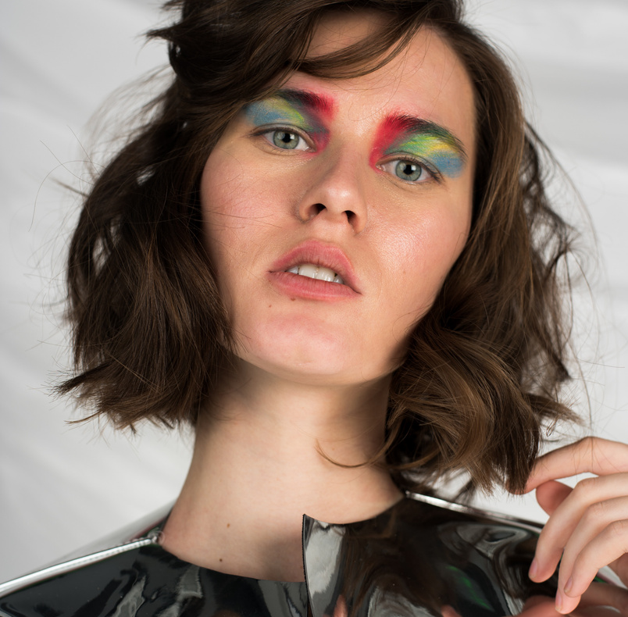


TESTIMONIAL
Olivia Wilson
Juliana Silva
Margarita Perez
Presentations are communication tools that can be used as demonstrations.
Presentations are communication tools that can be used as demonstrations.
Presentations are communication tools that can be used as demonstrations.
Page / 17

Slide 16

CONTACT US
Creative
Brand
Presentation
123-456-7890
hello@presentation.com
www.presentation.com
Page / 19

Slide 17
Creative
Presentation
THANK YOU
https://v.youku.com/v_show/id_XNTg4OTcwMDM3Ng==.html

