Slide 1
SARAH AMELIA
graphic designer
Graphic entrepreneur in presentation - Creative std.

Slide 2

About Me
EXPERIENCE
Presentations are communication tools that can be used as demonstrations, lectures, speeches, reports, and more.
AWARDS
Presentations are communication tools that can be used as demonstrations, lectures, speeches, reports, and more.
about me

Slide 3

Just keep moving forward
QUOTE

Slide 4

Welcome
creative std.
Presentations are communication tools that can be used as demonstrations, lectures, speeches, reports, and more.
Presentations are communication tools that can be used as demonstrations, lectures, speeches, reports, and more.

Slide 5

Introduction
Presentations are communication tools that can be used as demonstrations, lectures, speeches, reports, and more.
Presentations are communication tools that can be used as demonstrations, lectures, speeches, reports, and more.

Slide 6

Me Story
Presentations are communication tools that can be used as demonstrations, lectures, speeches, reports, and more.

Slide 7

Education
MASTERS IN PRODUCT DESIGN
Presentations are communication tools that can be used as demonstrations, lectures, speeches, reports
BA PRODUCT DESIGN
Presentations are communication tools that can be used as demonstrations, lectures, speeches, reports

Slide 8

What We Do
Copywriting
Layout design
Social media design
Photo editing
professional

Slide 9

Personal Skills
Time management
Creative spirit
Fast learner
Motivated
Professional
Organized
Reliable

Slide 10
Skills
ONE
THREE
Presentations are communication tools that can be used as demonstrations.
Presentations are communication tools that can be used as demonstrations.
TWO
FOUR
Presentations are communication tools that can be used as demonstrations.
Presentations are communication tools that can be used as demonstrations.

Slide 11

Experience
ONE
TWO
THREE
Presentations are communication tools that can be used as demonstrations.
Presentations are communication tools that can be used as demonstrations.
Presentations are communication tools that can be used as demonstrations.

Slide 12

BREAK TIME
break time
01.00 - 01.30 PM

Slide 13



Portfolio
Creative
ONE
TWO
THREE
Presentations are communication tools that can be used as demonstrations.
Presentations are communication tools that can be used as demonstrations.
Presentations are communication tools that can be used as demonstrations.

Slide 14

1
Portfolio
ONE
2
Presentations are communication tools that can be used as demonstrations.
Presentations are communication tools that can be used as demonstrations.
TWO
3
Presentations are communication tools that can be used as demonstrations.
THREE
Presentations are communication tools that can be used as demonstrations.

Slide 15

1
Portfolio
ONE
2
Presentations are communication tools that can be used as demonstrations.
TWO
Presentations are communication tools that can be used as demonstrations, lectures, speeches, reports, and more.
3
Presentations are communication tools that can be used as demonstrations.
Presentations are communication tools that can be used as demonstrations, lectures, speeches, reports, and more.
THREE
Presentations are communication tools that can be used as demonstrations.

Slide 16
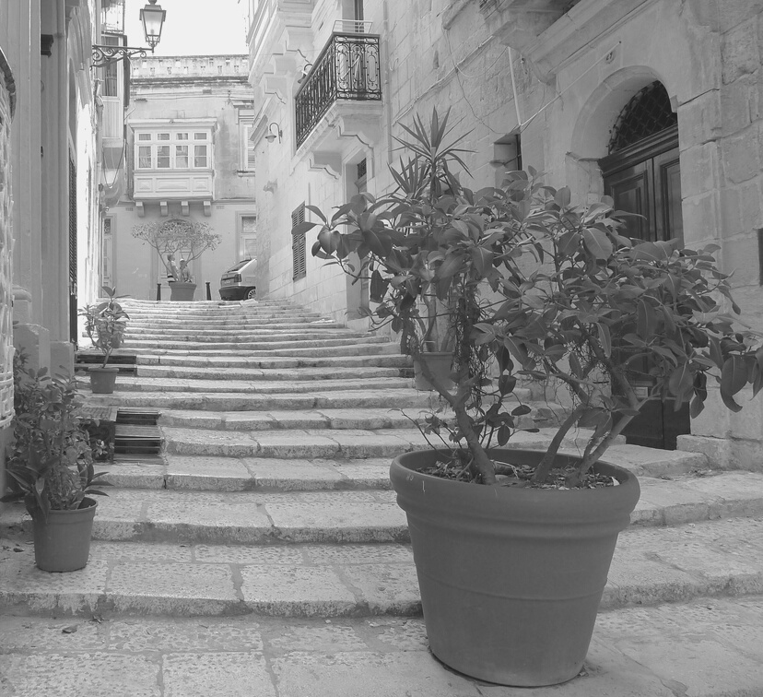


gallery
Presentations are communication tools that can be used as demonstrations, lectures, speeches, reports, and more.

Slide 17

Contact us
PHONE
EMAIL
ADDRESS
123-456-7890
hello@presentation.com
123 Anywhere St., Any City

