Slide 1
PhaseNet Global Fine-Tuning
Progress Report
Iterative retraining of jma_wc for cross-domain generalization
June 12, 2026
Akash Kharita · University of Washington

Slide 2
Project Goal
Improve PhaseNet's cross-domain P/S picking accuracy by fine-tuning on a diverse global dataset
Base model: jma_wc (pretrained PhaseNet, seisbench)
Benchmark dataset: 31,992 held-out traces from global seismic networks
Spans local, regional and teleseismic distance regimes
Key evaluation metrics:
P-MAE (s) — mean absolute pick-time error
P-Recall @ threshold 0.3 — detection completeness
MCC — Matthews Correlation Coefficient (phase discrimination)
P-Outlier fraction — picks with |error| > 1 s
Motivation: Out-of-the-box PhaseNet generalises poorly to stations / distance ranges outside its training domain

Slide 3
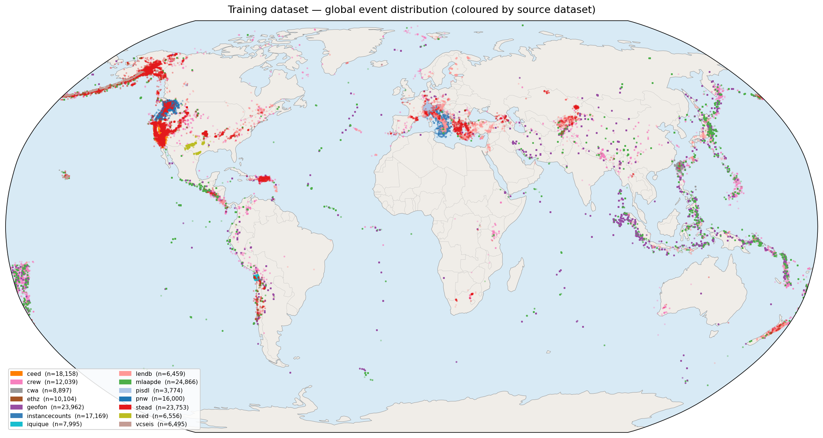
Training Dataset
527,477
125,218
275,660
~67 GB
Training traces
Validation traces
Test traces
RAM pre-loaded
Networks: JMA · SCEDC · ETHZ · Iquique · GEOFON · PNW · NCEDC · NEIC · and more

Slide 4
Approach: Knowledge Distillation + Timing Loss
Knowledge Distillation (KD)
Student model learns from frozen jma_wc teacher
Prevents catastrophic forgetting of pretrained weights
KD loss: α · KL(student ∥ teacher) + cross-entropy
α controls how strongly the teacher constrains the student
Hardware & Training Stack
Optimizer: AdamW
Mixed precision: torch.amp (AMP)
Compilation: torch.compile for speed
Batch size: 1024 · GPU: RTX 3090 (24 GB)
Timing Loss (new in v4+)
Soft-argmax extracts a differentiable pick position
L1 loss between predicted and true arrival time (in samples)
Loss term: β · L1(soft_argmax(pred), true_pos)
β controls timing-loss weight vs cross-entropy + KD
Hypothesis
KD alone prevents forgetting but doesn't explicitly sharpen timing
Adding a small β (0.01–0.1) should reduce P-MAE without hurting recall
v6 tests this at β=0.01 with v3's safe LR=5e-6

Slide 5
Training Runs Overview
Version | LR | KD α | Timing β | Scheduler | Early Stop | Epochs | Best val_loss
v3 | 5×10⁻⁶ | 0.3 | 0 | ReduceLROnPlateau | val_loss | ~96 | 0.0655
v4 ⚠ | 1×10⁻⁴ | 0.1 | 0.1 | Cosine + warmup | val_p_mae_s | 23 | 0.0703 (early stop bug!)
v5 | 1×10⁻⁴ | 0.1 | 0.1 | Cosine + warmup | val_loss | 123 | 0.0655
v6 ⟳ | 5×10⁻⁶ | 0.3 | 0.01 | ReduceLROnPlateau | val_loss | in progress | —
★ v3 = best cross-domain performance so far ⚠ v4 bug: ES monitored val_p_mae_s which peaked mid-warmup ⟳ v6 still training

Slide 6
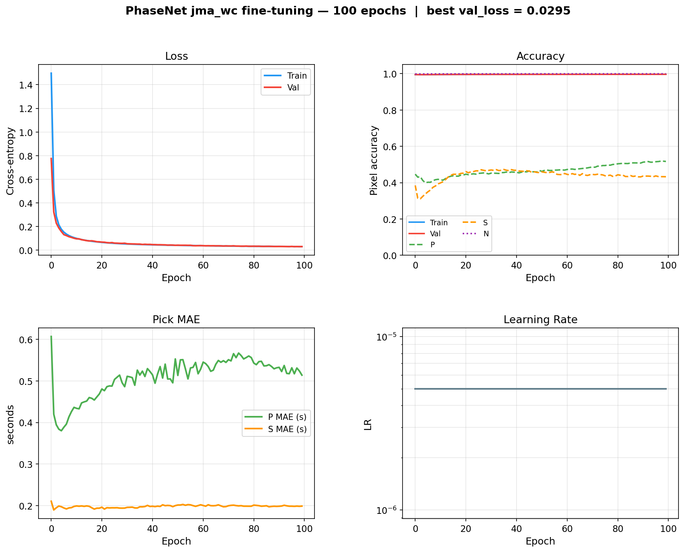
v3 Training — Best Performing Model
LR = 5×10⁻⁶ | KD α = 0.3 | ReduceLROnPlateau | ~96 epochs
Smooth convergence over ~96 epochs at LR = 5×10⁻⁶. Best val P-MAE = 0.37 s

Slide 7
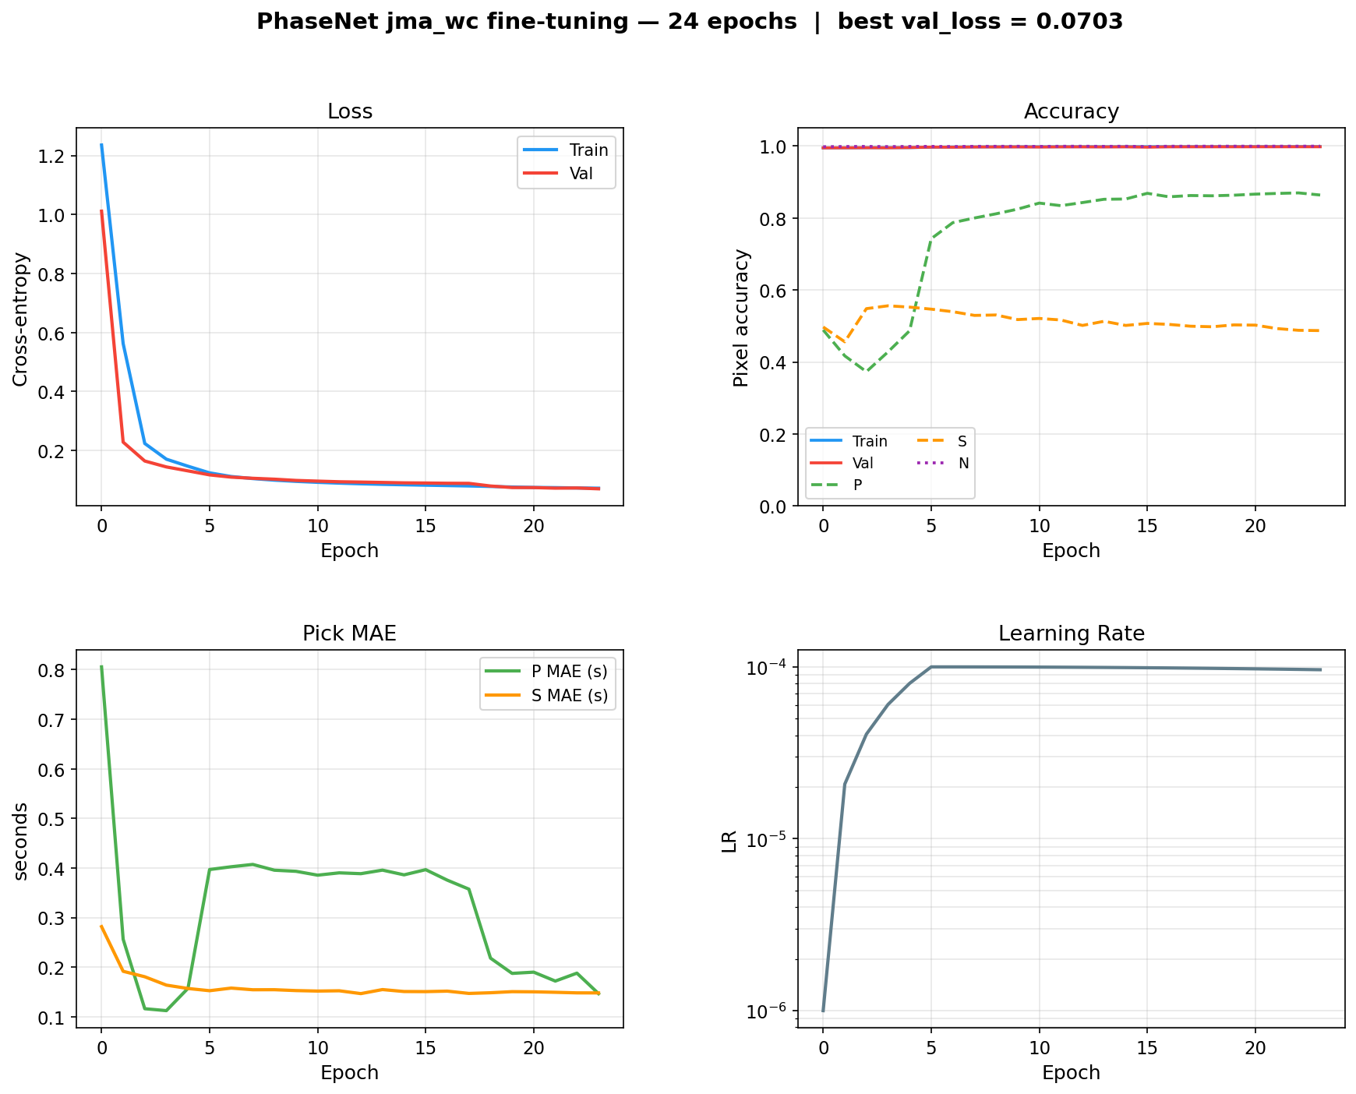
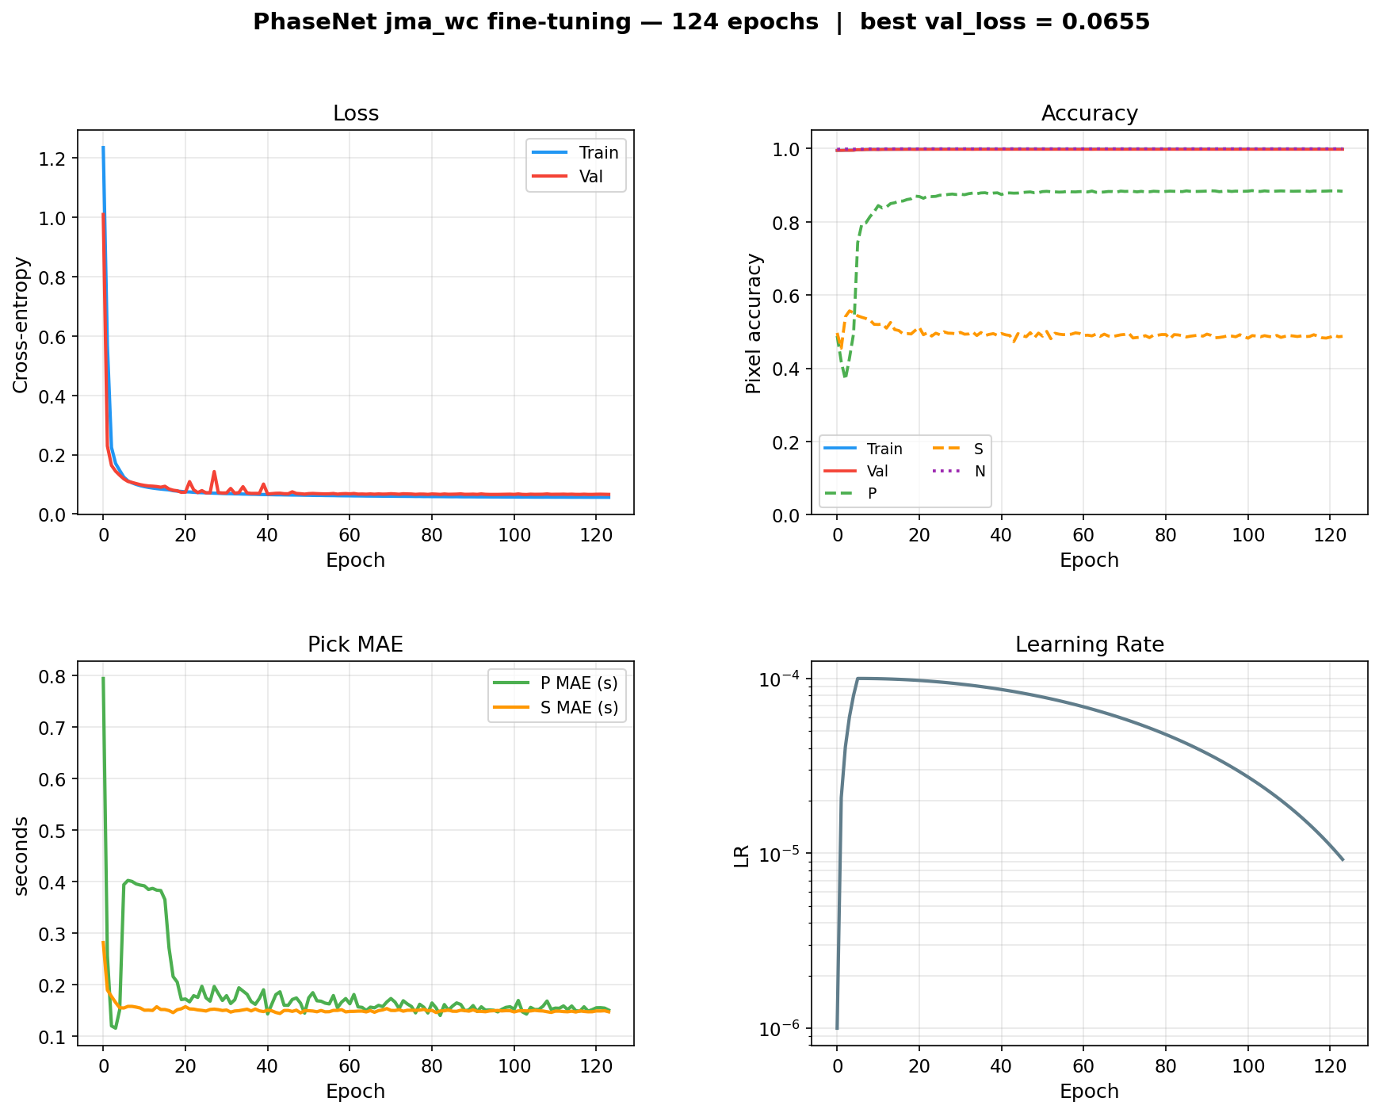
v4 & v5 — High-LR Cosine Schedule (Problematic Runs)
LR = 1×10⁻⁴ | KD α = 0.1 | Timing β = 0.1 | Cosine + warmup
v4 (epochs: 23, stopped early due to ES bug)
v5 (epochs: 123, high-LR drift)
v4: stopped at epoch 3 (wrong ES monitor — val_p_mae_s peaked mid-warmup). v5: ran 123 epochs but high LR caused drift from pretrained weights → recall collapses.

Slide 8
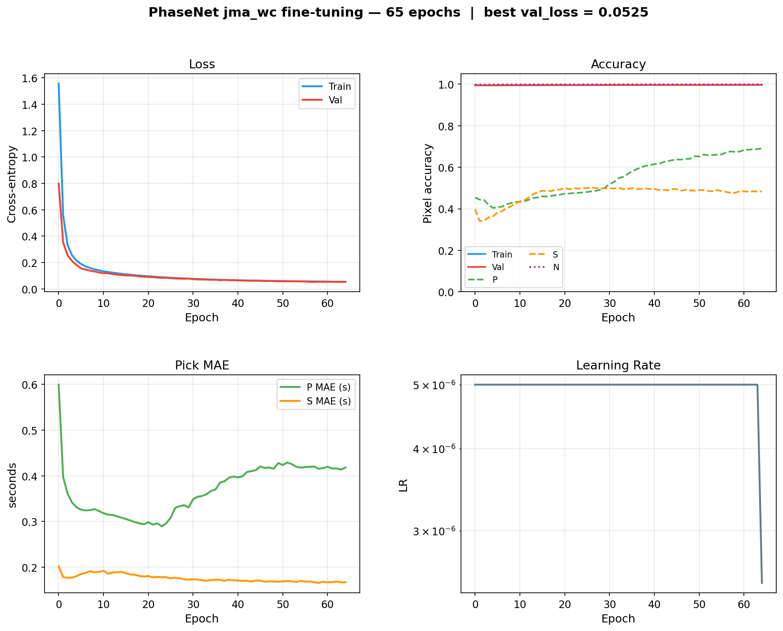
v6 Training — Back to v3 LR Regime + Timing Loss
LR = 5×10⁻⁶ | KD α = 0.3 | Timing β = 0.01 | ReduceLROnPlateau
v6: LR = 5×10⁻⁶, KD α = 0.3, timing β = 0.01. ~60 epochs done — val loss 0.054 and still falling.

Slide 9
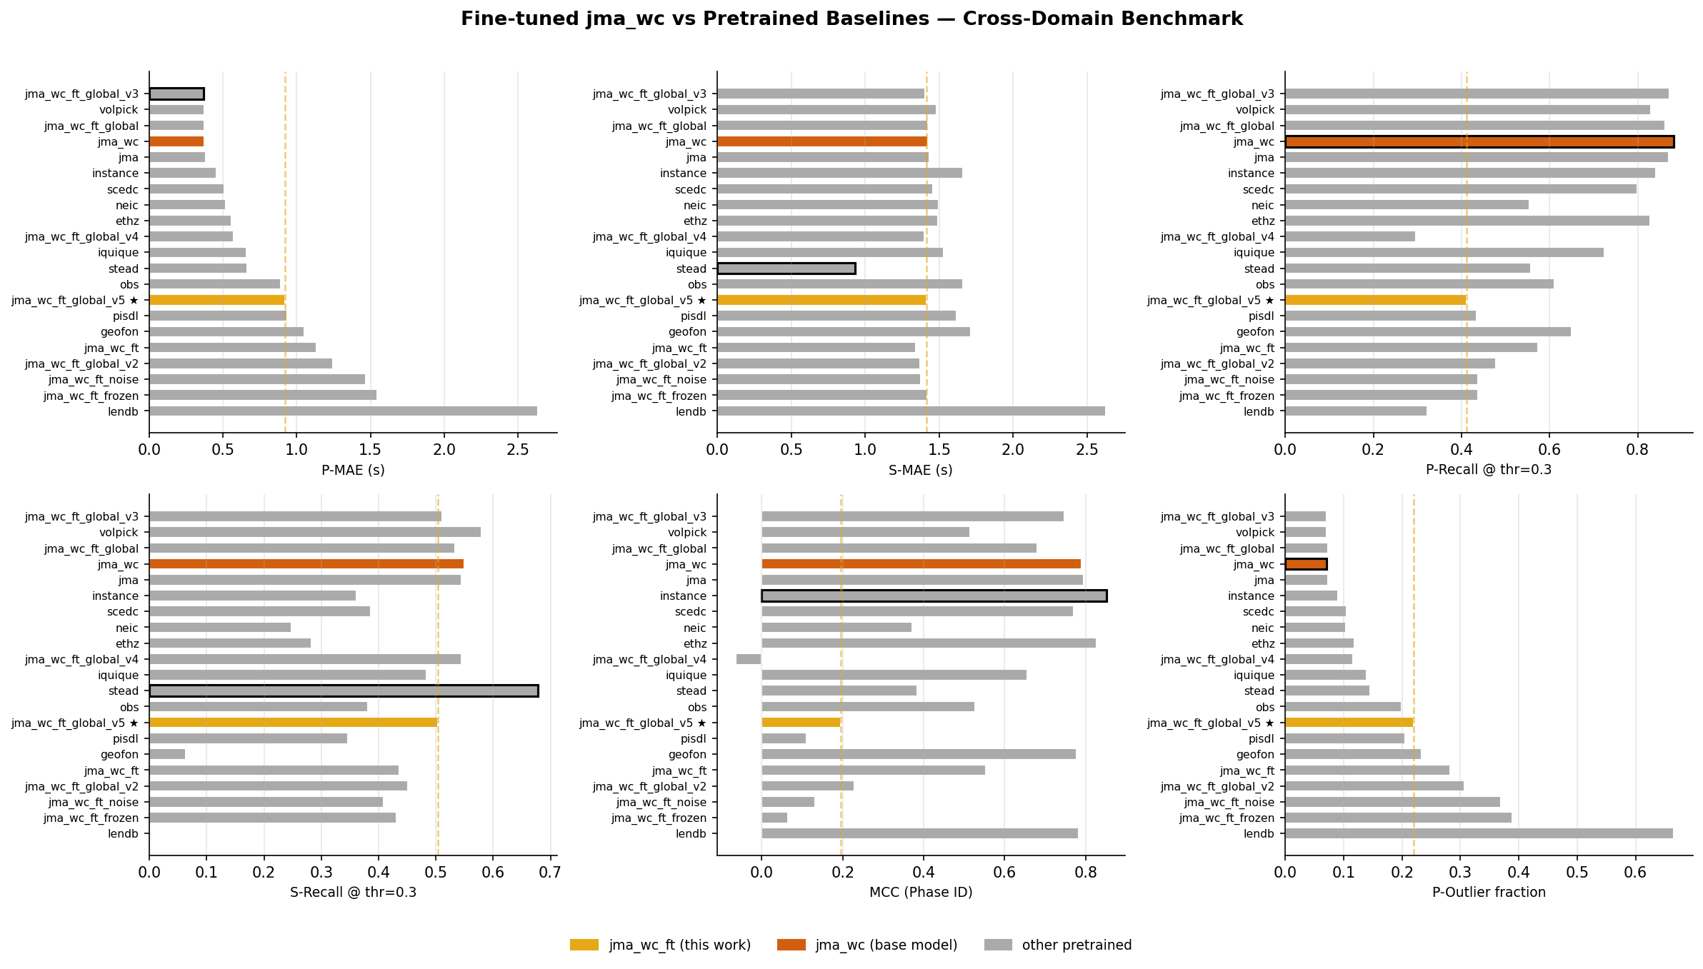
Cross-Domain Benchmark — P-MAE Ranking (all distances)
v3 leads all fine-tuned variants. v4 / v5 regressed due to high learning rate.

Slide 10
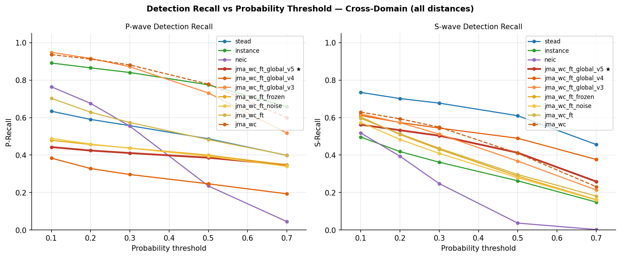
P-wave Detection Recall vs Threshold

Slide 11
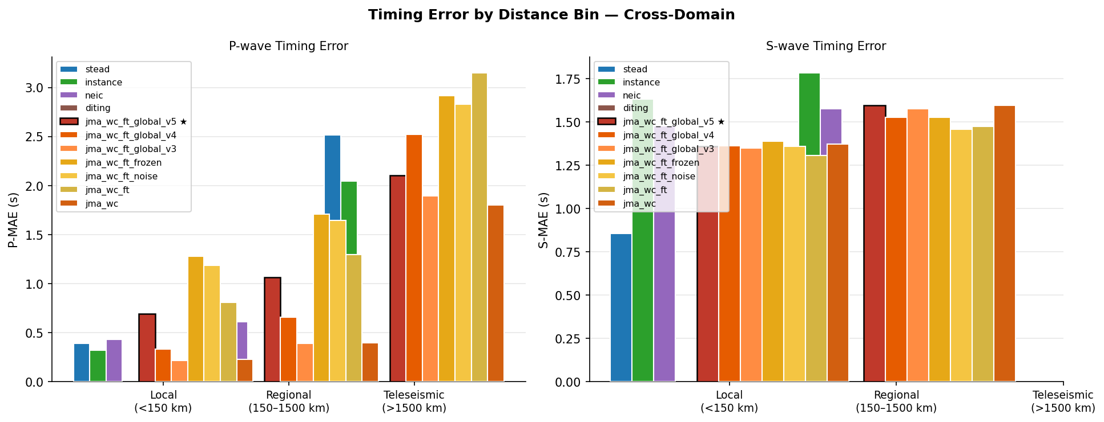
Timing Error by Distance Bin

Slide 12
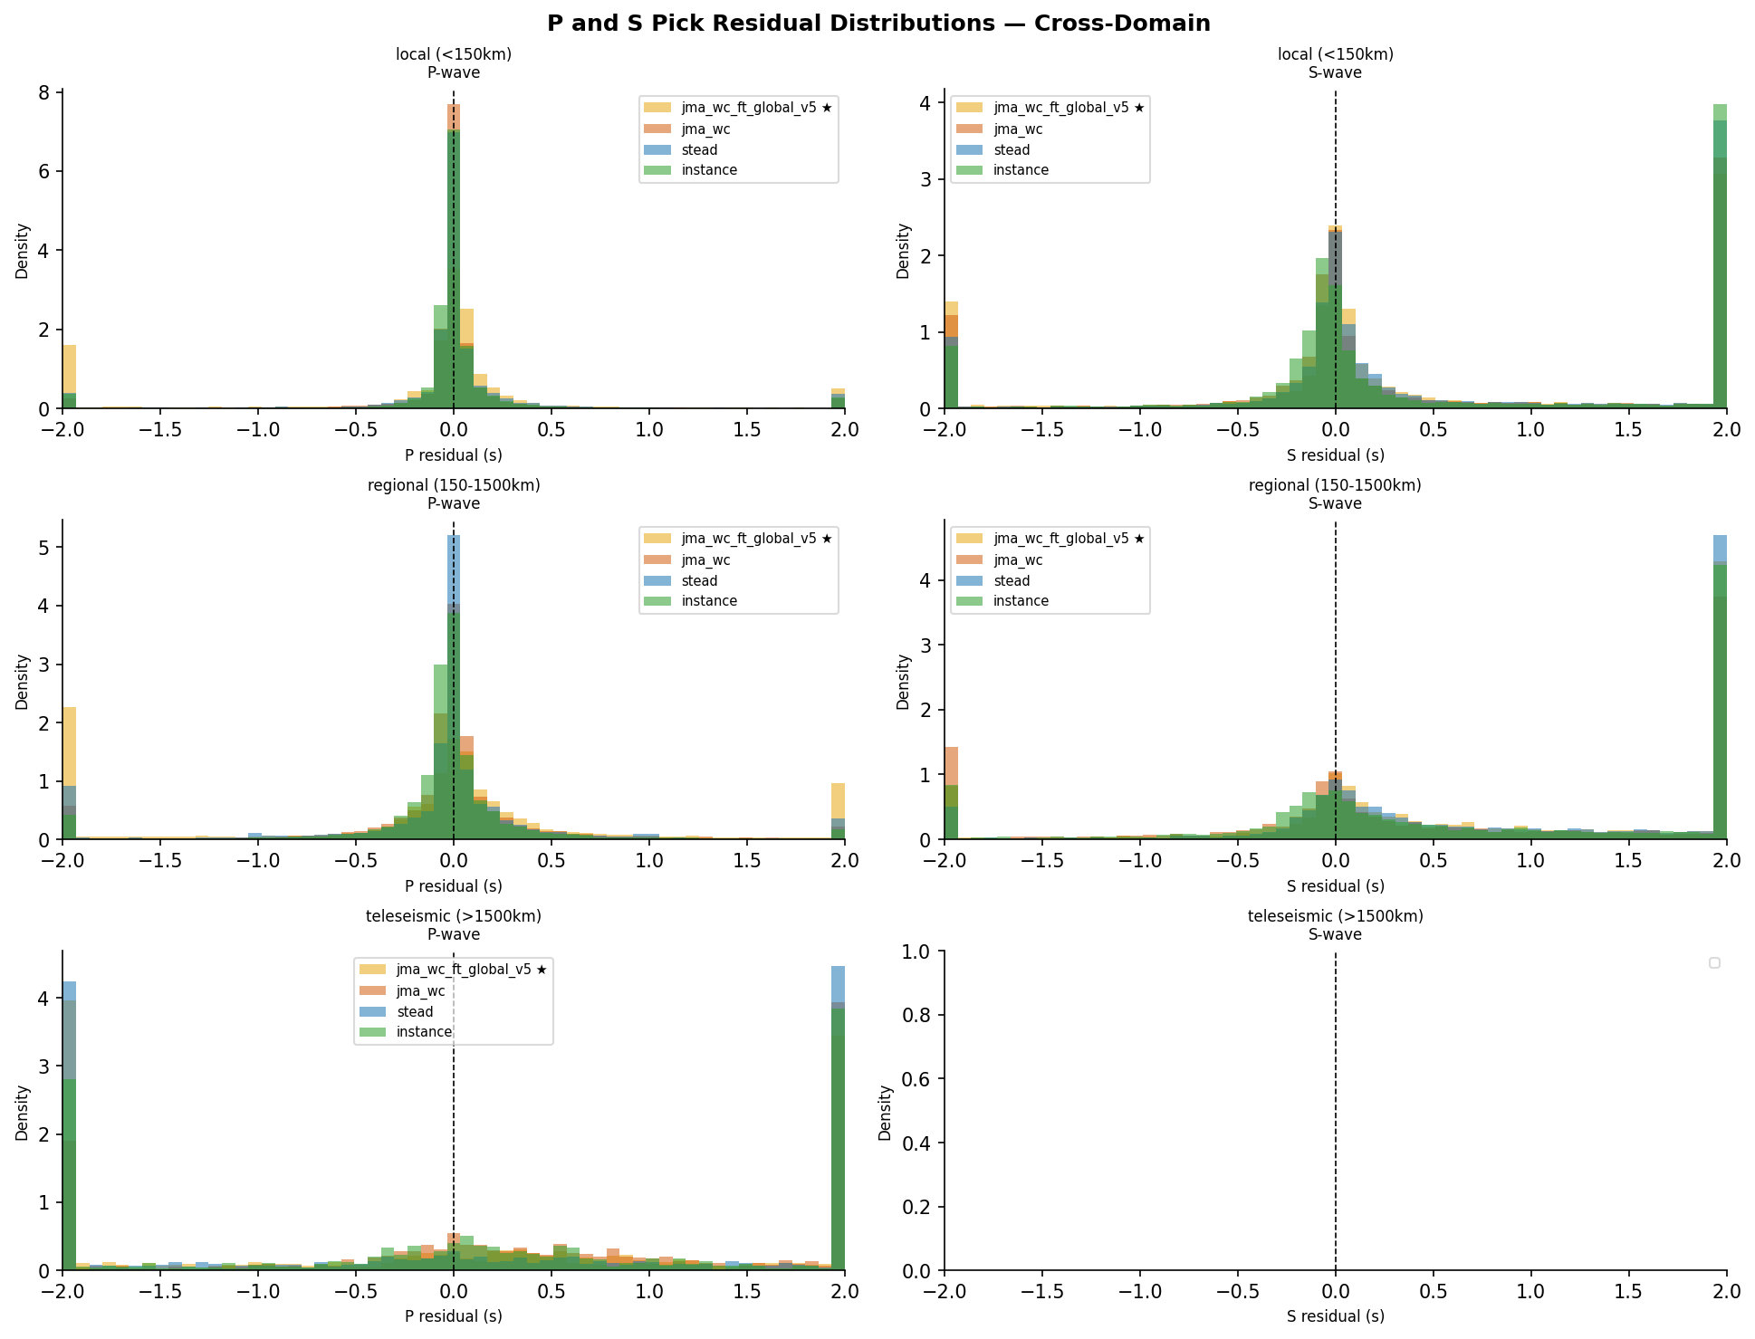
Pick Residual Distributions

Slide 13
Key Findings
v3 achieves best cross-domain performance: P-MAE = 0.368 s, P-Recall = 0.872
LR = 5×10⁻⁶ (v3) vs 1×10⁻⁴ (v4/v5): high LR is the primary driver of regression, not the timing loss
High LR drifts model far from pretrained jma_wc weights → P-Recall collapses to 0.30–0.41
v4 bug confirmed: early stopping monitored val_p_mae_s, which peaked at epoch 3 (mid-warmup) → severely undertrained
v5 fix: switched to val_loss ES → model trained fully (123 ep) but still regressed vs v3 — confirming LR is the culprit
Root cause: 1×10⁻⁴ destabilises KD — teacher signal too weak relative to gradient magnitude
v6 hypothesis: maintain v3 LR/KD regime (5×10⁻⁶, α=0.3), add small timing β=0.01
→ Test whether timing loss sharpens picks without sacrificing cross-domain recall
Baseline pretrained jma_wc still competitive (P-MAE 0.374 s, Recall 0.881) — any fine-tuned model must beat this

Slide 14
Benchmark Summary — Cross-Domain, All Distances
Model | P-MAE (s) | P-Recall | MCC | P-Outlier
jma_wc (pretrained baseline) | 0.374 | 0.881 | 0.790 | 0.071
jma_wc_ft_global_v3 ★ BEST | 0.368 | 0.872 | 0.747 | 0.071
instance | 0.453 | 0.841 | 0.851 | 0.090
neic | 0.517 | 0.554 | 0.372 | 0.104
jma_wc_ft_global_v5 | 0.921 | 0.411 | 0.196 | 0.220
jma_wc_ft_global_v4 | 0.573 | 0.296 | -0.064 | 0.117
★ Best fine-tuned model | Bold values = best in column | Green row = v3 (best FT) | Red rows = high-LR runs (regressed) | Lower P-MAE & P-Outlier is better; Higher Recall & MCC is better

Slide 15
Next Steps
Immediate
Evaluate v6 on the benchmark when training finishes (~2 hours)
Decision tree based on v6 results:
If v6 beats v3 → timing loss at β = 0.01 is beneficial → explore β = 0.05
If v6 matches v3 → timing loss is neutral → adopt v3 as production model
If v6 regresses → timing loss hurts even at β = 0.01 → drop it entirely
Deployment
Export best model checkpoint to SeisBench format for community sharing
Benchmark against additional held-out datasets (Ridgecrest, STEAD)
Longer-term
Consider curriculum training: start with local events, add teleseismic progressively
Explore S-wave timing loss (currently only P is targeted)
Investigate ensemble of v3 + v6 for improved robustness

