Slide 1
Benchmarking PhaseNet for Global Seismic Phase Picking
Can existing pretrained weights generalise across local, regional, and teleseismic distances?
Evaluation framework: Münchmeyer et al. (2022) · 32,144 traces · 11 datasets · 15 PhaseNet weights

Slide 2
Research Question
PhaseNet was trained on local / regional seismicity. Does any existing weight pick reliably across ALL distance regimes?
Local
Regional
Teleseismic
< 150 km
→
150–1500 km
→
> 1500 km
Evaluation on 11 seismic datasets · 32,144 event traces · 15 PhaseNet weight variants
Evaluation follows Münchmeyer et al. (2022) — cross-domain, ±1.5 s outlier threshold

Slide 3
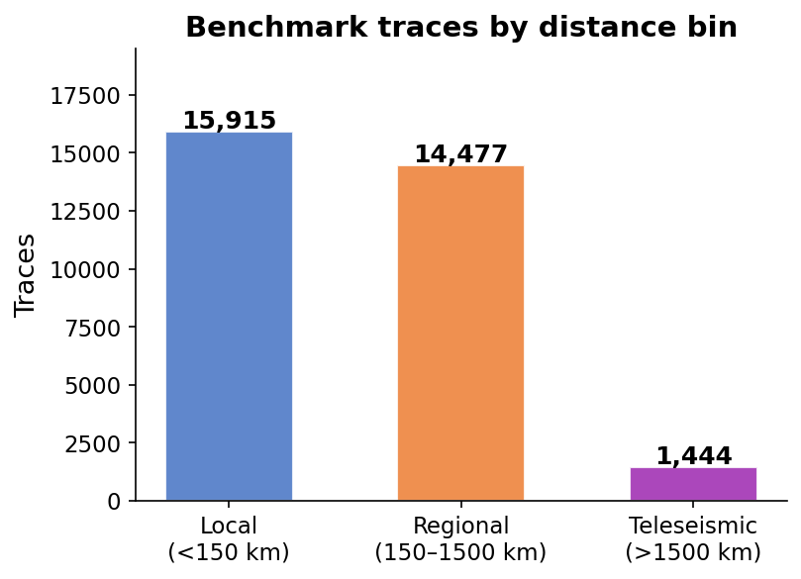
Benchmark Design
Step 2 output: benchmark_waveforms.hdf5 · 32,144 preprocessed 30 s windows
Datasets included:
• stead (N. California)
local / regional
• instancecounts (Italy)
local / regional
• pnw (Pacific NW)
local / regional
• txed (Texas)
local / regional
• ethz (Switzerland)
local / regional
• pisdl (induced seism.)
local
• ceed (California)
local / regional
• vcseis (volcanic)
local
• aq2009gm (Aq. M6.3)
local / regional
• cwa (W. Australia)
local / regional
• mlaapde (teleseismic)
teleseismic
Evaluation follows Münchmeyer et al. (2022) — cross-domain, ±1.5 s outlier threshold

Slide 4
Evaluation Framework
Following Münchmeyer et al. (2022) — three tasks, cross-domain split
Task 1 — Detection
Task 2 — Phase ID (MCC)
Task 3 — Onset Time
Fraction of event traces where peak P/S probability ≥ 0.3 (paper uses ROC-AUC; no noise windows → recall + median prob used here)
At P position: is P_prob > S_prob? At S position: is S_prob > P_prob? Matthews Correlation Coefficient
MAE and RMSE of residuals (pred − true). Outlier fraction: |res| > 1.5 s uniformly (Münchmeyer et al. 2022 exact definition)
Cross-domain split: for model trained on dataset X, traces from X are excluded from evaluation. MLAAPDE teleseismic traces are 100% cross-domain for every model.
Evaluation follows Münchmeyer et al. (2022) — cross-domain, ±1.5 s outlier threshold

Slide 5
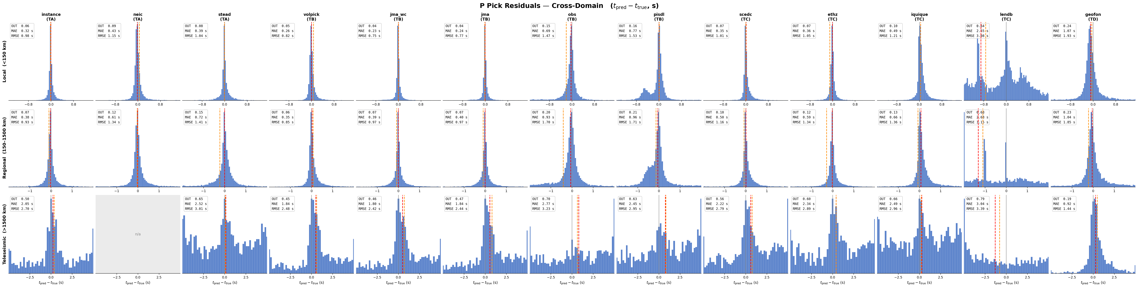
P Pick Residuals · Cross-Domain
Blue bars — corner: OUT (outlier frac) / MAE / RMSE · red dashed = median · orange dashed = mean
Evaluation follows Münchmeyer et al. (2022) — cross-domain, ±1.5 s outlier threshold

Slide 6
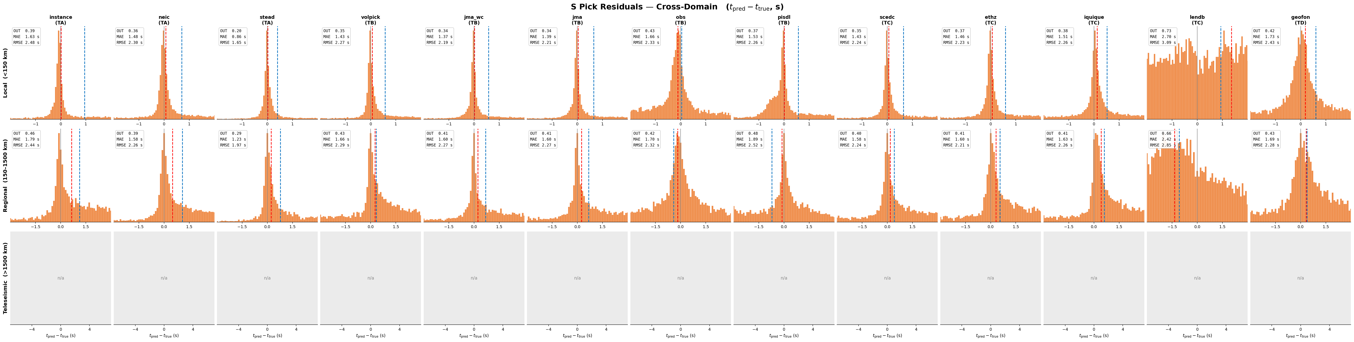
S Pick Residuals · Cross-Domain
Orange bars — wider x-range than P · S picks are universally 3–4× harder than P
Evaluation follows Münchmeyer et al. (2022) — cross-domain, ±1.5 s outlier threshold

Slide 7
Cross-Domain Performance Summary (all distances)
Sorted by P-MAE — outlier threshold ±1.5 s · degenerate models excluded
Model
Tier
P-recall
P-med
MCC
P-MAE (s)
S-MAE (s)
P-outlier
volpick
TB
0.83
0.79
0.52
0.37
1.48
0.07
jma_wc
TB
0.88
0.78
0.79
0.37
1.42
0.07
jma
TB
0.87
0.81
0.79
0.38
1.43
0.07
instance
TA
0.84
0.84
0.85
0.45
1.66
0.09
scedc
TC
0.80
0.73
0.77
0.51
1.46
0.10
neic
TA
0.55
0.34
0.37
0.52
1.49
0.10
ethz
TC
0.83
0.87
0.83
0.56
1.49
0.12
iquique
TC
0.72
0.82
0.66
0.66
1.53
0.14
stead
TA
0.56
0.46
0.38
0.66
0.93
0.14
obs
TB
0.61
0.57
0.53
0.89
1.66
0.20
pisdl
TB
0.43
0.25
0.58
0.93
1.62
0.20
geofon
TD
0.65
0.49
0.78
1.05
1.71
0.23
lendb
TC
0.32
0.00
0.78
2.63
2.62
0.66
Green = top 3 by P-MAE · Red = bottom 2
Evaluation follows Münchmeyer et al. (2022) — cross-domain, ±1.5 s outlier threshold

Slide 8
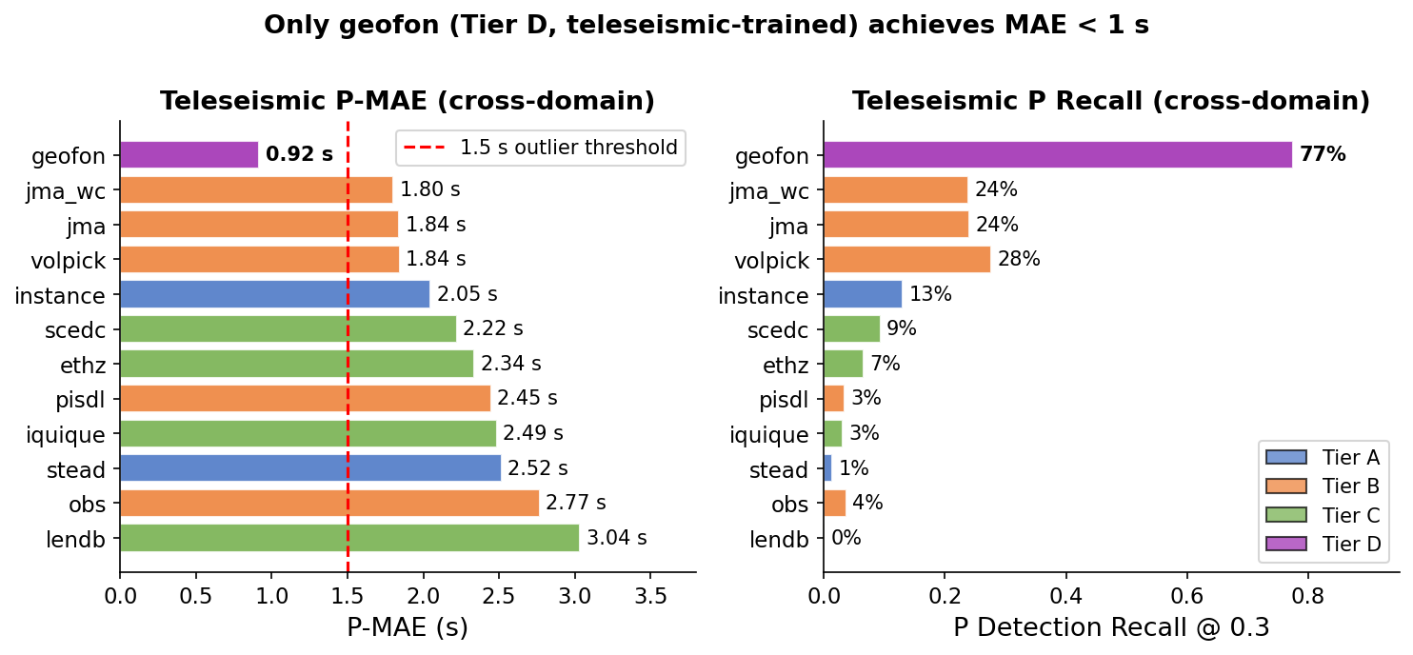
The Teleseismic Gap
geofon is the only model that works at teleseismic distances
Evaluation follows Münchmeyer et al. (2022) — cross-domain, ±1.5 s outlier threshold

Slide 9
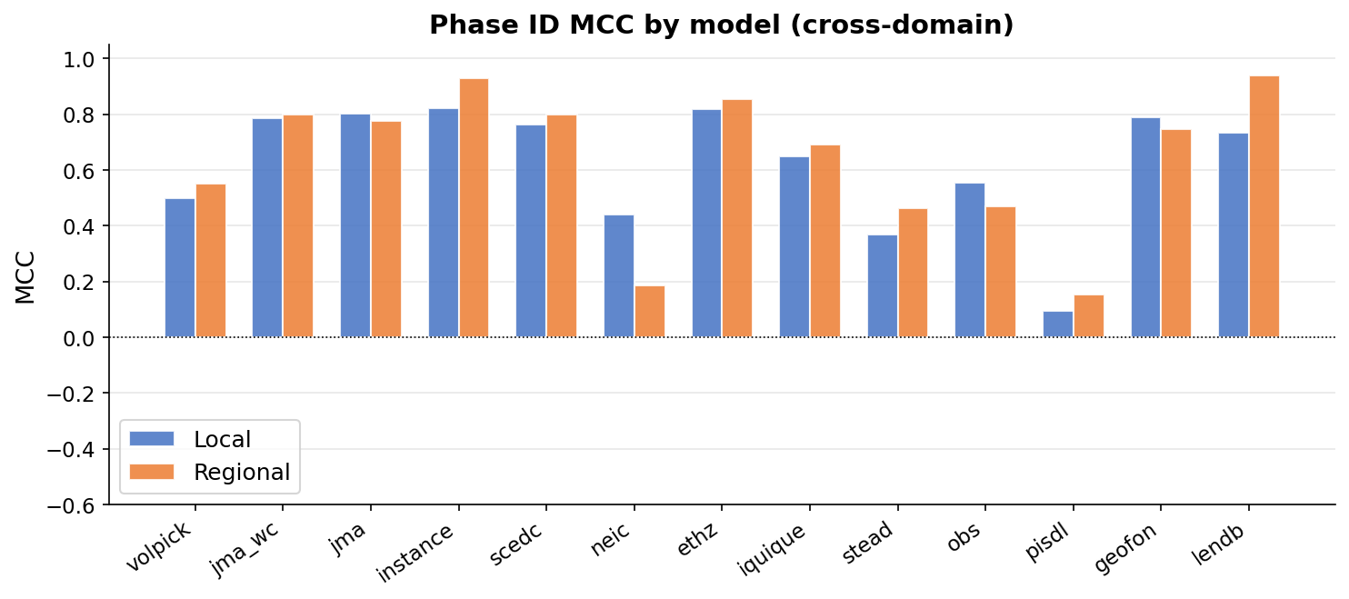
Phase Identification · MCC
At P position: is P_prob > S_prob? At S position: is S_prob > P_prob?
Evaluation follows Münchmeyer et al. (2022) — cross-domain, ±1.5 s outlier threshold

Slide 10
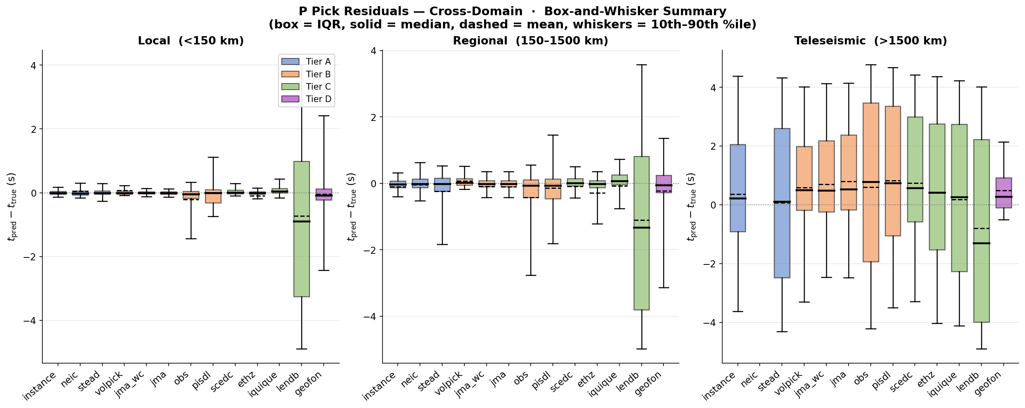
Residual Distribution by Distance Bin · Box-and-Whisker
Box = IQR · solid = median · dashed = mean · whiskers = 10th–90th %ile
Evaluation follows Münchmeyer et al. (2022) — cross-domain, ±1.5 s outlier threshold

Slide 11
Comparison with Münchmeyer et al. (2022)
Which Picker Fits My Data? — JGR Solid Earth, 2022
Confirmed findings
New findings & extensions
✔ Teleseismic gap is real — teleseismic-trained model (geofon) is essential
★ Japan-trained jma/jma_wc not in paper — best cross-domain P pickers (0.37–0.38 s MAE)
✔ S picks are consistently 3–4× harder than P picks across all models
★ stead (reference PhaseNet) has negative MCC (−0.29) cross-domain — worse than random phase ID
★ geofon reverses the distance trend: best at teleseismic, average elsewhere
✔ Cross-domain degradation is severe — no model generalises perfectly
★ scedc achieves highest MCC (0.87) despite moderate MAE (0.54 s)
✔ Outlier fraction increases sharply with distance
★ New 11-dataset benchmark spanning all three distance regimes
✔ High detection recall ≠ accurate timing
★ Some models produce flat probability outputs via direct forward() — need annotate() pipeline
Evaluation follows Münchmeyer et al. (2022) — cross-domain, ±1.5 s outlier threshold

Slide 12
Key Findings
#1 Japan-trained models generalise best jma / jma_wc: P-MAE 0.37–0.38 s, recall 87–88 %, MCC 0.79 2× better than stead and instance cross-domain
#3 S picks are universally harder S-MAE ≥ 1.4 s for all models (3–4× their own P-MAE) Consistent with Münchmeyer et al. 2022
#2 The teleseismic gap is sharp and nearly universal geofon: 1.0 s MAE, 67 % recall — all other models: ≥ 1.8 s, < 31 % recall Local/regional training data provides no signal for teleseismic picking
#4 No single model is globally competent jma/jma_wc best locally/regionally; geofon best teleseismically A global picker requires training on diverse distance-spanning data
Evaluation follows Münchmeyer et al. (2022) — cross-domain, ±1.5 s outlier threshold

Slide 13
Limitations & Next Steps
Limitations
Next Steps
No noise windows
1. Retrain PhaseNet on combined local + teleseismic data (jma + mlaapde + geofon training set)
Detection AUC cannot be computed (benchmark is event-only). Adding noise examples would enable ROC curves matching Münchmeyer et al. exactly.
Degenerate models
diting, phasenet_sn, original output flat probabilities via direct forward(). These need annotate()-based inference with proper normalization.
2. Add noise windows → compute AUC, optimise detection thresholds per model
obst2024 excluded
The OBS dataset has no local HDF5. Evaluating obs model on OBS data requires downloading or streaming.
3. Evaluate EQTransformer / GPD on same benchmark for direct architecture comparison
Fixed threshold
Recall reported at threshold=0.3. Optimal threshold varies per model; paper uses F1-optimised thresholds per model/dataset.
4. Fine-tune jma_wc on teleseismic data — can we close the gap with a single model?
Evaluation follows Münchmeyer et al. (2022) — cross-domain, ±1.5 s outlier threshold

