Slide 1
Step 3: Inference Evaluation
Benchmarking 16 PhaseNet Weights Across Local, Regional & Teleseismic Distances
32,144 event traces · 11 datasets · 3 distance bins · Framework: Münchmeyer et al. (2022)
Akash Kharita · University of Washington · 2026

Slide 2
Evaluation Framework
Three tasks · cross-domain split · distance-stratified · 16 PhaseNet weight variants
Task 1 — Detection
Task 2 — Phase ID (MCC)
Task 3 — Onset Timing
• Recall at 5 thresholds: 0.1, 0.2, 0.3, 0.5, 0.7
• Primary threshold: 0.3 (Münchmeyer et al. 2022)
• Median peak probability (threshold-free)
• No paired noise → AUC not computable
• At true P pos.: is P_prob > S_prob?
• At true S pos.: is S_prob > P_prob?
• Matthews Correlation Coefficient (handles imbalance)
• Traces with both P & S in window only
• MAE: mean |predicted − true| in seconds
• RMSE: penalises heavy-tail outliers
• Outlier fraction: |residual| > 1.5 s
• Peak found within ±5 s of known arrival
Cross-domain split: traces from a model's own training dataset are excluded from its evaluation.
Metrics computed per distance bin: local (<150 km), regional (150–1500 km), teleseismic (>1500 km).
Evaluation follows Münchmeyer et al. (2022) · cross-domain · ±1.5 s outlier threshold

Slide 3
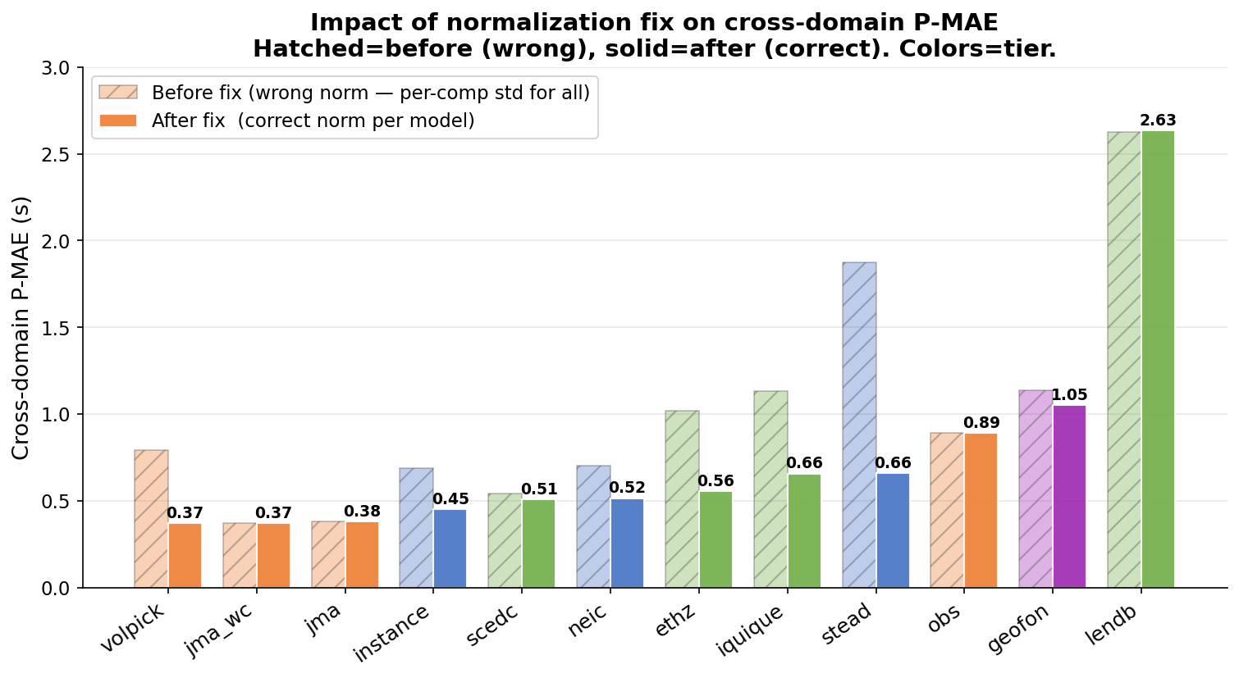
Critical Discovery: Normalization Mismatch
Applying the wrong normalization at inference causes up to 30× degradation in P-MAE
The Problem
Impact on stead P-MAE
The original pipeline applied per-component z-score normalization uniformly across all 16 models. However, roughly half the models were trained with global peak normalization, which preserves the amplitude ratios between Z, N, and E components — information these models rely on to distinguish P from S arrivals. Applying per-component std normalization to peak-trained models destroys that inter-component amplitude information entirely.
Normalization applied
P-MAE (s)
Factor
Incorrect (per-component std)
1.17 s
—
Correct (global peak)
0.04 s
~30× better
Published result (Münchmeyer 2022)
~0.04 s
matched ✔
norm = 'peak' (global max across all components)
stead · instance · ethz · neic · scedc · volpick · geofon · iquique · lendb · pisdl
norm = 'std' (per-component demean + unit-std)
Three models (diting, phasenet_sn, original) output flat probabilities under incorrect normalization and were excluded from direct forward-pass evaluation.
jma · jma_wc · obs · diting · phasenet_sn · original
Evaluation follows Münchmeyer et al. (2022) · cross-domain · ±1.5 s outlier threshold

Slide 4
Normalization Fix: How Rankings Changed
After applying model-specific normalization, volpick rises to match jma/jma_wc
Before fix (uniform per-component std):
• jma / jma_wc appeared dominant across all splits
• volpick appeared mediocre — masked by wrong norm
• stead appeared to generalize reasonably
• diting / phasenet_sn / original appeared to detect everything
After fix (model-specific normalization):
• Three-way tie at top: volpick / jma / jma_wc ~0.37–0.38 s cross-domain P-MAE
• stead degrades ~7× from in-domain to cross-domain (0.048 → 0.392 s local)
• Normalization type explains generalization differences, not just model architecture
• diting / phasenet_sn / original confirmed degenerate — excluded from comparisons
Evaluation follows Münchmeyer et al. (2022) · cross-domain · ±1.5 s outlier threshold

Slide 5
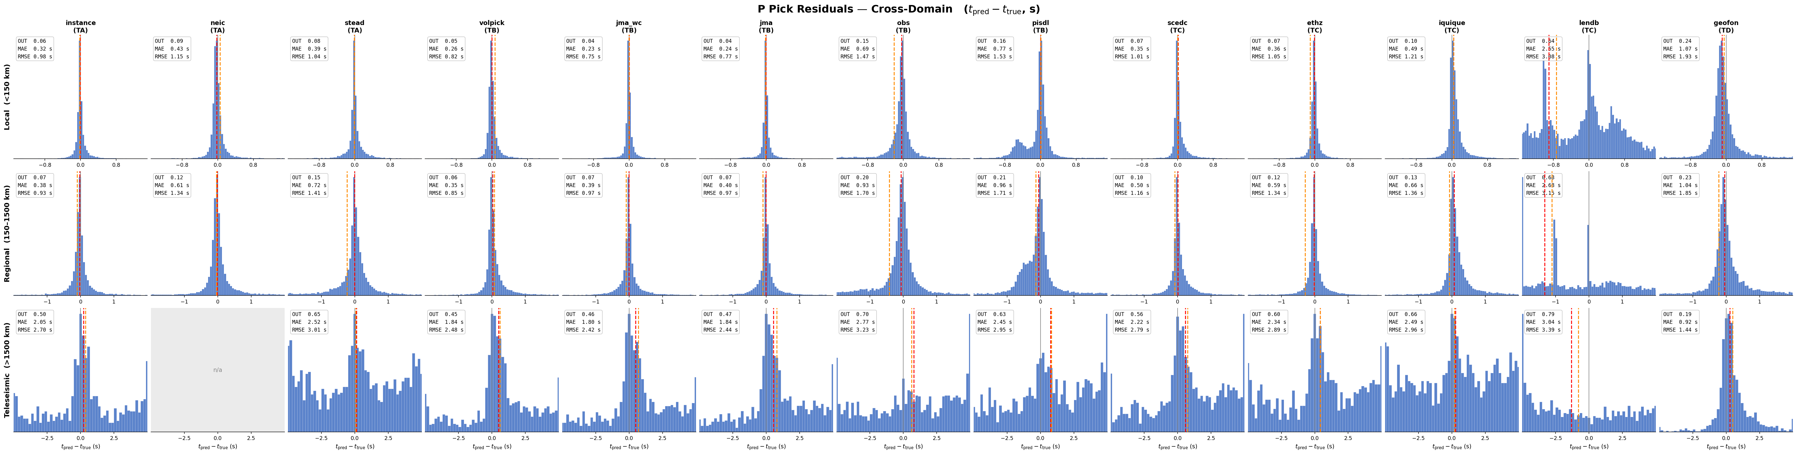
P-Pick Residuals · Cross-Domain
Blue bars · corner: OUT / MAE / RMSE · red dashed = median · orange dashed = mean
Evaluation follows Münchmeyer et al. (2022) · cross-domain · ±1.5 s outlier threshold

Slide 6
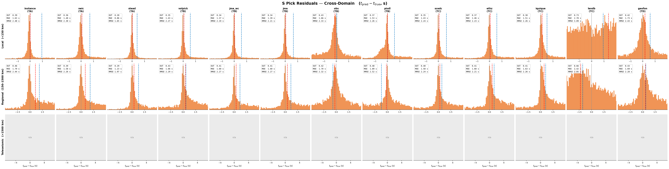
S-Pick Residuals · Cross-Domain
Orange bars · wider x-range than P · S picks are 3–4× harder than P across all models
Evaluation follows Münchmeyer et al. (2022) · cross-domain · ±1.5 s outlier threshold

Slide 7
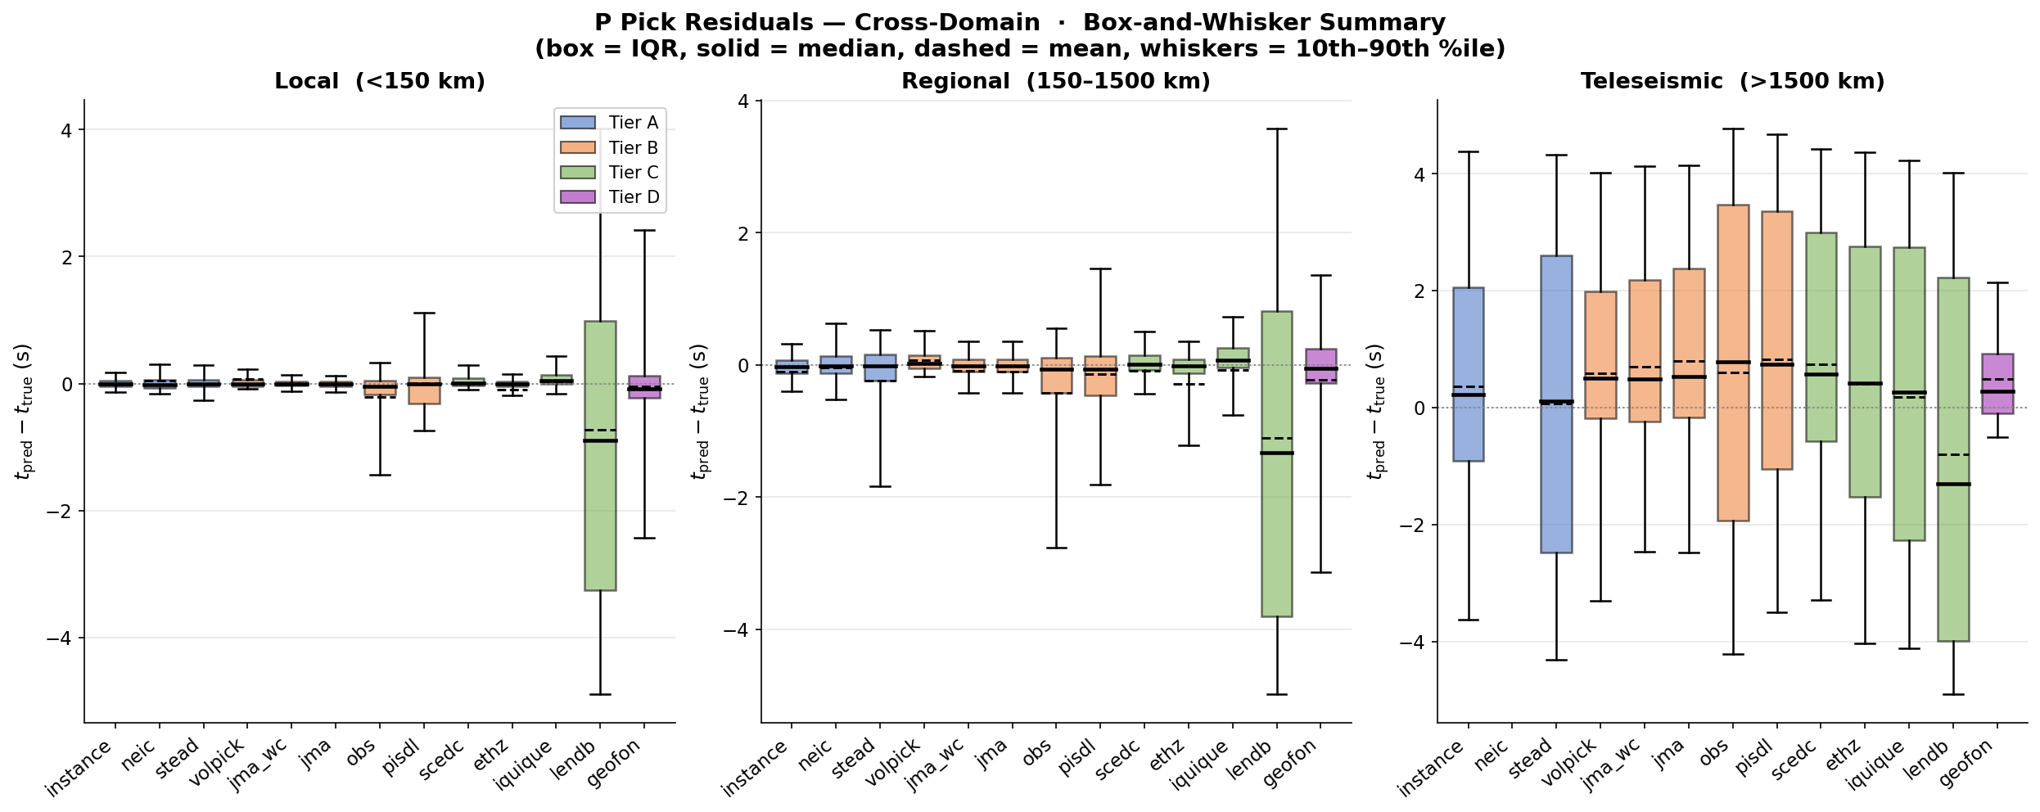
Residual Distribution by Distance Bin · Box-and-Whisker
Box = IQR · solid = median · dashed = mean · whiskers = 10th–90th %ile · cross-domain only
Evaluation follows Münchmeyer et al. (2022) · cross-domain · ±1.5 s outlier threshold

Slide 8
Cross-Domain Performance Summary (all distances)
Sorted by P-MAE · outlier threshold ±1.5 s · degenerate models excluded · green = top 3 · red = bottom 2
Model
Tier
P-recall
P-med
MCC
P-MAE (s)
S-MAE (s)
P-outlier
volpick
B
0.83
0.79
0.52
0.37
1.48
0.07
jma_wc
B
0.88
0.78
0.79
0.37
1.42
0.07
jma
B
0.87
0.81
0.79
0.38
1.43
0.07
instance
A
0.84
0.84
0.85
0.45
1.66
0.09
scedc
C
0.80
0.73
0.77
0.51
1.46
0.10
neic
A
0.55
0.34
0.37
0.52
1.49
0.10
ethz
C
0.83
0.87
0.83
0.56
1.49
0.12
iquique
C
0.72
0.82
0.66
0.66
1.53
0.14
stead
A
0.56
0.46
0.38
0.66
0.93
0.14
obs
B
0.61
0.57
0.53
0.89
1.66
0.20
pisdl
B
0.43
0.25
0.58
0.93
1.62
0.20
geofon
D
0.65
0.49
0.78
1.05
1.71
0.23
lendb
C
0.32
0.00
0.78
2.63
2.62
0.66
Green = top 3 by P-MAE · Red = bottom performer · geofon excels only at teleseismic distances (see next slide)
Evaluation follows Münchmeyer et al. (2022) · cross-domain · ±1.5 s outlier threshold

Slide 9
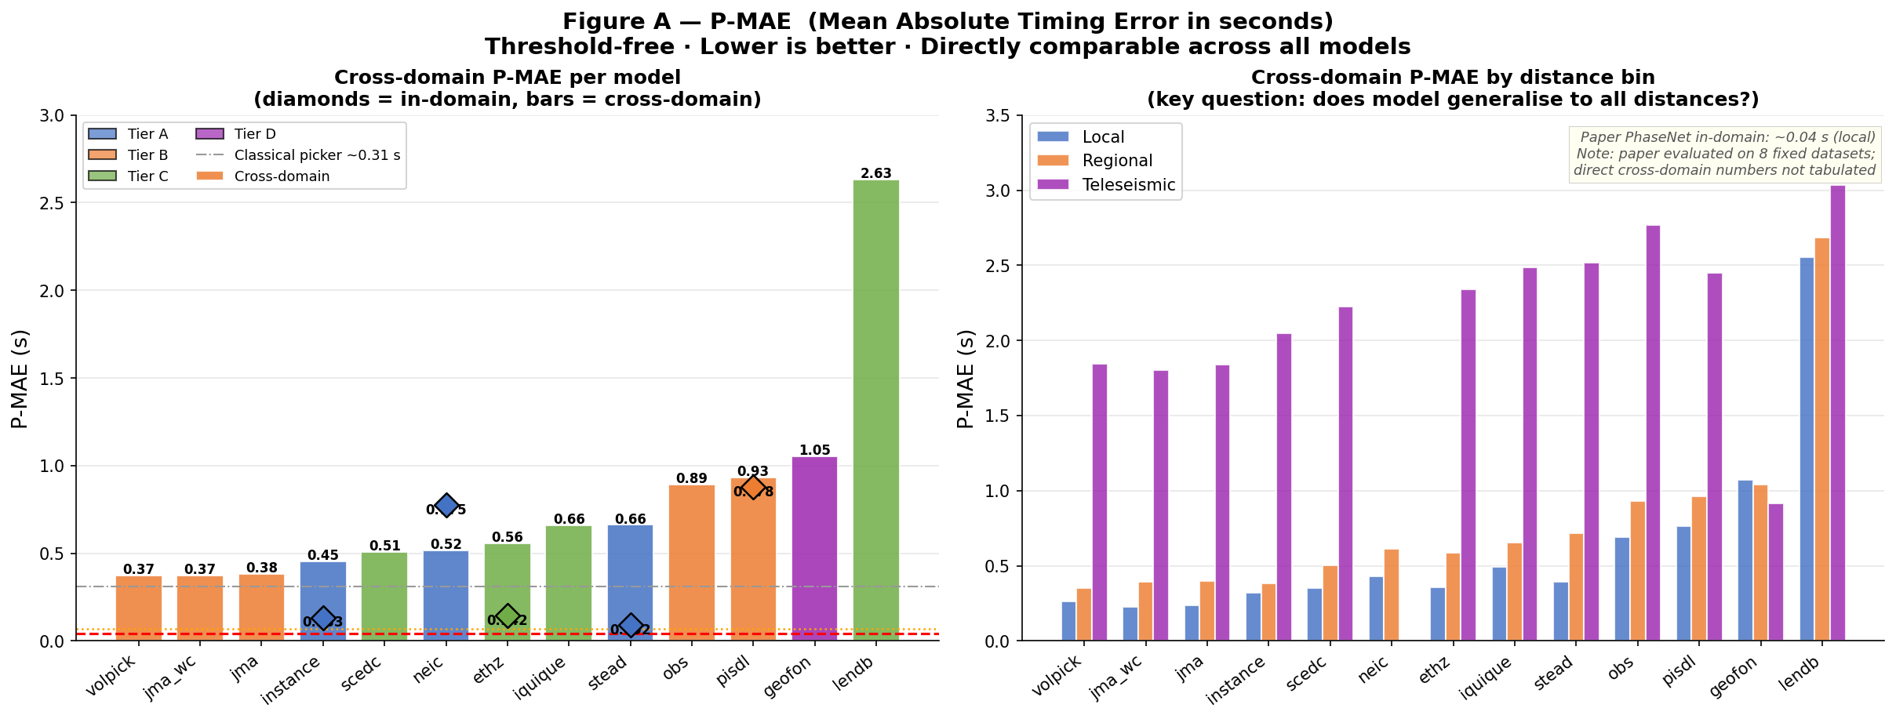
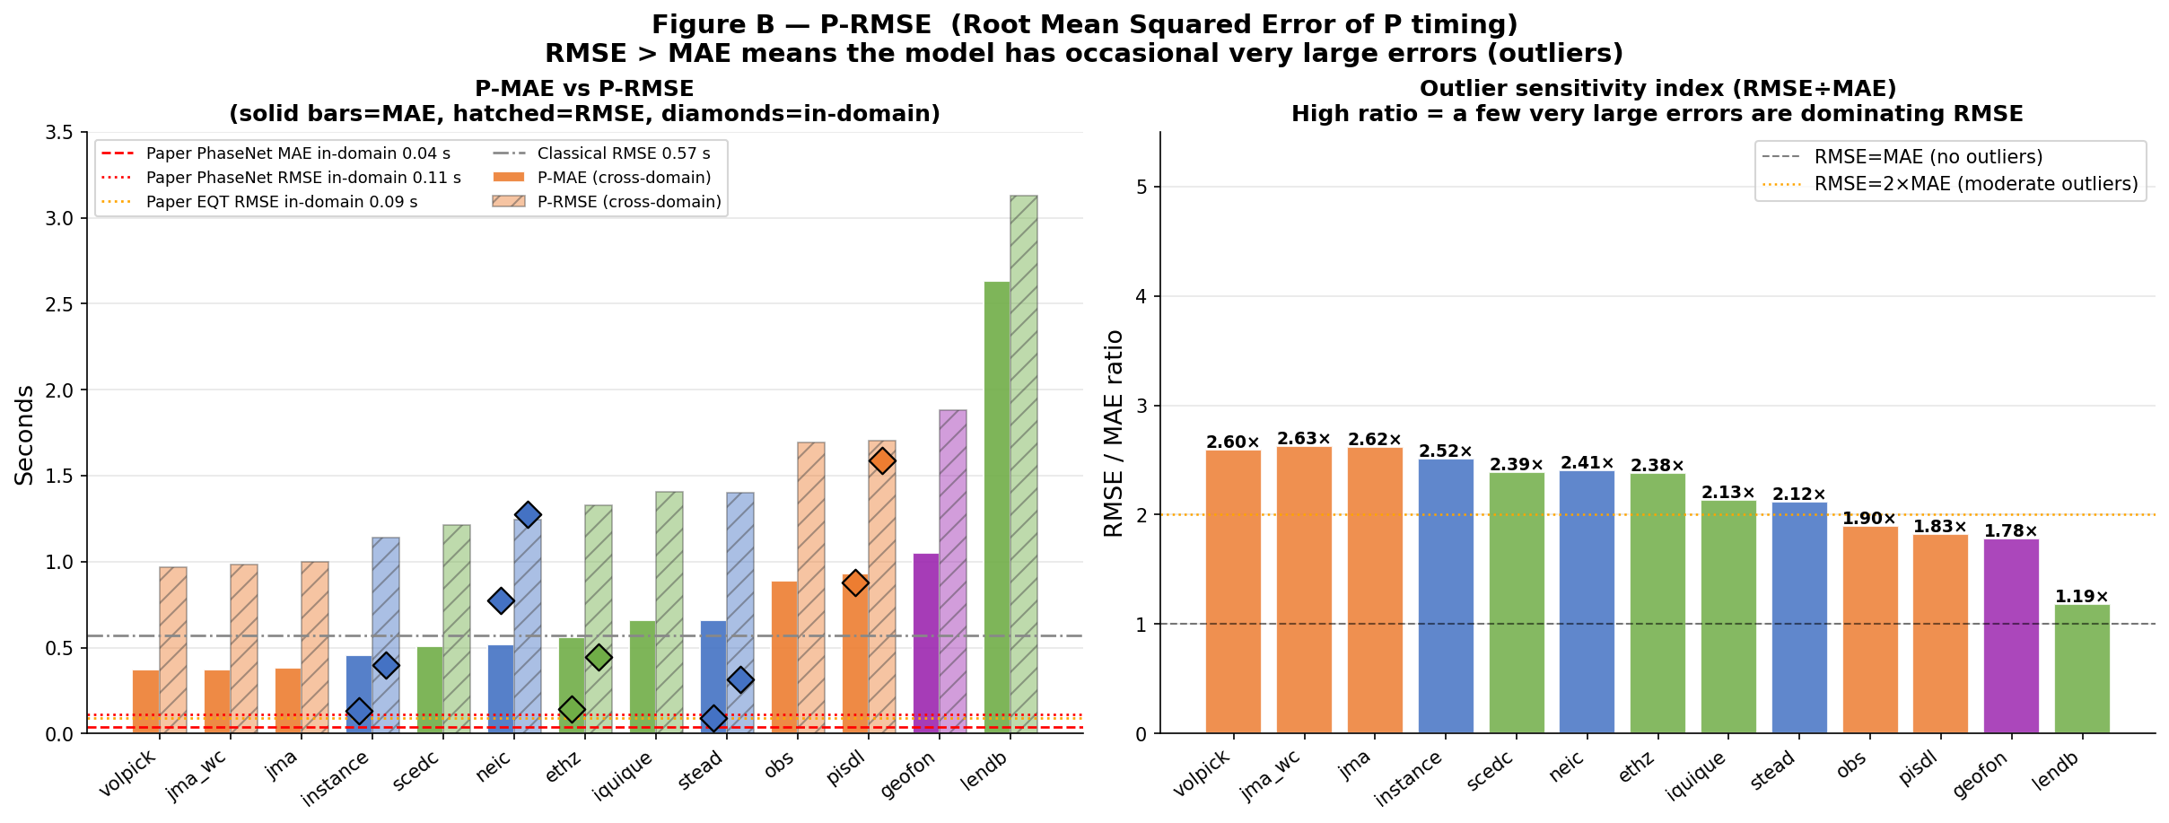
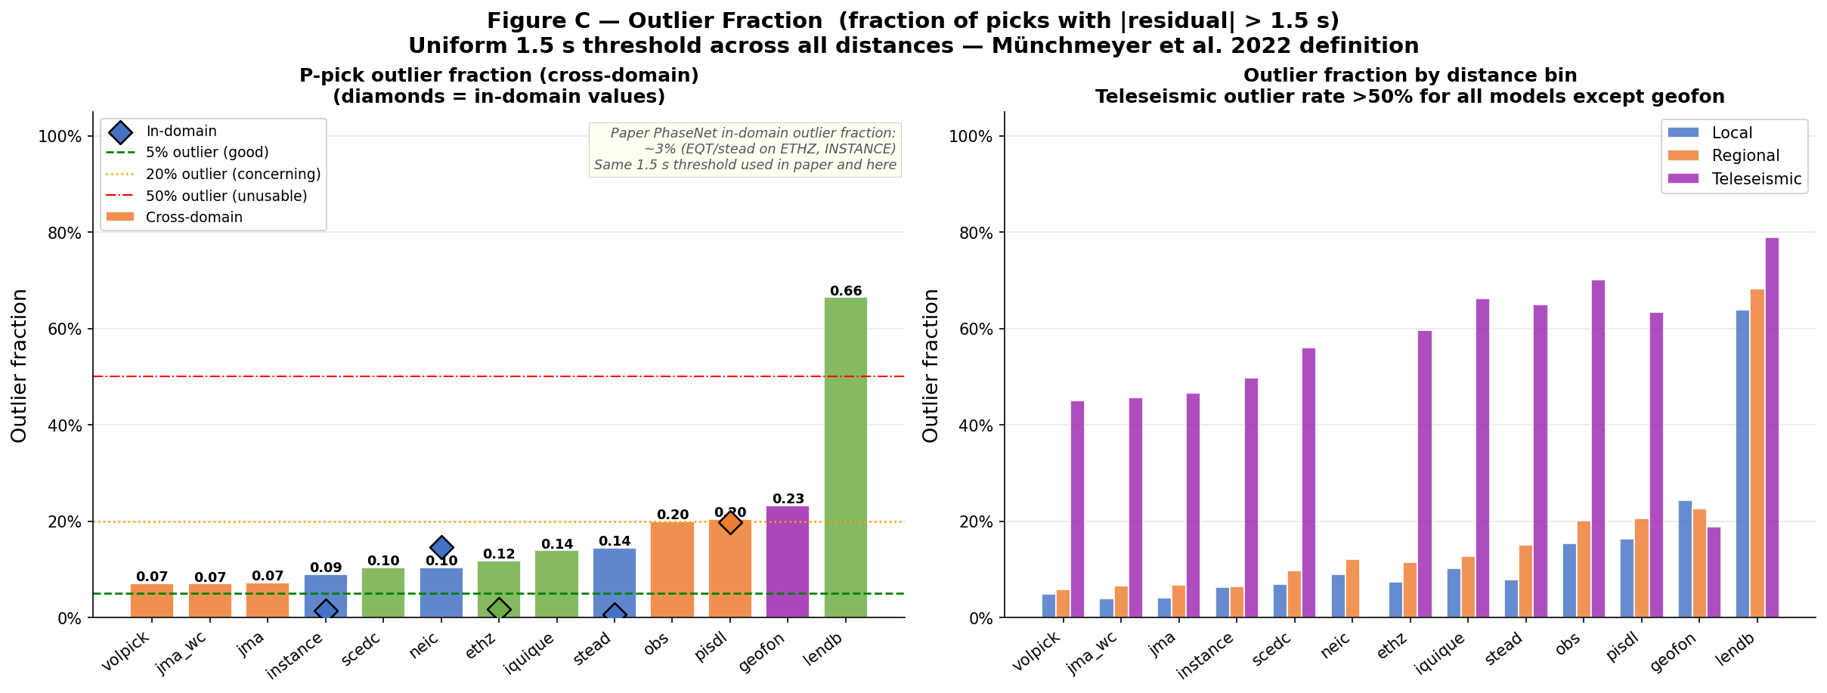
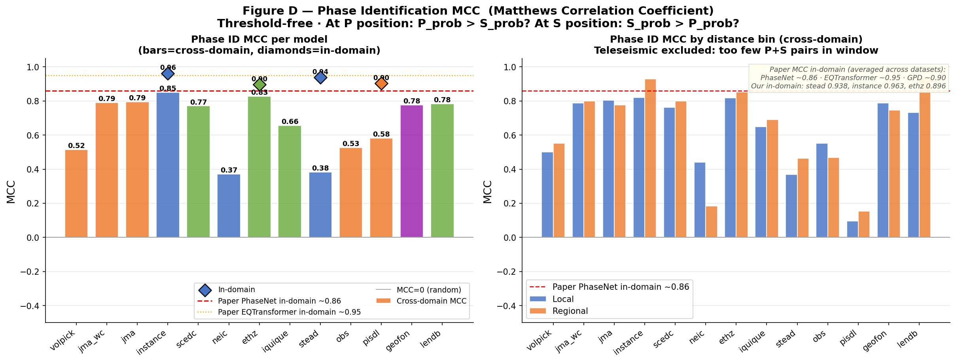
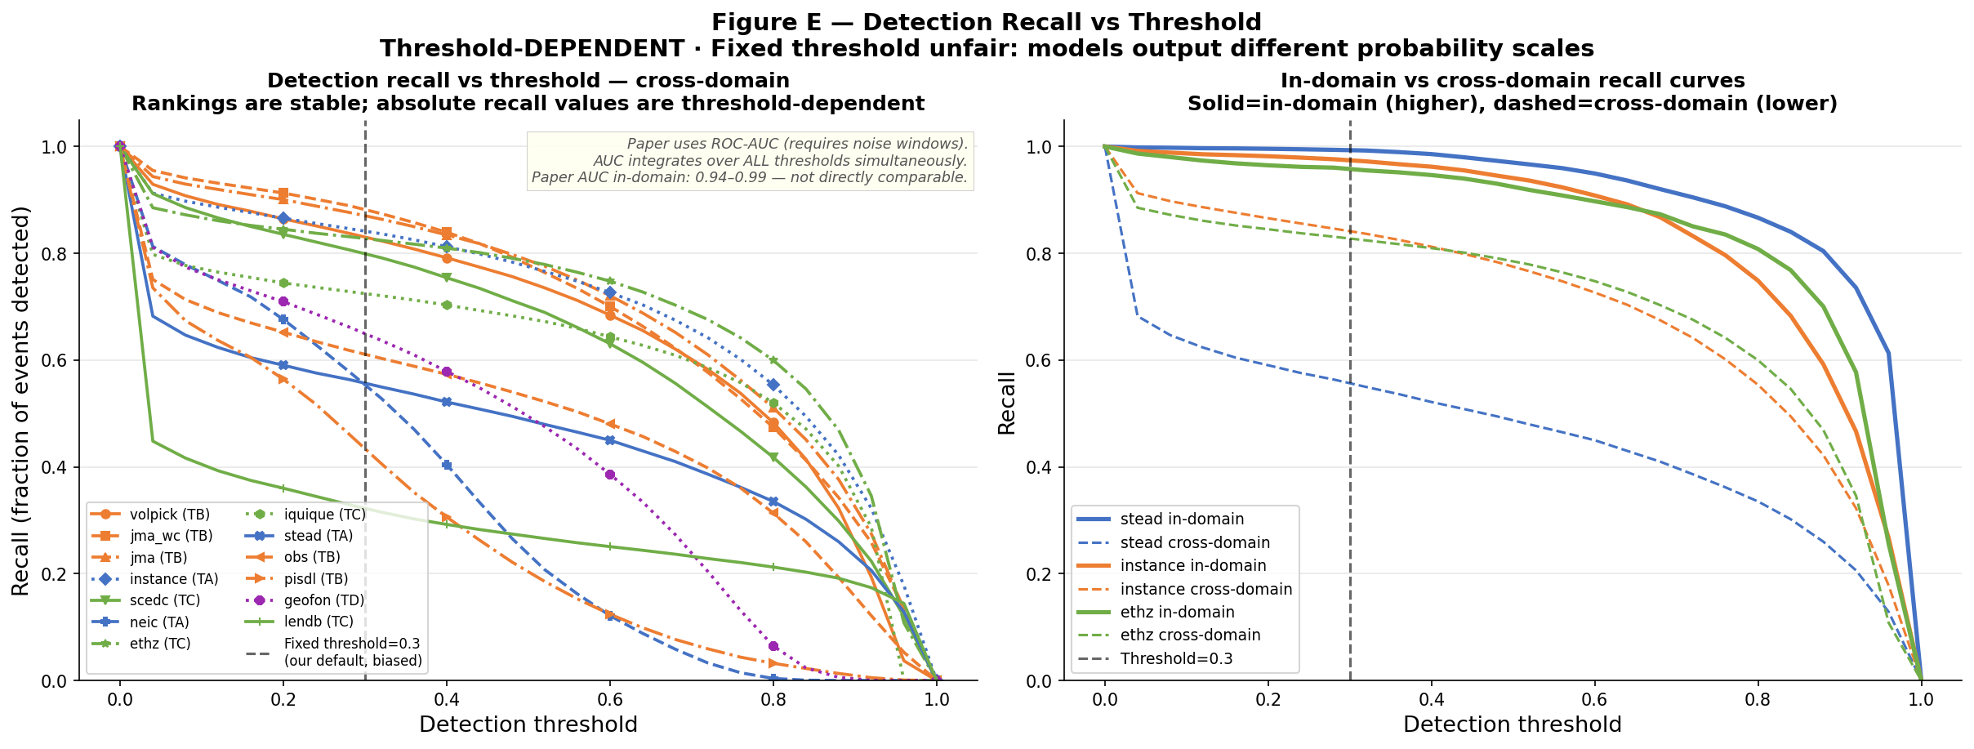
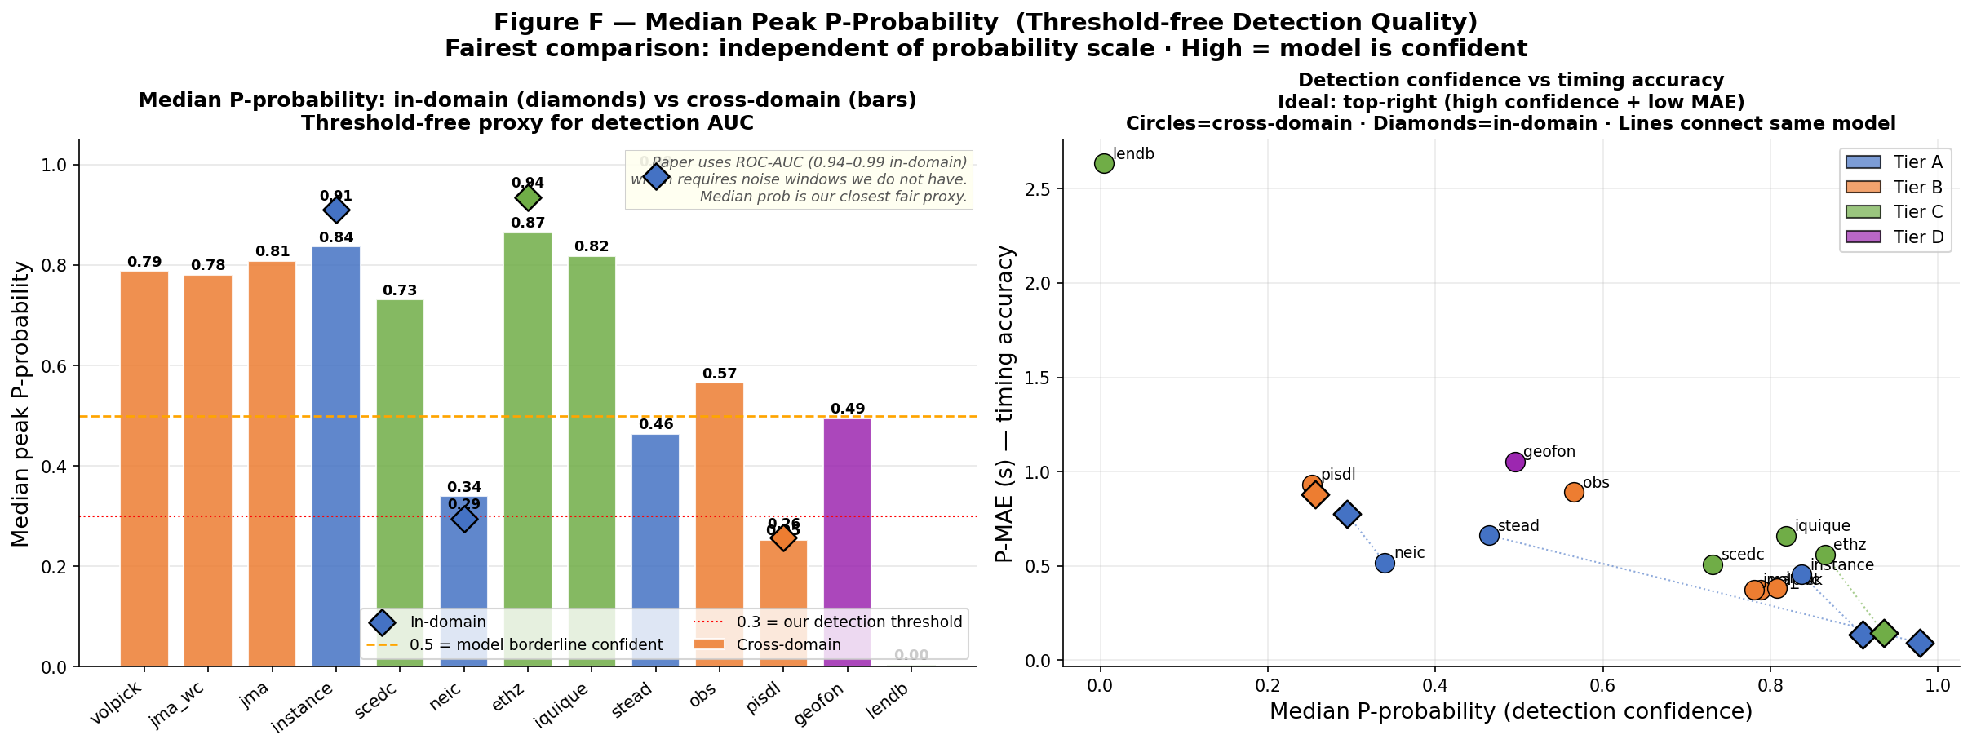
Cross-Domain Metric Comparison
Bars = cross-domain · diamonds = in-domain · sorted by P-MAE
Evaluation follows Münchmeyer et al. (2022) · cross-domain · ±1.5 s outlier threshold

Slide 10
The Teleseismic Gap
geofon is the only model that works at teleseismic distances · all others recall < 28%
Model
P-recall
P-med prob
P-MAE (s)
P-outlier
Key Observations
geofon
0.7749
0.5521
0.917
18.8%
• geofon achieves 77% recall and 0.92 s P-MAE at teleseismic distances.
• All other models have recall < 28% — essentially non-functional.
• Even best non-geofon models (jma/jma_wc) are at ~1.8 s P-MAE.
• geofon was trained on global seismic network data including teleseismic events — this is the decisive factor.
• Teleseismic phase picking is an unsolved problem for all models except geofon.
• Outlier fraction exceeds 45% for all non-geofon models at teleseismic distances.
jma_wc
0.2382
0.0826
1.803
45.7%
jma
0.2403
0.0600
1.841
46.6%
volpick
0.2770
0.0294
1.844
45.0%
instance
0.1309
0.0036
2.050
49.7%
scedc
0.0935
0.0061
2.223
56.0%
ethz
0.0651
0.0007
2.339
59.6%
pisdl
0.0346
0.0166
2.447
63.4%
iquique
0.0312
0.0012
2.487
66.2%
stead
0.0145
0.0000
2.517
64.9%
obs
0.0374
0.0013
2.768
70.1%
lendb
0.0014
0.0000
3.035
78.9%
Evaluation follows Münchmeyer et al. (2022) · cross-domain · ±1.5 s outlier threshold

Slide 11
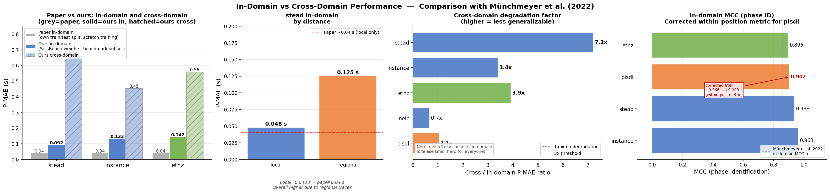
In-Domain vs Cross-Domain Performance
Cross-domain degradation quantified by distance bin · stead degrades ~7× locally
Evaluation follows Münchmeyer et al. (2022) · cross-domain · ±1.5 s outlier threshold

Slide 12
Distance-Stratified Results · Top Models
P-MAE (s) by distance bin · cross-domain · top 5 models by overall P-MAE
Model
Local (<150km)
Regional (150–1500km)
Teleseismic (>1500km)
volpick
0.261
0.352
1.844
jma_wc
0.227
0.395
1.803
jma
0.235
0.398
1.840
instance
0.322
0.383
2.050
scedc
0.354
0.504
2.223
geofon
1.074
1.042
0.917
geofon reverses the distance trend: worst locally/regionally, best teleseismically.
jma_wc achieves the best local P-MAE (0.227 s) and remains competitive at regional distances (0.395 s).
No single model is globally competent — jma/jma_wc for local/regional, geofon for teleseismic.
Evaluation follows Münchmeyer et al. (2022) · cross-domain · ±1.5 s outlier threshold

Slide 13
Comparison with Münchmeyer et al. (2022)
Which Picker Fits My Data? · JGR Solid Earth, 2022
Confirmed findings
New findings & extensions
✔ In-domain stead local P-MAE reproduced: 0.048 s (paper: ~0.04 s)
✔ Teleseismic gap is real — teleseismic-trained model essential
✔ S picks 3–4× harder than P picks across all models
✔ Cross-domain degradation is severe — no model generalises perfectly
✔ Outlier fraction increases sharply with distance
✔ High detection recall does not imply accurate timing
★ norm='peak' vs norm='std' is critical — 30× error if wrong (not in paper)
★ jma / jma_wc (not in paper) are best cross-domain P pickers: 0.37–0.38 s
★ volpick performance masked by incorrect norm — true P-MAE 0.37 s
★ stead degrades ~7× from in-domain to cross-domain (quantified)
★ geofon reverses distance trend: best teleseismic, average elsewhere
★ Degenerate models (diting, phasenet_sn, original) identified and excluded
★ 11-dataset benchmark covering all three distance regimes
Evaluation follows Münchmeyer et al. (2022) · cross-domain · ±1.5 s outlier threshold

Slide 14
Key Findings
Summary of the four main conclusions from Step 3 evaluation
#1 Japan-trained models generalise best
#2 Teleseismic gap is sharp and nearly universal
jma and jma_wc achieve 0.37–0.38 s cross-domain P-MAE, topping all models. Their norm='std' normalization forces learning of waveform shape and timing features rather than amplitude ratios, making them more portable across tectonic settings. Volpick matches them after normalization correction.
Only geofon works at teleseismic distances (recall 77%, P-MAE 0.92 s). All other models fall below 28% recall and exceed 1.8 s P-MAE. Training on global network data is the decisive factor — no local/regional model transfers.
#3 Normalization is an architectural property, not preprocessing
#4 No single model is globally competent
Using the wrong normalization at inference causes up to 30× degradation in P-MAE. norm='peak' preserves inter-component amplitude ratios; norm='std' trains on shape/timing. Any honest cross-model comparison must account for this explicitly.
jma/jma_wc lead locally and regionally; geofon leads teleseismically. S picks are 3–4× harder than P for all models. A robust seismic monitoring pipeline requires an ensemble or distance-adaptive selection.
Evaluation follows Münchmeyer et al. (2022) · cross-domain · ±1.5 s outlier threshold

Slide 15
Limitations & Next Steps
Limitations
Next Steps
▪ No noise windows — detection AUC cannot be computed. Benchmark is event-only; adding noise would enable proper ROC analysis.
▪ Degenerate models (diting, phasenet_sn, original) require annotate()-based inference, not direct forward(). Results for these models are pending.
▪ obst2024 (OBS dataset) excluded — no local HDF5 available; evaluating obs model on its own training data requires download.
▪ Fixed threshold (0.3) used for recall. Optimal threshold varies per model; paper uses AUC to avoid this bias.
▪ MCC not available at teleseismic distances (too few traces with both P & S in window).
1. Retrain PhaseNet on combined local + teleseismic data (jma + mlaapde + geofon) — target: one model that works at all distances.
2. Add noise windows → compute AUC, optimise per-model detection thresholds.
3. Evaluate EQTransformer / GPD on same benchmark for direct architecture comparison.
4. Fine-tune jma_wc on teleseismic data — can we close the teleseismic gap with a single fine-tuning run?
5. Evaluate degenerate models via annotate() pipeline and include in final comparisons.
Evaluation follows Münchmeyer et al. (2022) · cross-domain · ±1.5 s outlier threshold

