Slide 1
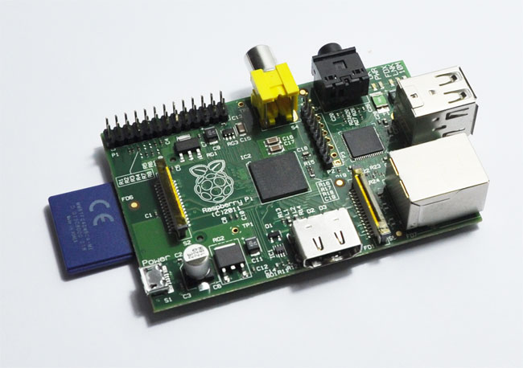
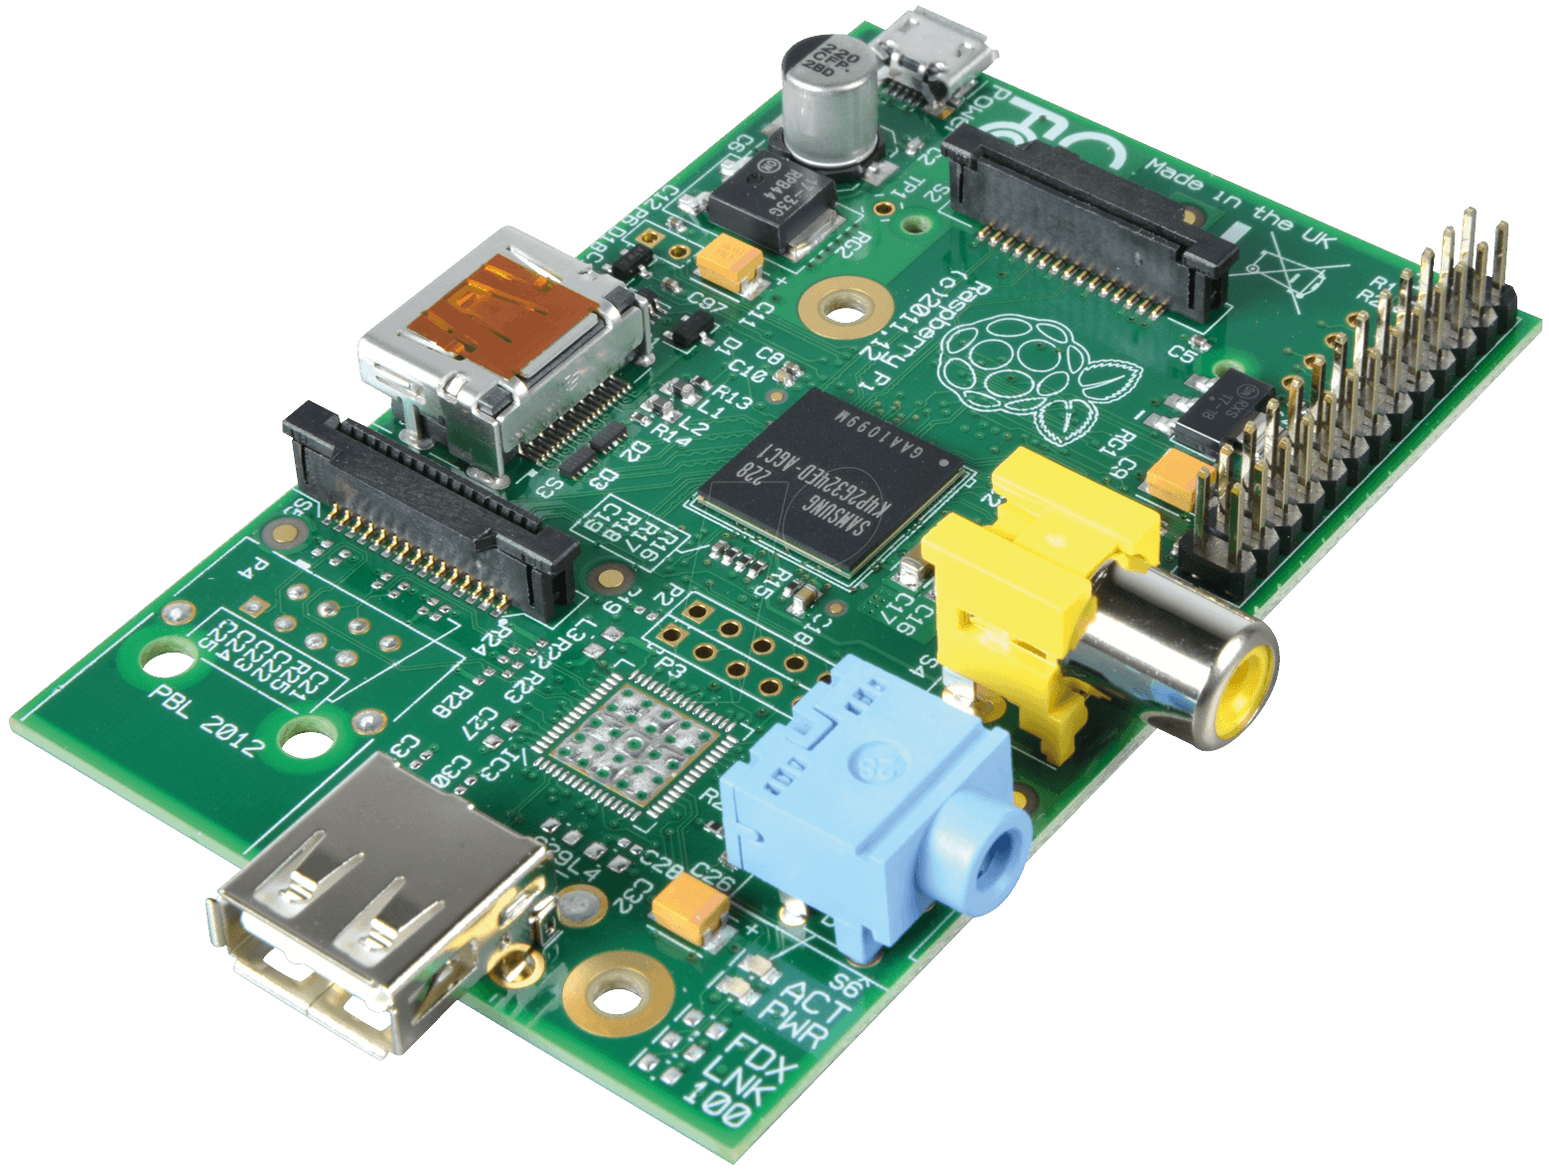
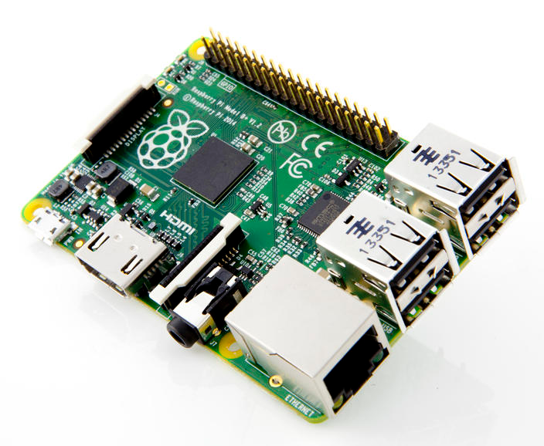
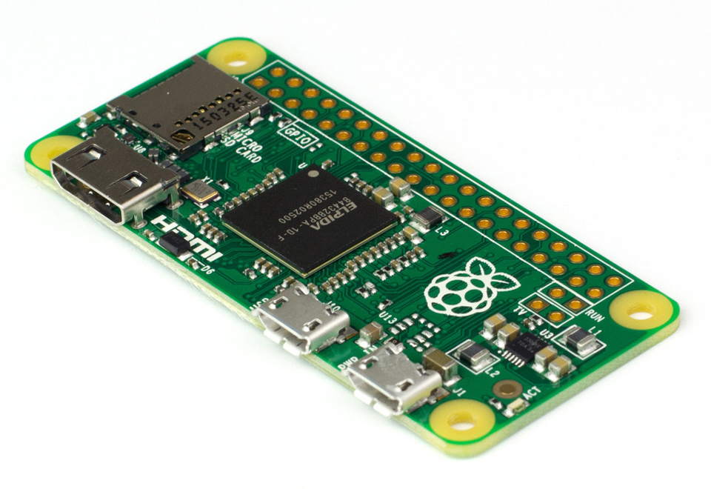
Raspberry Pis
Image credit: cnet.com, geeky-gadgets.com, drchaos.com

Slide 2
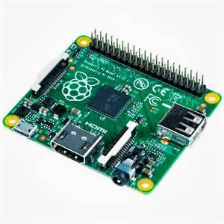
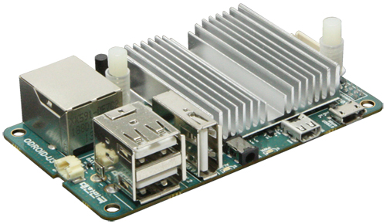
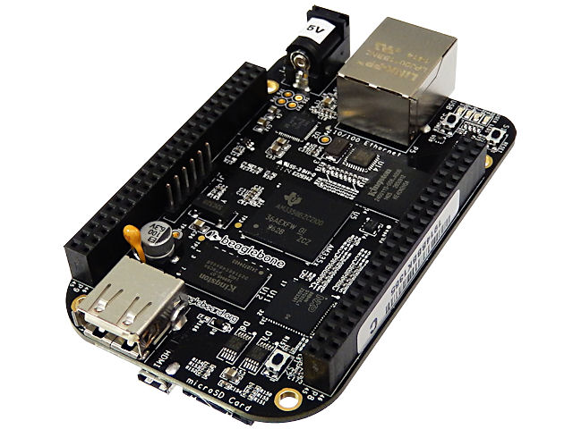
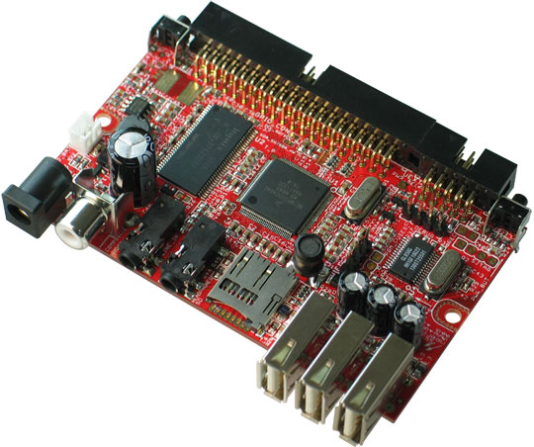
They Are Many
Top row: Raspberry Pi models A, B, 3B, A+, and Zero
Bottom row: Odroid U3, BeagleBone Black, and OlinuXino Mini
Image credit: cnet.com, geeky-gadgets.com, drchaos.com, sonicolor.es, pixhawk.org,
akizukidenshi.com, electrokit.com

Slide 3
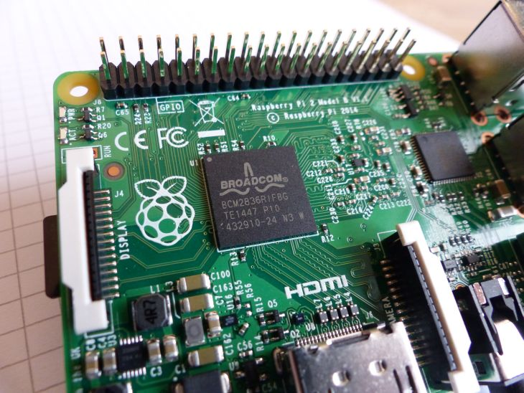
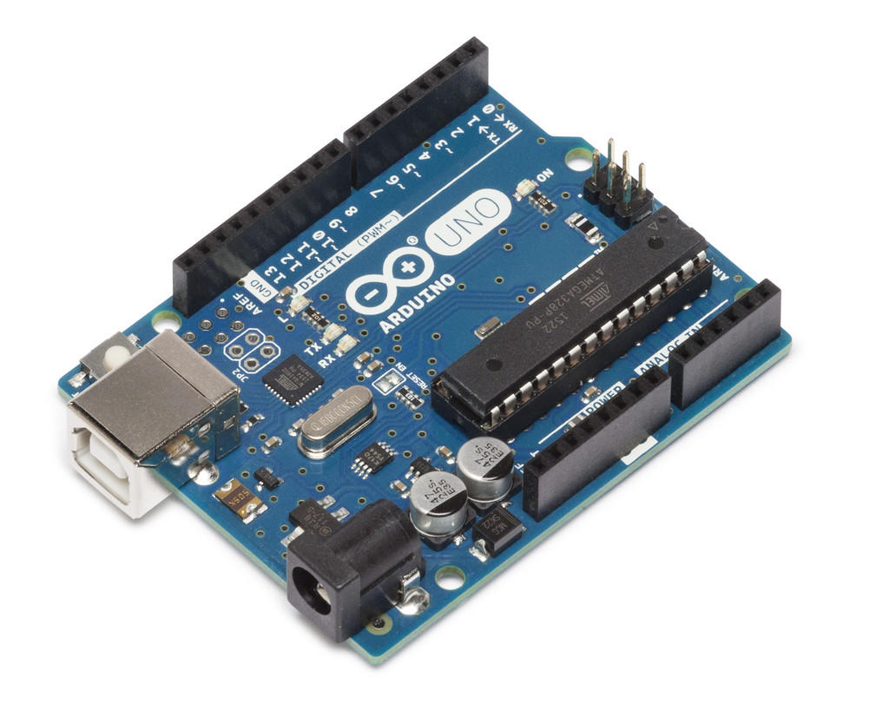
GPIO
Look familiar? Both of these are GPIO headers. RPi has serial, I2C, SPI, and one lonely hardware PWM.
Image credit: geeks3d.com, arduino.cc

Slide 4
Cost
 | RPi Zero | RPi 3B | Boring laptop | Boring desktop
Base cost | $5 | $35 | $250 | $300
Cost w/ everything | $25 | $45
Power draw (idle) | 0.5 W | 2 W | 40 W | 100 W
Energy cost (continuous low use) | $0.04 / month | $0.15 / month | $2.92 / month | $7.30 / month

Slide 5
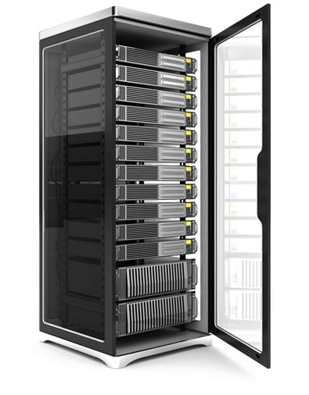
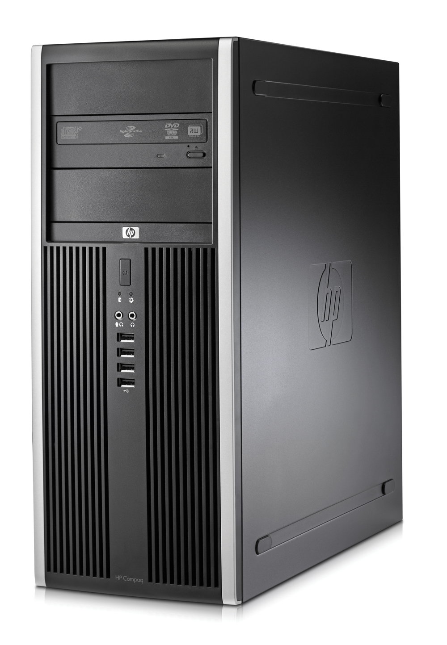
Runs Linux
As far as Linux is concerned, these are all basically the same.
(Images guestimated to scale.)
Image credit: mzcomputer.ca, cnet.com, rapid-switch.com

Slide 6
Linux
595,194 commits and infinity contributors on GitHub
56,857 packages in Debian repo
Widely used in web servers, supercomputers, and robots
Some people even use it on regular desktops!
Primary Linux distribution for RPi Raspbian

Slide 7
Windows
Windows 10 IoT Core can run on RPi 2 and 3
People do this for some reason

Slide 8
So what can you do with all that hardware and software?

Slide 9
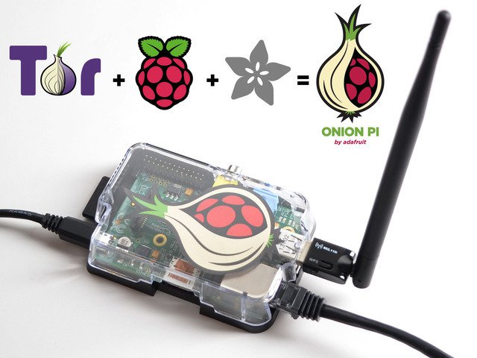
Onion Pi
Creates Tor node
Creates Wifi AP
Routes Wifi users over Tor
Project details at https://learn.adafruit.com/onion-pi
Image credit: adafruit.com

Slide 10
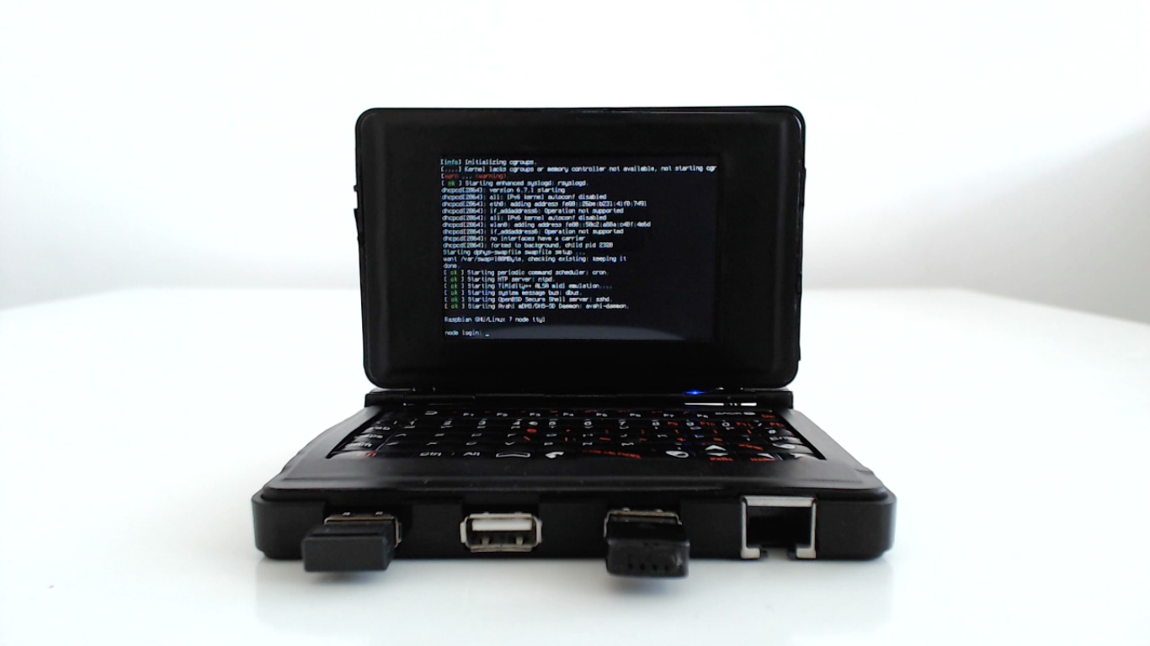
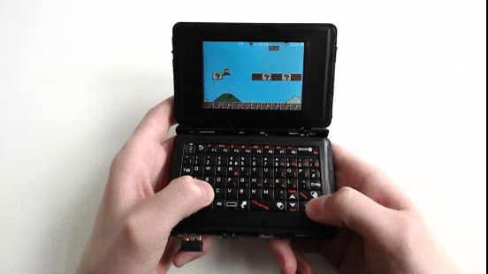
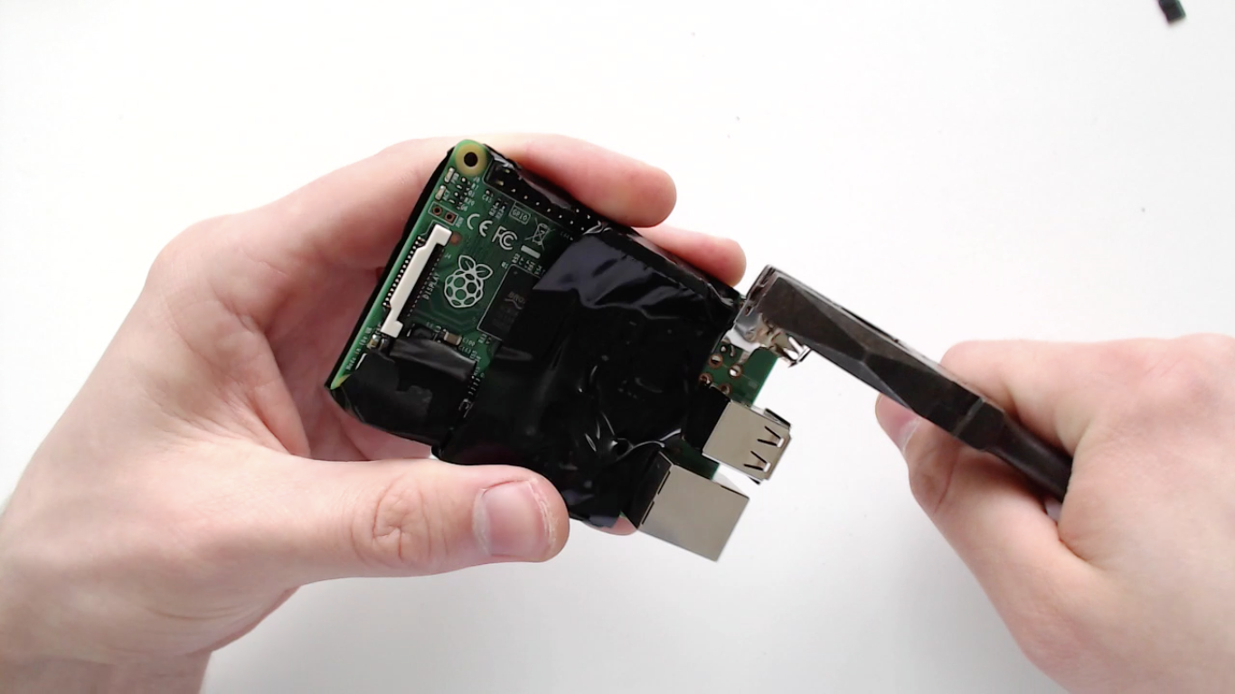
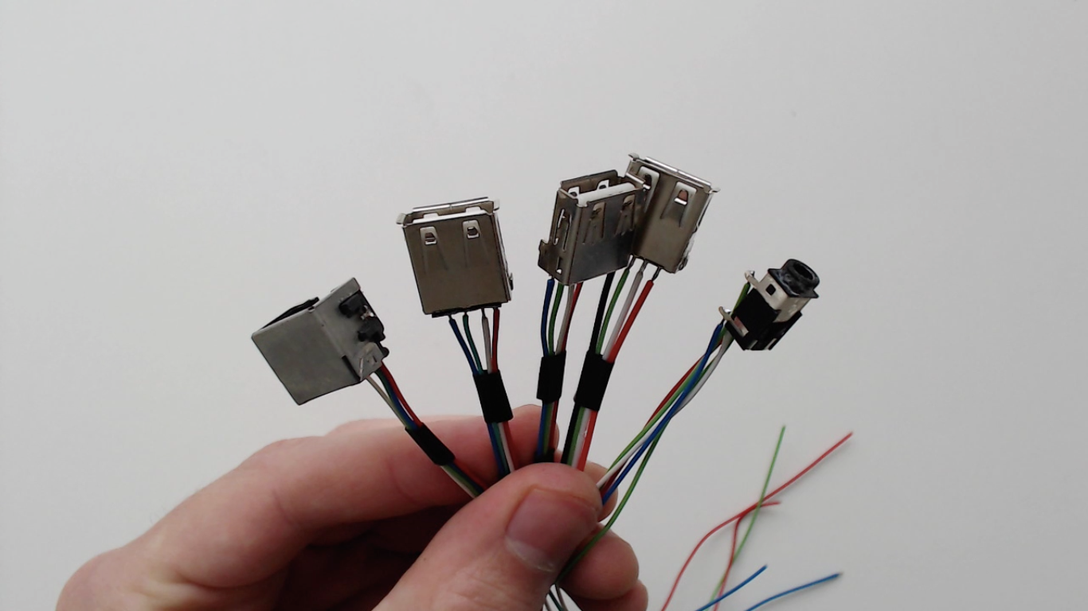
Pocket RPi
Project details at http://imgur.com/gallery/J0P5n
Image credit: imgur.com/user/nodenet

Slide 11
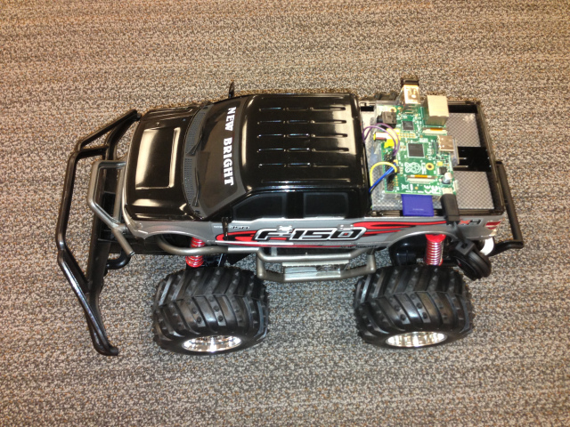
RC Car
Project details at https://blog.kaazing.com/2013/04/01/remote-controlling-a-car-over-the-web-ingredients-smartphone-websocket-and-raspberry-pi/
Image credit: blog.kaazing.com

Slide 12
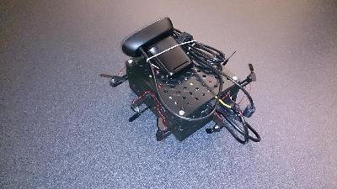
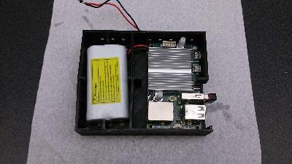
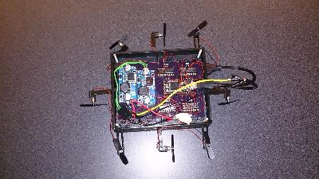
Telepresence (for space)
Project details at http://ncsu-space.github.io/projects.html
Image credit: Me

Slide 13
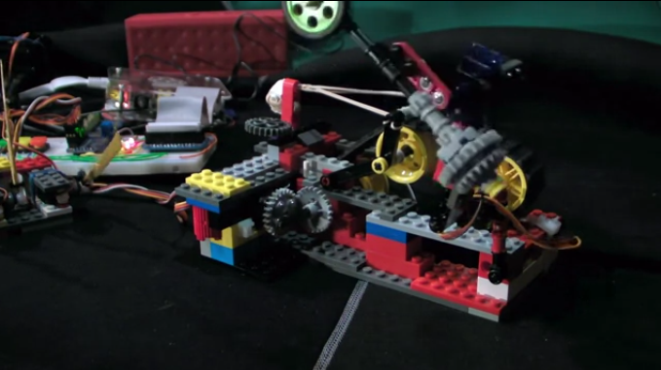
Dancing Lego
Project details at http://www.smokedbits.com/2013/05/dancing-lego-and-five-servos.html
Image credit: smokedbits.com

Slide 14
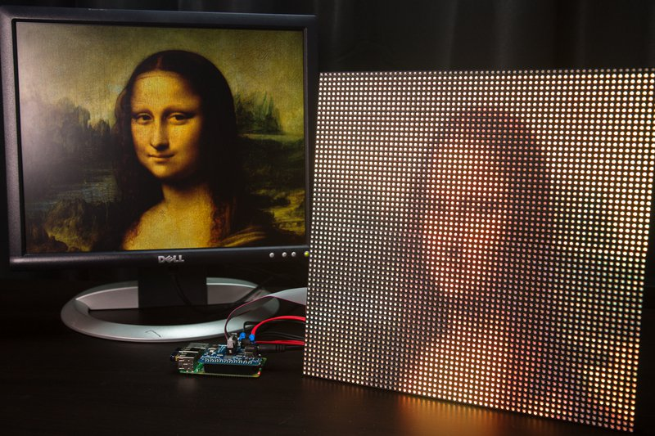
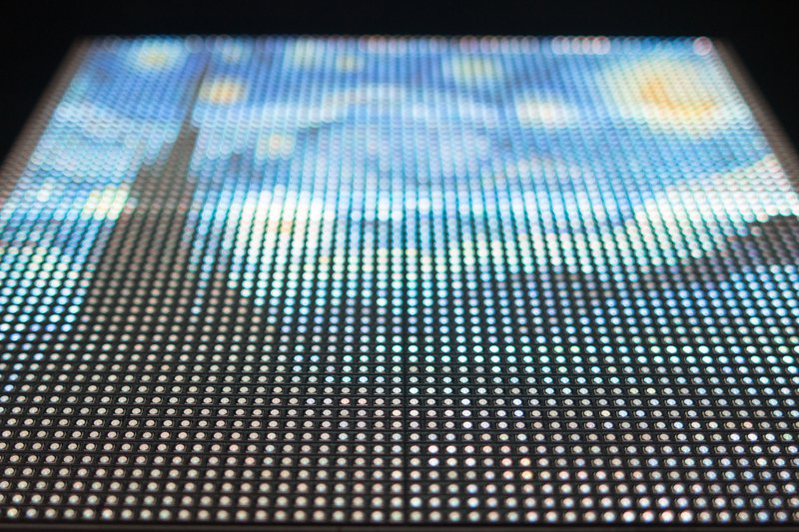
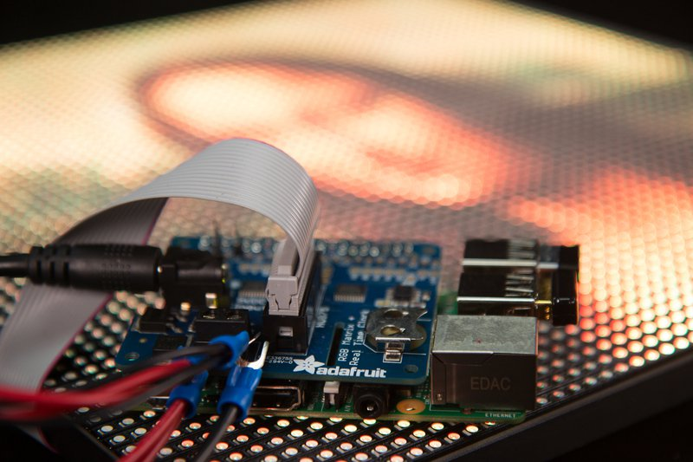
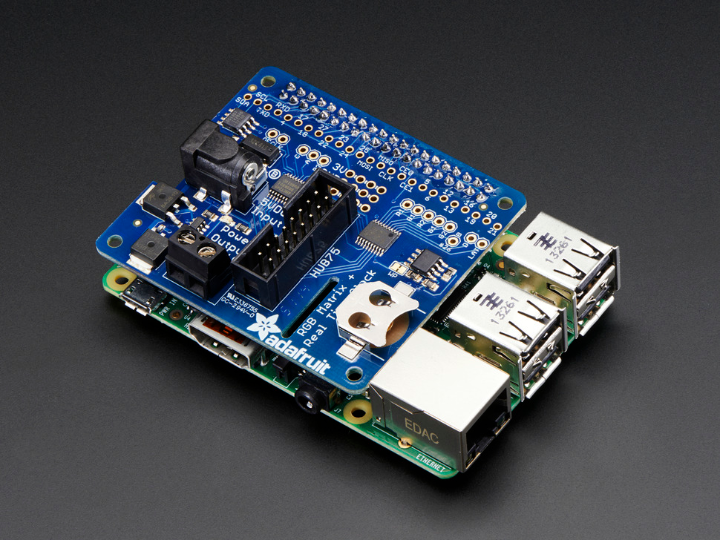
LED Matrix
Project details at https://learn.adafruit.com/raspberry-pi-led-matrix-display
Image credit: adafruit.com

Slide 15
Demo!
OS available at https://www.raspberrypi.org/downloads/
Very thorough introduction at http://www.codeproject.com/Articles/839230/Introduction-to-Raspberry-Pi-with-Raspbian-OS
Slides can be found at https://github.com/Densaugeo/Intro-to-RPi

