Slide 1
Game Design
1. Introduction
Unity Workshop - WS 19-20

Slide 2



About Me
2010-2017: HS Ravensburg-Weingarten
2014: Zeitland media&games
2016: Gründung Ten Eyes media
Seit 2017: Technische Universität Wien

Slide 3

Unity3D
Widely used with many building platforms
Fast development of prototypes
Get started quickly (even for non-programmer)
Many tutorials
unity3d.com/learn/tutorials

Slide 4
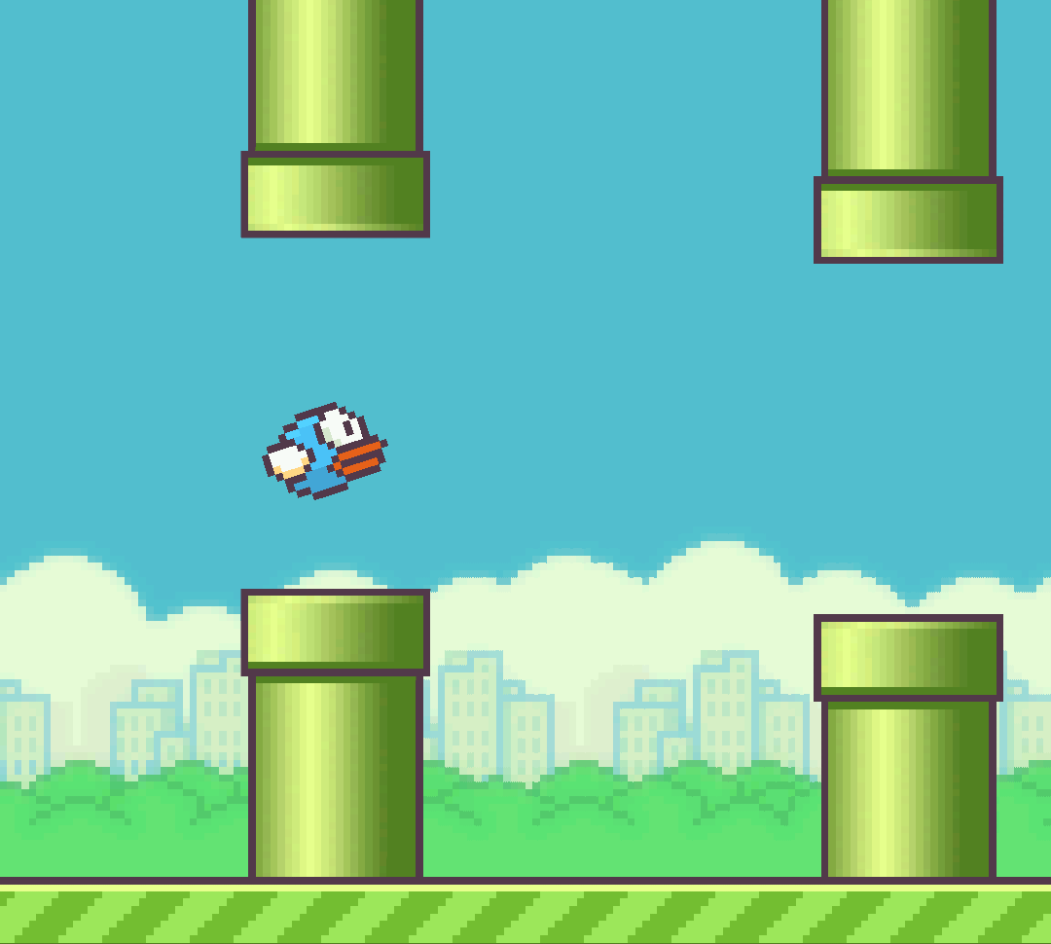
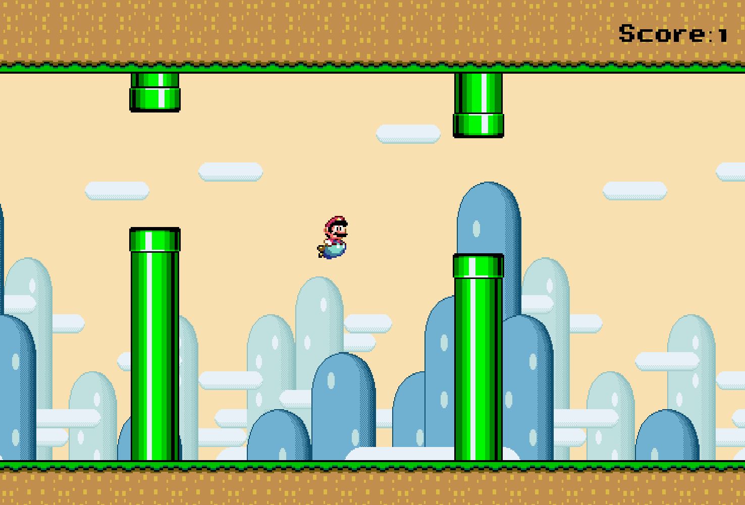
What we do
Flappy Bird Clone (https://unity3d.com/de/learn/tutorials/s/2d-game-creation)
Textures and Sprite Rendering
2D Physics
C# Scripting
Simple 2D Animations
Game- and Sound-Management
Level-Generation with Object Pooling
Your ideas and questions
https://github.com/Densen90/FlappyWorld

