Slide 1
Game Design
2. UnityEditor And Sprites
Unity Workshop - WS 19-20

Slide 2
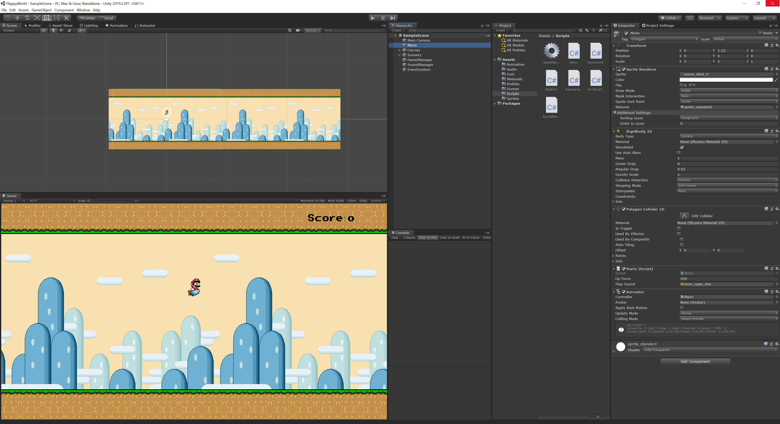
Unity Editor
Scene-View:
Arrangement of the objects in the scene
(comp.: Blender, Maya…)
Hierarchy: Objects in the scene
Inspector:
All components which are attached to the selected object
Game-View:
How it looks in the final game
Console:
Show Debug Logs

Slide 3


Sprites
Images, which are used for UI or 2D games are called Sprites
Other types: Texture, Normal Map, Light Map etc.
Can be a single image, or a image with multiple sprites (Tilemap)
Different Wrapping (e.g. Clamp, Repeat, Mirror etc.)
Ground, single, repeat
Player, tiles, clamp
Background, single, repeat
Pipe, single, clamp

Slide 4
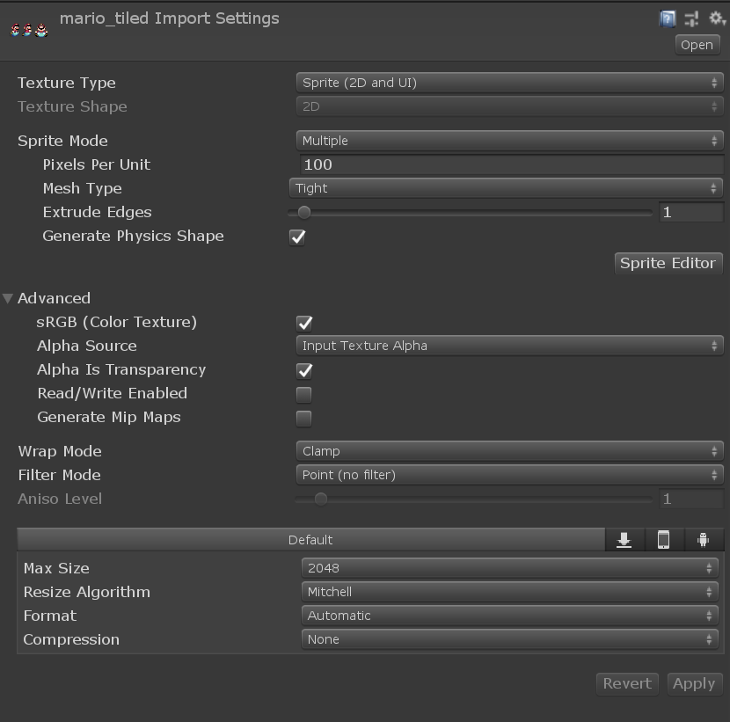
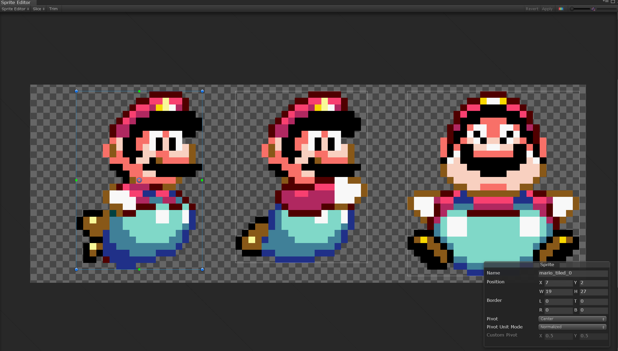
Sprites
Sprite Editor: Slice Tilemaps and Border Images
Image Import Settings: all settings for an imported image

Slide 5
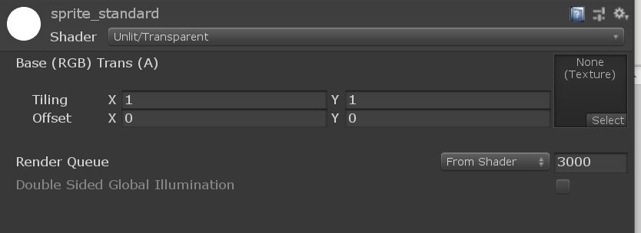

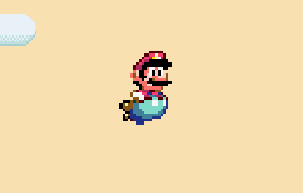
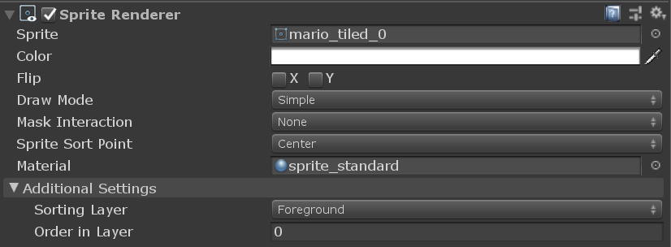
Sprite Rendering
Sprite
Material → Shader for the rendering
→ Tiling/Offset
SpriteRenderer Component
Rendering in Scene

Slide 6
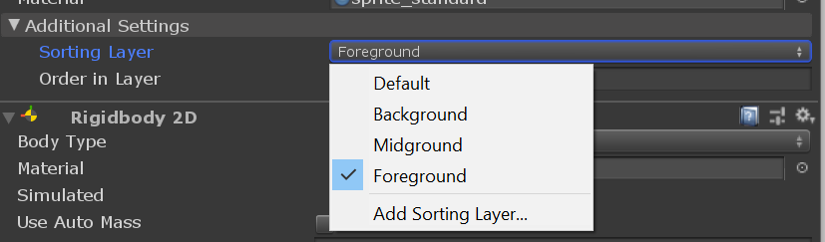
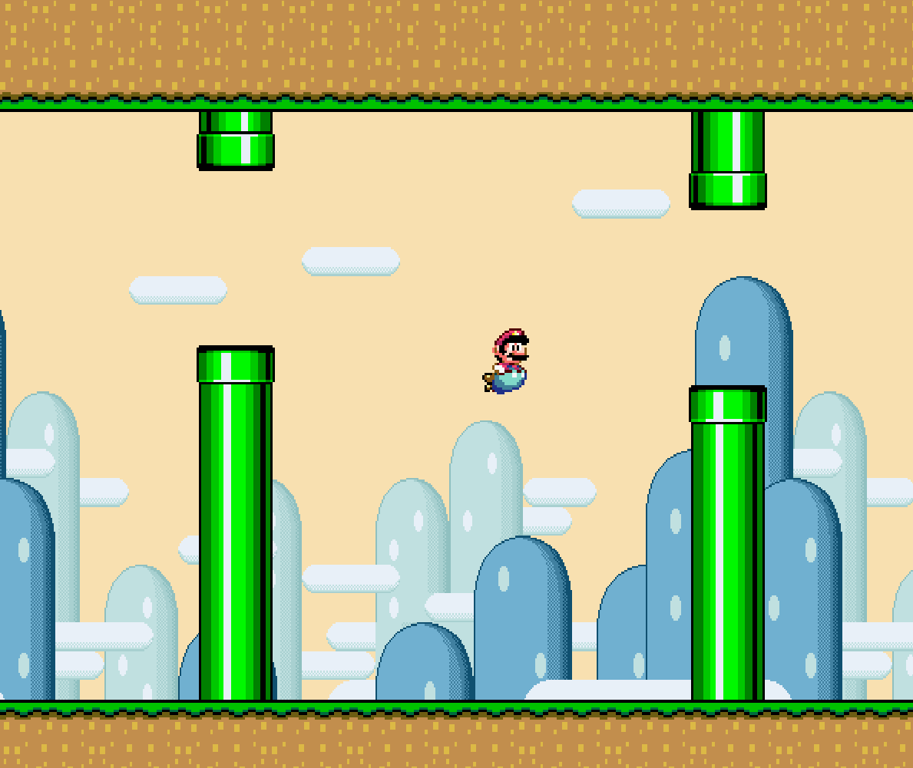
Sorting Layer
Foreground
Create as many Sorting Layers as you want
The lower the layer, the further forward the sprite renders
Order in Layer orders the sprites inside one Sorting Layer
The higher Order In Layer is, he further forward the sprite renders
Midground
Background

