Slide 1
Game Design
3. 2d physics and Control
Unity Workshop - WS 19-20

Slide 2
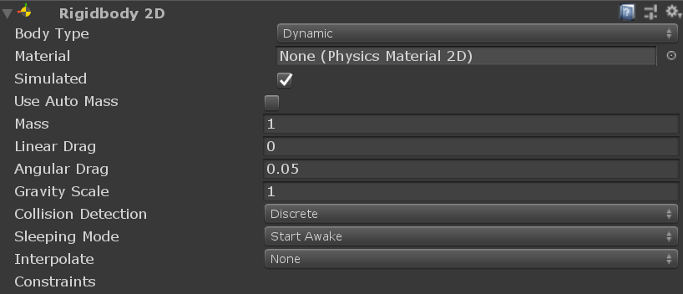
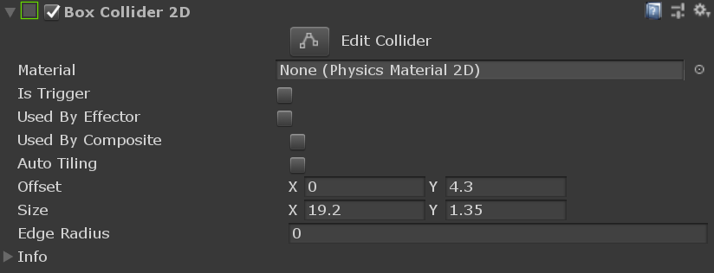
Unity Physics
Rigidbody
Collider
Enable physical behaviour for an object
Respond to gravity
Respond to external forces
Respond to incoming collisions (if also collider is attached)
Move by applying forces, not changing transform
For 2D and 3D objects
Shape of object for physical collisions
Can be used as triggers, without influencing collisioning objects
Mostly rough approximation of shape is better for performance
For 2D and 3D objects
Collisions can be handled in script (OnCollisionEnter(…), OnTriggerEnter(…) etc.)

Slide 3


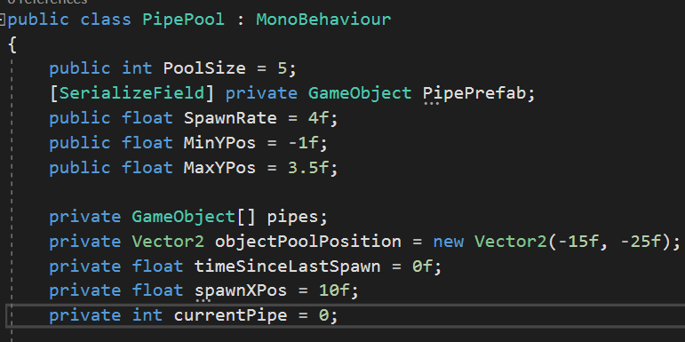
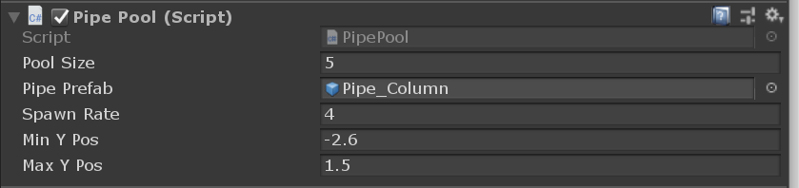
Scripting in Unity
- Main Programming language is C# with .NET 2.0 (or .NET 4.x)
Default a created script inherits from MonoBehaviour
Script can be used as component an a GameObject
Script can receive Unity Events
Can perform tasks inside Unitys Game Loop
Variables can be visible inside the inspector to set
Easier to test values without changing the script
Variable has either be „public“ or tagged as „[SerializeField]“

Slide 4
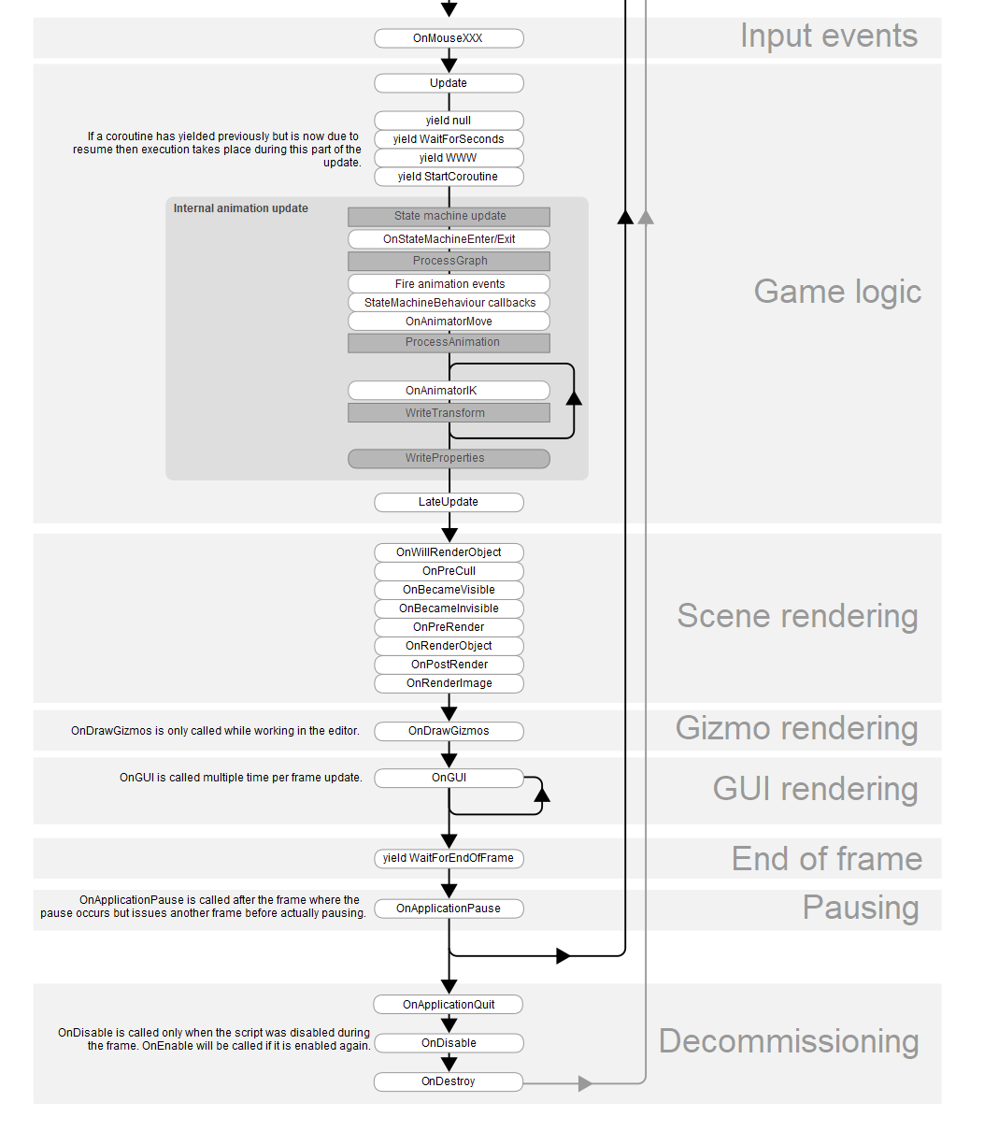
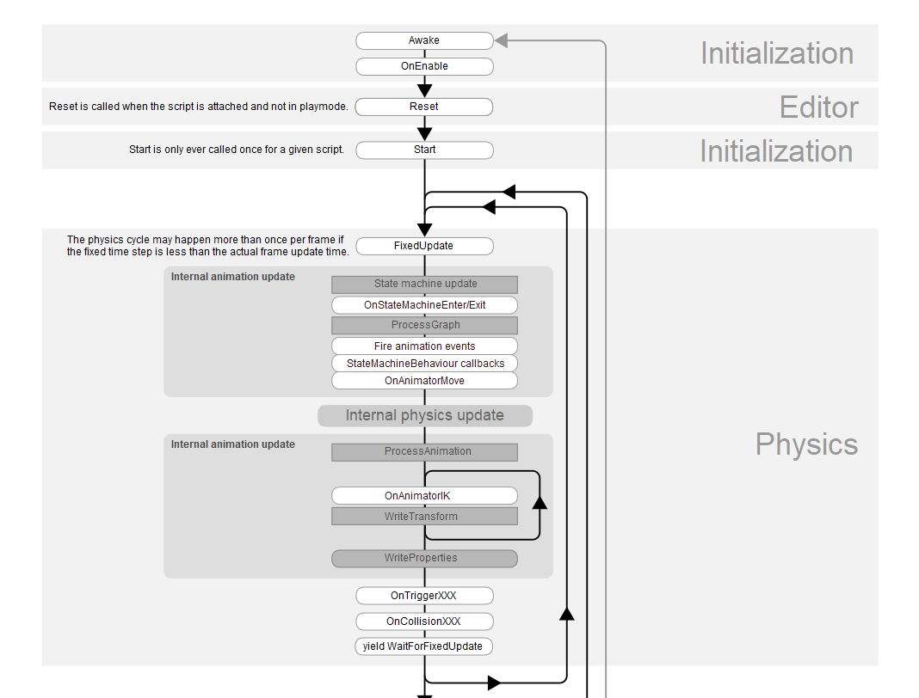
Unity Events – Order of Execution

Slide 5
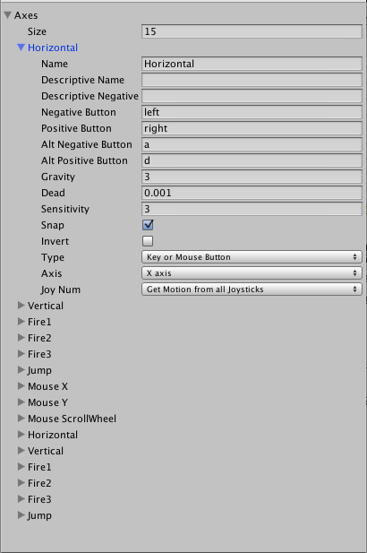
Input
Input from Axes
Predefined axes inside Unitys Project Settings
Own definitions can be added
Input.GetAxis(„AxisName“) → [-1;1]
2. Input from Key Definition
For Keyboard Keys
Input.GetKey/GetKeyDown(KeyCode) → true/false
Input.getMousButtonDown(buttonID) → true/false
3. Mouse Input from Events
Implement Listener interfaces (e.g. IPointerClickHandler)
public void OnPointerClick(PointerEventData pointerEventData) is called when Mouse button is pressed

Slide 6
Player Script
Structure
public class Player : MonoBehaviour {
//Have variables here we need (e.g. Rigidbody)
//Unity Event for intialization, initialize your needed variables here with GetComponent<Type>()
void Start(){
}
//Game loop of Unity, check here for input and react on input bychanging rigidbody values
//do not react on input if player is dead
void Update(){
}
//Event called if the player hits another collider (only if player has rigidbody and collider)
//handle the players death here
void OnCollisionEnter2D(Collision2D col){
}
}

