Slide 1
Game Design
2. UI and manager
Unity Workshop - WS 19-20

Slide 2
Unity UI - Canvas
Canvas
Canvas holds all UI elements as children and handles the rendering and transformations for different screen sizes
Image
Text
Mask

Slide 3
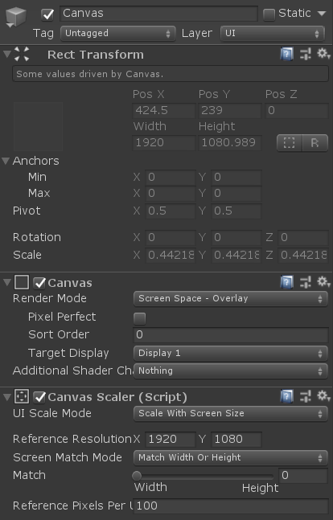
Unity UI - Canvas
RectTransform = Transform for 2D
→ Position, Size, Scale and Anchoring for element
Canvas element
Render Mode on Screen or in World (e.g. Lifebar)
Canvas scaler scales all children components
→ Scale with screen size has reference resolution. All children elements are positioned as if the screen has this resolution

Slide 4
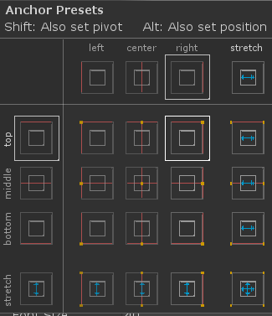
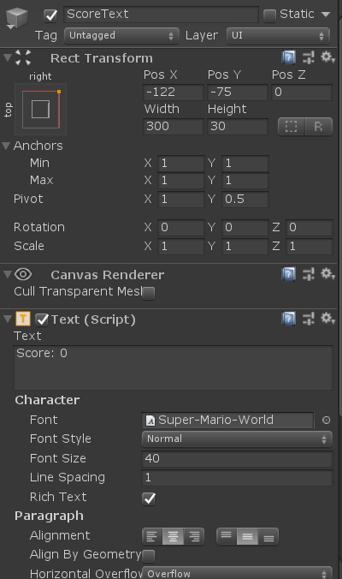
Unity UI – UIText Example
RectTransform
Position and size depending on canvas scaler
Anchor sets how it will be positioned relative to ist parent
Scale should be 1, is handled by Canvas
Text
Component of a UI-Object
Standard Settings of a Text (Size, Content, Spacing, Alignment etc.)
Overflow settings if text is larger than the RectTransform size
Sharper Text → TextMeshPro Plugin

Slide 5
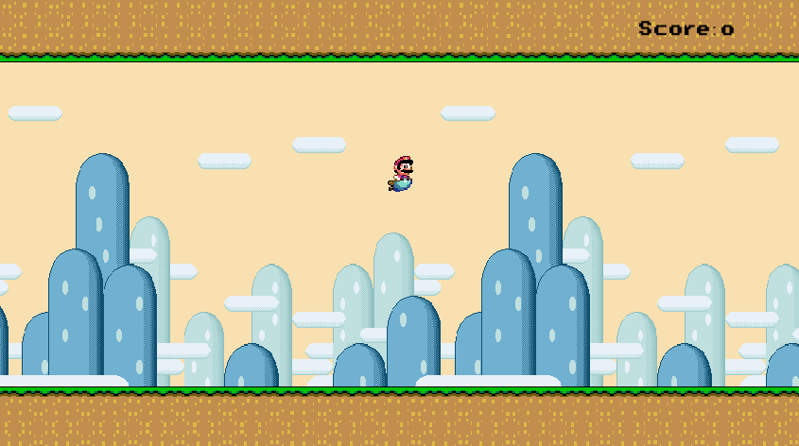
Unity UI – Scene
Text anchored to the upper left of canvas
Canvas

Slide 6


Unity – Managers
GameManager
SoundManager
Has overview over game (is it running or game over?)
Can handle essential functionalities of the game (e.g. initialization/loading)
Can handle different phases of a game (e.g. a State Machine)
Controls the playing of Audio clips
Can differentiate between background music and sound effects
Controls the number of AudioSources in the scene

Slide 7

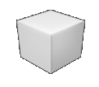

Unity – Singleton Pattern
Conventional implementation
One class implementation
Multiple instantiations of that class
Several scripts can use different instatiations of the class
Used for objects, which need several instances in the game (e.g. enemies, collectables, audio sources etc.
→ Mostly used!

Slide 8
Unity – Singleton Pattern
Singleton implementation
One class implementation
Only one instantiation of this class in whole environment
Every script calls the same object
Used for objects, which only needs one instance in the whole environment
Mostly used for managers (GameManager, AudioManager)
Be carefeul: Singletons are static, therefore they exist across multiple scenes
→ many possible errors and bugs

Slide 9
Unity – Singleton Pattern
Method 1 – Getter for class
Method 2 – Awake for MonoBehaviours
public class Manager
{
private static Manager instance = null;
public static Manager Instance
{
get
{
if(instance == null) instance = new Manager();
return instance;
}
}
}
public class Manager : MonoBehaviour
{
private static Manager instance = null;
public static Manager Instance
{
get
{
return instance;
}
}
void Awake()
{
DontDestroyOnLoad(this.gameObject);
if(instance == null) instance = this;
else if (instance != this) Destroy(this.gameObject);
}
}

Slide 10
Put together
Create an Canvas with a text component in the corner
Create a GameManager script and object
Save and show score
Handle death and reloading of scene
Create as a singleton
Create a SoundManager script and object
Have an AudioSource for SFX
Have an AudioSource for Background Music
Can play and stop sfx and background for a given AudioClip with specified volume
Create as a singleton

Slide 11
Extend your game
Find some mechanics, to enhance your game, some examples:
Make the level scroll faster the longer the round lasts
Make the obstacles move up and down
Add new obstacle (e.g. shooting ones)
Add some powerups (e.g. invincibility for some time)

