Slide 1
Game Design SS18
Unity3D Workshop – Player Movement

Slide 2
Player Movement
Notes:
Sprung Animation erstellen
Input Abfragen
Timed execution / Lock Input / delta Time für Bewegungen / Coroutine
Kamera Setup
Camera Follow Script
Kollisionserkennung / Trigger
Raycast für Objekte

Slide 3
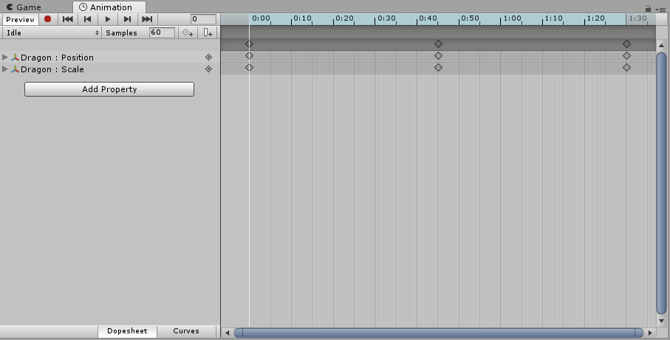
Player Movement - Animation
Animation Window
Record animations
Set keyframes
Change values of properties
Adjust curves
Notes:
Sprung Animation erstellen
Input Abfragen
Timed execution / Lock Input / delta Time für Bewegungen / Coroutine
Kamera Setup
Camera Follow Script
Kollisionserkennung / Trigger
Raycast für Objekte

Slide 4
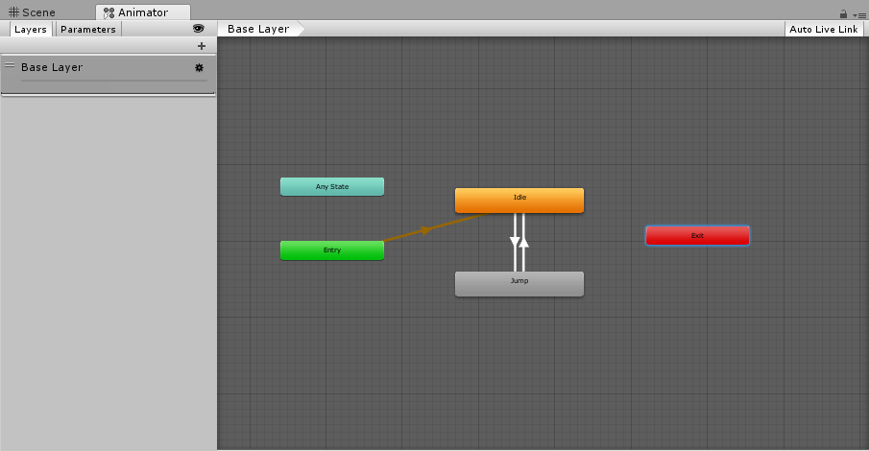
Player Movement - Animation
Animator Window
State Machine
Animations are in states
Transitions between states
Notes:
Sprung Animation erstellen
Input Abfragen
Timed execution / Lock Input / delta Time für Bewegungen / Coroutine
Kamera Setup
Camera Follow Script
Kollisionserkennung / Trigger
Raycast für Objekte

Slide 5
Player Movement - Animation
public void SetTrigger(string name);
public void SetTrigger(int id);
Idle
public Animator anim;
anim.SetTrigger(“jump“);
Jump
Notes:
Sprung Animation erstellen
Input Abfragen
Timed execution / Lock Input / delta Time für Bewegungen / Coroutine
Kamera Setup
Camera Follow Script
Kollisionserkennung / Trigger
Raycast für Objekte

Slide 6



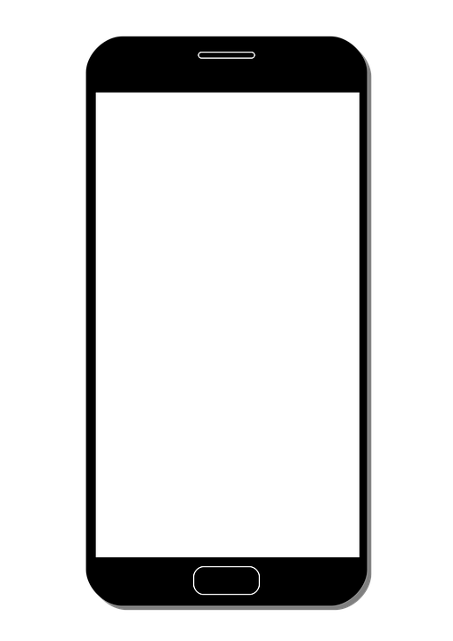
Player Movement - Input
Notes:
Sprung Animation erstellen
Input Abfragen
Timed execution / Lock Input / delta Time für Bewegungen / Coroutine
Kamera Setup
Camera Follow Script
Kollisionserkennung / Trigger
Raycast für Objekte

Slide 7
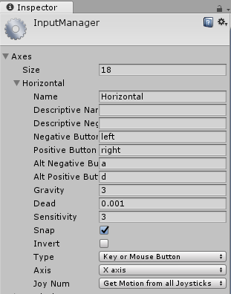
Player Movement - Input
public static float GetAxis(string axisName);
if (Input.GetAxis("Horizontal") > 0)
{
MoveRight();
}
Notes:
Sprung Animation erstellen
Input Abfragen
Timed execution / Lock Input / delta Time für Bewegungen / Coroutine
Kamera Setup
Camera Follow Script
Kollisionserkennung / Trigger
Raycast für Objekte

Slide 8

Player Movement – Timed Execution
Notes:
Sprung Animation erstellen
Input Abfragen
Timed execution / Lock Input / delta Time für Bewegungen / Coroutine
Kamera Setup
Camera Follow Script
Kollisionserkennung / Trigger
Raycast für Objekte

Slide 9

Player Movement – Timed Execution
public static float deltaTime;
float timeElapsed = 0f;
void Update()
{
timeElapsed += Time.deltaTime
}
Notes:
Sprung Animation erstellen
Input Abfragen
Timed execution / Lock Input / delta Time für Bewegungen / Coroutine
Kamera Setup
Camera Follow Script
Kollisionserkennung / Trigger
Raycast für Objekte

Slide 10
Player Movement – Timed Execution
public Coroutine StartCoroutine(IEnumerator routine);
void Start()
{
print(“Start“ + Time.time);
StartCoroutine(WaitAndPrint());
}
IEnumarator WaitAndPrint()
{
yield return new WaitForSeconds(5);
print(“WaitAndPrint“ + Time.time;
}
Notes:
Sprung Animation erstellen
Input Abfragen
Timed execution / Lock Input / delta Time für Bewegungen / Coroutine
Kamera Setup
Camera Follow Script
Kollisionserkennung / Trigger
Raycast für Objekte

Slide 11
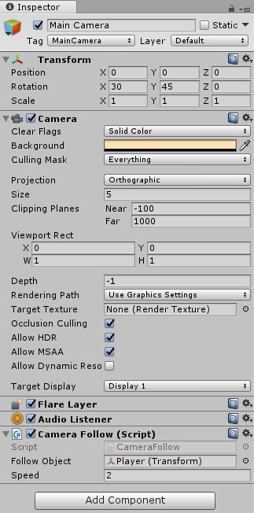
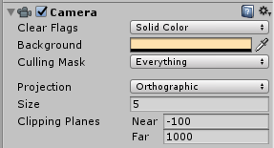

Player Movement – Camera Setup
Smooth follow using Lerp:
public static Vector3 Lerp(Vector3 a, Vector3 b, float t);
Notes:
Sprung Animation erstellen
Input Abfragen
Timed execution / Lock Input / delta Time für Bewegungen / Coroutine
Kamera Setup
Camera Follow Script
Kollisionserkennung / Trigger
Raycast für Objekte

Slide 12
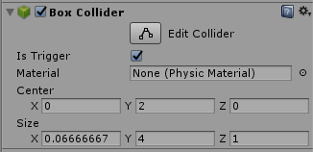
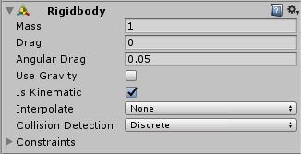
Player Movement – Collision Detection
Object that something can collide with
Object that collides with something
Notes:
Sprung Animation erstellen
Input Abfragen
Timed execution / Lock Input / delta Time für Bewegungen / Coroutine
Kamera Setup
Camera Follow Script
Kollisionserkennung / Trigger
Raycast für Objekte

Slide 13
Player Movement – Collision Detection
Object that collides with something
Collider.OnTriggerEnter(Collider)
void OnTriggerEnter(Collider other)
{
Destroy(other.gameObject);
}
Notes:
Sprung Animation erstellen
Input Abfragen
Timed execution / Lock Input / delta Time für Bewegungen / Coroutine
Kamera Setup
Camera Follow Script
Kollisionserkennung / Trigger
Raycast für Objekte

Slide 14
Player Movement – Raycast
Raycasting Object
Origin
Hit Object
Direction
Ray
public static bool Raycast(Vector3 origin, Vector3 direction, out RaycastHit hitInfo,
float maxDistance = Mathf.Infinity,
int layerMask = DefaultRaycastLayers,
QueryTriggerInteraction queryTriggerInteraction = QueryTriggerInteraction.UseGlobal);
Notes:
Sprung Animation erstellen
Input Abfragen
Timed execution / Lock Input / delta Time für Bewegungen / Coroutine
Kamera Setup
Camera Follow Script
Kollisionserkennung / Trigger
Raycast für Objekte

Slide 15
Player Movement – Raycast
void Update()
{
RaycastHit hit;
if(Physics.Raycast(this.transform.position, Vector3.right, out hit))
{
print(“Found an object – distance: “ + hit.distance);
}
}
Notes:
Sprung Animation erstellen
Input Abfragen
Timed execution / Lock Input / delta Time für Bewegungen / Coroutine
Kamera Setup
Camera Follow Script
Kollisionserkennung / Trigger
Raycast für Objekte

Slide 16
Player Movement – Tasks
Create an animation for your character
Set up the camera with the following functionality:
Set your camera to orthographic
Write a CameraFollow Script that follows your player using a Lerp
Create a PlayerMove Script with the following functionality:
Move your player according to the received input
Check if your player falls of the level using triggers
Lock the received input while your character is moving
Check for obstacles before your character moves using Raycasts
Notes:
Sprung Animation erstellen
Input Abfragen
Timed execution / Lock Input / delta Time für Bewegungen / Coroutine
Kamera Setup
Camera Follow Script
Kollisionserkennung / Trigger
Raycast für Objekte

