Slide 1

Cellular Component Ontology Prediction
JMA team - MVA ALTeGraD course 2022/2023
Jérémie Dentan - Abdellah El Mrini - Meryem Jaaidan

Slide 2
Contents
Introduction
General overview of our pipeline
Computational details
Sequence based embeddings
Attention-based embeddings
TF-IDF
Structure based embeddings
GNN, DGCNN, HGP, GraphSAGE, GAT
Classifiers and results
Classifier and feature selection
Results

Slide 3
Contents
Introduction
General overview of our pipeline
Computational details
Sequence based embeddings
Attention-based embeddings
TF-IDF
Structure based embeddings
GNN, DGCNN, HGP, GraphSAGE, GAT
Classifiers and results
Classifier and feature selection
Results

Slide 4
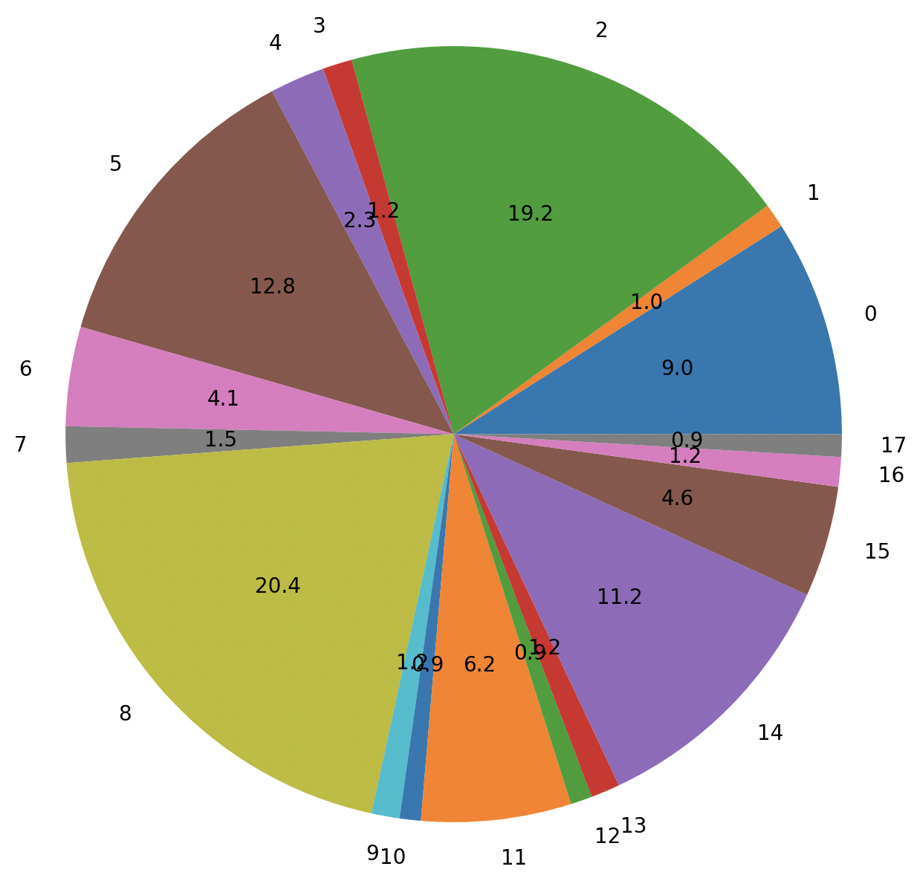
Introduction
Our task: classify proteins between 18 classes.
Main challenges:
Unbalanced dataset
Multimodal data:
Node features
Edge features
Sequences
Small dataset:
Overfitting
Lack of information
No domain-knowledge on the classes
Repartitions of the classes in the train set

Slide 5
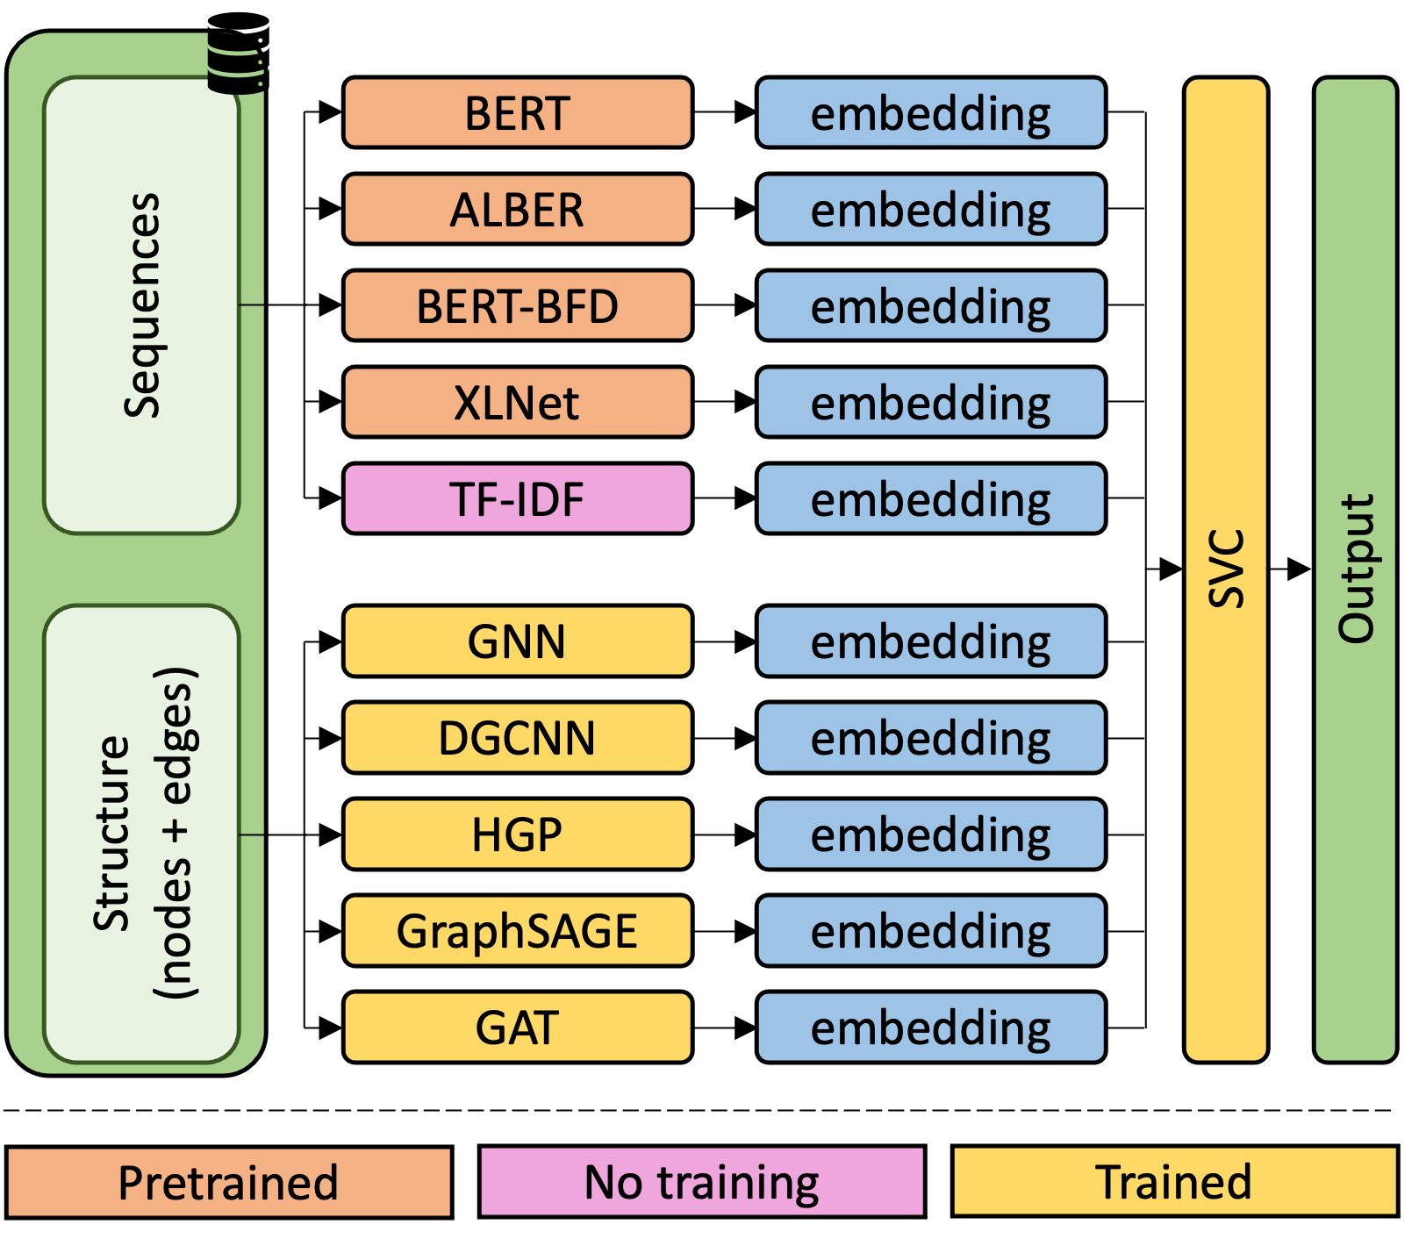
Our pipeline
Main idea: embeddings of all proteins.
Sequence-based embeddings:
As text mining with 20 tokens
Pretrained LLMs
TF-IDF vectorization
Structure-based embeddings:
Message-passing networks
Attention-based networks
A final classifier: SVC

Slide 6
Some computational details
Data and preprocessing:
6111 proteins: 4644 train, 244 valid, 1223 test
Normalization for non-categorical features
PCA to reduce input size
Computational resources: DIX devices:
CPU: Intel Xeon W-1290P 3.70GHz 10 cores
GPU: NVIDIA GeForce RTX 3090 24Go
But really few disk storage
To avoid overfitting:
A common validation set for all models
Early stopping and dropout in models
Use of benchmarks:
Some benchmarks exist, using the same type of features [4]*
Hard to reuse since we don’t know the details of our classification task
*cf. the report for the references

Slide 7
Contents
Introduction
General overview of our pipeline
Computational details
Sequence based embeddings
TF-IDF
Attention-based embeddings
Structure based embeddings
GNN, DGCNN, HGP, GraphSAGE, GAT
Classifiers and results
Classifier and feature selection
Results

Slide 8
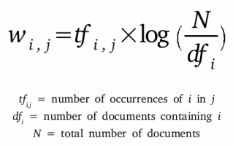
Sequence based embeddings
TF-IDF : Term Frequency - Inverse document frequency
How meaningful is each chunk of the protein sequence to the sequence ?
4-Gram => 151901 features
Image taken from : https://mungingdata.wordpress.com/

Slide 9
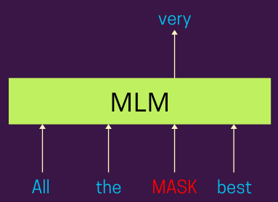
Sequence based embeddings
Unsupervised protein language models
Language models on a dictionary of size 20 (number of amino acids).
Pre-trained on a Masked Language Modeling (MLM) objective.
Use the embeddings (along with other features) for the downstream classification task. (No extra fine tuning)
Figure from Towards Data science

Slide 10
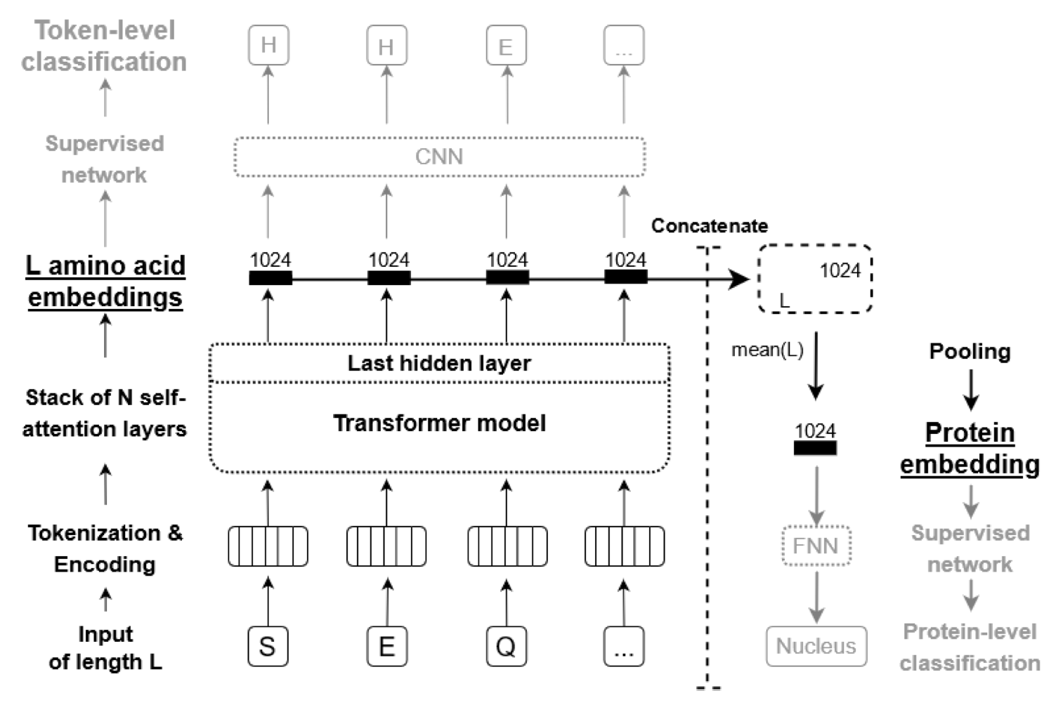
Sequence based embeddings
Feature extraction architecture : ProtTrans models

Slide 11
Sequence based embeddings
Transformer-based architectures
ProtBert (420M) - Based on BERT, a standard NLP model for transfer learning.
ProtBert-BFD (420M) : Same architecture as ProtBert, but also trained on an additional dataset.
ProtAlbert (224M) : Hard parameters sharing between attention layers.
ProtXLNet (409M) : No maximum sequence length required thanks to a memory mechanism.
An issue:
Sentences in spoken language are 15-30 words long
Protein sequences are way longer than that : Up to 989 in our case.

Slide 12
Contents
Introduction
General overview of our pipeline
Computational details
Sequence based embeddings
Attention-based embeddings
TF-IDF
Structure based embeddings
GNN, DGCNN, HGP, GraphSAGE, GAT
Classifiers and results
Classifier and feature selection
Results

Slide 13
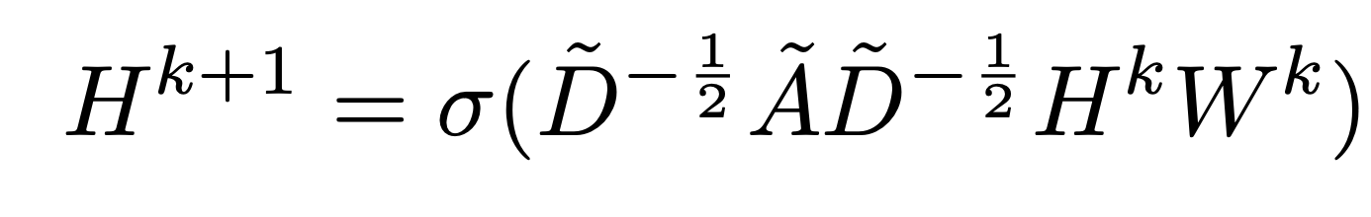
Structure based embeddings
Graph Convolution Network - GCN :
Linear operations on the node attributes and its neighbours
W : weights
Ã : adjacency matrix
D : degree matrix with added self loops

Slide 14
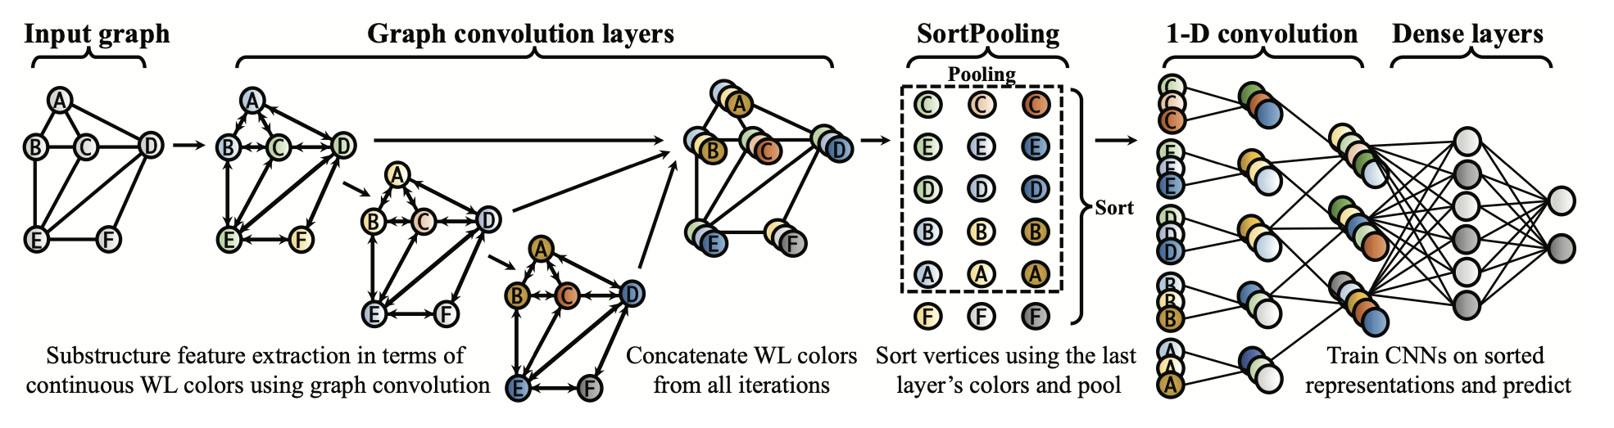
Structure based embeddings
Deep Graph Convolutional Neural Network - DGCNN :

Slide 15
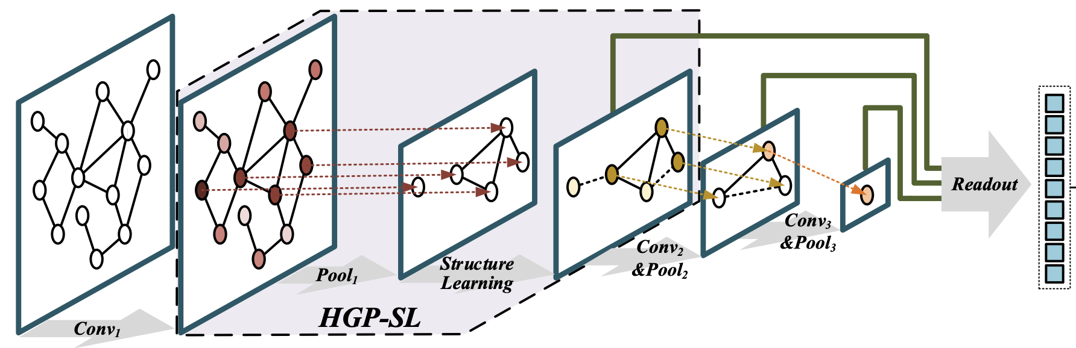
Structure based embeddings
Hierarchical graph pooling with Structure Learning - HGP-SL :
Graph pooling -> subgraphs - preserve informative nodes
SL : Learn refined graph structures
+ Preserves graph structure information

Slide 16
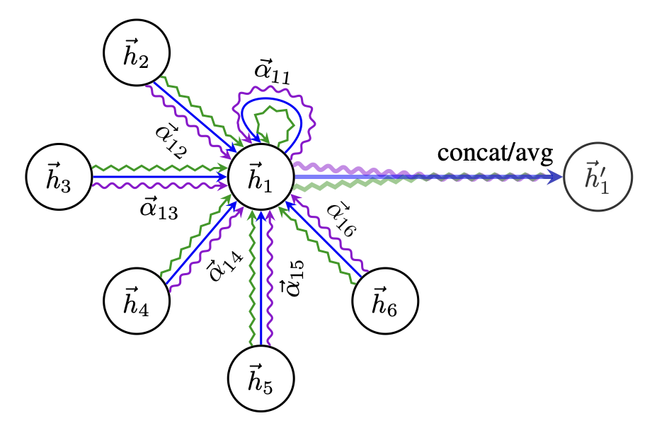
Structure based embeddings
GAT :
Leverage masked self-attention layers
Use Graph attention layers
Different level of importance to different nodes
Doesn’t depend on the knowledge of the whole graph
Available with Pytorch Geometric

Slide 17
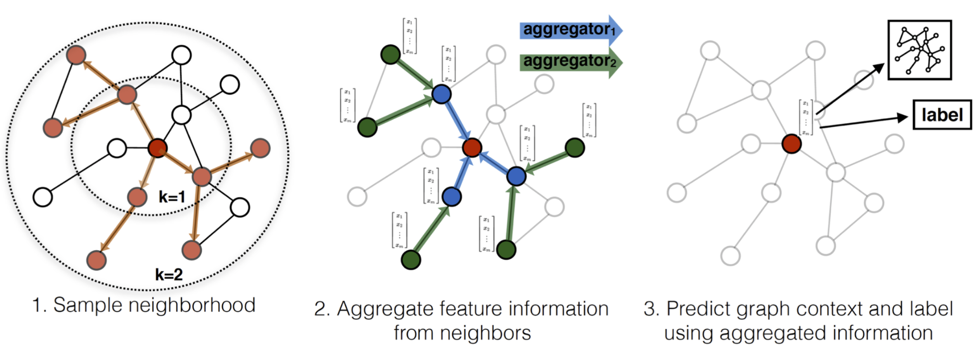
Structure based embeddings
GraphSAGE :

Slide 18
Contents
Introduction
General overview of our pipeline
Computational details
Sequence based embeddings
Attention-based embeddings
TF-IDF
Structure based embeddings
GNN, DGCNN, HGP, GraphSAGE, GAT
Classifiers and results
Classifier and feature selection
Results

Slide 19
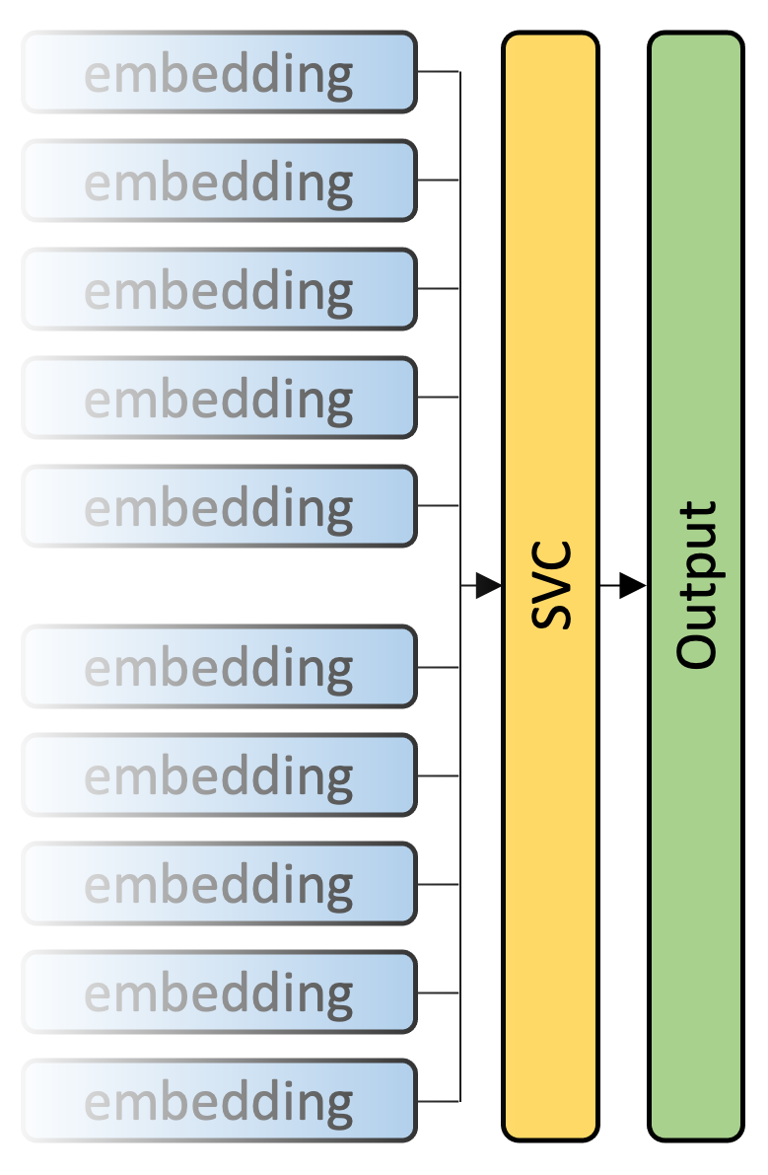
Final classification
Choice of classifier:
Insight from [4]: SVC behaves very well
Classifier tested:
KNN classifier
SVC -> best performance
Gaussian Process (based on Laplace approximation)
Desision tree
MLP
AdaBoost classifier
Hyperparameter tuning: using our validation set

Slide 20
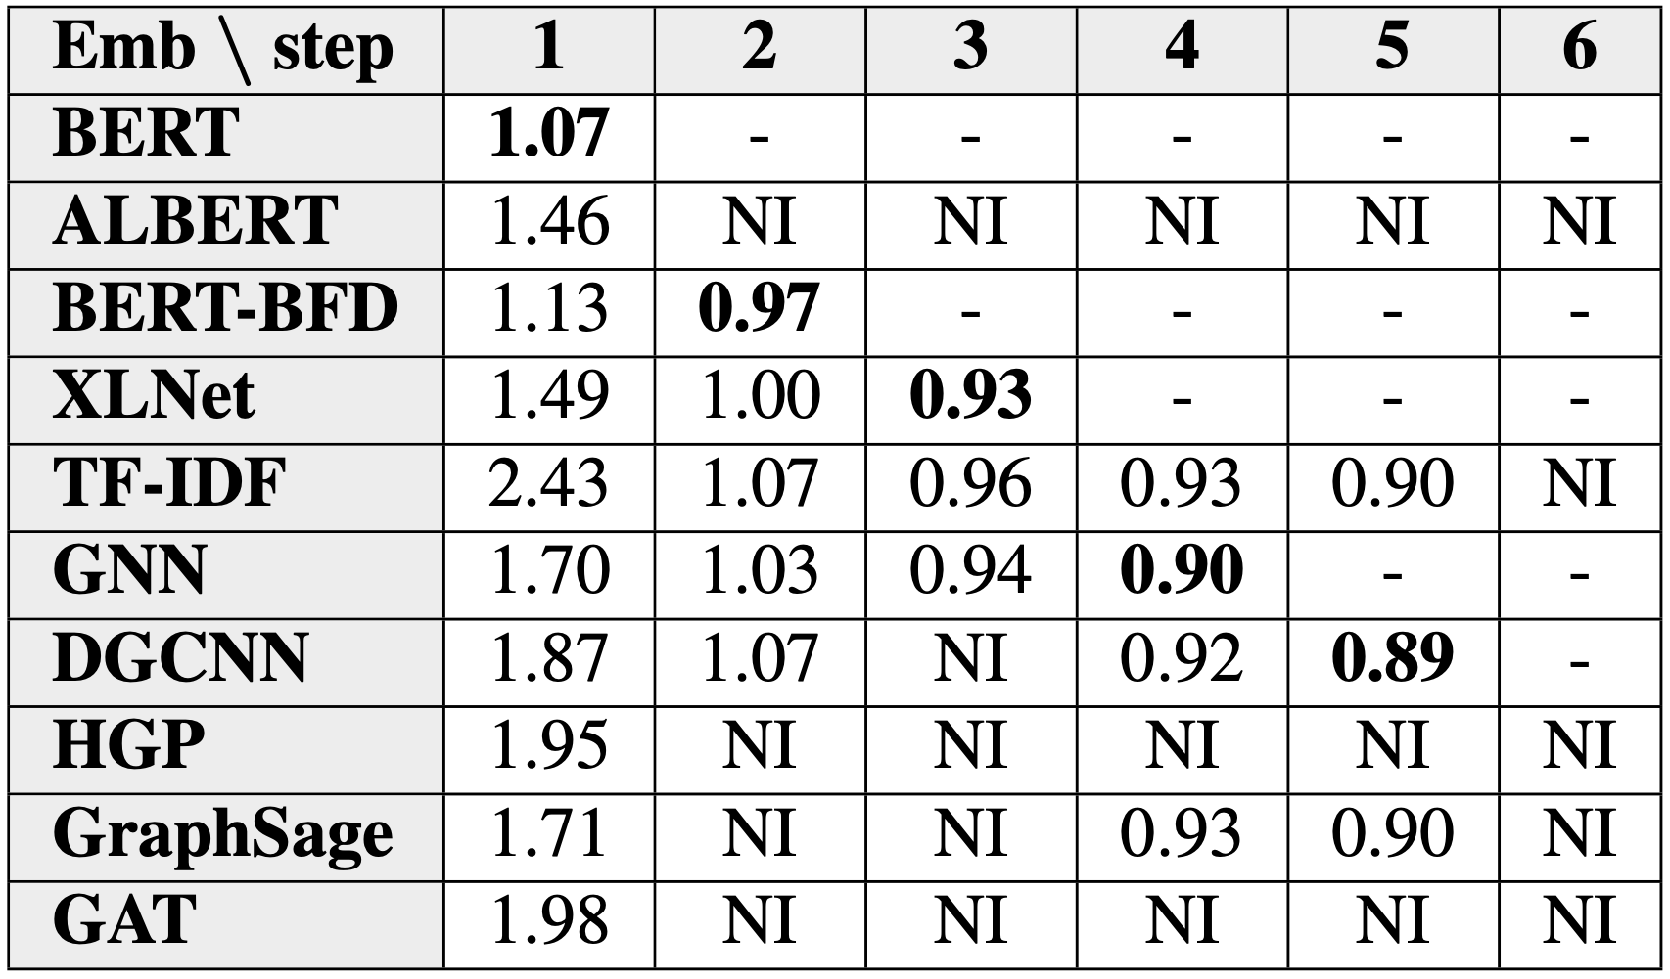
Feature selection
Why do we need this?
Some classifier does this natively
But SVC performances decrease with additional non-informative features
How to select the features?
State of the art: information theory, correlation with the classification.
In our case: greedy optimization: at each time, add the embeddings that improve the most.
Performances over the steps of feature selection

Slide 21
Conclusion
Satisfactory performances with reasonable computation time:
Private score of 0.8467 (16th) and private score of 0.8995 (17th)
About 1h30 of computation for sequence-based embeddings ; about 20min for structure-based
Many ways of improvement:
Train the LLMs instead of simply computing embeddings
Data augmentation: both for underrepresented classes and to avoid overfitting
Trainable readout
More advanced method for feature selection and hyperparameter tuning
Final thought: sequence-based embeddings seem to behave better

Slide 22
Thanks for listening !

