Slide 1
MAP583 Jeremie Dentan – Ahmed Laftit – Dan Meller

Slide 2
Plan de la présentation
Introduction
First discussion: performance: modify lap_pos_enc
Without positional embedding
Exponential factors
Absolute value
Homothety
Increasing the dimension of the embedding
Second discussion: stability: modify the dataset:
Presentation of the dataset
Changing the probability q
Changind the size of the dataset

Slide 3
Introduction
Two discussions
Performance : modify the laplacian positional embedding (lap_pos_enc)
=> Train new networks on GPUs
Stability : train a network and test it on another dataset
=> Generate new datasets on CPUs
Table 1: comparison of the GPU used.
Table 2: presentation of the CPU and computation time
GPU | Our experiments | Paper’s experiments
Material | 1 Nvidia Quatro 4000 8Go (~1000€) | 4 Nvidia 1080Ti 11Go (~4x1000€)
Epochs | 80 max | 1000 max
Computation time | 5h max per experiment | 24h max per experiment
Matériel CPU | Datasets created | Computation time/dataset
2 Intel Xeon E-2174 3.80GHz | 5 | 5h

Slide 4
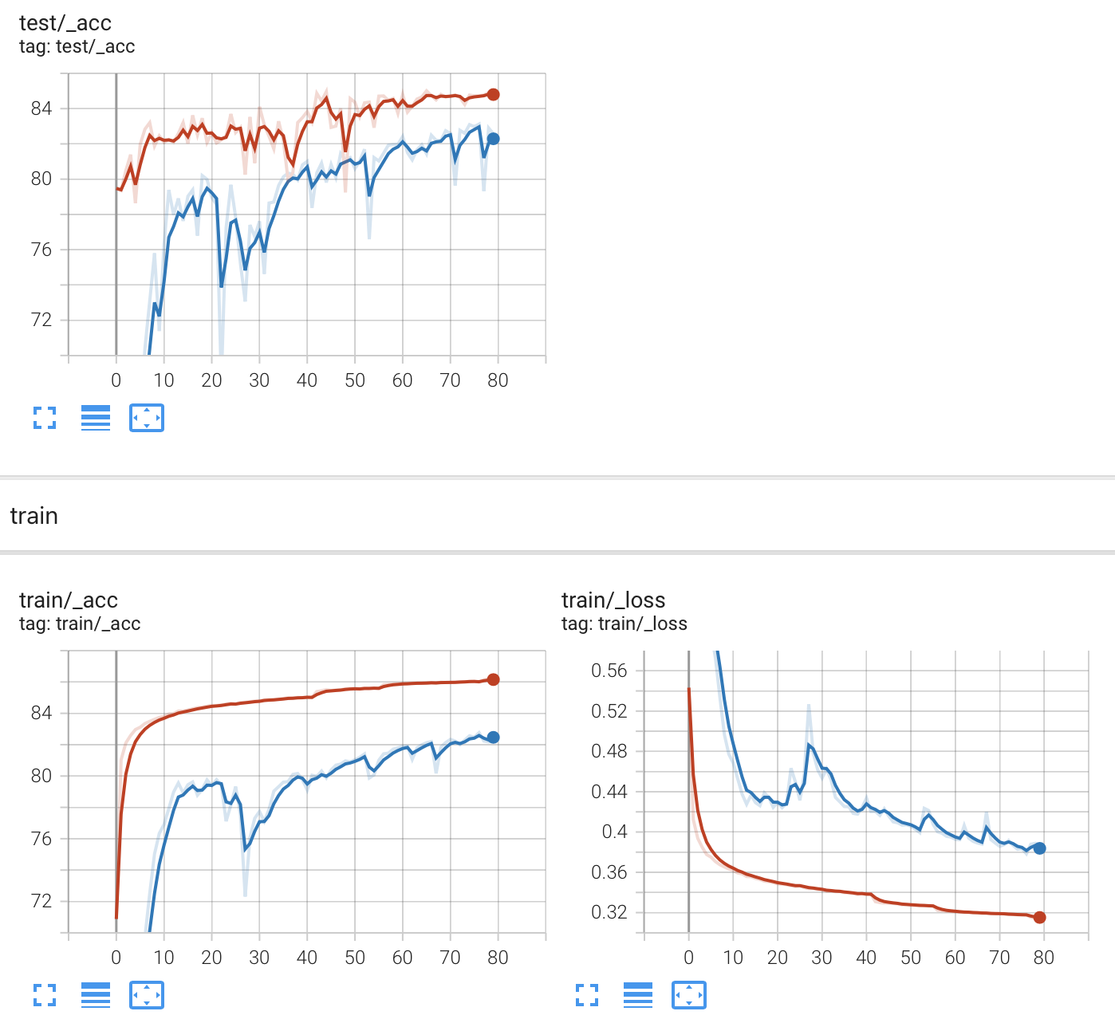
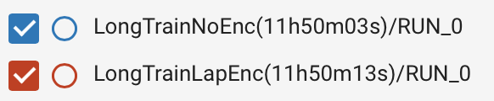
1-a\ Performance – With or without embedding ?
Much faster and precise training with the embedding.
The gap is smaller and smaller with training
About 20% accuracy gap for the first epoch.

Slide 5
1-b\ Performance – Exponential factors
Exponential: give more weight to smaller eigenvalues :
Absolute value: increase sign symetry:

Slide 6
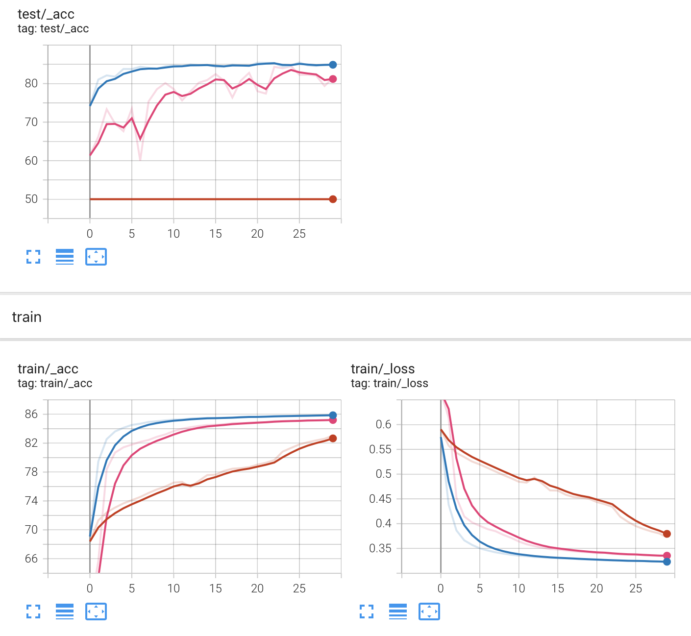
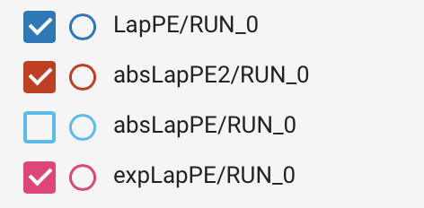
1-b\ Performance - Exponential factors
Results:

Slide 7
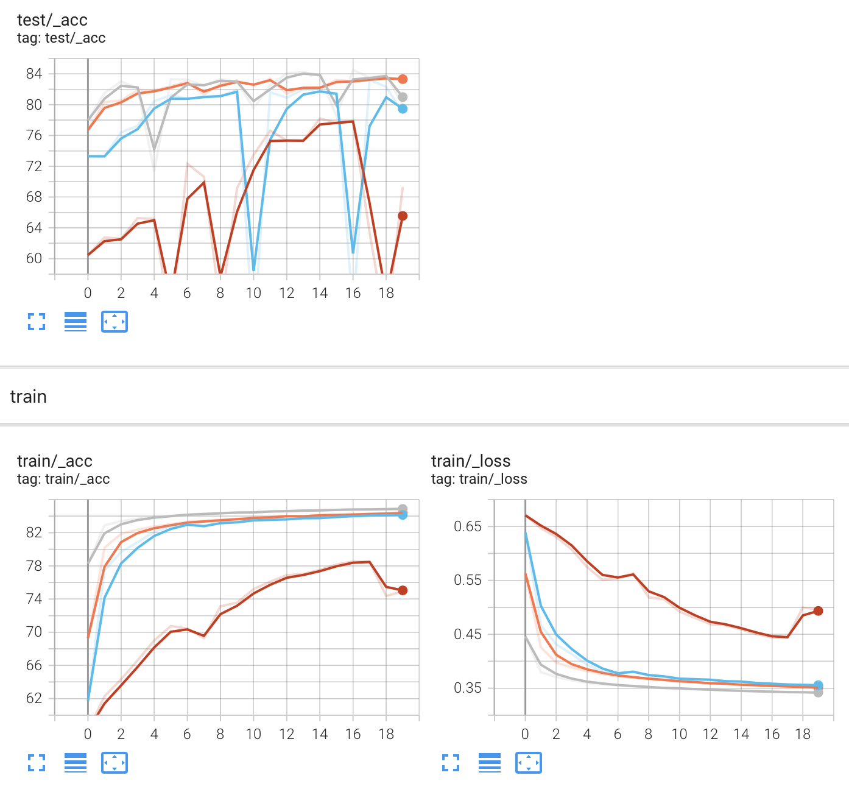
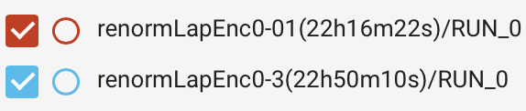

1-c\ Performance - Homothety
Homothety :
In theory: no change due to the neural network
In practice: difference since the signal is harder for the network to pick up information

Slide 8
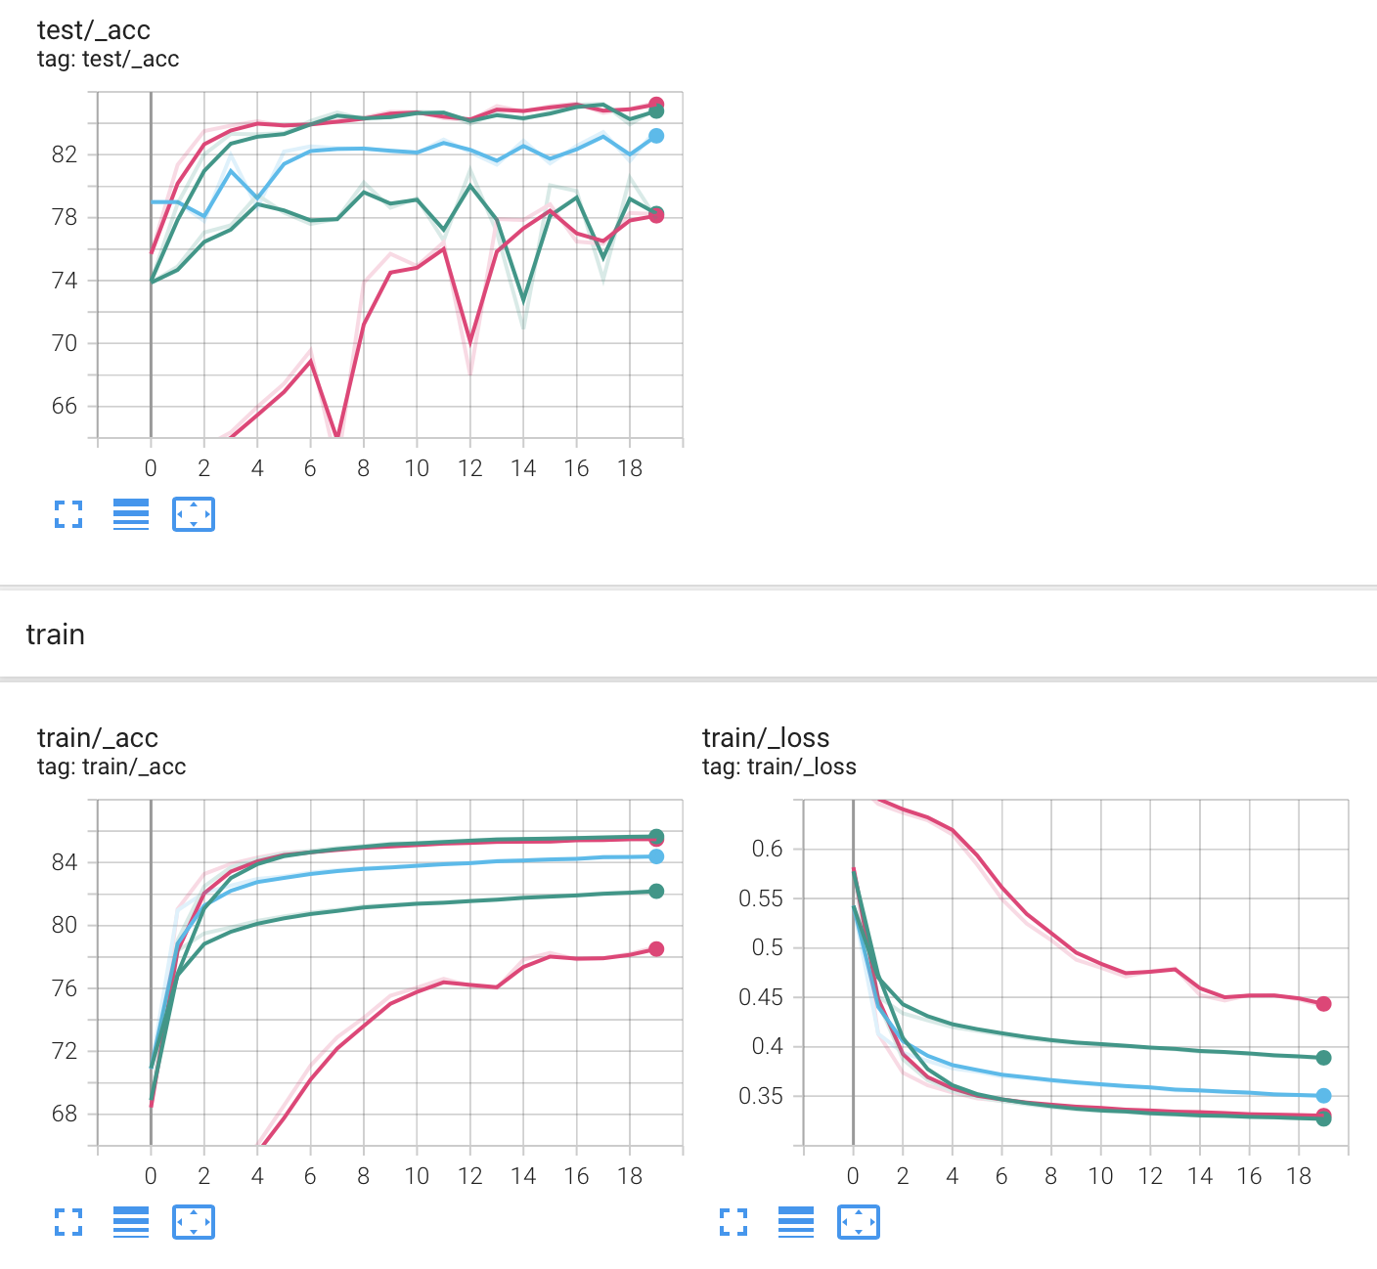

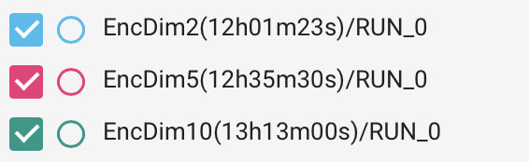
1-d\ Performance - Dimension
The code of the paper uses the k=2 smallest eigenvalues of the Laplacian by default.
Better performances can be achieved with k=5 in the long run. Few changes for k>5.

Slide 9
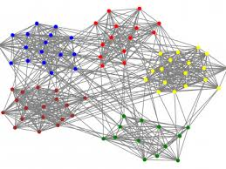
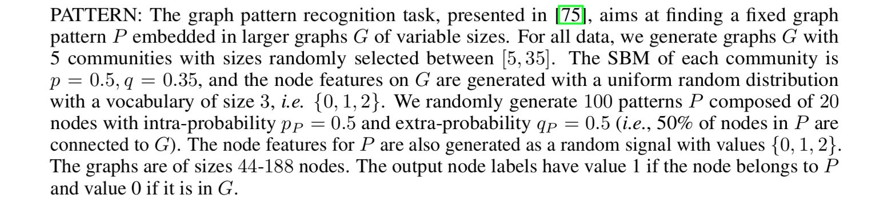
2-a\ Stability: the PATTERN dataset
5 communities are generated with the same probabilities for each block
We add a 6th community with a different extra-link probability
Communities’ average size is 20
The goal is to classify the dataset and find which individuals belong to the 6th community

Slide 10


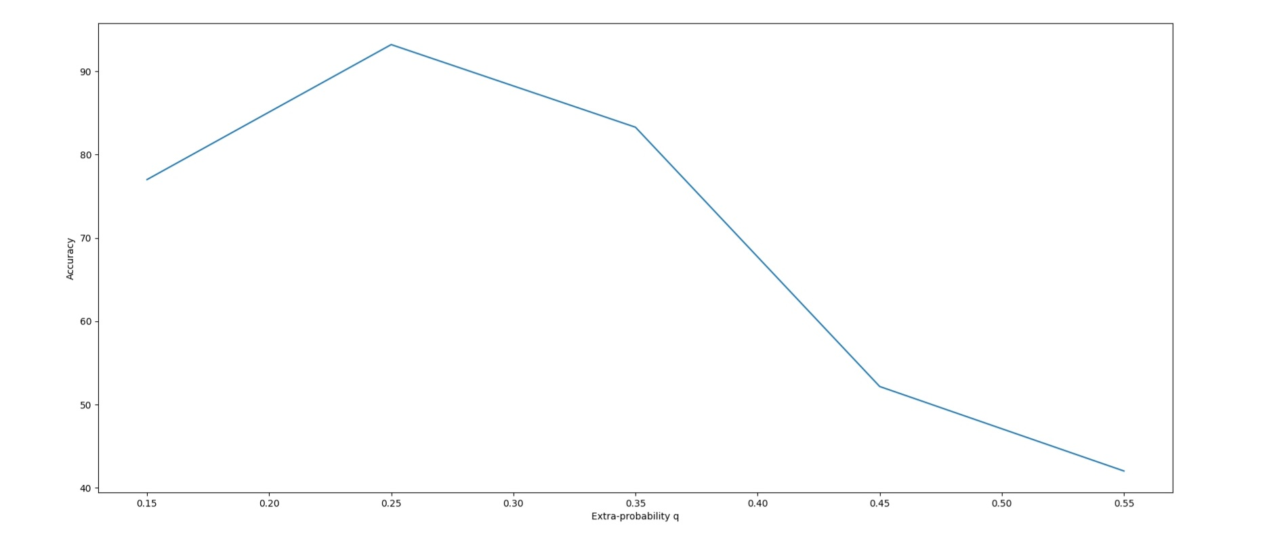
2-b\ Stabilité : faire varier q
When , it’s easier at first to find the different community
However, when is big, the model starts to lose accuracy.
The 20 epochs model seems to generalize better than the 80 epochs one.
Extra-link probability q | Model 20 epochs | Model 80 epochs
0.15 | 77.0046 | 69.1981
0.25 | 93.2172 | 92.2461
0.35 (original model) | 83.2934 | 84.7762
0.45 | 52.1648 | 51.5637
0.55 | 42.0210 | 41.8587

Slide 11
2-c\ Stability: size of the dataset
As we could expect, the bigger the graph, the harder it is for the model
The 20 epochs model seems to generalize better than the 80 epochs one
Community sizes | Model 20 epochs | Model 80 epochs
Uniform between 5 and 35 | 83.2934 | 84.7762
Uniform between 35 and 65 | 68.4562 | 65.9456
Uniform between 65 and 95 | 39.8145 | 33.6427

Slide 12
Thank you !

