Slide 1
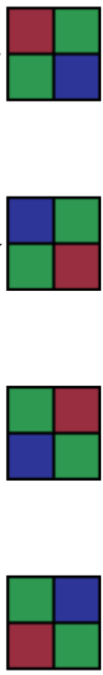
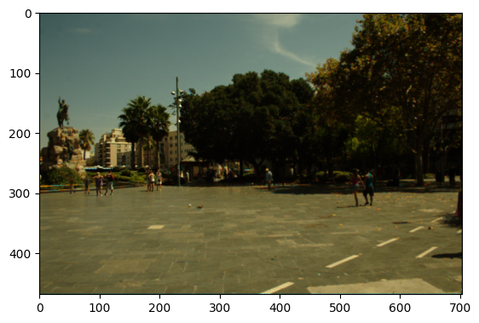
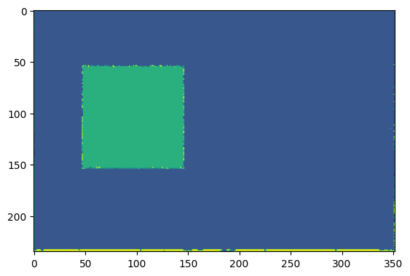

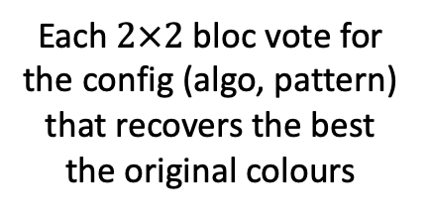


$×$3 algorithms
$×$3 algorithms
Forgery detection
$×$3 algorithms
Image
$×$3 algorithms
Each $2×2$ bloc vote for the config (algo, pattern) that recovers the best the original colours
CFA-Bayer mosaicing and then demosaicing with 12 configs (algo, pattern)

Slide 2
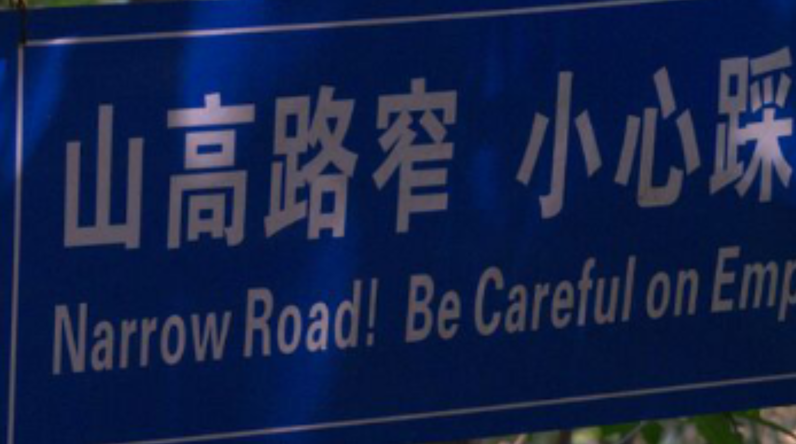
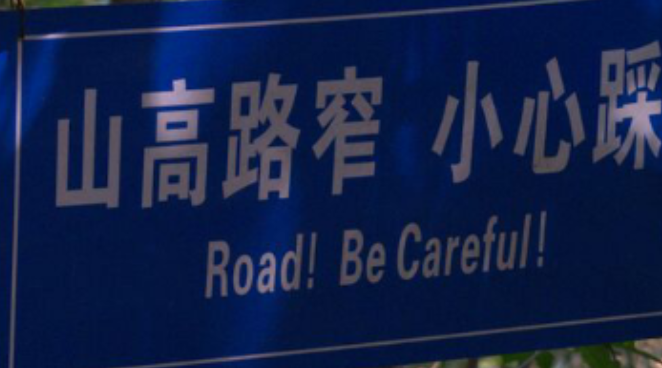

Original Image
Fake image
Detection

