Slide 1
🩺 dataDoctor
Data Quality Intelligence Report
Dataset: sample_sales | Score: 90.6/100 | Grade: A | 2026-04-26
Notes:
Welcome to the dataDoctor Data Quality Report. This presentation covers the quality analysis of sample_sales.

Slide 2
Agenda
1. Overall Quality Score
2. Dimension Breakdown
3. Key Issues
4. Recommendations
5. Missing Values Analysis
6. Distributions
7. Dataset Statistics
8. Summary
dataDoctor | 2026-04-26
Notes:
Overview of today's presentation.

Slide 3
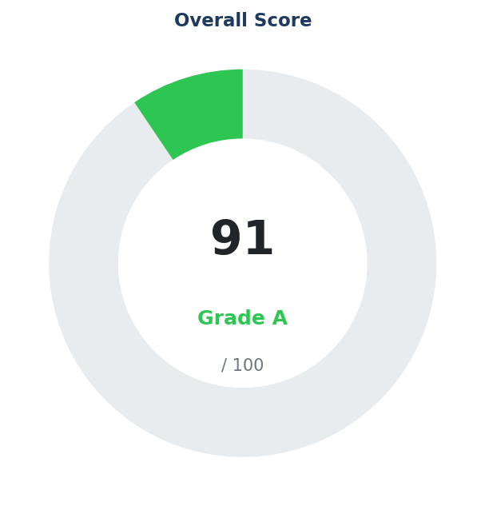
Overall Quality Score
Grade: Excellent 🟢
🟢 Healthy
Rows: 15 | Columns: 8 | Numeric: 4
Total Issues Found: 6
dataDoctor | 2026-04-26
Notes:
Score: 90.6/100, Grade: A

Slide 4
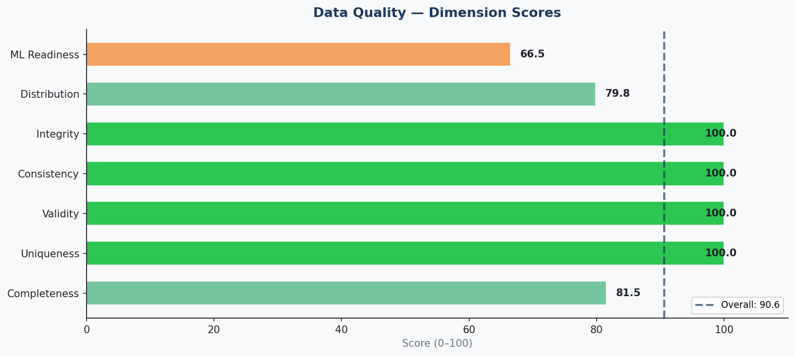
Quality Dimension Scores
dataDoctor | 2026-04-26
Notes:
Each bar shows the score for one dimension.

Slide 5
Dimension Score Summary
Dimension | Score /100 | Weight | Status | Issues
Completeness | 81.5 | 22% | 🟡 Good | 1
Uniqueness | 100.0 | 15% | ✅ Excellent | 0
Validity | 100.0 | 18% | ✅ Excellent | 0
Consistency | 100.0 | 15% | ✅ Excellent | 0
Integrity | 100.0 | 10% | ✅ Excellent | 0
Distribution | 79.8 | 10% | 🟡 Good | 4
ML Readiness | 66.5 | 10% | 🟠 Fair | 1
dataDoctor | 2026-04-26

Slide 6
Top Issues Identified
• 4 column(s) with minor missing values (<10%)
• 'quantity': moderate skewness (2.61)
• 'total': moderate skewness (1.51)
• 'quantity': 14.3% outlier rate (IQR)
• 'total': 20.0% outlier rate (IQR)
• Only 15 rows — ML models need ≥100
dataDoctor | 2026-04-26

Slide 7
Recommendations
1. ✅ Dataset quality is excellent. Ready for analysis and ML.
2. 🤖 ML: Only 15 rows — ML models need ≥100
3. 🟡 Apply log/sqrt transform: 'quantity': moderate skewness (2.61)
4. 🟡 Apply log/sqrt transform: 'total': moderate skewness (1.51)
5. 🟡 Handle outliers: 'quantity': 14.3% outlier rate (IQR)
6. 🟡 Handle outliers: 'total': 20.0% outlier rate (IQR)
dataDoctor | 2026-04-26

Slide 8
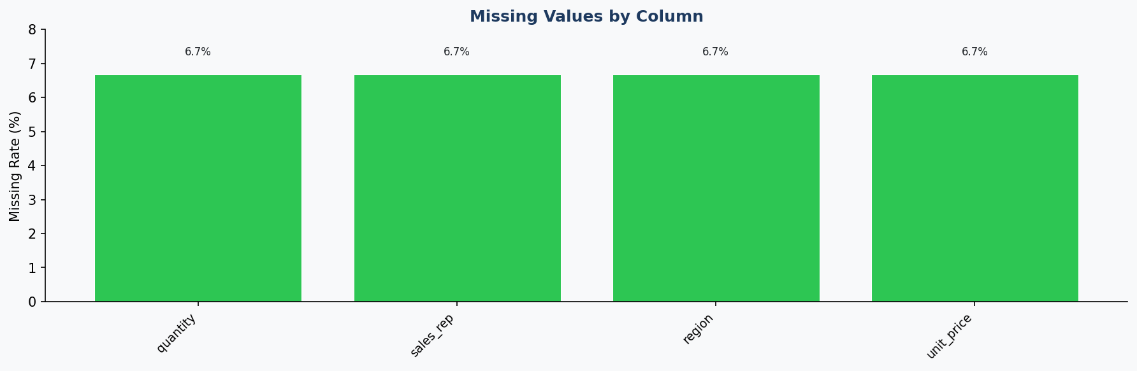
Missing Values Analysis
dataDoctor | 2026-04-26

Slide 9
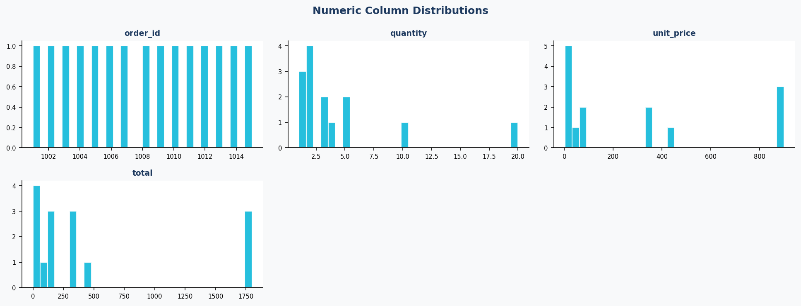
Numeric Distributions
dataDoctor | 2026-04-26

Slide 10
Dataset Statistics
Rows: 15
Overall Null Rate: 3.33%
Columns: 8
Duplicate Rows: 0
Numeric Columns: 4
Memory (MB): 0.002
Null Cells: 4
dataDoctor | 2026-04-26

Slide 11
Next Steps & Summary
1. Address critical issues (🔴) before deploying the dataset
2. Impute or remove missing values in key columns
3. Anonymize any detected PII columns
4. Re-run dataDoctor after cleaning to verify improvement
5. Export cleaned pipeline via CLI: python cli.py pipeline <file>
🩺 dataDoctor — github.com/Denterio1/dataDoctor
dataDoctor | 2026-04-26

