Slide 1
Bug Tracking System
Group ID: WFS3_PUN_Team 1
Arpit Sagar (Team Leader) (45393742)
Gautam Khaire (45393748)
Pankaj Kumar (45393344)
Niharika Harmalkar (45393428)
Aayush Ranjan (45393340)
Abhijeet Bahuguna (45393528)
Abhisek Singh (45393491)
Naveen Datti (45394141)
Anushka Agarwal (45393574)

Slide 2
Problem Statement
The project is an online bug tracking system for projects. The application allows software testers to report bugs for a project, project managers to view all bugs, assign bugs to developers and developers to update the bug status.

Slide 3
Application Features
Project Management:
Create New Projects: Project Managers can create and manage projects with
automatic unique ID generation.
Team Assignment: Project Managers can assign team members to projects,
with constraints on how many projects a user can be assigned.
Project Overview: Detailed view of project information, including project
name, start date, status, and assigned team members.
Project Status Tracking: Projects can have statuses like "In Progress", “Closed”
and “Open" helps to monitor project progress.

Slide 4
Application Features
Bug Reporting & Management:
Bug Reporting: Testers can report bugs against projects they are assigned to,
capturing critical details like severity, title, and description.
Bug Assignment: Project Managers can assign reported bugs to developers for
resolution.
Bug Status Tracking: Track the lifecycle of a bug from "Open" to "Closed," with updates
as developers work on resolving issues.
Severity Levels: Bugs can be categorized by severity (Low, Medium, High, Critical), impacting their priority and resolution timelines.

Slide 5
Application Features
Dashboard & User Interface:
Personalized Dashboards: Separate dashboards for Project Managers, Developers, and
Testers with relevant project and bug information.
Project Manager Dashboard: Overview of all managed projects, team members, and bug
status with options to create new projects.
Tester Dashboard: Display of assigned projects and bugs reported by the tester, with the ability to report new bugs.
Developer Dashboard: Display of assigned projects and bugs, with the ability to mark bugs as resolved or closed.

Slide 6
Frontend Website Components
Login/ Signup Page - Registration for new users, or log into existing account for existing users
Bug Tracking Page – Create a new project, display a list of all projects and their details, Raise a new bug, Role-based (Project Manager, Developer, Tester) page layouts
New Project Form - Create a new project having a Project name, Start Date at least 2 days later than the current date, Project status as “In Progress”, Developers assignment, etc.
Report New Bug Form – Report a new bug with a project name, description, severity level, title, etc.

Slide 7
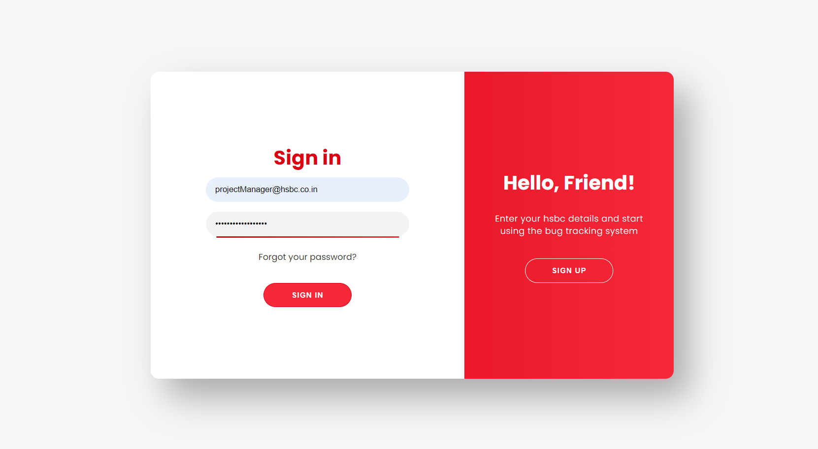
UI Snapshots
Sign in Page

Slide 8
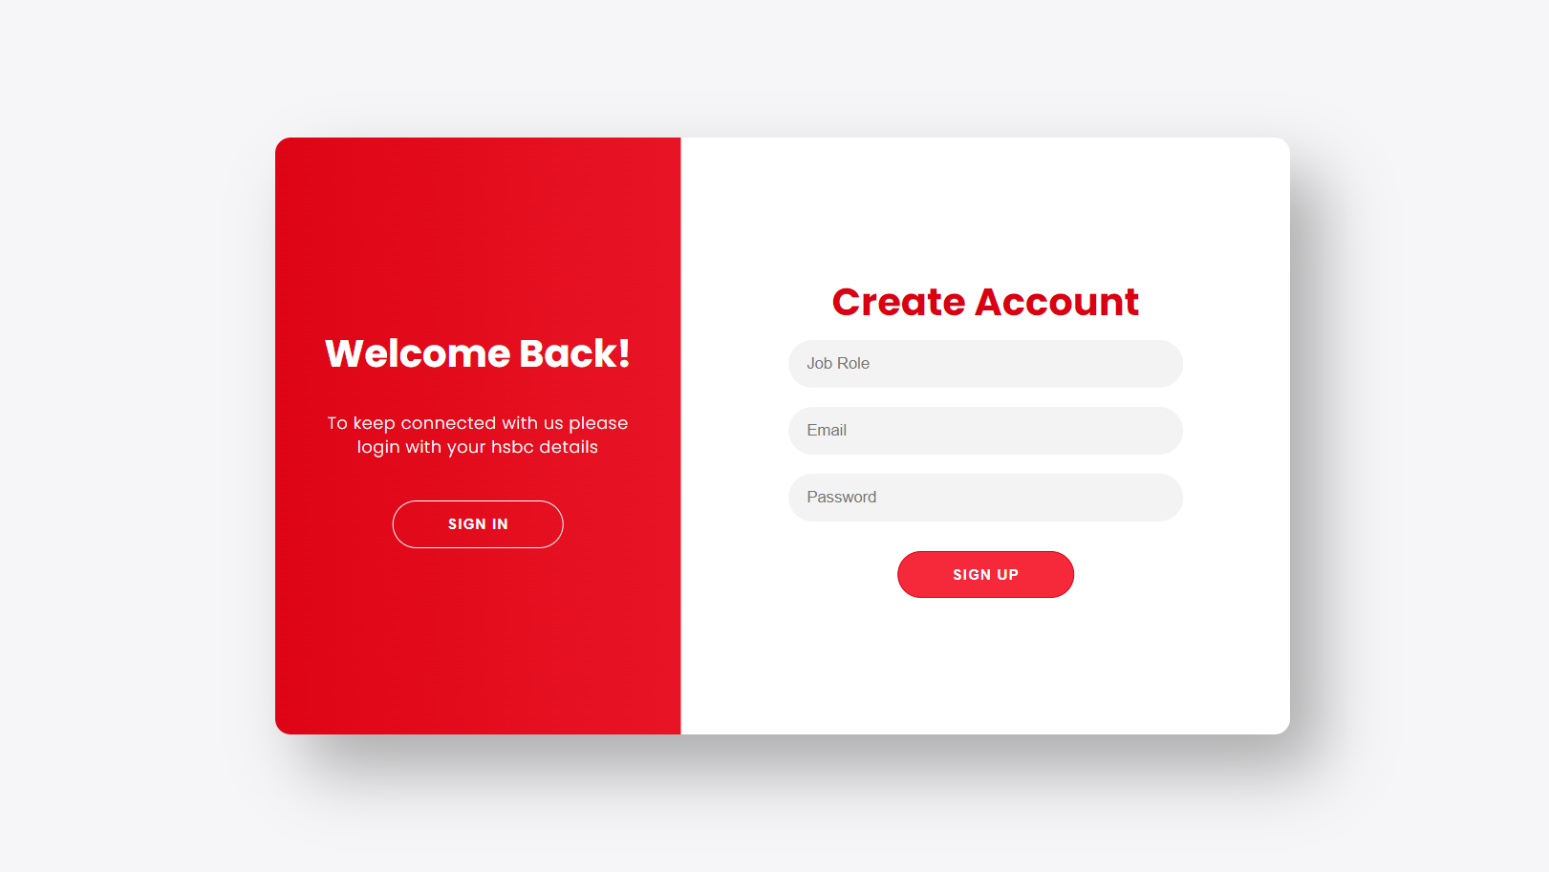
UI Snapshots
Sign up Page

Slide 9
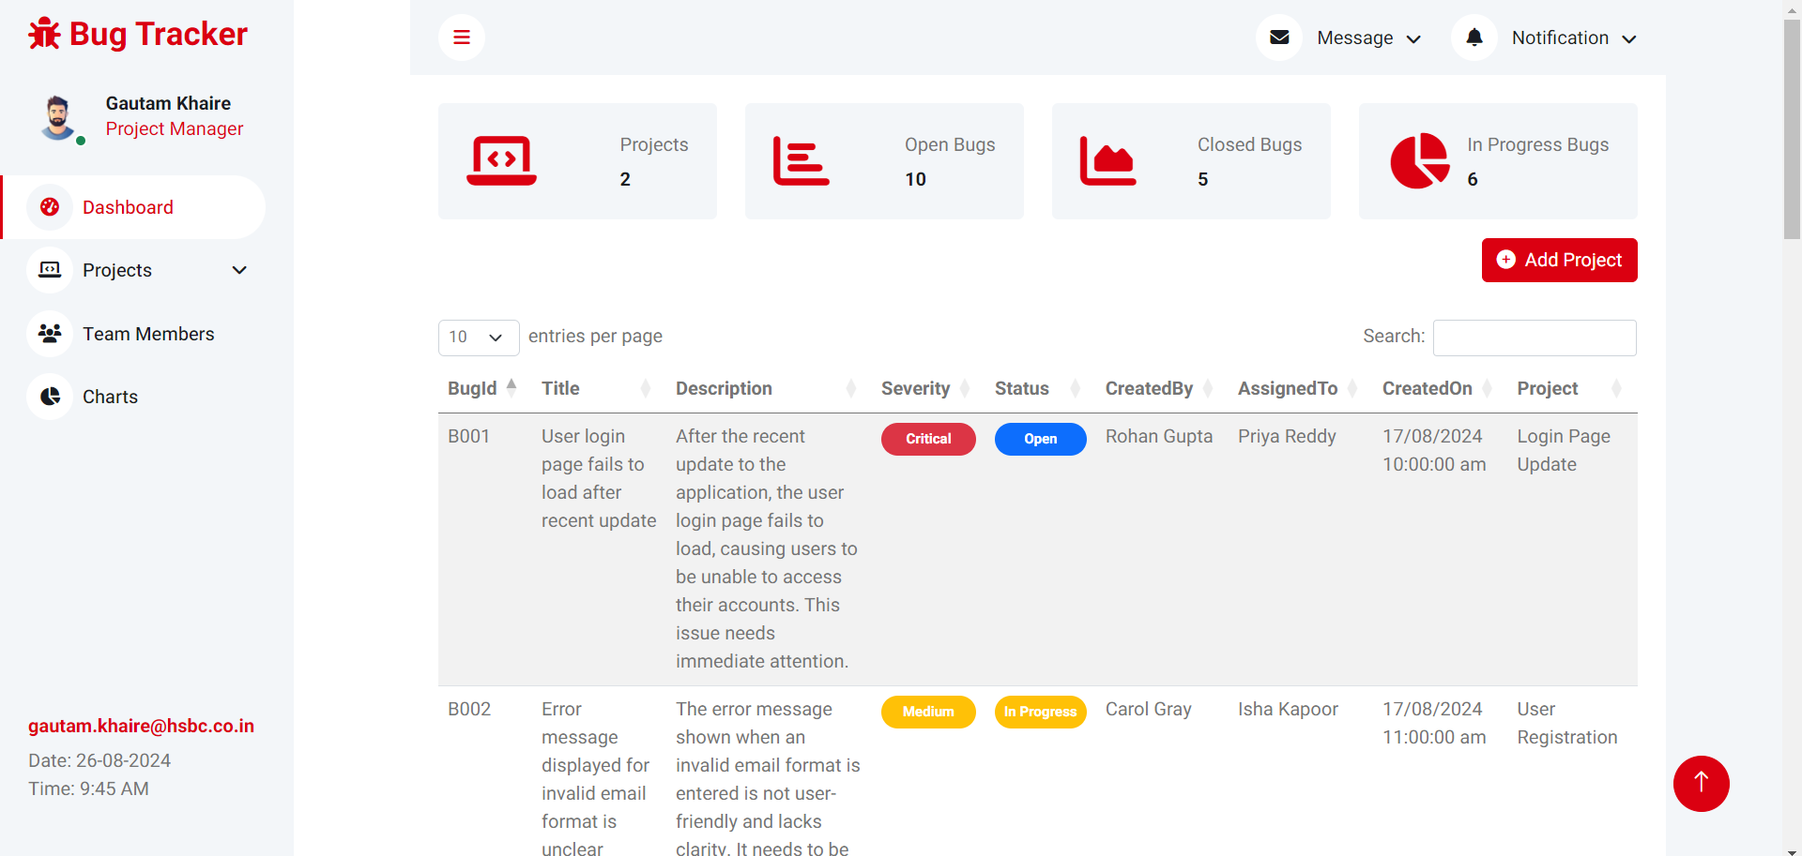
UI Snapshots
Bug Tracking Page

Slide 10
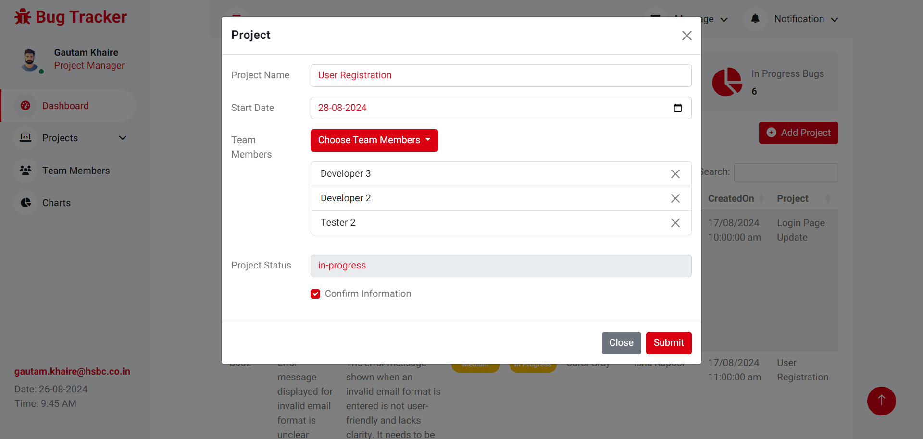
UI Snapshots
New Project Form

Slide 11
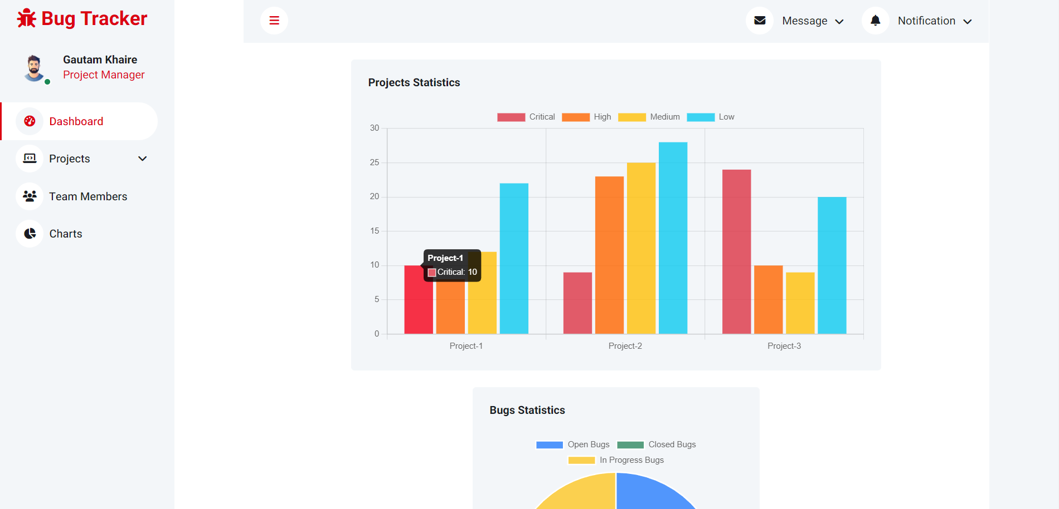
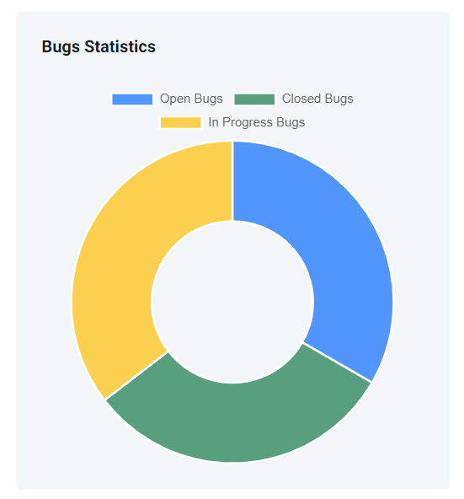
UI Snapshots
Charts
(for better visualization of bugs)

Slide 12
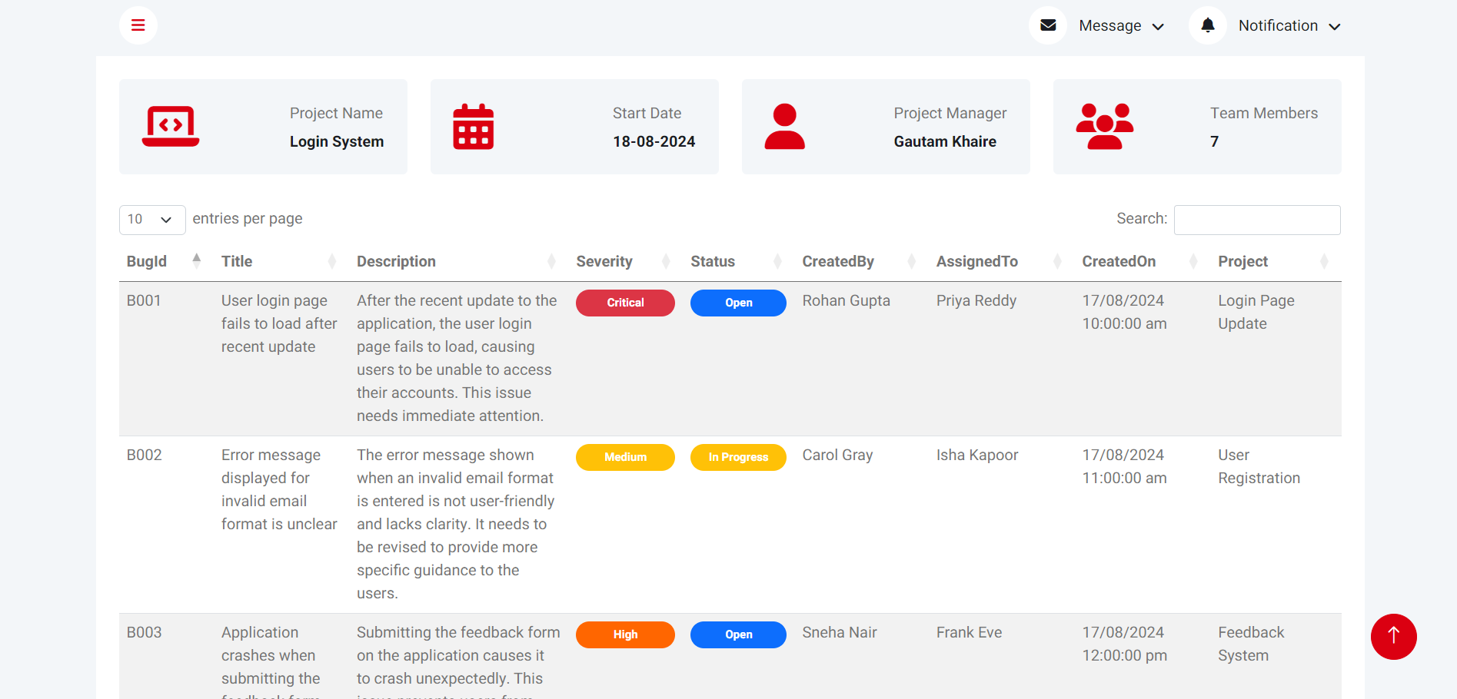
UI Snapshots
Individual Project Details Page

Slide 13
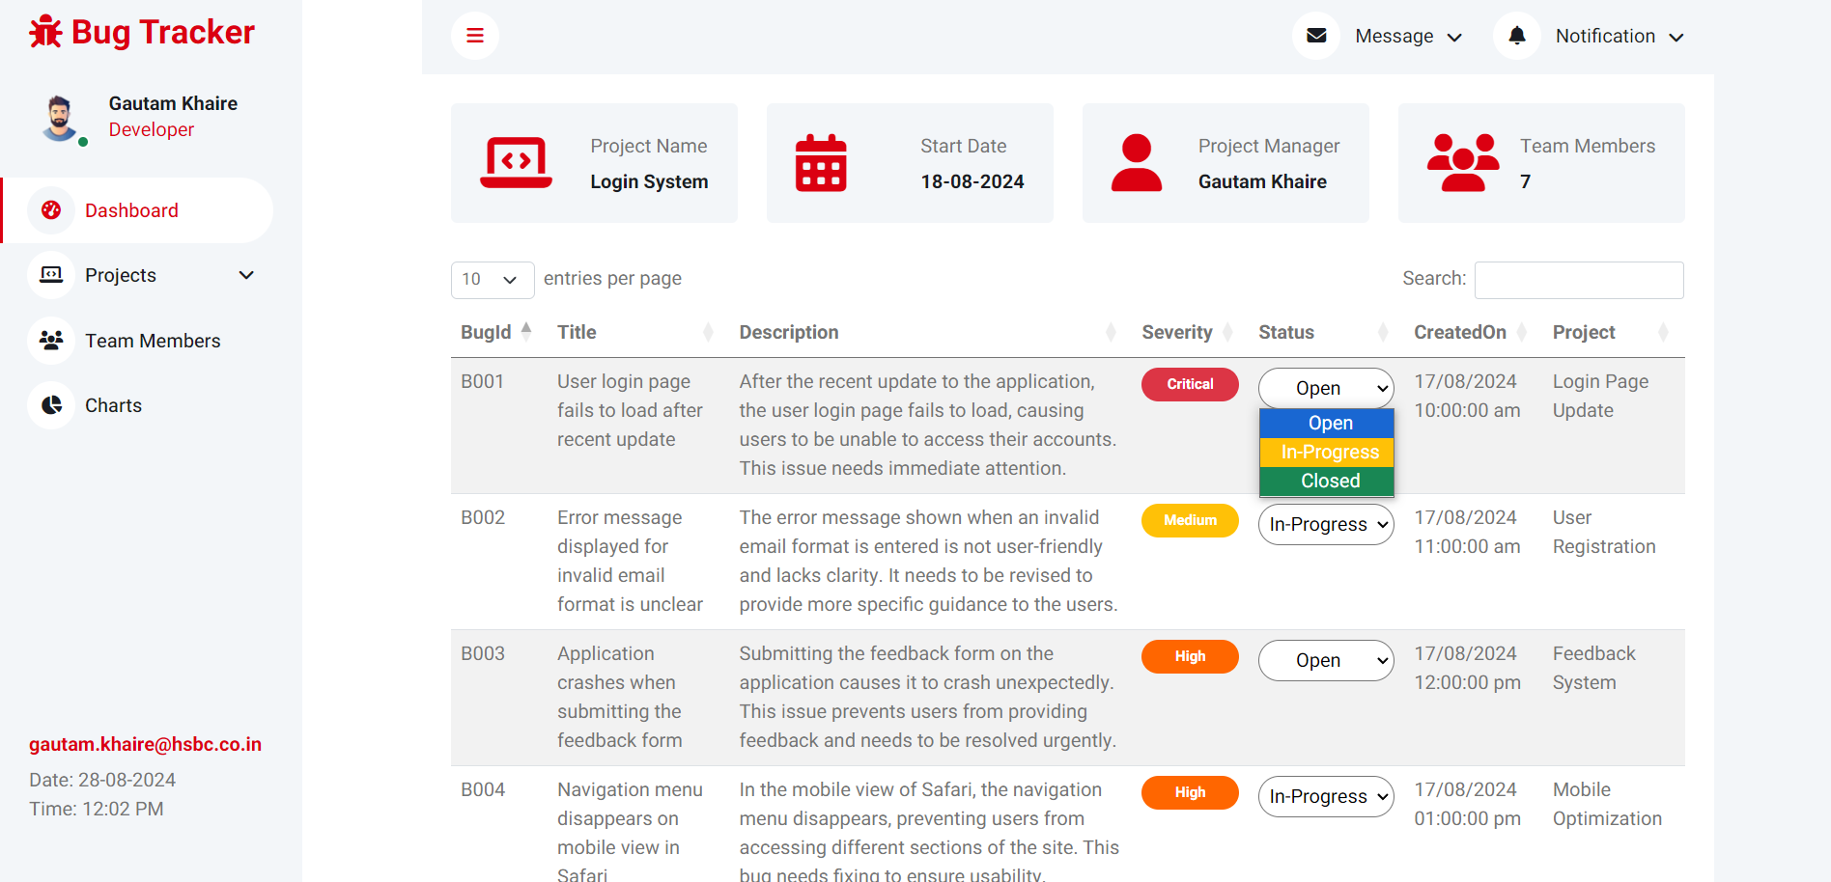
UI Snapshots
Developer
Bug Tracking Page

Slide 14
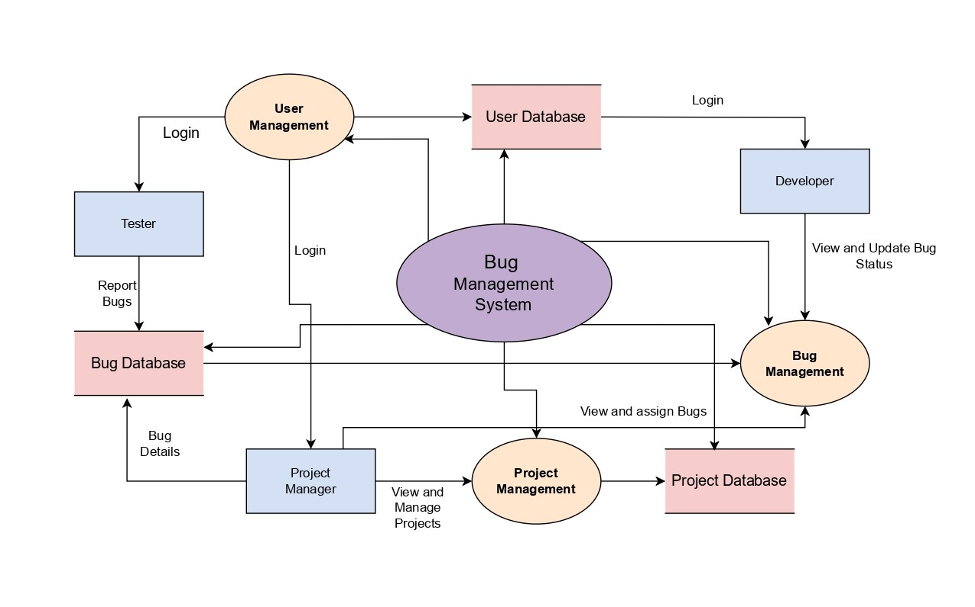
UML Diagrams
Data Flow Diagram (DFD)

Slide 15
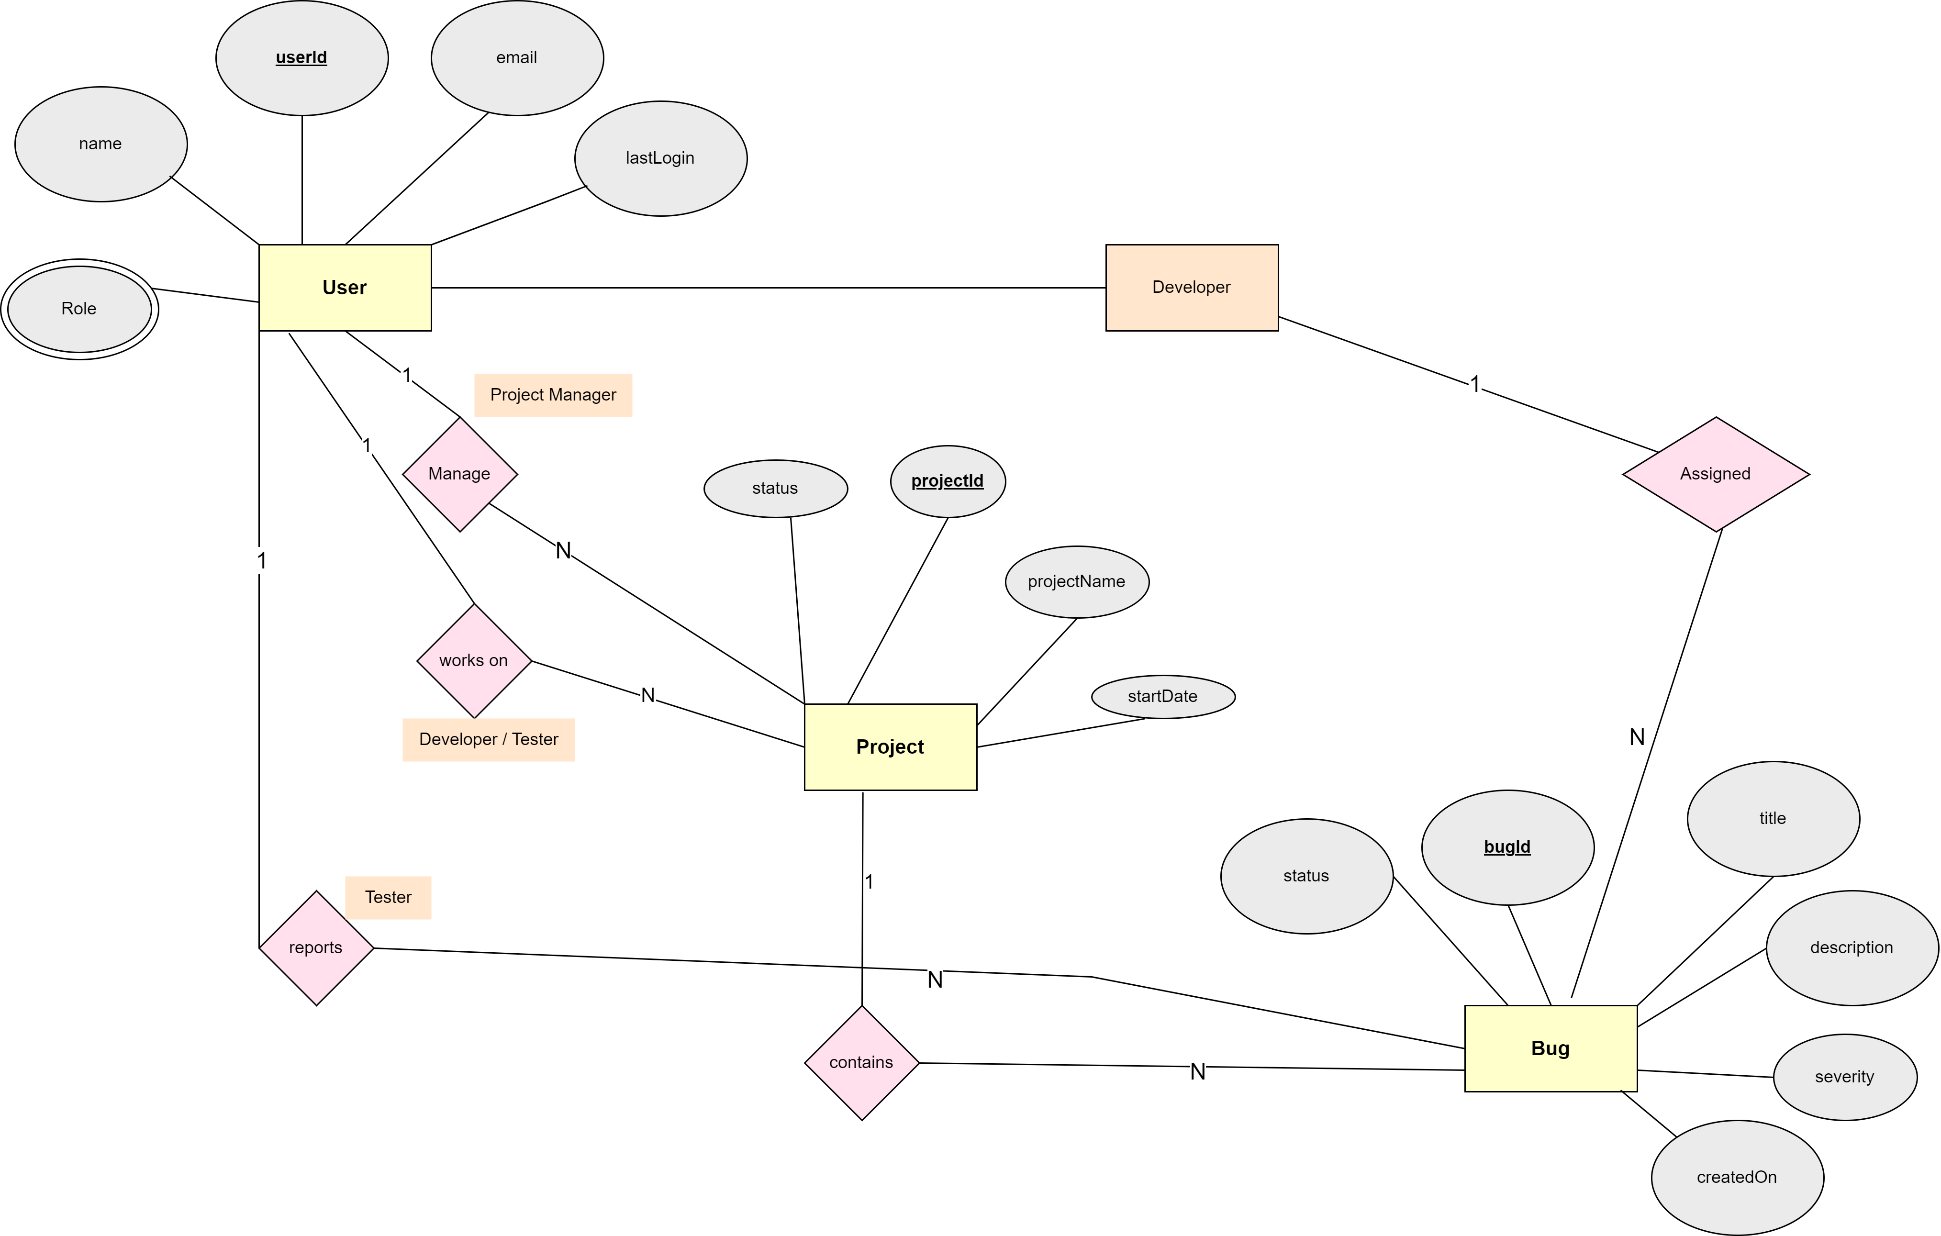
UML Diagrams
ER Diagram

Slide 16
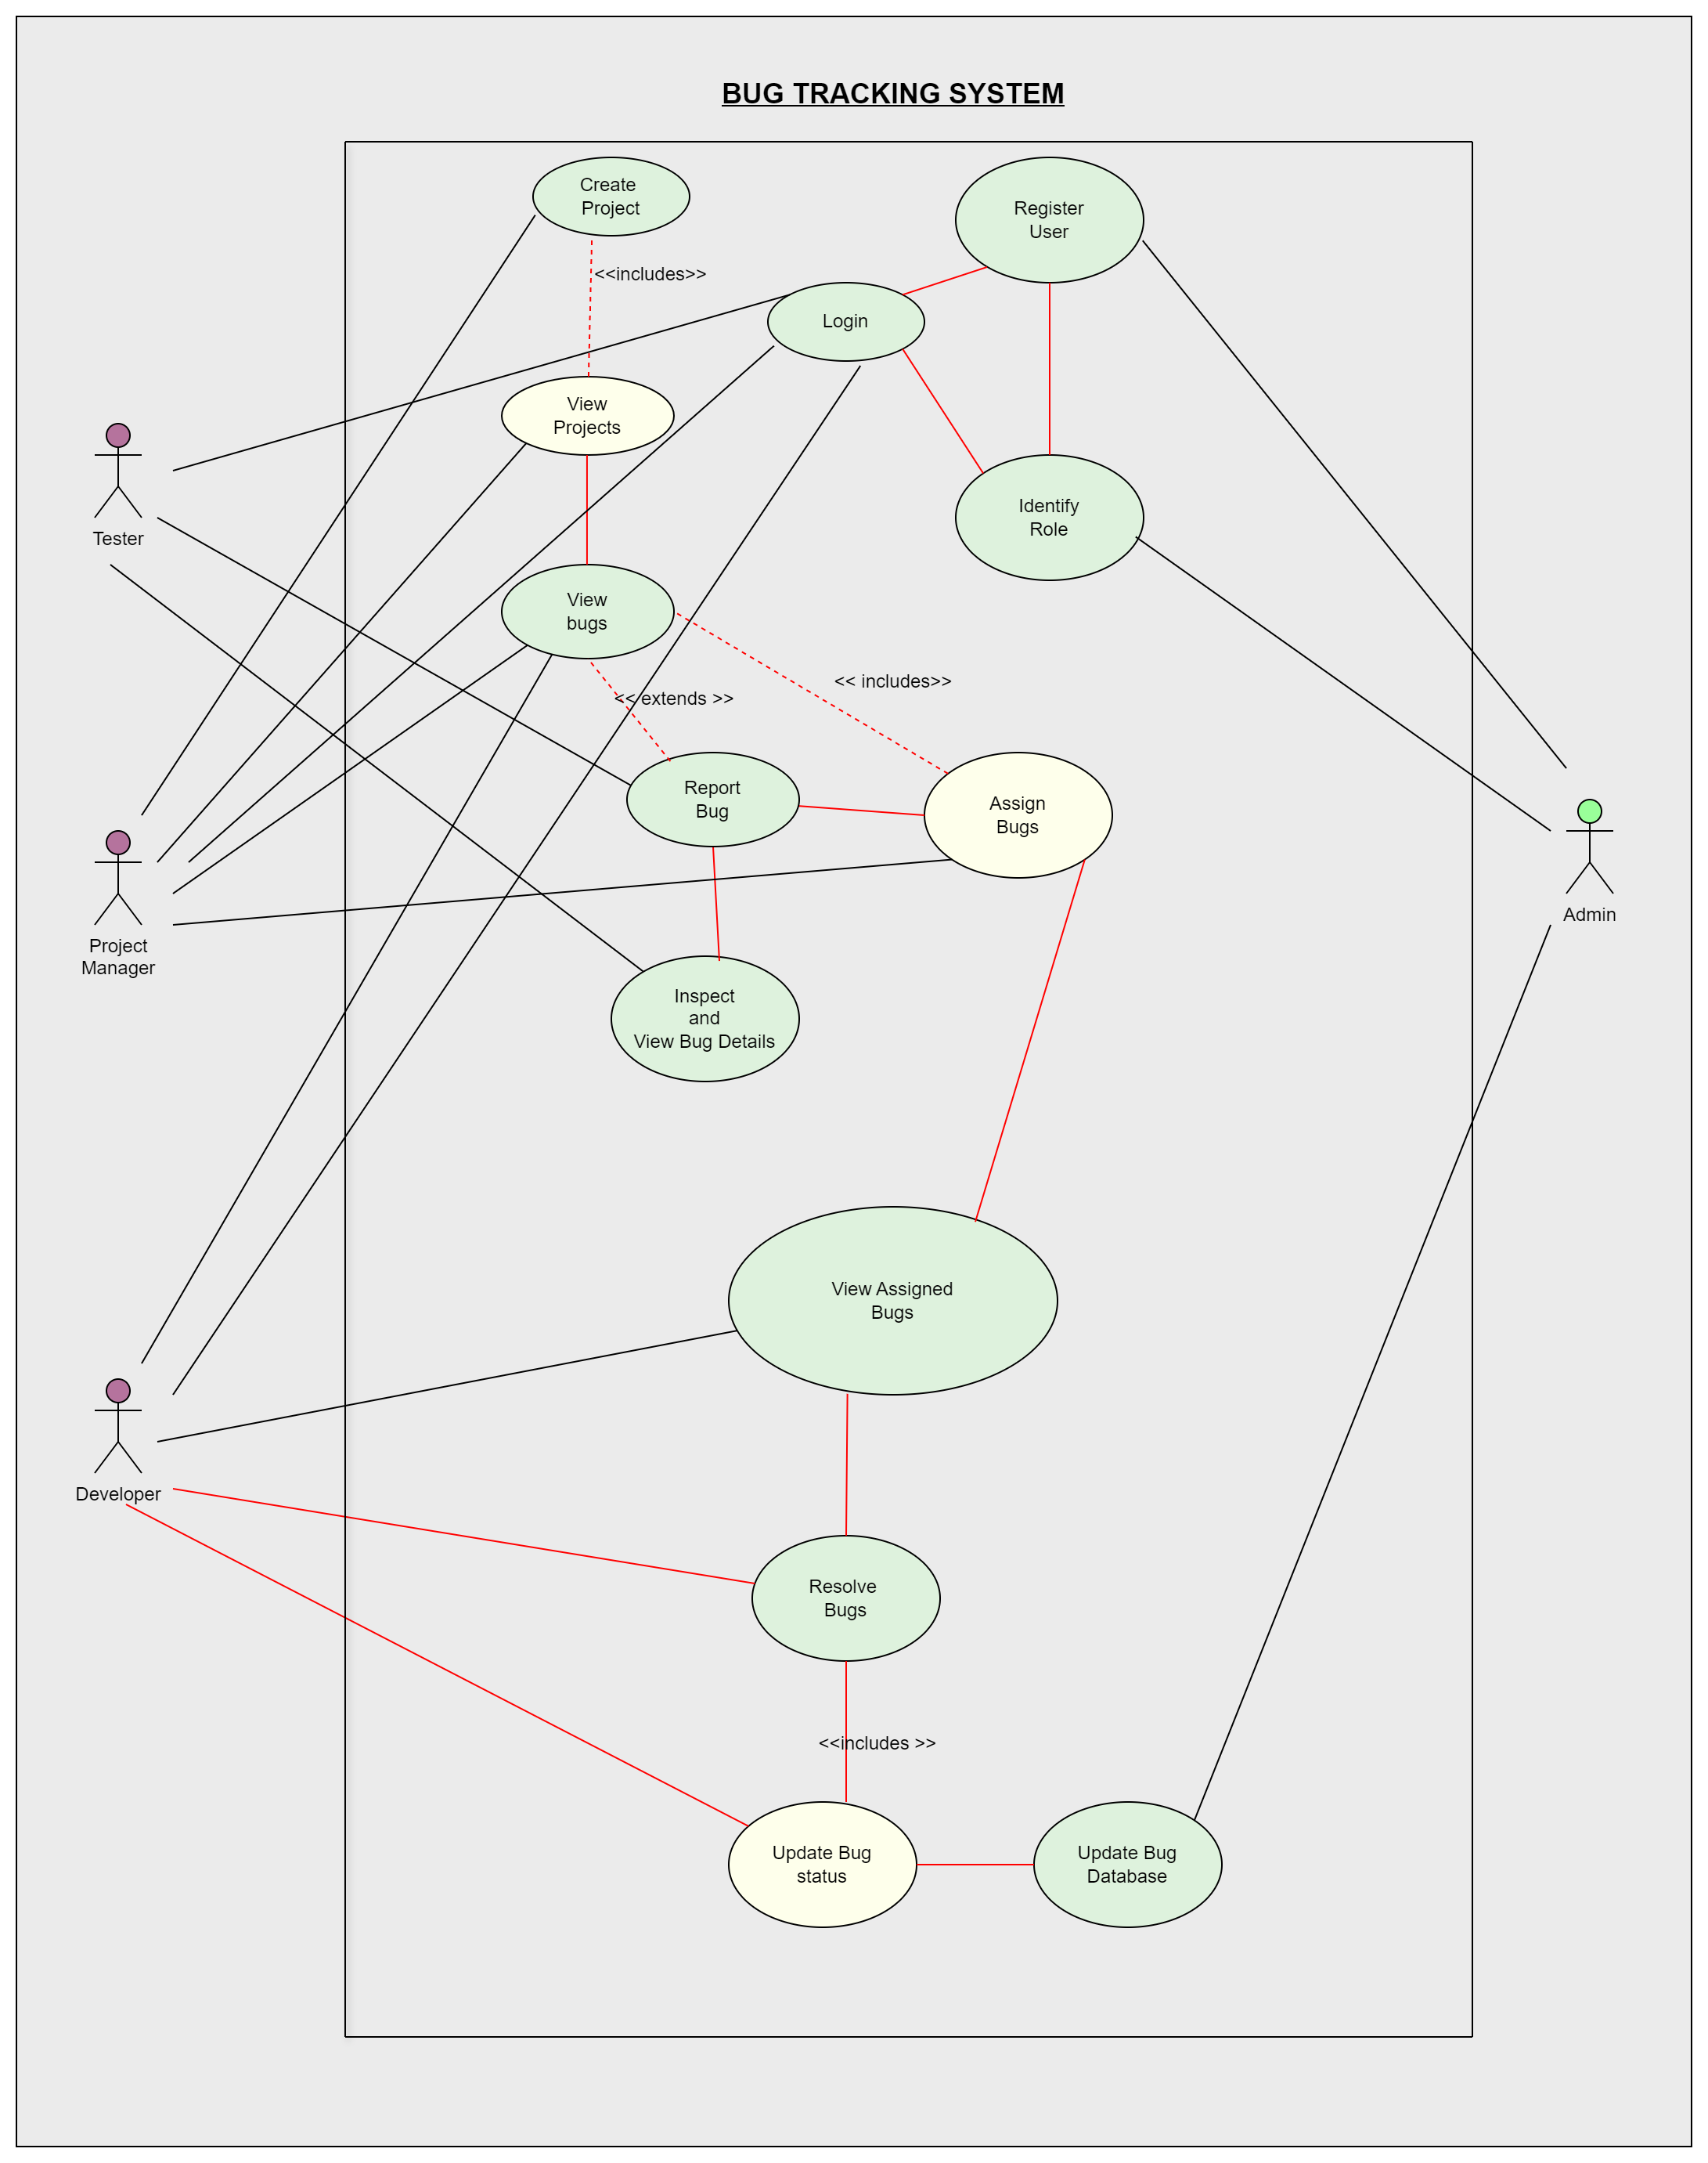
UML Diagrams
Use Case Diagram

Slide 17
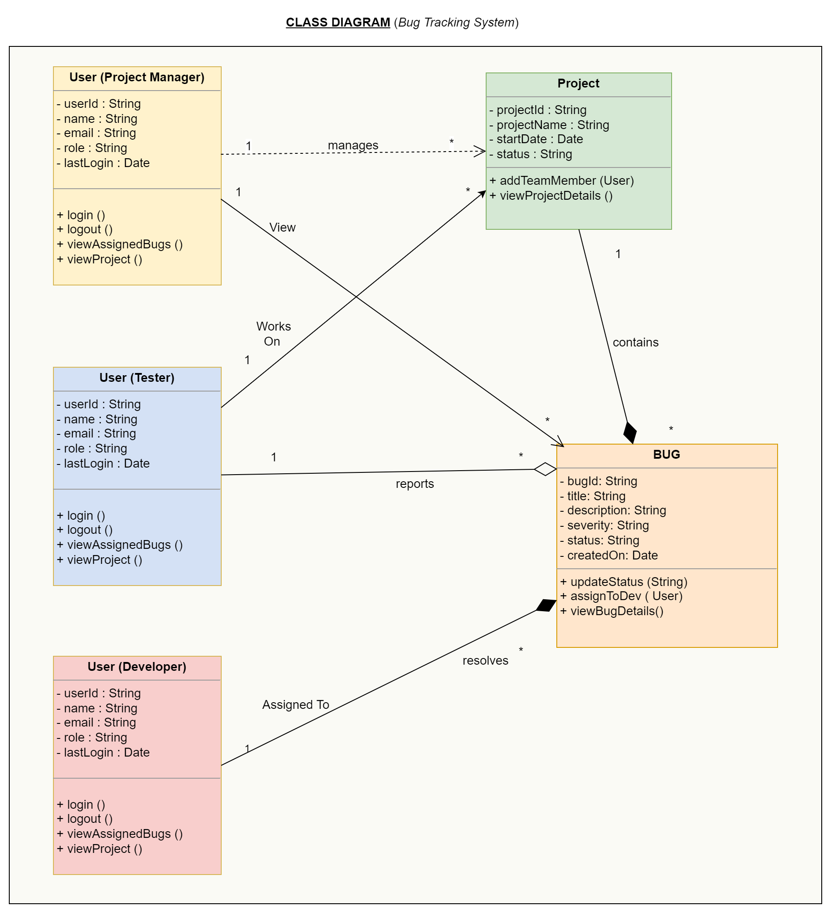
UML Diagrams
Class Diagram

Slide 18
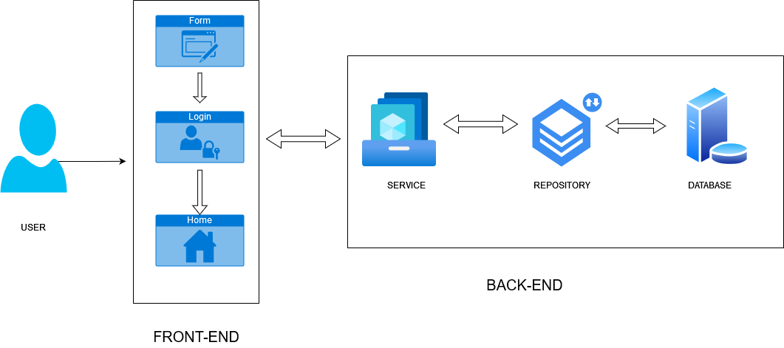
Application Workflow

Slide 19
Implementation Details
Project Management (addProject, updateProject, deleteProject):
These methods handle core business operations related to managing projects within the bug tracking system.
addProject and updateProject methods ensure that the system maintains accurate and up-to-date project data.
deleteProject is crucial for maintaining data integrity, ensuring that projects can be safely removed while handling cases where the project does not exist, which is managed by throwing a ProjectNotFoundException.

Slide 20
Implementation Details
Bug Management (addBug, updateBug, deleteBug, assignBug):
The methods for managing bugs, such as addBug and updateBug, represent essential business logic to maintain a current record of all issues within projects. assignBug involves business logic to ensure that the right users (like developers or testers) are assigned to resolve specific bugs, directly impacting workflow and resource management.
Handling the deletion of bugs with deleteBug involves validation to ensure the bug exists, throwing a BugNotFoundException if it does not.

Slide 21
Implementation Details
User Management (addUser, updateUser, deleteUser):
User management methods are central to maintaining a secure and functional system where users (project managers, testers, developers) can perform their roles.
addUser ensures that new users are only added if they do not already exist, handling conflicts through a UserAlreadyExistsException.
deleteUser includes logic to ensure that users who are referenced in other parts of the system (like assigned bugs) are handled correctly, preventing potential data corruption or orphaned records by throwing UserNotFoundException when necessary.

Slide 22
Thank
You!

