Slide 1
Oncology Bioinformatics Project_Denver
Denver Ncube

Slide 2
Objective
Use basic Deseq2 for biomarker discovery
Data visualization

Slide 3
The dataset used in this presentation is based on an actual study: "Kim SK, Kim SY, Kim JH, Roh SA, Cho DH et al. (2014) A nineteen gene-based risk score classifier predicts prognosis of colorectal cancer patients.
Notes:
As it can be seen the first 18 samples are primary tumors (colorectal cancer) and the next 19 are normal and then the rest are liver metastasis samples. For this tutorial we will use only the first 37, so primary tumor and normal samples.

Slide 4
Overview of analysis
Run DESEQ
Filter for High expression
Run GSEA

Slide 5
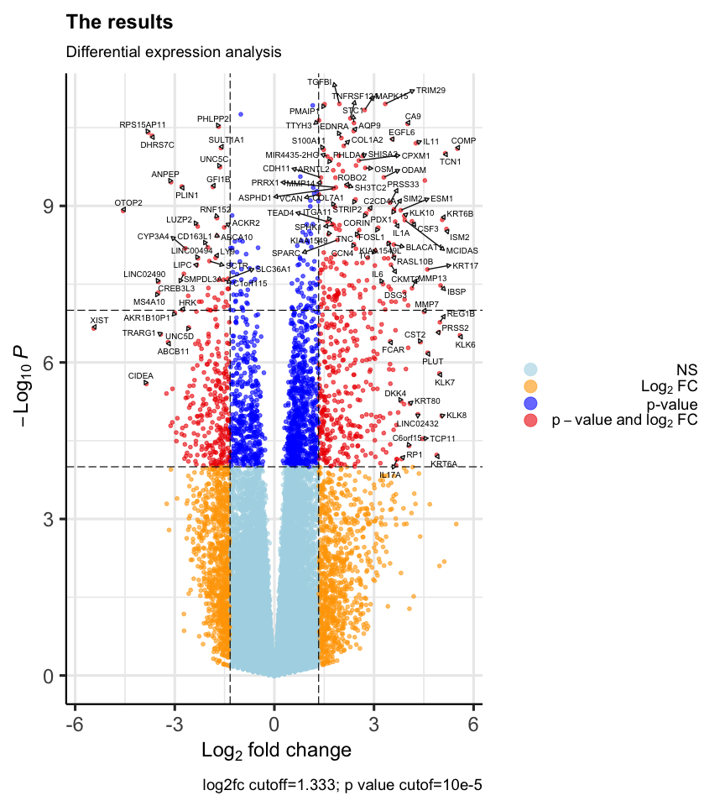
Notes:
out of 40166 with nonzero total read count adjusted p-value < 1e-06 LFC > 0 (up) : 121, 0.3% LFC < 0 (down) : 30, 0.075% outliers [1] : 0, 0% low counts [2] : 17491, 44% (mean count < 1) [1] see 'cooksCutoff' argument of ?results [2] see 'independentFiltering' argument of ?results

Slide 6
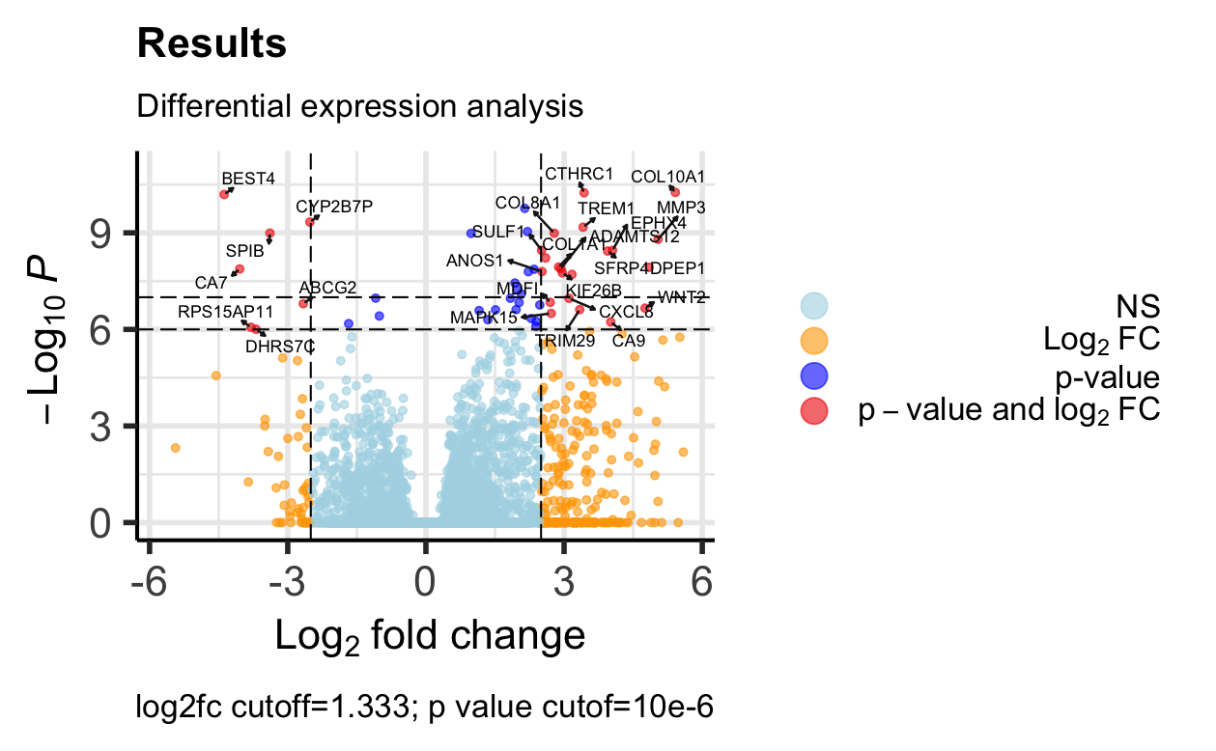

Slide 7
Overview of DESEQ result
Out of 40166 with nonzero total read count adjusted p-value < 1e-06
LFC > 0 (up) : 121, 0.3%
LFC < 0 (down) : 30, 0.075%

Slide 8
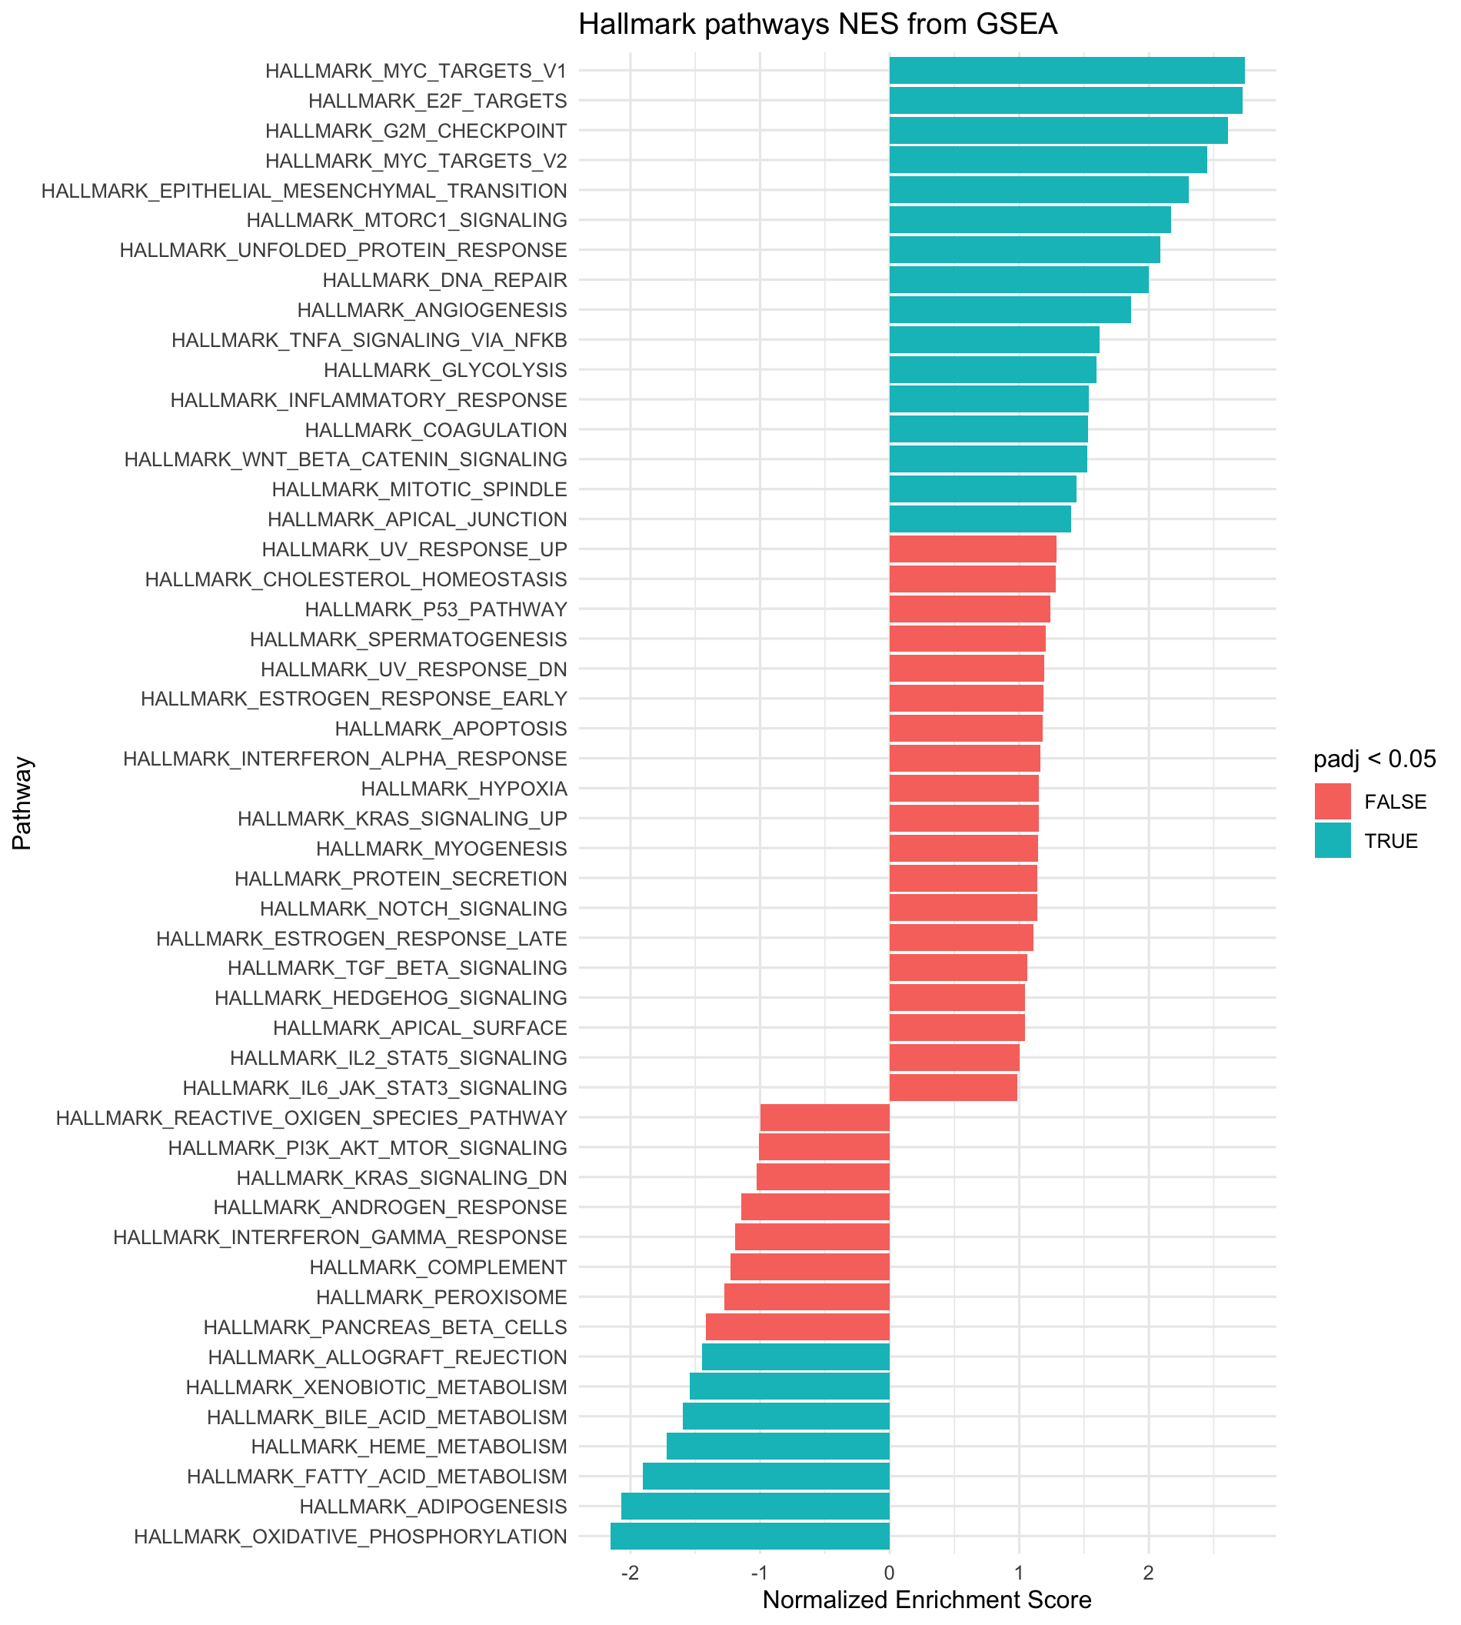
Gene Set Enrichment
Important pathways that are enriched
Myc
G2M checkpoint
EMT
DNA Repair
Angiogenesis
Wnt-B-catenin signalling
Important pathways that are NOT enriched
IL6-JAK-STAT3 pathway*
IL2-STAT5
KRAS-signalling
Complement pathway

Slide 9
Insights from GSEA + Next Steps
Final interpretation would be that the interesting genes were identified starting with COL11A1, CEMIP, ADAM12, MMP1, OTOP3.
Further experimental research would be needed to conclude if any of these are potential cancer treatment targets.
Whole Exome Seq plus variant curation

