Slide 1

TEACHERS’ COMMUNICATION STYLE AND
STUDENTS’ ACADEMIC ENGAGEMENT
ATIENZA, KOBE NEIL
GUTIERREZ,JONIETHEL
MARANAN, CHARLENE
SALAZAR, NICOLE

Slide 2

Introduction
This study aims to explore the communication style used by the faculty members of Batangas State University TNEU- Lipa and highlight its effects on the academic engagement of students based on the teachers’ perception.

Slide 3
Respondents of the Study
Respondents: Teaching personnel of Batangas State University
TNEU Lipa
Total Population: 200
Sample Size: 112 random teaching personnel
Sampling Method: Stratified Random Sampling

Slide 4
Research Method
Quantitative Research Method
Gathered Data needed through survey questionnaires
Used Stratified Random Sampling

Slide 5
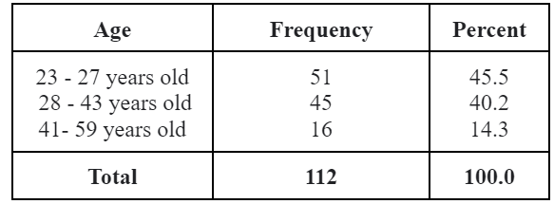
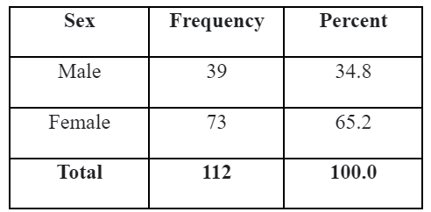
Results and Discussions
Table 1
Distribution of Respondents by Age
Table 2
Distribution of the Respondents by Sex

Slide 6
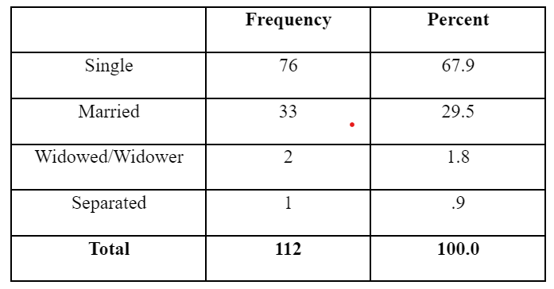
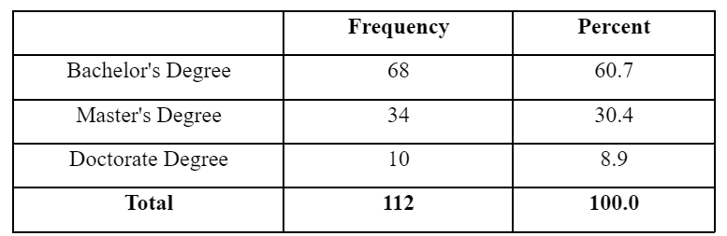
Results and Discussions
Table 3
Distribution of respondents by Civil Status
Table 4
Highest Educational Attainment

Slide 7
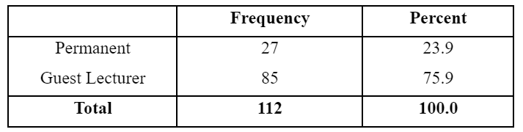
Results and Discussions
Table 5
Distribution of respondents by Employment Status

Slide 8
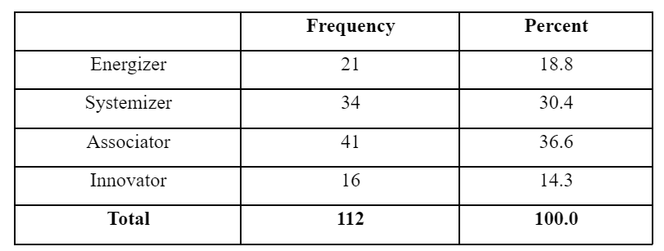
Results and Discussions
Table 6
Communication Styles being Used by the Professors

Slide 9
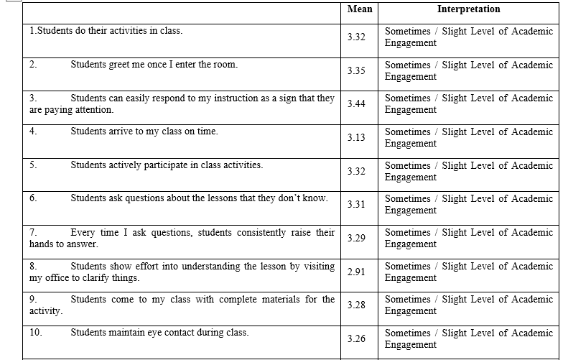
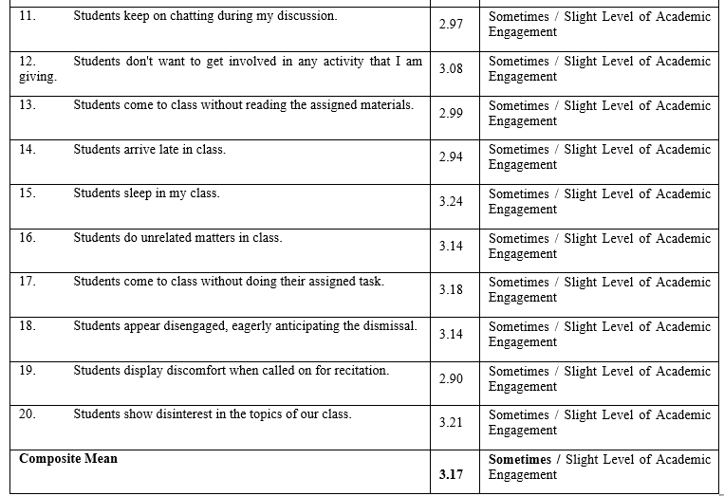
Results and Discussions
Table 7. Assessment on the Level of Engagement of the Students in terms of Behavioral Engagement

Slide 10
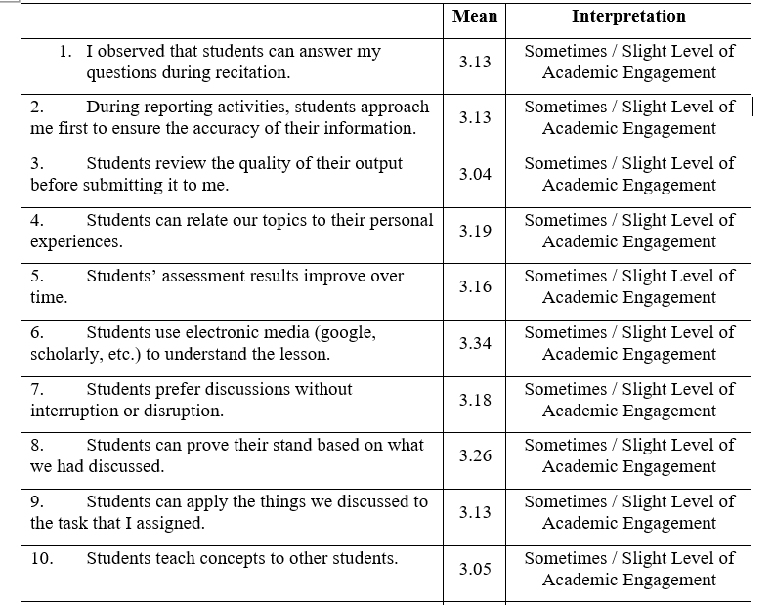
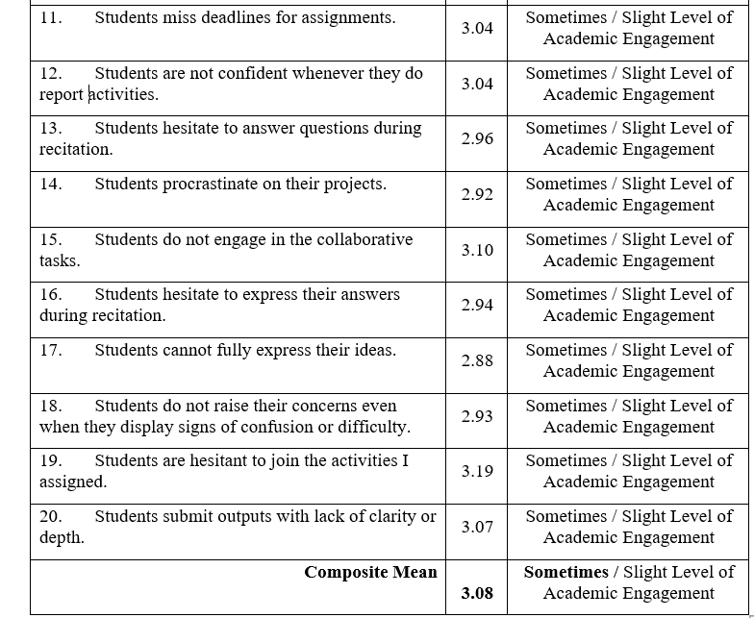
Results and Discussions
Table 8.
Assessment on the Level of Engagement of the Students in terms of Cognitive Engagement

Slide 11
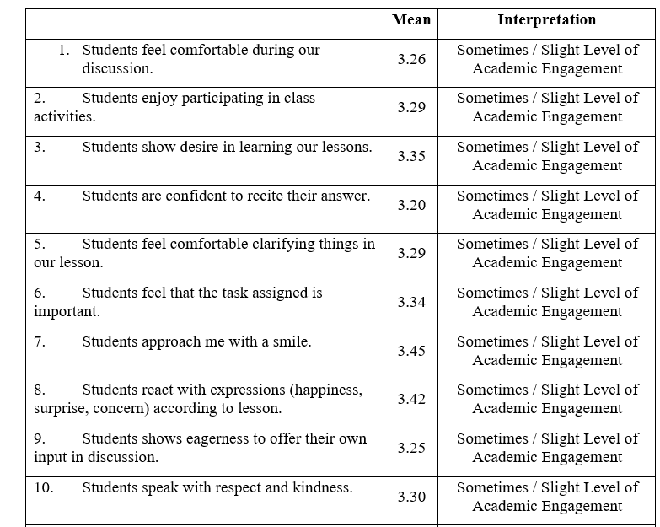
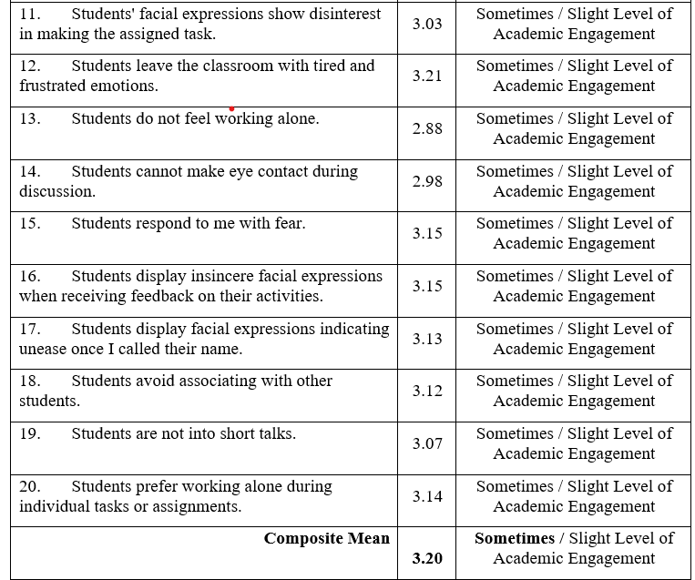
Results and Discussions
Table 9. Assessment on the Level of Engagement of the Students in terms of Emotional Engagement

Slide 12
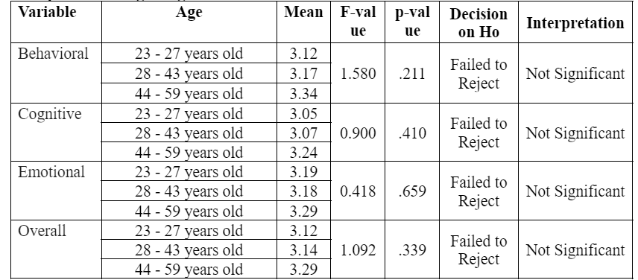
Results and Discussions
Table 10
Differences in the Assessed Students’ Level of Academic Engagement when Grouped according to Age

Slide 13
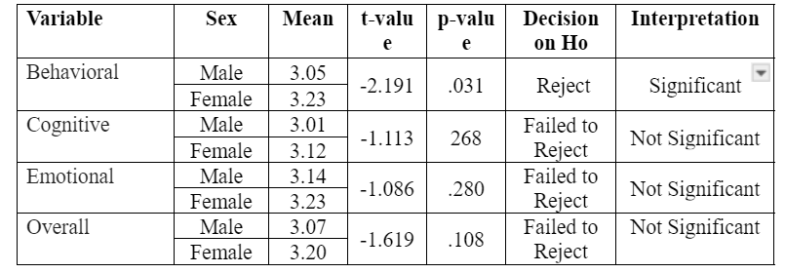
Results and Discussions
Table 11
Differences in the Assessed Students’ Level of Academic Engagement when Grouped according to Sex

Slide 14
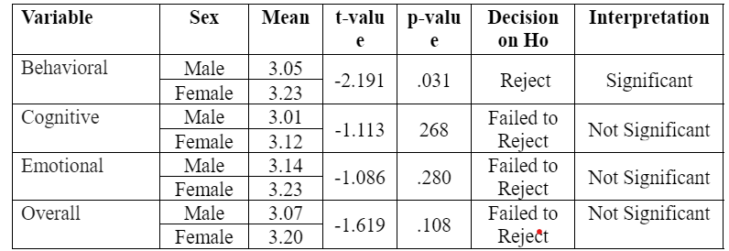
Results and Discussions
Table 11
Differences in the Assessed Students’ Level of Academic Engagement when Grouped according to Sex

Slide 15
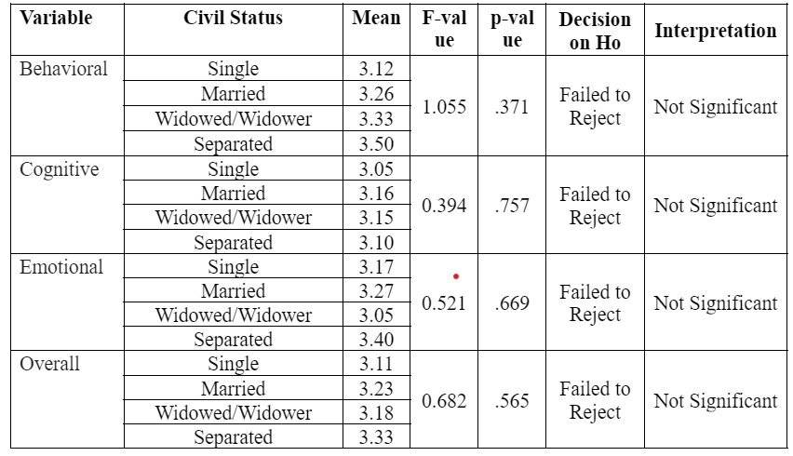
Results and Discussions
Table 12
Differences in the Assessed Students’ Level of Academic Engagement when Grouped according to Civil Status

Slide 16
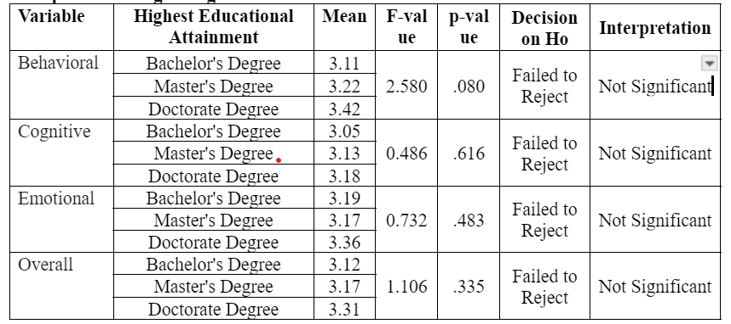
Results and Discussions
Table 13
Differences in the Assessed Students’ Level of Academic Engagement when Grouped according to Highest Educational Attainment

Slide 17
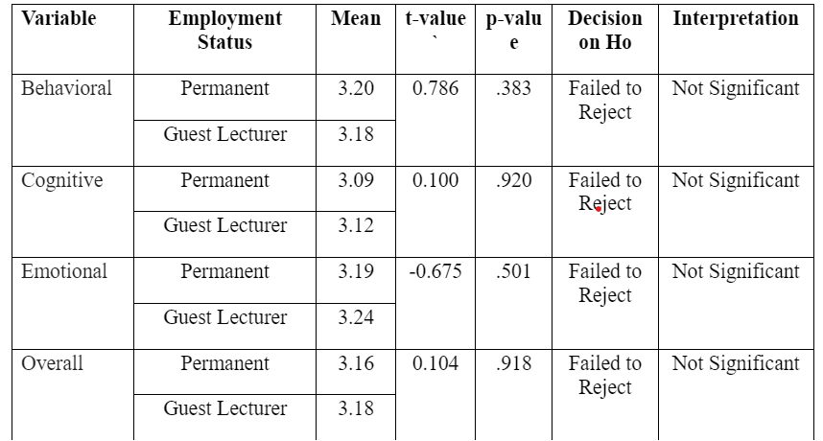
Results and Discussions
Table 14
Differences in the Assessed Students’ Level of Academic Engagement when Grouped
According to Employment Status

Slide 18
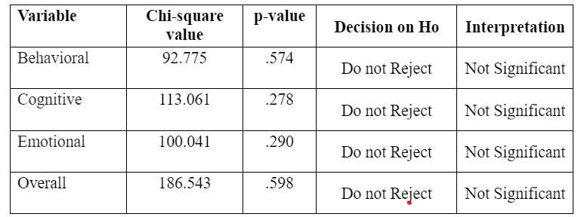
Results and Discussions
Table 15
Relationship between Communication Style and Assessed Level
of Academic Engagement

Slide 19
Results and Discussions
Findings
Proposed Communication Output
The proposed communication output of this study is a flier involving the meaning of different communication styles and student academic engagement. This flier format offers a visually engaging way to present the information. The advantages of these materials is that it is a practical tool for teaching personnel to have easy access to important information about the communication style and student academic engagement.

Slide 20
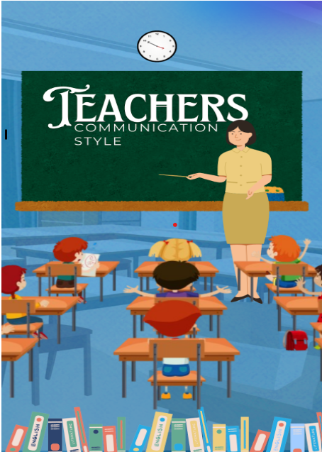
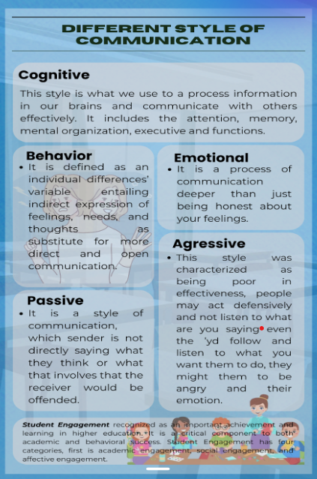
Output

Slide 21
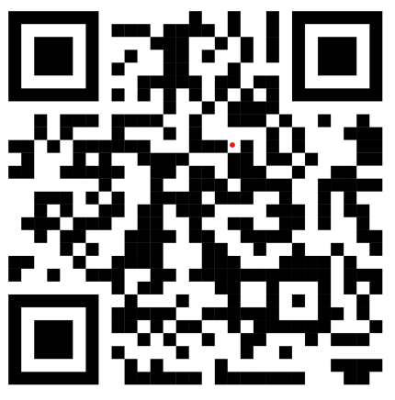
Output
QR Code

Slide 22
Conclusion
1. Results revealed that most of the respondents are 23-27 years old, and most of them are female. Most of the respondents are single with the highest educational attainment of bachelors degree and most of them are guest lecturers.
2. Respondents' communication styles being used is associated. Associator is the combination of a passive and aggressive style. This style requires a high self-esteem, and fairness. These people will clearly state their opinions or feelings.
3.Respondents' level of engagement on the students, students have a slight level of engagement when it comes to behavioral while in the cognitive do have a slight level of academic engagement and in emotional engagement students feel a slight level of engagement.
4. There is no significant difference in the respondents level of academic engagement when grouped according to their profile variables.
5.The developed output, an infomercial was proposed to the teaching personnel, which will help them to have knowledge on communication style that they need to use to their student.

Slide 23
Recommendations
1. Based on the results of the study teachers’ communication style on student engagement there is no significant difference in the variable, it is recommended to identify the other factors such as religion, culture, and beliefs that could contribute to the result that could further improve the findings of this study.
2. Future researchers may conduct the same study in order to broaden its available related resources.
3. The Batangas State University TNEU Lipa may provide lecture sessions like seminars or webinars highlighting different communication styles.
4.It is recommended for the future researchers to conduct further studies regarding this study. Moreover, they should include the other variables that may affect the communication styles of teaching personnel along the teaching learning process to know the best communication style that suits the learning process of students.

Slide 24
Thank you!

