Slide 1
Introduction to PHP
#Start
Prepared by: Bryan Emmanuel Paz

Slide 2
Client-Side Programming
Refers to scripts that run in the user's web browser. The primary purpose is to create a responsive and interactive user experience.
Commonly includes HTML, CSS, and JavaScript. Frameworks and libraries like React, Angular, and Vue.js are also widely used.
Functionality:
Manipulates the Document Object Model (DOM) to change content and styles dynamically.
Handles user interactions (like clicks and keyboard input).
Advantages:
Reduces server load since some processing is done on the client’s side.
Provides a more interactive and responsive user experience.

Slide 3
Server-Side Programming
Involves scripts that run on the server before the content is sent to the user's browser. It's responsible for managing and processing data, handling business logic, and serving web pages.
Languages: Common languages include PHP, Python, Ruby, Java, and Node.js (JavaScript on the server side).
Functionality:
Interacts with databases to retrieve, manipulate, and store data.
Authenticates and authorizes users.
Generates dynamic content based on user requests and server-side logic.
Advantages:
Can handle complex processing and data management that cannot be performed on the client side.
Maintains a higher level of security since sensitive operations and data are kept on the server.

Slide 4
Advantages of PHP over Other Languages
• Easy to learn: PHP is easy to learn and use. For beginner programmers who just started out in web development, PHP is often considered as the preferable choice of language to learn.
• Open source: PHP is an open-source project. It is developed and maintained by a worldwide community of developers who make its source code freely available to download and use.
• Portability: PHP runs on various platforms such as Microsoft Windows, Linux, Mac OS, etc. and it is compatible with almost all servers used today such Apache, IIS, etc.
• Fast Performance: Scripts written in PHP usually execute or runs faster than those written in other scripting languages like ASP, Ruby, Java, etc.
• Vast Community: Since PHP is supported by the worldwide community, finding help or documentation related to PHP online is extremely easy.

Slide 5
WHAT IS PHP
• PHP stands for Hypertext Preprocessor. PHP is a very popular and widely-used open-source server-side scripting language to write dynamically generated web pages. PHP was originally created by Rasmus Lerdorf in 1994. It was initially known as Personal Home Page.
• PHP scripts are executed on the server and the result is sent to the web browser as plain HTML. PHP can be integrated with the number of popular databases, including MySQL, PostgreSQL, Oracle, Microsoft SQL Server, Sybase, and so on.

Slide 6
What is a PHP File?
• PHP files may contain text, HTML tags and scripts.
• PHP files are returned to the browser as plain HTML.
• PHP files have a file extension of ".php", ".php3", or ".phtml"

Slide 7
PHP Syntax

Slide 8
Basic PHP Syntax
A PHP script starts with the <?php and ends with the ?> tag.
The PHP delimiter <?php and ?> in the following example simply tells the PHP engine to treat
the enclosed code block as PHP code, rather than simple HTML

Slide 9
Basic PHP Syntax
In PHP, there are two basic ways to get output:
echo and print
echo and print are more or less the same. They are both used to output data to the screen.
The differences are small: echo has no return value while print has a return value of 1 so it can be used in expressions. echo can take multiple parameters (although such usage is rare) while print can take one argument. echo is marginally faster than print.

Slide 10
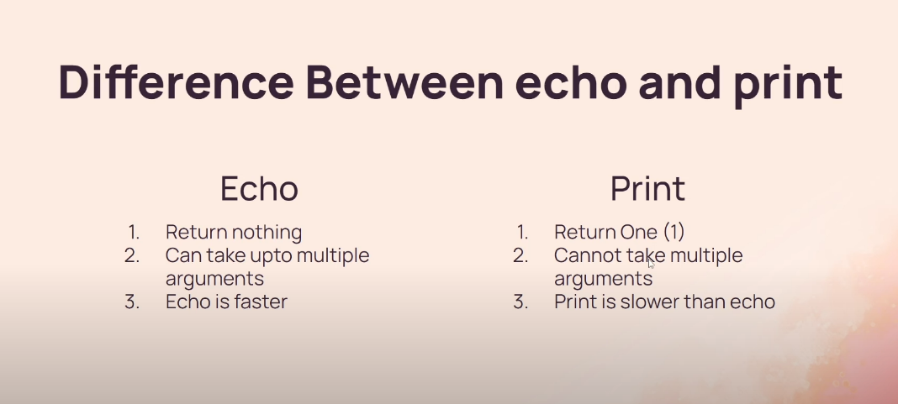
PHP echo and print Statements ❮ PreviousNext ❯

Slide 11
PHP echo and print Statements ❮ PreviousNext ❯
The PHP echo Statement
The echo statement can be used with or without parentheses: echo or echo().
The PHP print Statement
The print statement can be used with or without parentheses: print or print().
<?php
echo "Hello World";
echo ("Hello World");
echo "<br>";
print "Hello World";
print ("Hello World");
?>
<?php
$result = print("Hello");
echo $result; // Outputs 1
$result = "Hello";
echo $result;
?>

Slide 12
Setting Up a Local Web Server

Slide 13
Setting Up a Local Web Server
PHP script execute on a web server running PHP. So, before We start writing any PHP program you need the following program installed on your computer.
• The Apache Web server
• The PHP engine
• The MySQL database server
You can either install them individually or choose a pre-configured package for your operating system like Linux and Windows. Popular pre-configured package are XAMPP and WampServer.

Slide 14
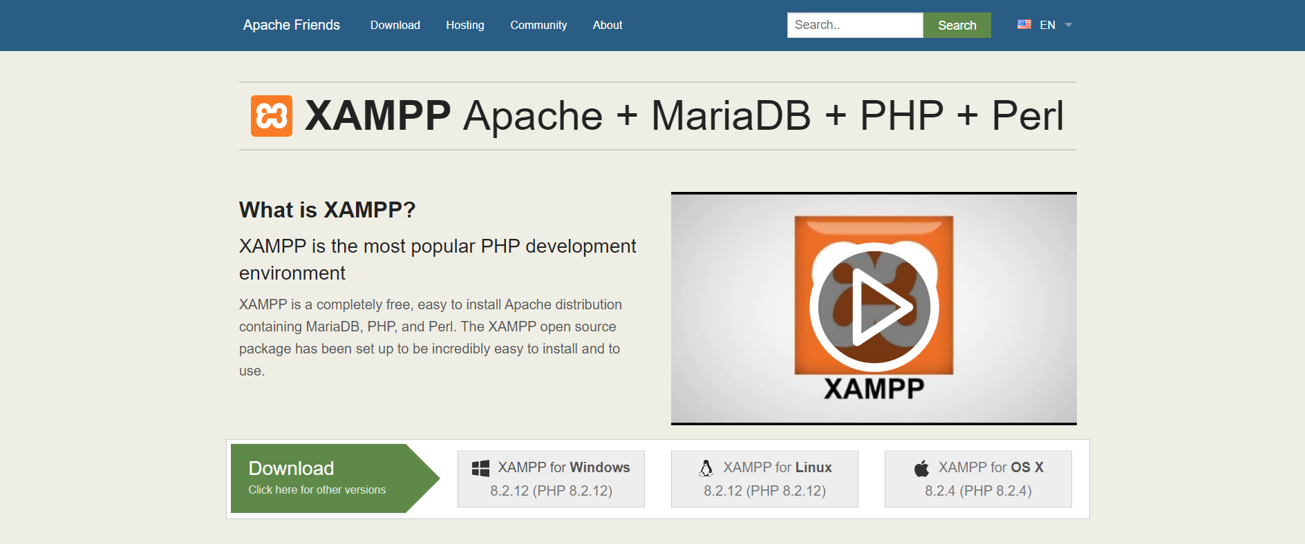
Setting Up a Local Web Server
Download Here: https://www.apachefriends.org/index.html

Slide 15
Example. Follow the steps below.
Step 1. Create a document in your text editor.
Step 2. Type the code as shown below
Step 3. Save the file as test.php Since PHP is a server-side programming language, you need to save it in XAMPP directory. Basically, it is in your c drive, folder xampp, then go to your htdocs folder.
<html>
<body>
<?php echo "Welcome to PHP programming"; ?> </body>
</html>
Take note of the extension name. it is now php and not html.
Each code line in PHP must end with a semicolon. The semicolon is a separator and is used to distinguish one set of instructions from another.
In PHP, variable and constant names are case sensitive, while function names are not

Slide 16
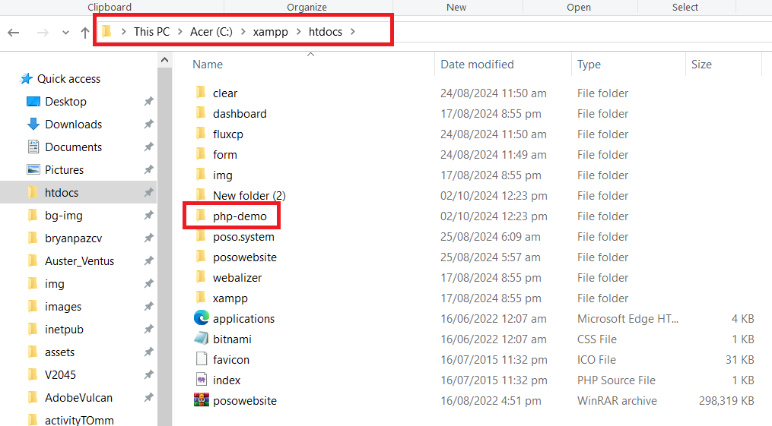
Example. Follow the steps below.
Step 4. View your php program in the browser by typing
http://localhost/php-demo/index.php
Localhost is your host name or server name, if you are running the program in a server. test.php is your php program
Note. instead of host name, you can also your ip address.
Like
http://127.0.0.1/php-demon/index.php

Slide 17
PHP Variables

Slide 18
Variables in PHP
Variables are "containers" for storing information like text strings, numbers or arrays
All variables in PHP start with a $ sign symbol.
In PHP, a variable does not need to be declared before adding a value to it.
PHP automatically converts the variable to the correct data type, depending on its value.

Slide 19
Rules in Declaring Variables
• A variable name must start with a letter or an underscore "_" -- not a number
• A variable name can only contain alpha-numeric characters, underscores (a-z, A-Z, 0-9, and _ )
• A variable name should not contain spaces. If a variable name is more than one word, it should be separated with an underscore ($my_string) or with capitalization ($myString)

Slide 20
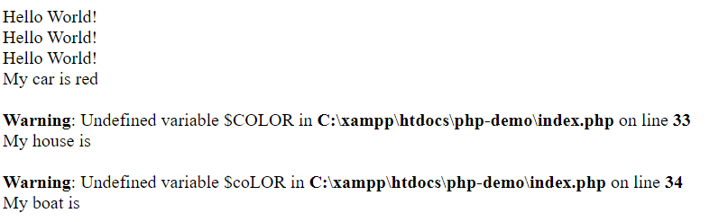
Variables in PHP
<?php
ECHO "Hello World!<br>";
echo "Hello World!<br>";
EcHo "Hello World!<br>";
$color="red";
echo "My car is " . $color . "<br>";
echo "My house is " . $COLOR . "<br>";
echo "My boat is " . $coLOR . "<br>"; ?>
PHP Case Sensitivity - In PHP, all user-defined functions, classes, and keywords (e.g. if, else, while, echo, etc.) are NOT case-sensitive.
However; in PHP, all variables are case-sensitive.
OUTPUT
All three echo statements below are legal (and equal)
for the car display only the first statement is valid(this is because $color, $COLOR, and $coLOR are treated as three different variables)

Slide 21
Comments in PHP - In PHP, we use // to make a single-line comment or /* and */ to make a large
comment block.
<?php
//echo "Hello" this is single line comment ; /*
echo "Welcome to PHP programming1";
echo "Welcome to PHP programming2";
this is multiple line comment
*/
?>

Slide 22
PHP Concatenation
The concatenation operator (.) is used to put two string values together.
To concatenate two string variables together, use the concatenation operator:
<?php
$firstName = "Bryan";
$secondName ="Emmanuel";
$lastName = "Paz";
$fullName = $firstName." ".$secondName." ".$lastName;
echo "Hello my First Name is $firstName <br>";
echo "Hello my Second Name is $secondName"."<br>";
echo 'Hello my FullName is '.$fullName.'^^';
?>

Slide 23
Loosely typed language
PHP is a loosely typed language. This means that you do not need to explicitly declare the data type of a variable. PHP automatically determines the type of a variable based on the value assigned to it, and it allows variables to change types dynamically during script execution.

Slide 24
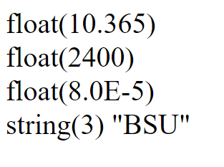
PHP 5 Data Types
String, Integer, Floating point numbers, Boolean, Array, Object, NULL.
The PHP var_dump() function returns the data type and value of variables:
<?php
$x = 10.365;
var_dump($x); // output is float(10.365)
echo "<br>";
$x = 2.4e3;
var_dump($x); // output is float(2400)
echo "<br>";
$x = 8E-5;
var_dump($x); // output is float(8.0E-5)
echo "<br>";
$x = "BSU";
var_dump($x); // output is string(3) “BSU”
?>

Slide 25
PHP Operators

Slide 26
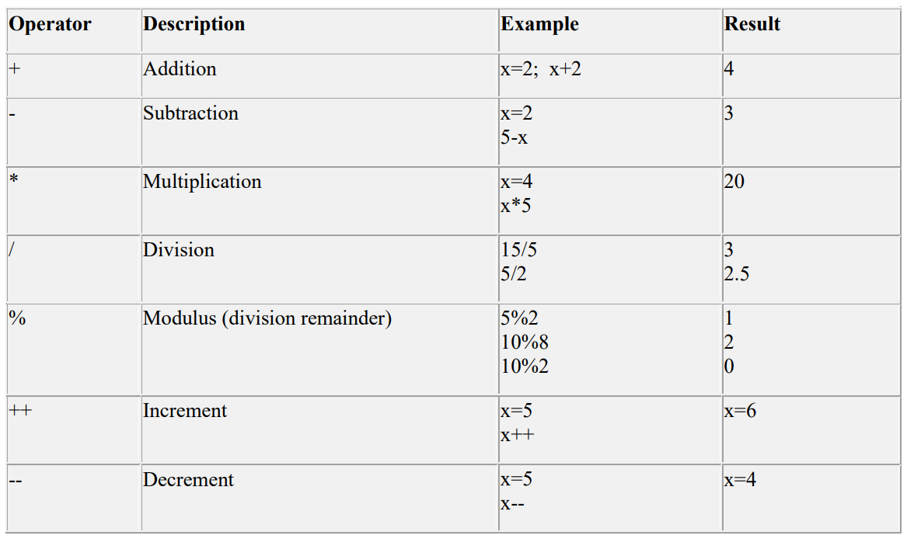
Arithmetic Operators

Slide 27
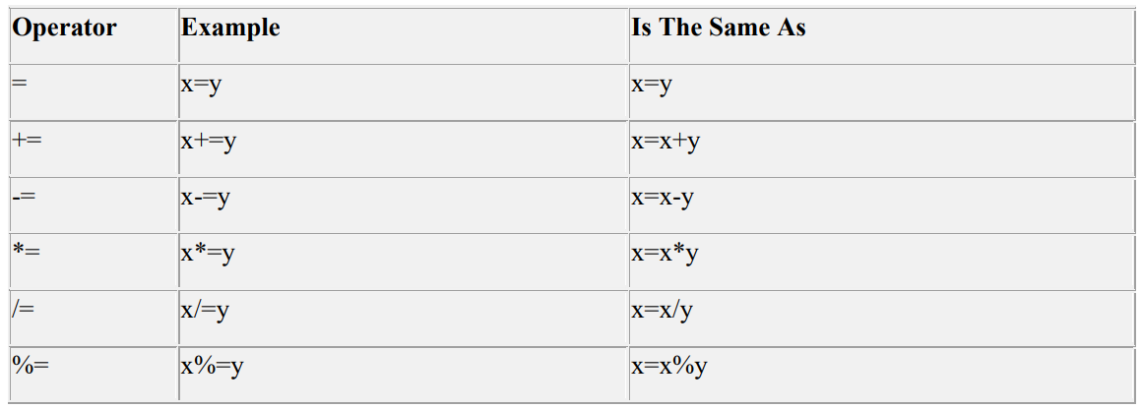
Assignment Operators

Slide 28
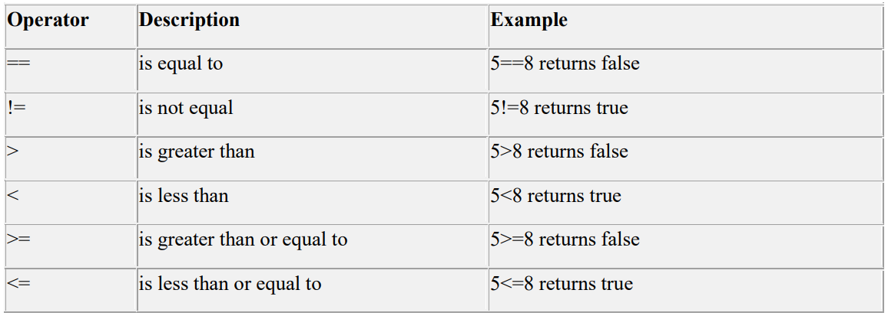
Comparison Operators

Slide 29
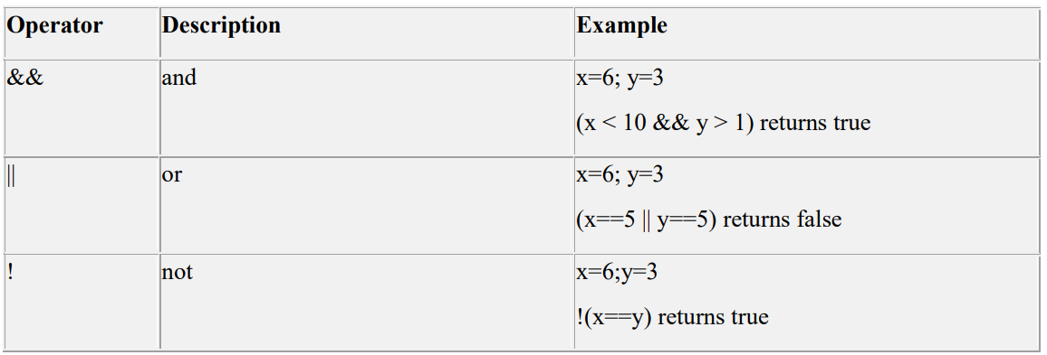
Logical Operators

Slide 30
Example
$x=120; $y=120;
$diff=$x-$y;
echo "the sum is : ".($y+$x);
echo "<br><div class='bb'>the product is</div> : ".($y*$x);
echo "<br>the quotient is : ".($y/$x);
echo "<br>the difference is: $diff";
echo "<hr>";
$x = 'r';
$y = 1;
echo "the sum is : ".($y+$x); //output is 1. it will ignore $x

Slide 31
Exercise 1 (operators)

Slide 32
Exercise
Write a PHP script that introduces a person named Kazuto, who is currently 22 years old. The script should also display the following:
Kazuto's birth year.
Whether Kazuto is an adult.
How old Kazuto will be next year.
How many years Kazuto has until they turn 30.
Whether Kazuto is a teenager.
A sentence about Kazuto's hobby (graphic designing) and future goal (becoming a front-end web developer).
Use appropriate variables for the name, age, hobby, and goal, and include basic conditional statements to determine adult status and teenage status.

Slide 33
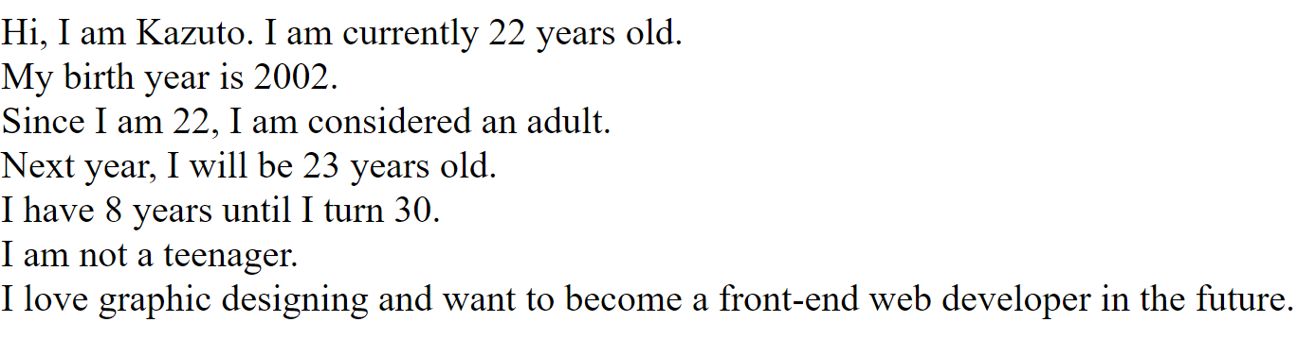
Exercise output
Hi, I am Kazuto. I am currently 13 years old. My birth year is 2011. I am not yet an adult. Next year, I will be 14 years old. I have 17 years until I turn 30. I am a teenager. I love graphic designing and want to become a front-end web developer in the future.

Slide 34
Conditional Statements

Slide 35
Conditional Statements
Very often when you write code, you want to perform different actions for different decisions. You can use conditional statements in your code to do this
In PHP we have following conditional statements:
if statement - use this statement to execute some code only if a specified condition is true
if...else statement - use this statement to execute some code if a condition is true and another code if the condition is false
if...else if....else statement - use this statement to select one of several blocks of code to be executed
switch statement - use this statement to select one of many blocks of code to be executed

Slide 36

PHP IF STATEMENT
<!DOCTYPE html>
<html lang="en">
<head>
<meta charset="UTF-8">
<meta name="viewport" content="width=device-width, initial-scale=1.0">
<title>Web and System</title>
</head>
<body> <?php
$grade=80;
if ($grade>=75
echo "Passed!";
?> </body>
</html>
if (condition)
code to be executed if condition is true;
Output:

Slide 37
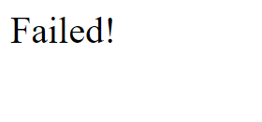
PHP IF-ELSE STATEMENT
<!DOCTYPE html>
<html lang="en">
<head>
<meta charset="UTF-8">
<meta name="viewport" content="width=device-width, initial-scale=1.0">
<title>Web and System</title>
</head>
<body>
<?php
$grade=74;
if ($grade>=75)
echo "Passed!";
else
echo "Failed
?> </body>
</html>
if (condition)
code to be executed if condition is true;
else
code to be executed if condition is false;
Output:

Slide 38
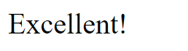
PHP ELSE-IF STATEMENT
<!DOCTYPE html>
<html lang="en">
<head>
<title>Web and System</title>
</head>
<body>
<?php
$grade=100;
if ($grade>=90)
echo "Excellent!";
elseif ($grade>=75)
echo "Not bad!";
else
echo "Failed!";
?>
</body>
</html>
if (condition)
code to be executed if condition is true;
else if(condition)
code to be executed if condition is true;
else
code to be executed if condition is false;
Output:

Slide 39
The Switch Statement
If you want to select one of many blocks of code to be executed, use the switch statement.
switch (expression)
{
case label1:
code to be executed if expression = label1;
break;
case label2:
code to be executed if expression = label2;
break;
default:
code to be executed
if expression is different from both label1 and label2;
}
$x = "4";
switch ($x) {
case 1:
echo "Number 1";
break;
case 2:
echo "Number 2";
break;
default:
echo "No number between 1 and 2";
}

Slide 40
Loops

Slide 41
PHP Looping
Very often when you write code, you want the same block of code to run a number of times. You can use looping statements in your code to perform this.
In PHP we have the following looping statements:
while - loops through a block of code as long as a specified condition is true
do...while - loops through a block of code once, and then repeats the loop as long as a special condition is true
for - loops through a block of code a specified number of times
foreach - loops through a block of code for each element in an array
Looping Basic Parameters
init: Mostly used to set a counter (but can be any code to be executed once at the beginning of the loop)
condition: Evaluated for each loop iteration. If it evaluates to TRUE, the loop continues. If it evaluates to FALSE, the loop ends.
increment: Mostly used to increment a counter (but can be any code to be executed at the end of the loop)

Slide 42
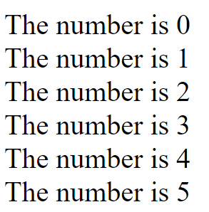
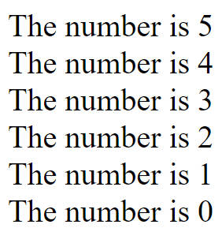
PHP while Statement
Output:
The while statement will execute a block of code if and as long a condition is true.
while (condition)
code to be executed;
<?php
$i=0; //init
while($i<=5) {
echo "The number is " . $i . "<br />";
$i++; //increment
}
?>
<?php
$i=5; //init
while($i>=0) {
print "The number is " . $i . "<br />";
$i--; //decrement
}
?>

Slide 43
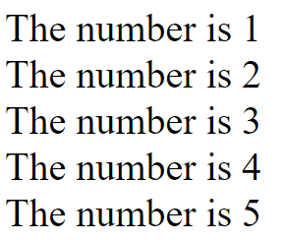
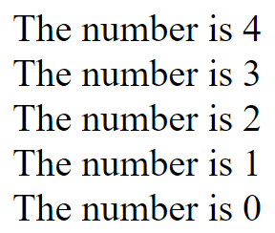
The do...while Statement
<?php
$i=0; ; //init
do {
$i++; //INCREMENT
echo "The number is " . $i . "<br />";
}while ($i<5);
?>
The do...while statement will execute a block of code at least once - it then will repeat the loop as long as a condition is true.
do {
code to be executed;
} while (condition);
<?php
$i=5; ; //init
do {
$i--; //DECREMENT
echo "The number is " . $i . "<br />"; }
while ($i>0);
?>

Slide 44
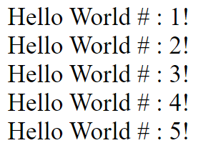
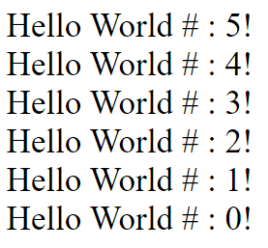
The for Statement
<?php
for ($i=1; $i<=5; $i++) {
echo "Hello World # : ",$i,"!<br />"; }
?>
The for statement is used when you know how many times you want to execute a statement or a list of statements.
for (initialization; condition; increment) { code to be executed; }
<?php
for ($i=5; $i>=0; $i--) {
echo "Hello World # : ",$i,"!<br />"; }
?>
Note: The for statement has three parameters. The first parameter is for initializing variables, the second parameter holds the condition, and the third parameter contains any increments required to implement the loop. If more than one variable is included in either the initialization or the increment section, then they should be separated by commas. The condition must evaluate to true or false.

Slide 45
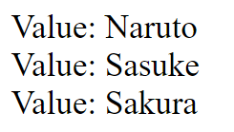
The foreach Statement
<?php
$arr=array("Naruto", "Sasuke", "Sakura");
foreach ($arr as $value) {
echo "Value: " . $value . "<br />"; }
?>
Loops over the array given by the parameter. On each loop, the value of the current element is assigned to
$value and the array pointer is advanced by one - so on the next loop, you'll be looking at the next
element.
foreach (array as value) { code to be executed; }
Loops over the array given by the parameter. On each loop, the value of the current element is assigned to $value and the array pointer is advanced by one - so on the next loop, you'll be looking at the next element.

Slide 46
PHP Arrays

Slide 47
PHP Arrays
• An array variable is a storage area holding a number or text. The problem is, a variable will hold only one value.
• An array is a special variable, which can store multiple values in one single variable.

Slide 48
In PHP, there are three kinds of arrays:
Numeric array - An array with a numeric index .
Associative array - An array where each ID key is associated with a value.
Multidimensional array - An array containing one or more arrays.

Slide 49
Create Array
You can create arrays by using the array() function:
You can also use a shorter syntax by using the [] brackets:
$cars = array("Volvo", "BMW", "Toyota");
$cars = ["Volvo", "BMW", "Toyota"];

Slide 50
Multiple Lines
Line breaks are not important, so an array declaration can span multiple lines:
$cars = array(
"Volvo",
"BMW",
"Toyota“
);
$cars = [
"Volvo",
"BMW",
"Toyota“
];

Slide 51
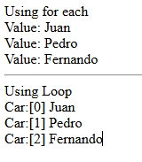
PHP Numeric Arrays
• A numeric array stores each array element with a numeric index.
• There are two methods to create a numeric array.
<?php
//using Foreach
$cars=array("Juan", "Pedro", "Fernando");
echo "Using for each<br>";
foreach ($cars as $value){
echo "Value: ". $value . "<br />";
}
//using loop
echo "<hr>Using Loop<br>";
for ( $x = 0; $x<=2; $x++){
echo "Car:[$x] " . $cars[$x] . "<br />";
}
?>

Slide 52
PHP Associative Arrays
• With an associative array, each ID key is associated with a value.
• When storing data about specific named values, a numerical array is not always the best way to do it.
• With associative arrays we can use the values as keys and assign values to them.
In this example we use an array to assign ages to the different persons:
$ages=array("Pedro"=>20,"Juan"=>22,"Fernando"=>32);
var_dump($ages);
This example is the same as the one above, but shows a different way of creating the array:
$ages["Pedro"]="20";
$ages["Juan"]="22";
$ages["Fernando"]="32";
Then the ID keys can be used in a script to display the data
• $ages["Pedro"];

Slide 53
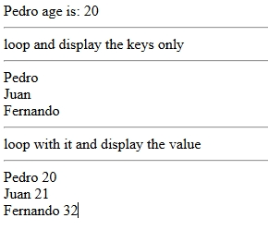
PHP Associative Arrays
$ages=array("Pedro"=>20,"Juan"=>21,"Fernando"=>32);
echo 'Pedro age is: '.$ages["Pedro"]; //display age of pedro which is 20
echo '<br>';
echo '<hr>loop and display the keys only<hr>';
$keys = array_keys($ages);
foreach($keys as $key) {
echo($key). "<br>";
}
echo '<hr>loop with it and display the value<hr>’;
foreach($ages as $key => $value) {
echo($key). " " . $value . "<br>";
}

Slide 54
PHP Multidimensional Arrays
A multidimensional array is an array containing one or more arrays.
PHP supports multidimensional arrays that are two, three, four, five, or more levels deep. However, arrays more than three levels deep are hard to manage for most people.
The dimension of an array indicates the number of indices you need to select an element.
For a two-dimensional array you need two indices to select an element
For a three-dimensional array you need three indices to select an element

Slide 55
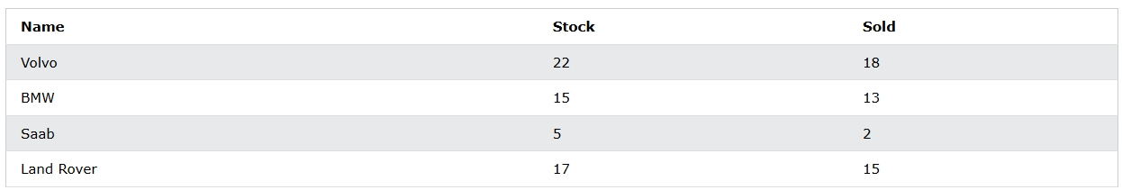
PHP - Two-dimensional Arrays
A two-dimensional array is an array of arrays (a three-dimensional array is an array of arrays of arrays).
First, take a look at the following table:
We can store the data from the table above in a two-dimensional array, like this:
$cars = array (
array("Volvo",22,18),
array("BMW",15,13),
array("Saab",5,2),
array("Land Rover",17,15)
);

Slide 56

PHP - Two-dimensional Arrays
Now the two-dimensional $cars array contains four arrays, and it has two indices: row and column.
To get access to the elements of the $cars array we must point to the two indices (row and column):
echo $cars[0][0].": In stock: ".$cars[0][1].", sold: ".$cars[0][2].".<br>";
echo $cars[1][0].": In stock: ".$cars[1][1].", sold: ".$cars[1][2].".<br>";
echo $cars[2][0].": In stock: ".$cars[2][1].", sold: ".$cars[2][2].".<br>";
echo $cars[3][0].": In stock: ".$cars[3][1].", sold: ".$cars[3][2].".<br>";

Slide 57
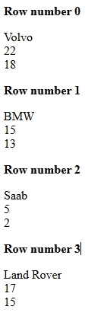
PHP - Two-dimensional Arrays
We can also put a for loop inside another for loop to get the elements of the $cars array (we still have to point to the two indices):
<?php
$cars = array (
array("Volvo",22,18),
array("BMW",15,13),
array("Saab",5,2),
array("Land Rover",17,15)
);
for ($row = 0; $row < 4; $row++) {
echo "<p><b>Row number $row</b></p>";
for ($col = 0; $col < 3; $col++) {
echo $cars[$row][$col]."<br>";
}
}

Slide 58
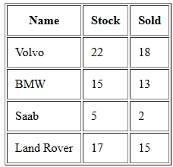
PHP - Two-dimensional Arrays
$cars = array (
array("Volvo",22,18),
array("BMW",15,13),
array("Saab",5,2),
array("Land Rover",17,15)
);
echo "<table border='1' cellpadding='10'>";
echo "<tr><th>Name</th><th>Stock</th><th>Sold</th></tr>";
for ($row = 0; $row < 4; $row++) {
echo "<tr>";
for ($col = 0; $col < 3; $col++) {
echo "<td>".$cars[$row][$col]."</td>";
}
echo "</tr>";
}
echo "</table>";
?>

Slide 59
Functions

Slide 60

PHP Functions – User Defined
Besides the built-in PHP functions, it is possible to create your own functions.
Besides the built-in PHP functions, we can create our own functions.
A function is a block of statements that can be used repeatedly in a program.
A function will not execute immediately when a page loads. You need to call it.
A function will be executed by a call to the function.
function writeMsg(){
echo "Hello world!";
}
writeMsg(); // call the function ?>
Syntax:
function functionName() {
Code to be executed;
}
Output:

Slide 61

Function with Arguments
To add more functionality to a function, we can add parameters. A parameter is just like a variable.
Parameters are specified after the function name, inside the parentheses.
<?php
function familyName($fname) {
echo "$fname .<br>";
}
familyName("Naruto");
familyName("Boruto");
familyName("Himawari");
familyName("Hinata"); ?>
Output:

Slide 62

Function with Multiple Arguments
The following example has a function with two arguments ($fname, $year):
<?php
function deathNote($fname, $year) {
echo "$fname $year <br>";
}
deathNote("Light", "1999");
deathNote("Ryuk", "1878");
deathNote("Near", "2022");
?>
Output:

Slide 63

PHP Default Argument Value
The following example shows how to use a default parameter. If we call the function setHeight() without arguments it takes the default value as argument:
<?php
function setHeight($minheight = 50) {
echo "The height is : $minheight <br>";
}
setHeight(350);
setHeight(); // will use the default value of 50
setHeight(135);
setHeight(80); ?>

Slide 64

PHP Functions - Returning values
The following example shows how to use a default parameter. If we call the function setHeight() without arguments it takes the default value as argument:
<?php
function sum($x,$y) {
$z=$x+$y;
return $z;
}
echo "7 + 13 = " . sum(7,13) . "<br>";
echo "2 + 4 = " . sum(2,4);
?>

Slide 65
Variable Number of Arguments
By using the ... operator in front of the function parameter, the function accepts an unknown number of arguments. This is also called a variadic function.
The variadic function argument becomes an array.
function sumMyNumbers(...$numbers) {
$total = 0;
$len = count($numbers);
for($i = 0; $i < $len; $i++) {
$total += $numbers[$i];
}
return $total;
}
$sum = sumMyNumbers(5, 5, 5, 5,5, 5);
echo $sum;
Output:
30

Slide 66
Variable Local and Global Scope
• A variable declared outside a function has a GLOBAL SCOPE and can only be accessed outside a function.
• A variable declared within a function has a LOCAL SCOPE and can only be accessed within that function.
PHP The global Keyword
<?php
$x=5;
$y=10;
function myTest() {
global $x,$y;
$y=$x+$y;
}
myTest();
echo $y; // outputs 15
?>
• The global keyword is used to access a global variable from within a function.
• To do this, use the global keyword before the variables (inside the function):

