Slide 1


SPOTIFY RECOMMENDATION SYSTEM
How Machine Learning Powers Music Suggestions
Project Done By:
Dennis Muriungi
Jasmine Mwangi
Simon Muema
Lenny Mubea
Mathews Trevor

Slide 2
1. INTRODUCTION TO SPOTIFY
What is Spotify?
Spotify is a digital music streaming service that offers users access to millions of songs, podcasts and videos.
Spotify’s personalized features, like Discover Weekly, Daily Mixes, and Release Radar, allow users to discover new content tailored to their unique tastes. These personalized recommendations, powered by Spotify’s advanced recommendation system, are key to enhancing user engagement and ensuring a dynamic listening experience.

Slide 3
2. OVERVIEW OF RECOMMENDATION SYSTEMS
What are Recommendation Systems?
This are algorithms designed to predict and suggest content that users are likely to enjoy based on their past behavior and preferences
These systems are crucial for platforms like Spotify, where personalization keeps users engaged and discovering new music
Spotify recommends songs based on what you’ve listened to, your favorite genres, or similar users’ preferences

Slide 4
3. Types of recommendation algorithms
Content-Based Filtering: Recommends songs similar to what the user has liked
Collaborative filtering: Recommends songs based on what other users with similar tastes enjoy
Our preferred algorithm is Content-Based filtering

Slide 5
4. Content based Filtering in Spotify
Spotify recommends songs based on the features of the music a user has already enjoyed.
Therefore characteristics like genre, popularity, energy level etc have been used to find similar tracks with similar characteristics
This method ensures that users receive personalized recommendations aligned with that user’s taste, rather than other users’ preferences.

Slide 6
5. DATA COLLECTION AND PROCESSING
Spotify collects vast amounts of data from user interactions like songs played, songs liked etc.
This data driven approach ensures that Spotify delivers relevant music tailored to each users’ preferences

Slide 7
6. EVALUATING THE SYSTEM
Spotify evaluates the effectiveness of its recommendation system using various metrics, such as accuracy, precision and recall
Continuous evaluation and iteration help maintain a high-quality user experience and improve recommendation accuracy.

Slide 8
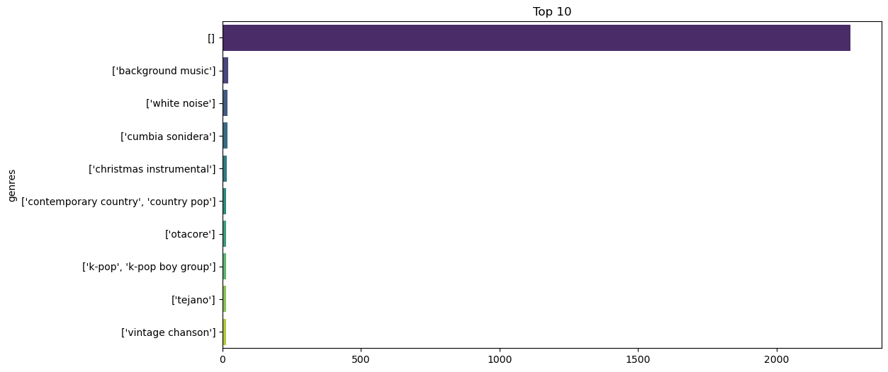

Slide 9
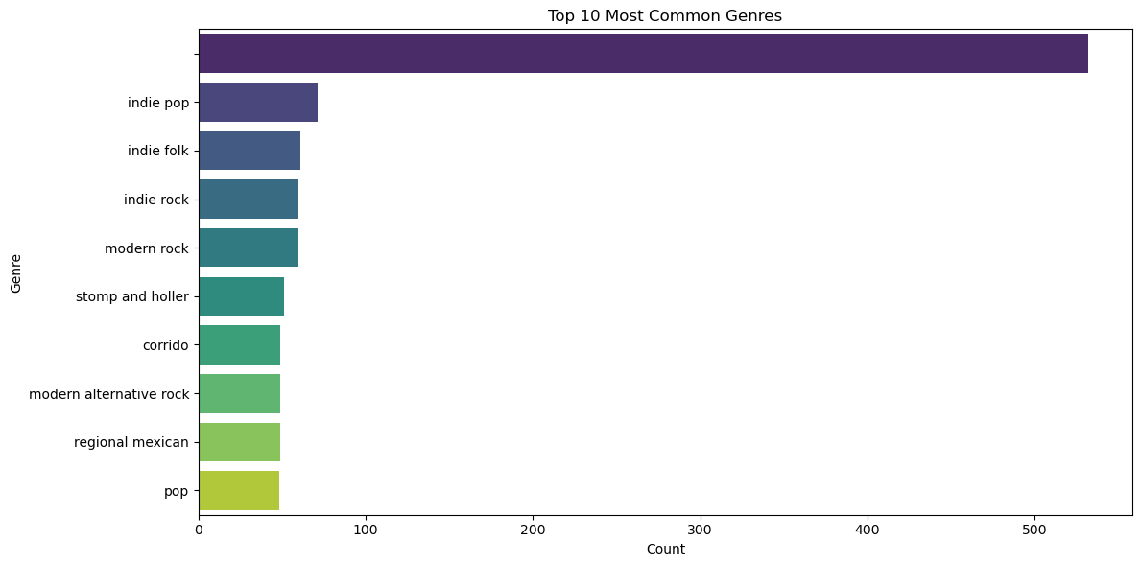

Slide 10
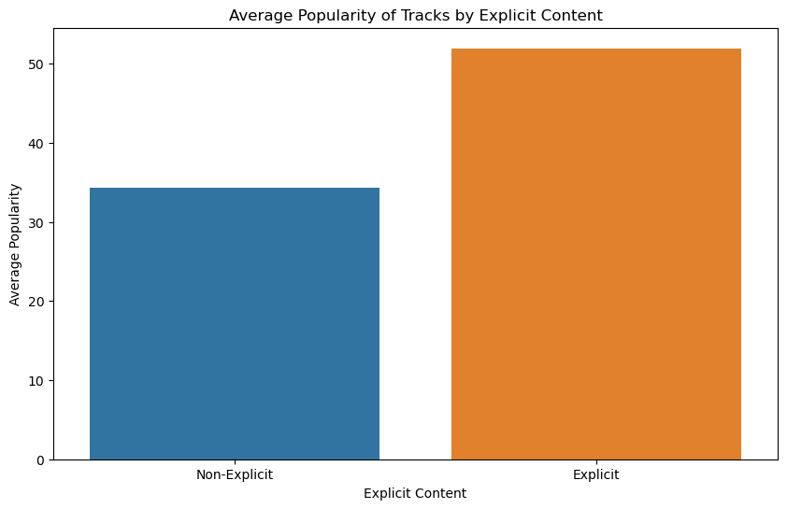

Slide 11
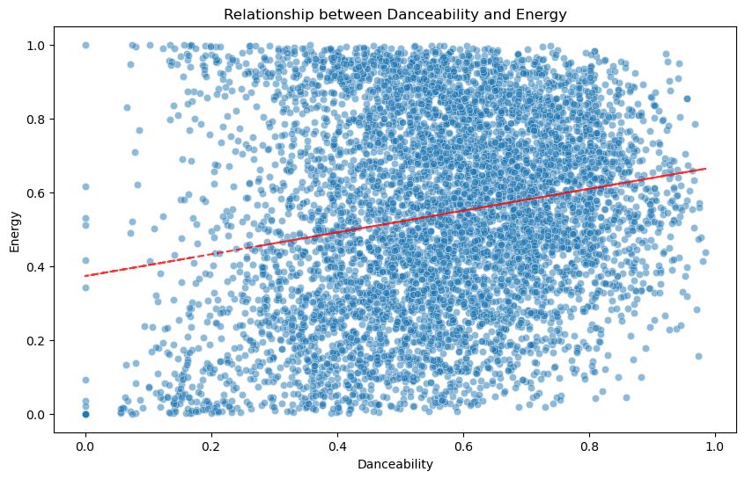

Slide 12
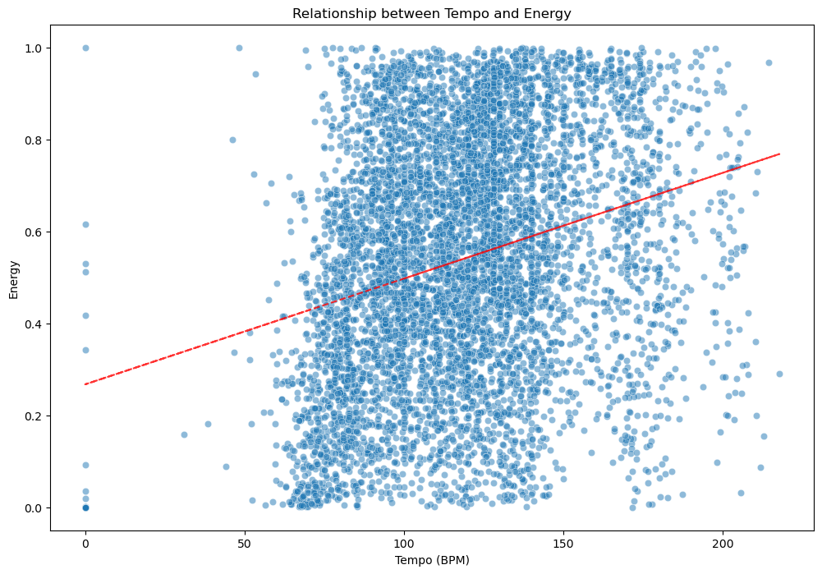

Slide 13
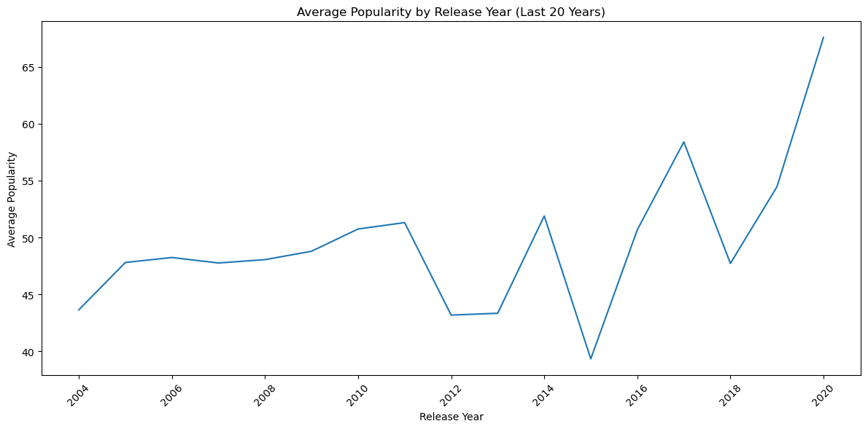

Slide 14
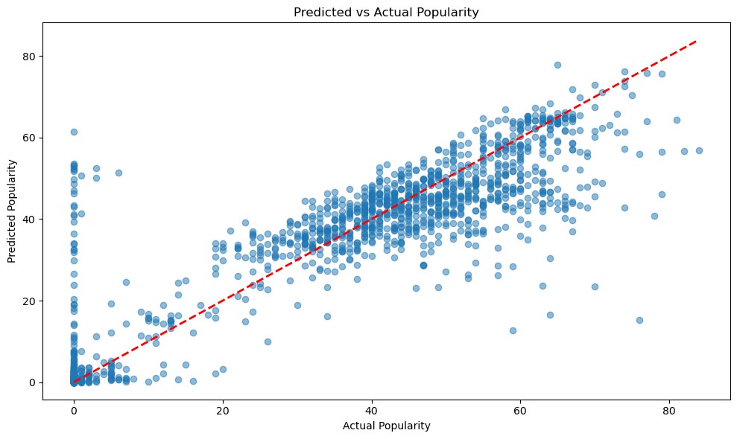

Slide 15
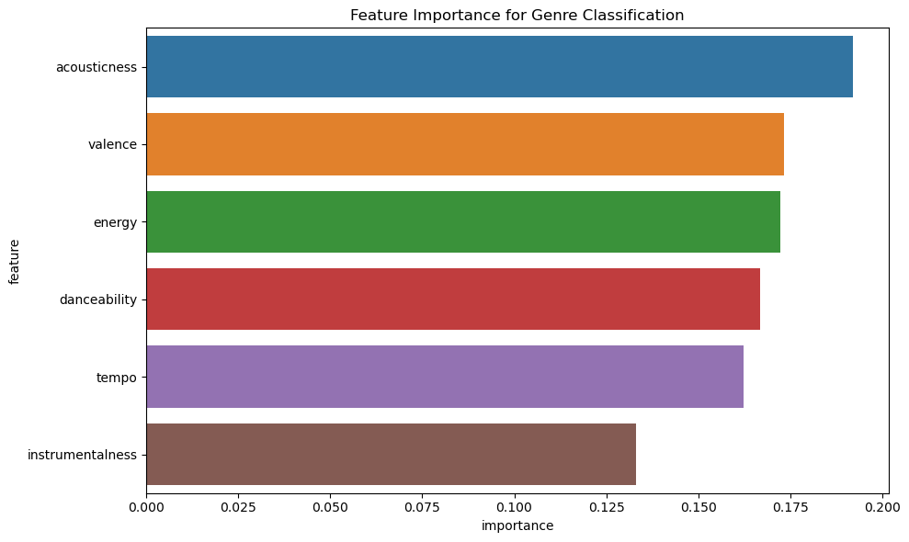

Slide 16
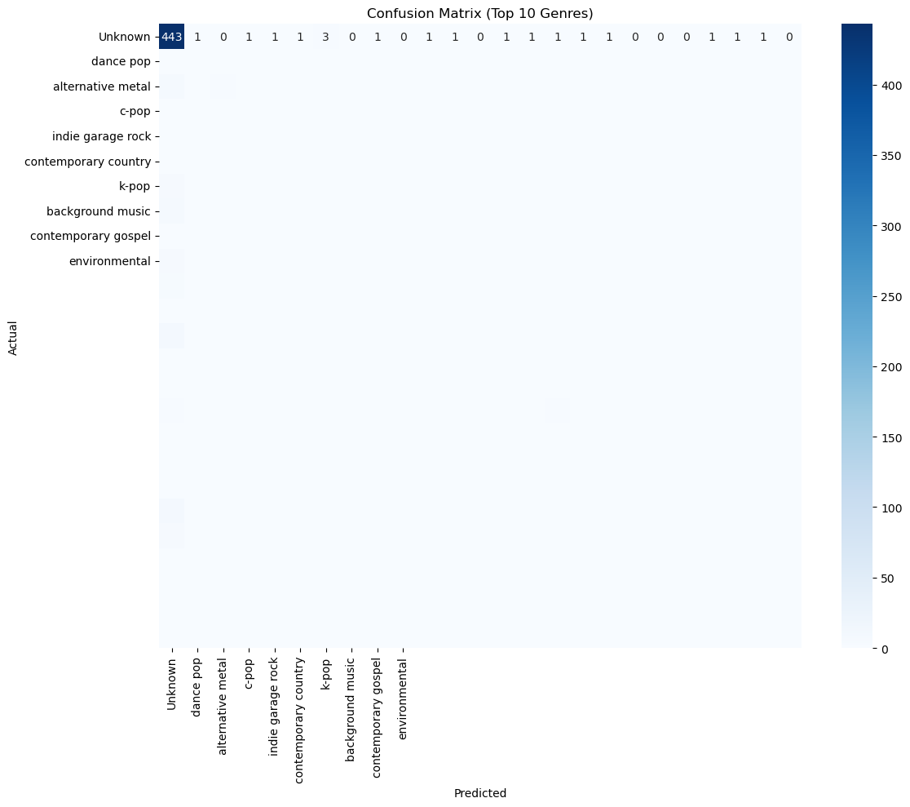

Slide 17
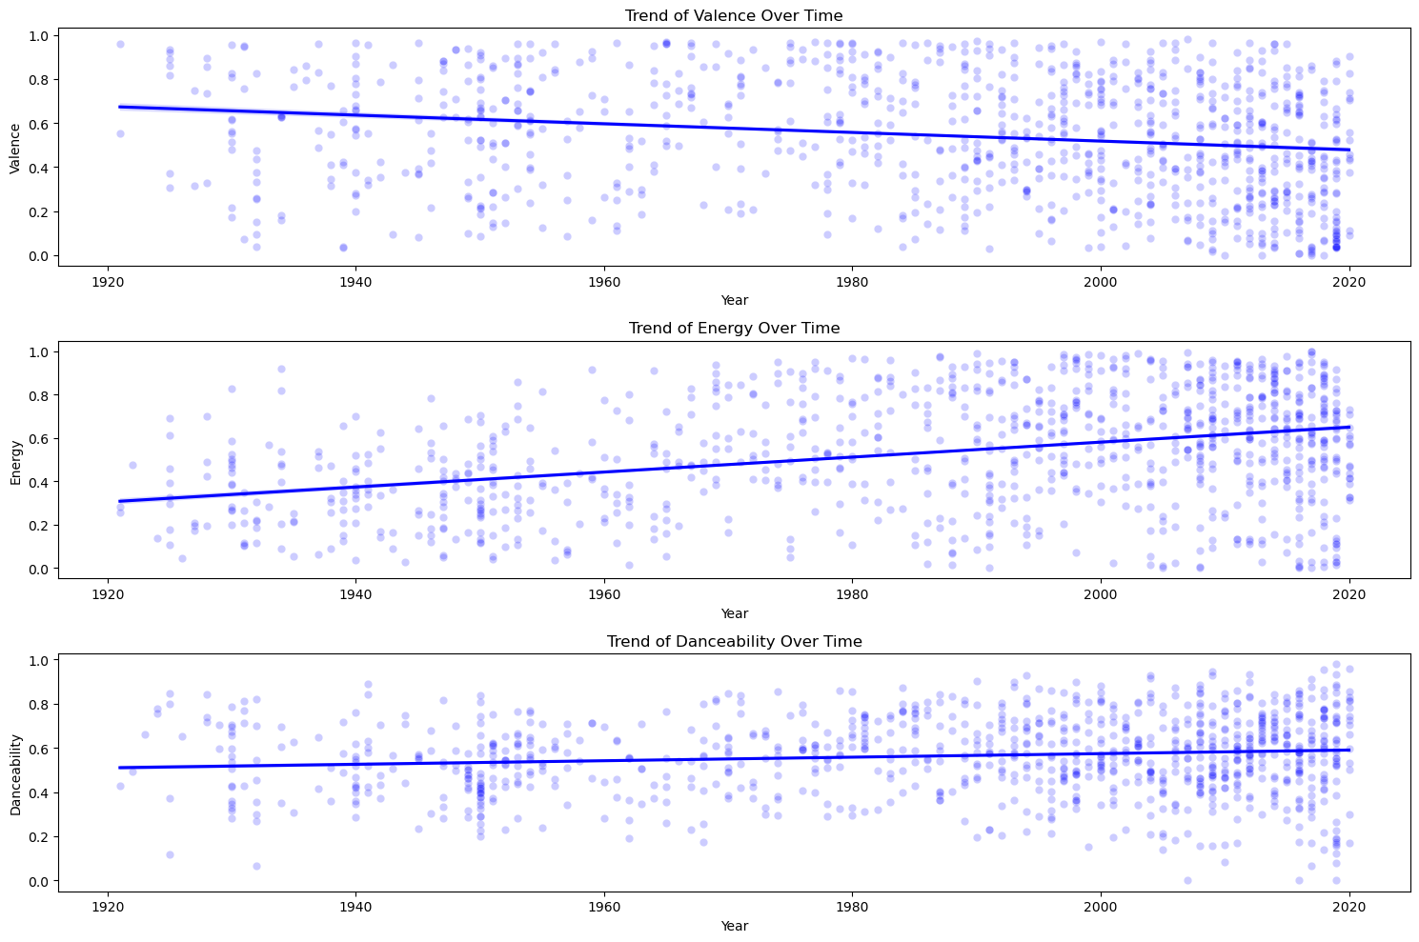

Slide 18
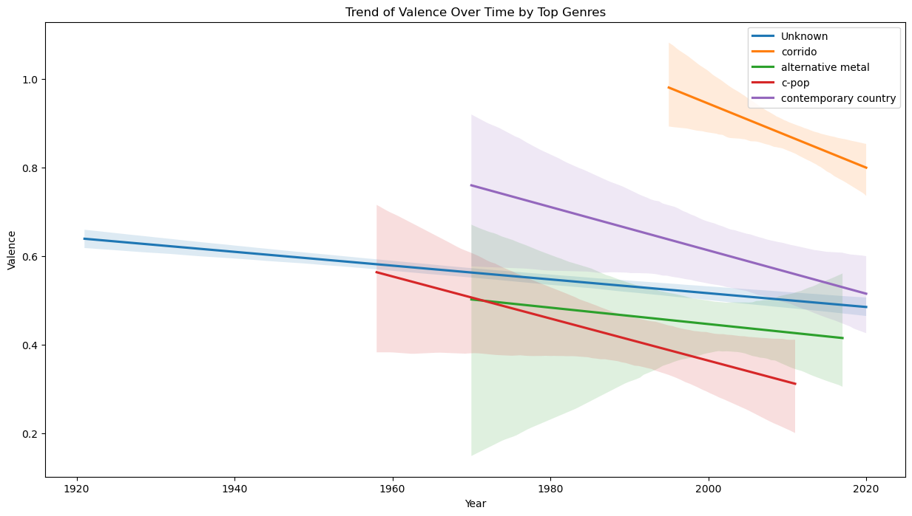

Slide 19
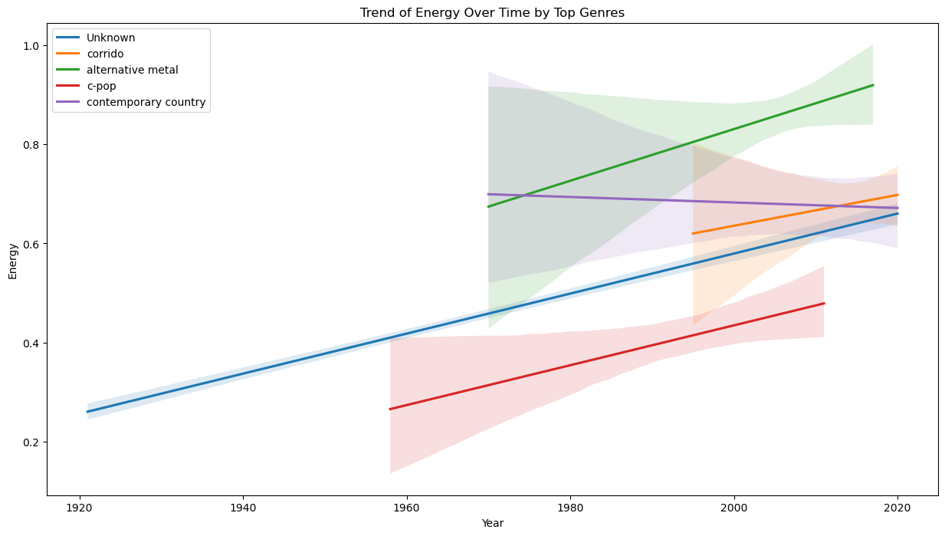

Slide 20
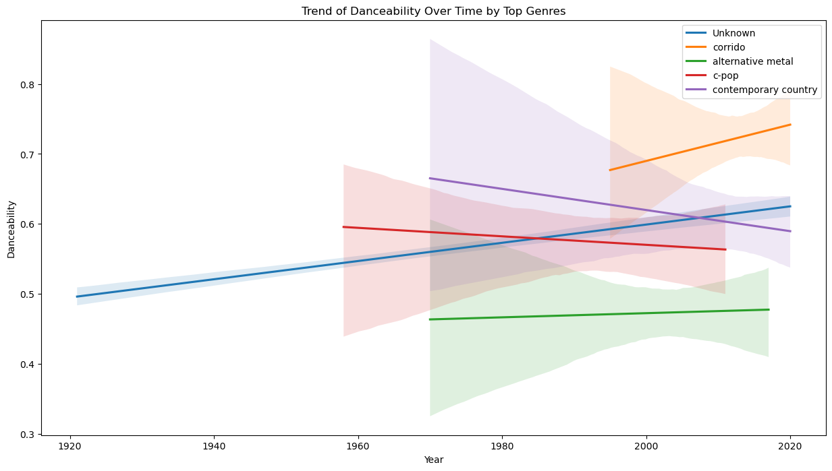

Slide 21


Slide 22
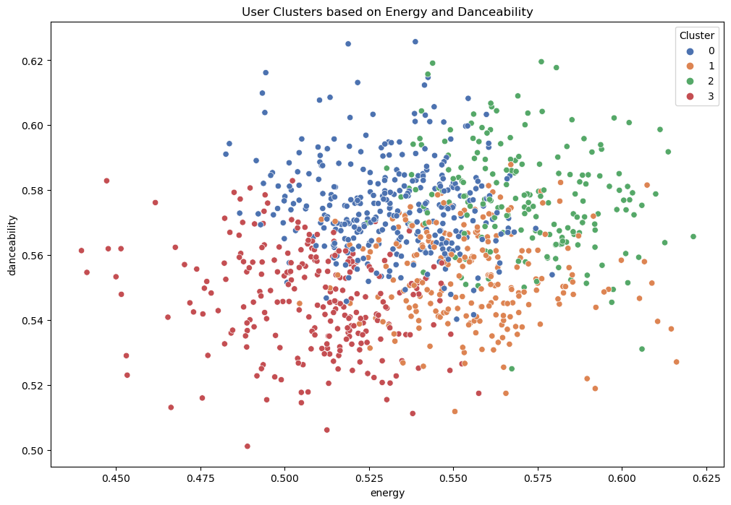

Slide 23
7.CHALLENGES
Cold Start Problem - new users or songs have little data for accurate recommendations
Serendipity – the ability to offer new content while staying within the user’s preferences
Overcoming these challenges helps Spotify improve its recommendation system and user experience

Slide 24
8. CONCLUSION
The system relies on content-based filtering to provide accurate and relevant recommendations.
The recommendation system is central to its ability to engage users through personalized music suggestions

Slide 25


Thank You

