Slide 1
Business solutions for the new aviation department.
My name is Dennis and
Welcome to my data analysis of the business problem and solutions for the companys’ business expansion project.

Slide 2
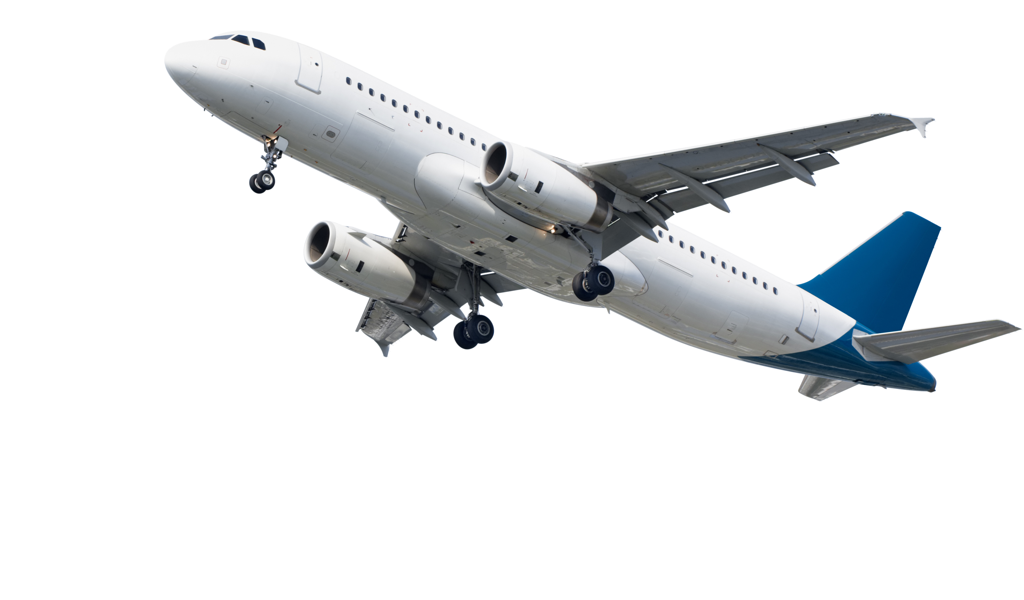
Business Understanding.
The Company is looking into expanding its portfolio and investing in new industries, they’re mainly focused on purchasing and operating airplanes for commercial and private enterprises but they don’t know anything about potential risks of aircrafts.
It’s my assignment as a data analyst to provide well tabled data/information to help the department make better and well informed decisions on matters aircraft risks and how to manage the risks to help the company invest well.

Slide 3
Data Understanding and Analysis
The data that I will be using was sourced from the National Transportation and Safety Board and it includes aviation accident data and selected incidents.
Here I will use my knowledge in data analysis to interpret and visualize the data for the board to easily understand the conclusions of my findings.
In my dataset I will get values that show the number of accidents per selected flight makes and from the two I will make recommendations on the most preferred one that I would recommend to the company for purchase.

Slide 4
Cont.
I will also select plane makes and models with minimal fatality and injury rates; which I will also recommend because their minimal injury and fatality rates indicate that incase of an accident the company liability costs will be limited because minimal fatalities and injuries mean; minimal renumeration costs to those injured and to the families of the deceased.
I will also look into planes with minimal aircraft damage during accidents; incase of an accident, the company will save on repairs .

Slide 5
Conclusion.
From the recommendations given, the department can now go and plan the budget for the purchase of the plane makes and models they’ll find safer from my presentation.

