Slide 1
Blind Equalisation in Optical Fibre Communication using RL EE4902
Charan SRiKKanth
Guide: Lakshmi narasimhan theagarajan
Co-Guide: Deepa Venkitesh

Slide 2
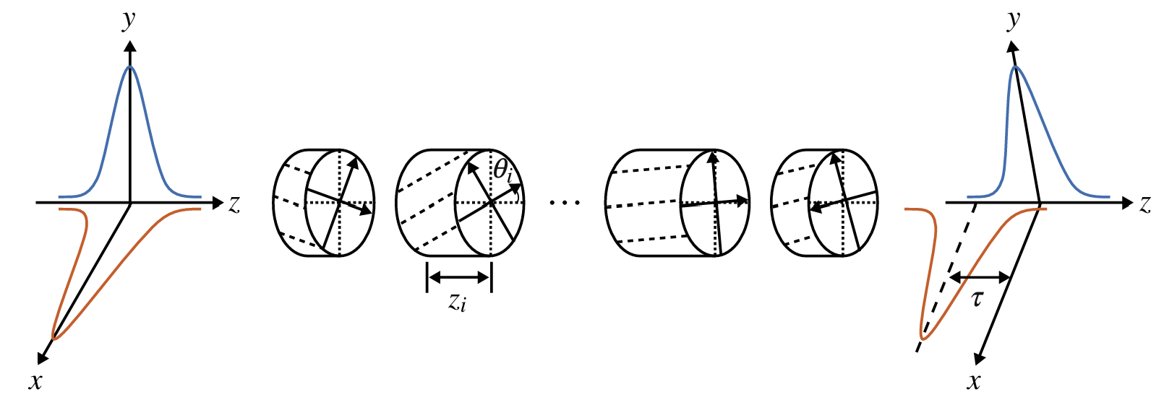
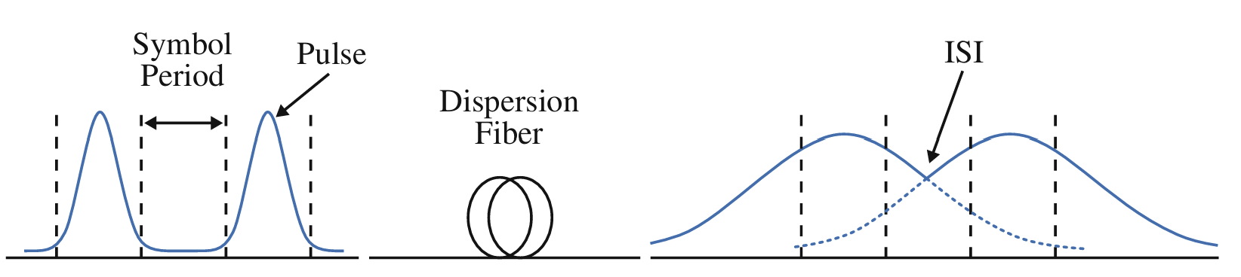
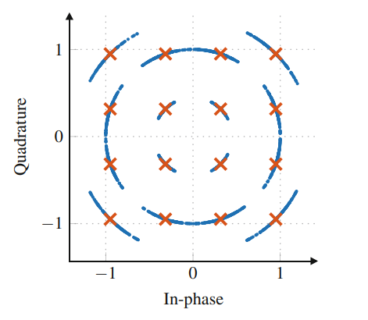
Introduction
Currently there are various distortions in an optical fibre channel
PMD
Chromatic Dispersion
Phase Noise

Slide 3



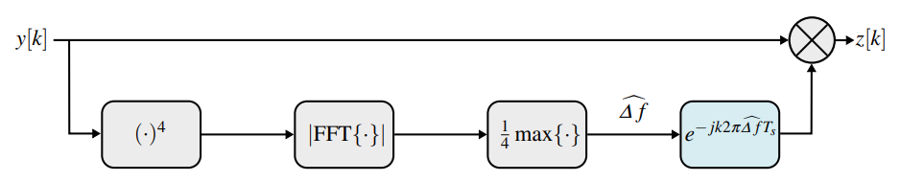
Introduction
Current ways to correct these distortions
CMA
LMS
Frequency
Offset Correction

Slide 4
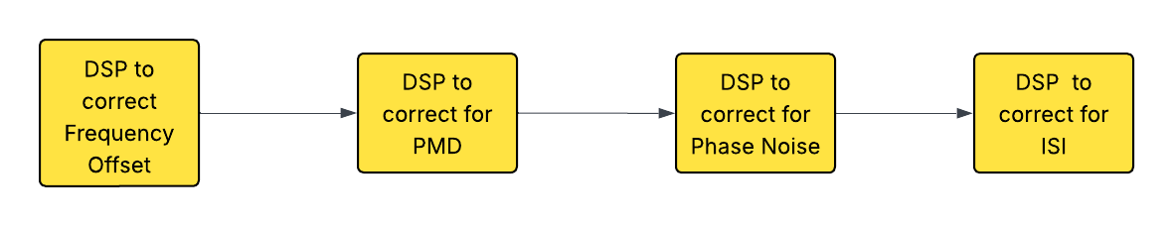
Introduction
Forthcomings of current approaches
Sequential in nature
Fails at high data rates
Time varying
Propose to use a single block to correct all distortions simultaneously

Slide 5


Problem Formulation
We tried to correct PMD. (With negligible amount of DGD).
2x2 MIMO system which had 4 filters Pxx, Pxy, Pyx, Pyy.
Each filter had 3 taps.
We made sure that the problem was solvable by CMA in order to validate our results.

Slide 6
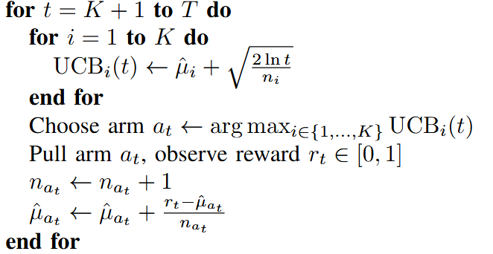
Multi Armed Bandits
Initial aim was to use MAB to solve our problem.
UCB algorithm
Gave 3 choices to each filter tap (total 3¹² arms).
One of the choices was the converged filter by CMA.
Due to exponential increase in arms we tried other methods.

Slide 7
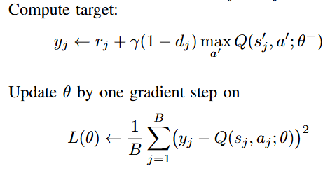

Deep Q Learning
DQN algorithm
Defined action as increase, decrease or stay same.
Total of 72 actions, 3 actions for each of the filter taps (real and imaginary).
Poor convergence.

Slide 8
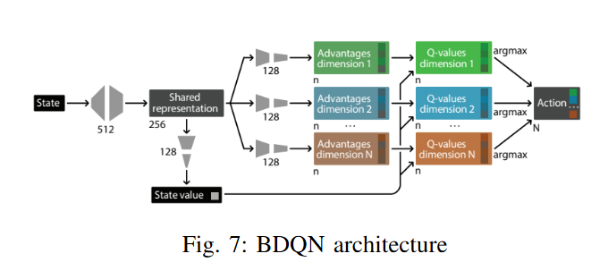

Branching Dueling Q Network
This is from the paper “Action Branching Architectures for Deep Reinforcement Learning” by Arash Tavakoli, Fabio Pardo, Petar Kormushev.
DQN for large action spaces.
Prioritised Replay buffer.
Double DQN.
Dueling Architecture.

Slide 9
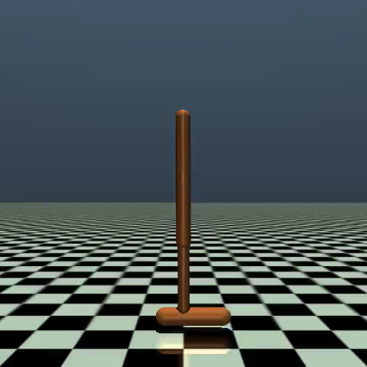
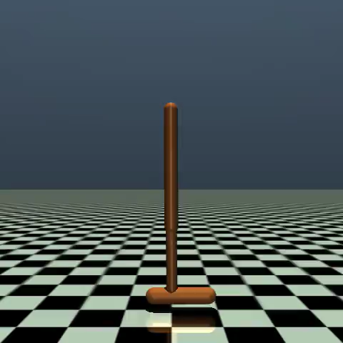
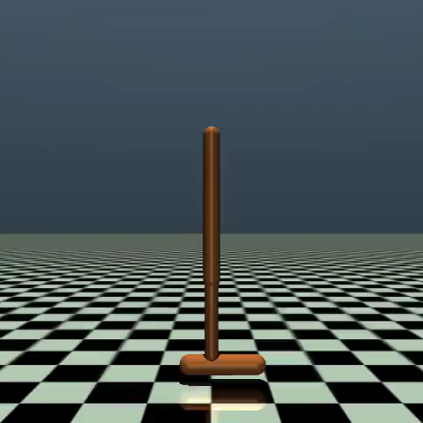
Continuous Control RL
Since none of our algorithms had converged till now we went to continuous RL.
In order to validate our model – Open AI’s Gym environment – Hopper.
We tried Deep Deterministic Policy Gradient(DDPG) and Soft Actor Critic(SAC).
BDQN
DDPG
SAC

Slide 10
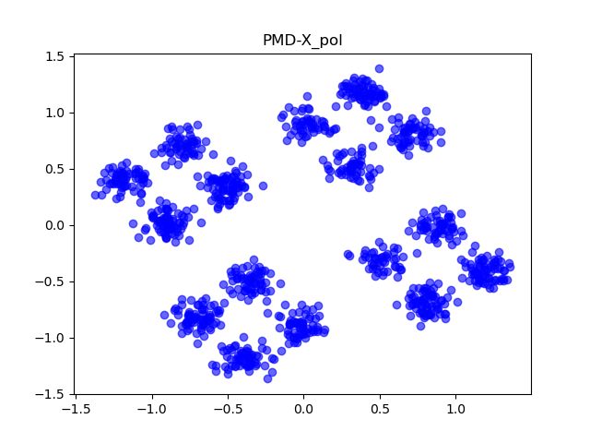
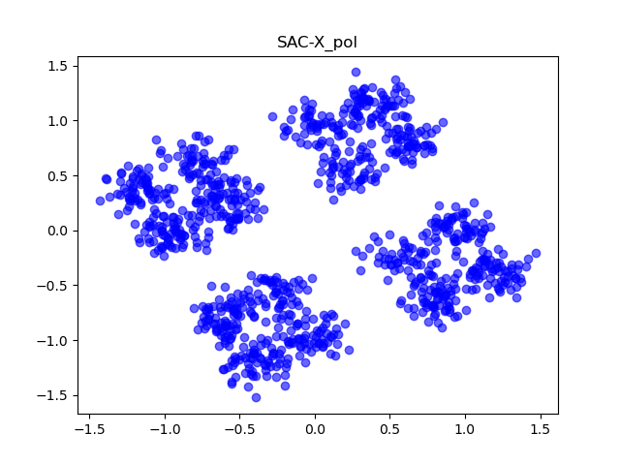
Soft Actor Critic
Not only maximises reward but also entropy of the policy.
Samples from a gaussian and produces a (24,) dim action.

Slide 11
Future Work
Improve SAC by hyperparameter tuning and better architectures
Correlated bandits
Combinatorial bandits
Restless bandits

Slide 12
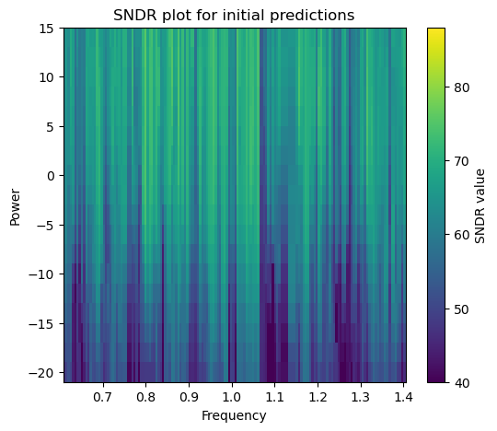
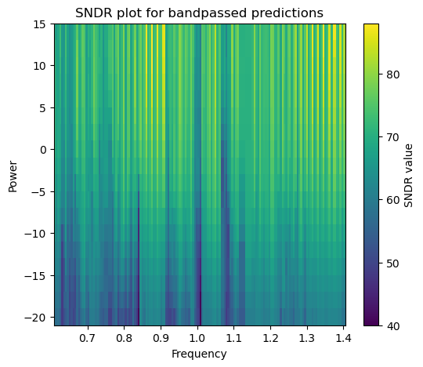
Past Work
The initial month I worked on training a model to improve on SNDR for the outputs from the FFNN model.
Created a network to predict centre frequency and took bandpass on it.
Improves SNDR by 7db on the dataset.

Slide 13
Conclusion
Special thanks to Prof. LNT and Prof. Deepa for guiding me in this project.
Special thanks to Medha for her collaboration and discussions.
THANK YOU

