Slide 1


Redis and Rate Limiting with Java

Slide 2


Redis
Redis (Remote Dictionary Server) is a source-available, in-memory data store widely used as a distributed key–value database, cache, and message broker, with optional durability features. Its in-memory design enables low-latency reads and writes, making it particularly effective for caching and real-time applications. As the most popular NoSQL database, Redis is also recognized as one of the most widely used databases overall, catering to a variety of high-performance use cases.

Slide 3

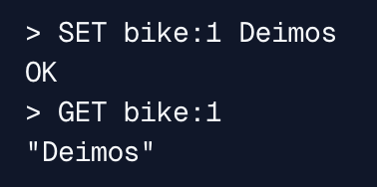
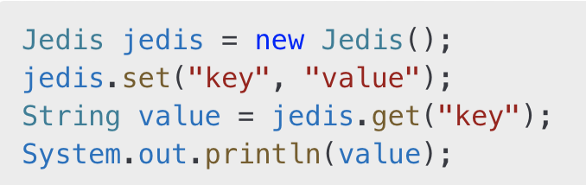
Main Redis Data Types
A simple key-value pair
Command:
Example:
Jedis example (Java):
Strings

Slide 4


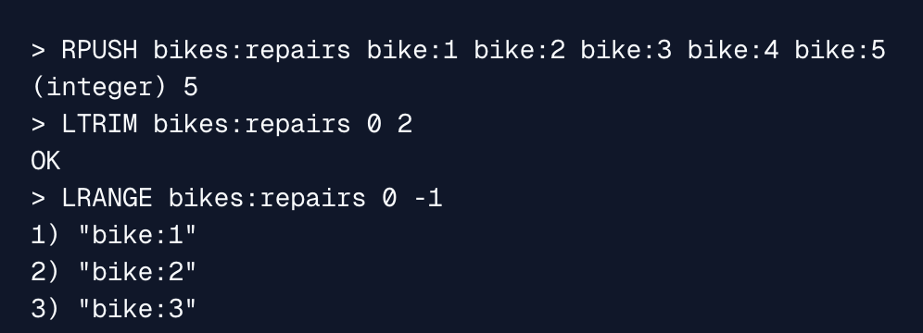
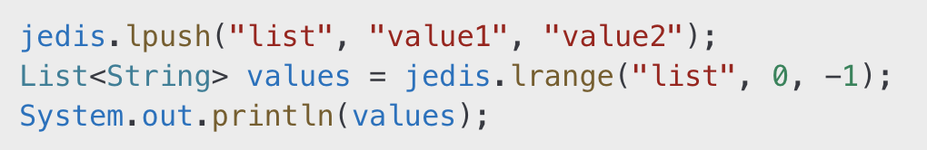
Main Redis Data Types
Ordered collection of strings.
Command:
Example:
Jedis example (Java):
Strings
Lists

Slide 5


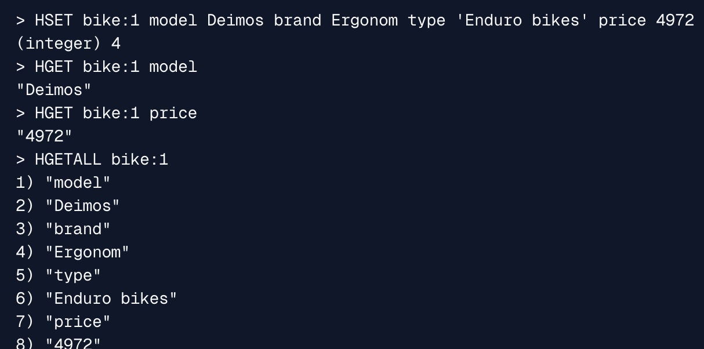
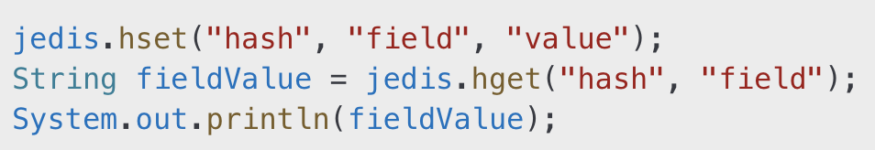
Main Redis Data Types
Key-value pairs within a key.
Command:
Example:
Jedis example (Java):
Strings
Step 2
Lists
Hashes

Slide 6


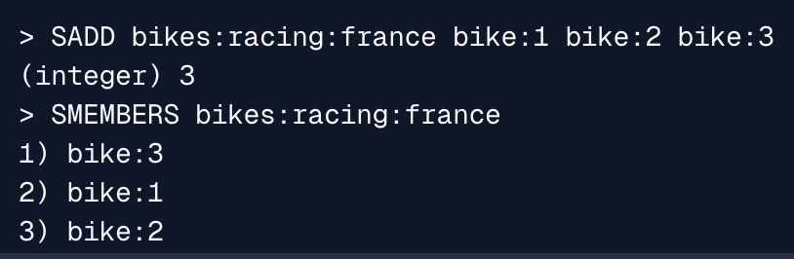
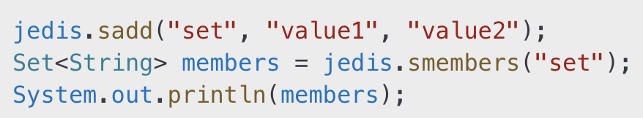
Main Redis Data Types
Unordered collection of unique strings.
Command:
Example:
Jedis example (Java):
Strings
Step 2
Lists
Hashes
Step 3
Sets

Slide 7

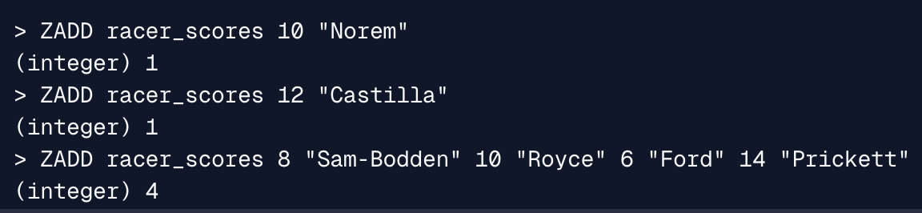
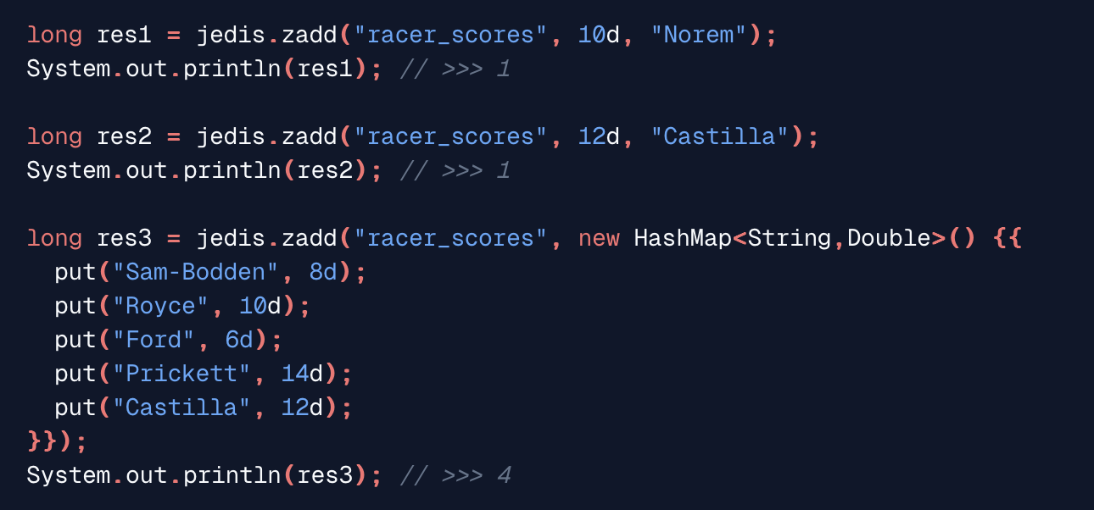
Main Redis Data Types
Similar to sets but with scores for ordering.
Unordered collection of unique strings.
Command:
Example:
Jedis example (Java):
Strings
Step 2
Lists
Hashes
Step 3
Sets
Step 4
Sorted Sets (ZSets)

Slide 8
Pipelines and Transactions

Slide 9
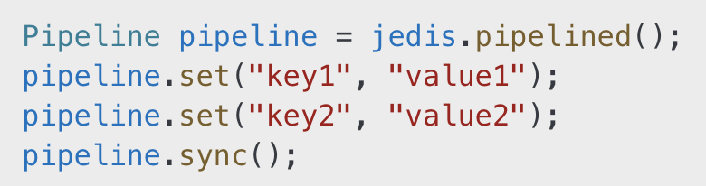
Pipelines
Used to reduce the number of round trips to the Redis server.

Slide 10
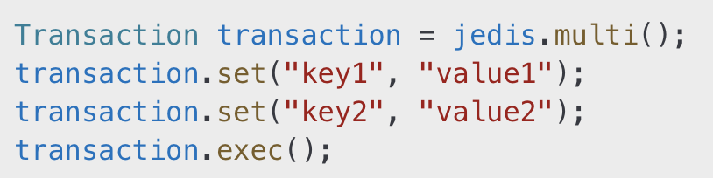
Transactions
Ensures atomic execution of a series of commands.

Slide 11
Lua Scripts in Redis

Slide 12
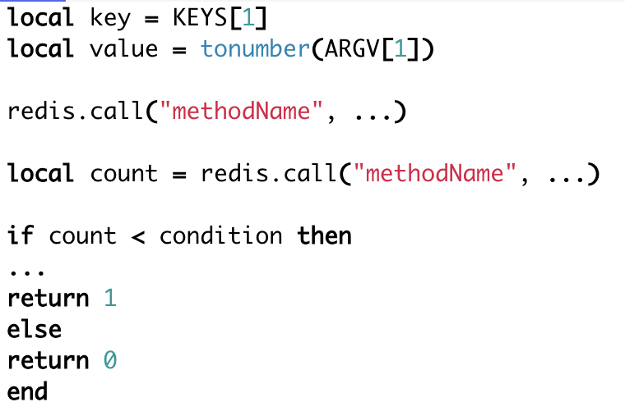
Lua Scripts in Redis
Lua scripting allows you to run server-side scripts in Redis for atomic operations.
Key Benefits:
Minimized network round-trips.
Atomic execution.

Slide 13
Rate Limiter

Slide 14
What is Rate Limiting
Rate Limiting entails techniques to regulate the number of requests a particular client can make against a networked service. It caps the total number and/or the frequency of requests.

Slide 15
Fixed Window Algorithm
Divides time into fixed intervals (e.g., 1 minute).
Pros: Simple implementation.
Cons: Potential for burst traffic at interval edges.
Useful command in Jedis:
INCR and EXPIRE

Slide 16
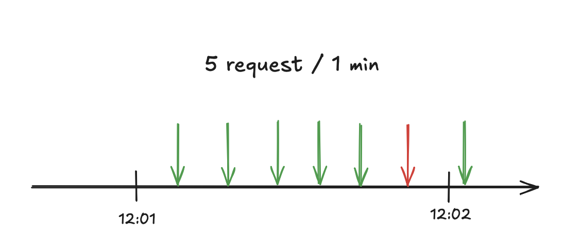
Fixed Window Algorithm

Slide 17
Sliding Window Algorithm
Allows smoother rate limiting by sliding the window dynamically.
Uses sorted sets with timestamps.
Useful command in Jedis:
ZADD, ZREMRANGEBYSCORE, and ZCARD.

Slide 18
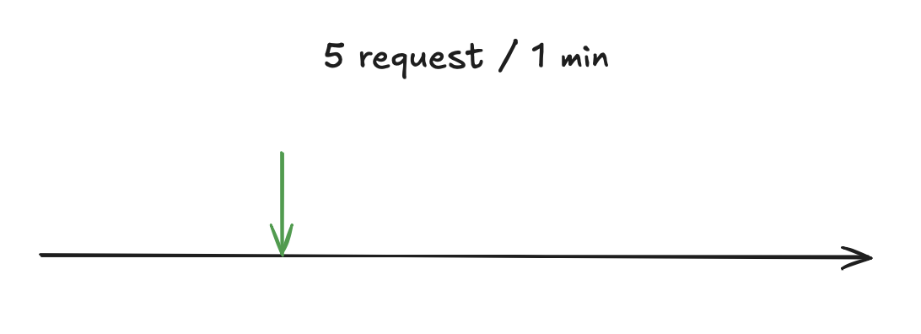
Sliding Window Algorithm

Slide 19
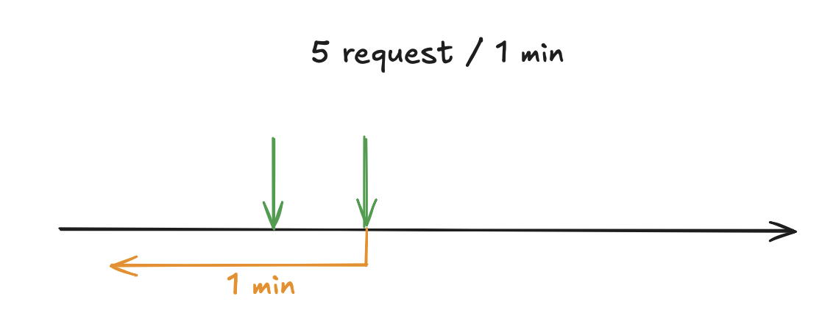
Sliding Window Algorithm

Slide 20
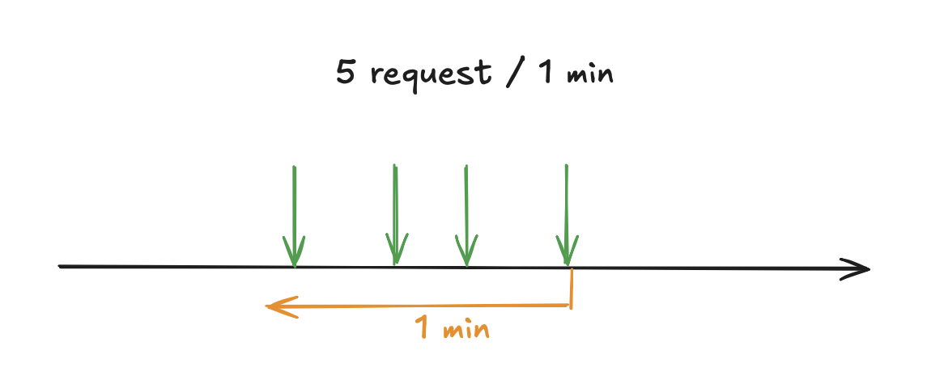
Sliding Window Algorithm

Slide 21
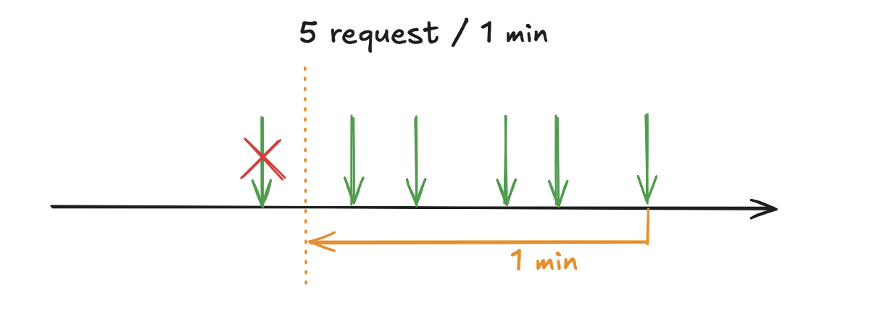
Sliding Window Algorithm

Slide 22
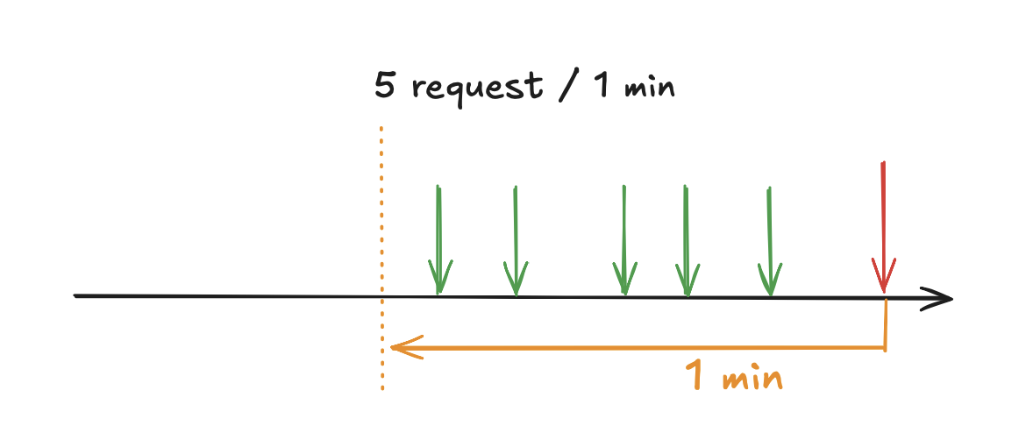
Sliding Window Algorithm

Slide 23

Thank you
Author: Dmytro Halchenko
My LinkedIn: https://www.linkedin.com/in/dmytro-halchenko-0307751b6/
Date: January 2025
Join Codeus community in Discord
Join Codeus community in LinkedIn

