Slide 1
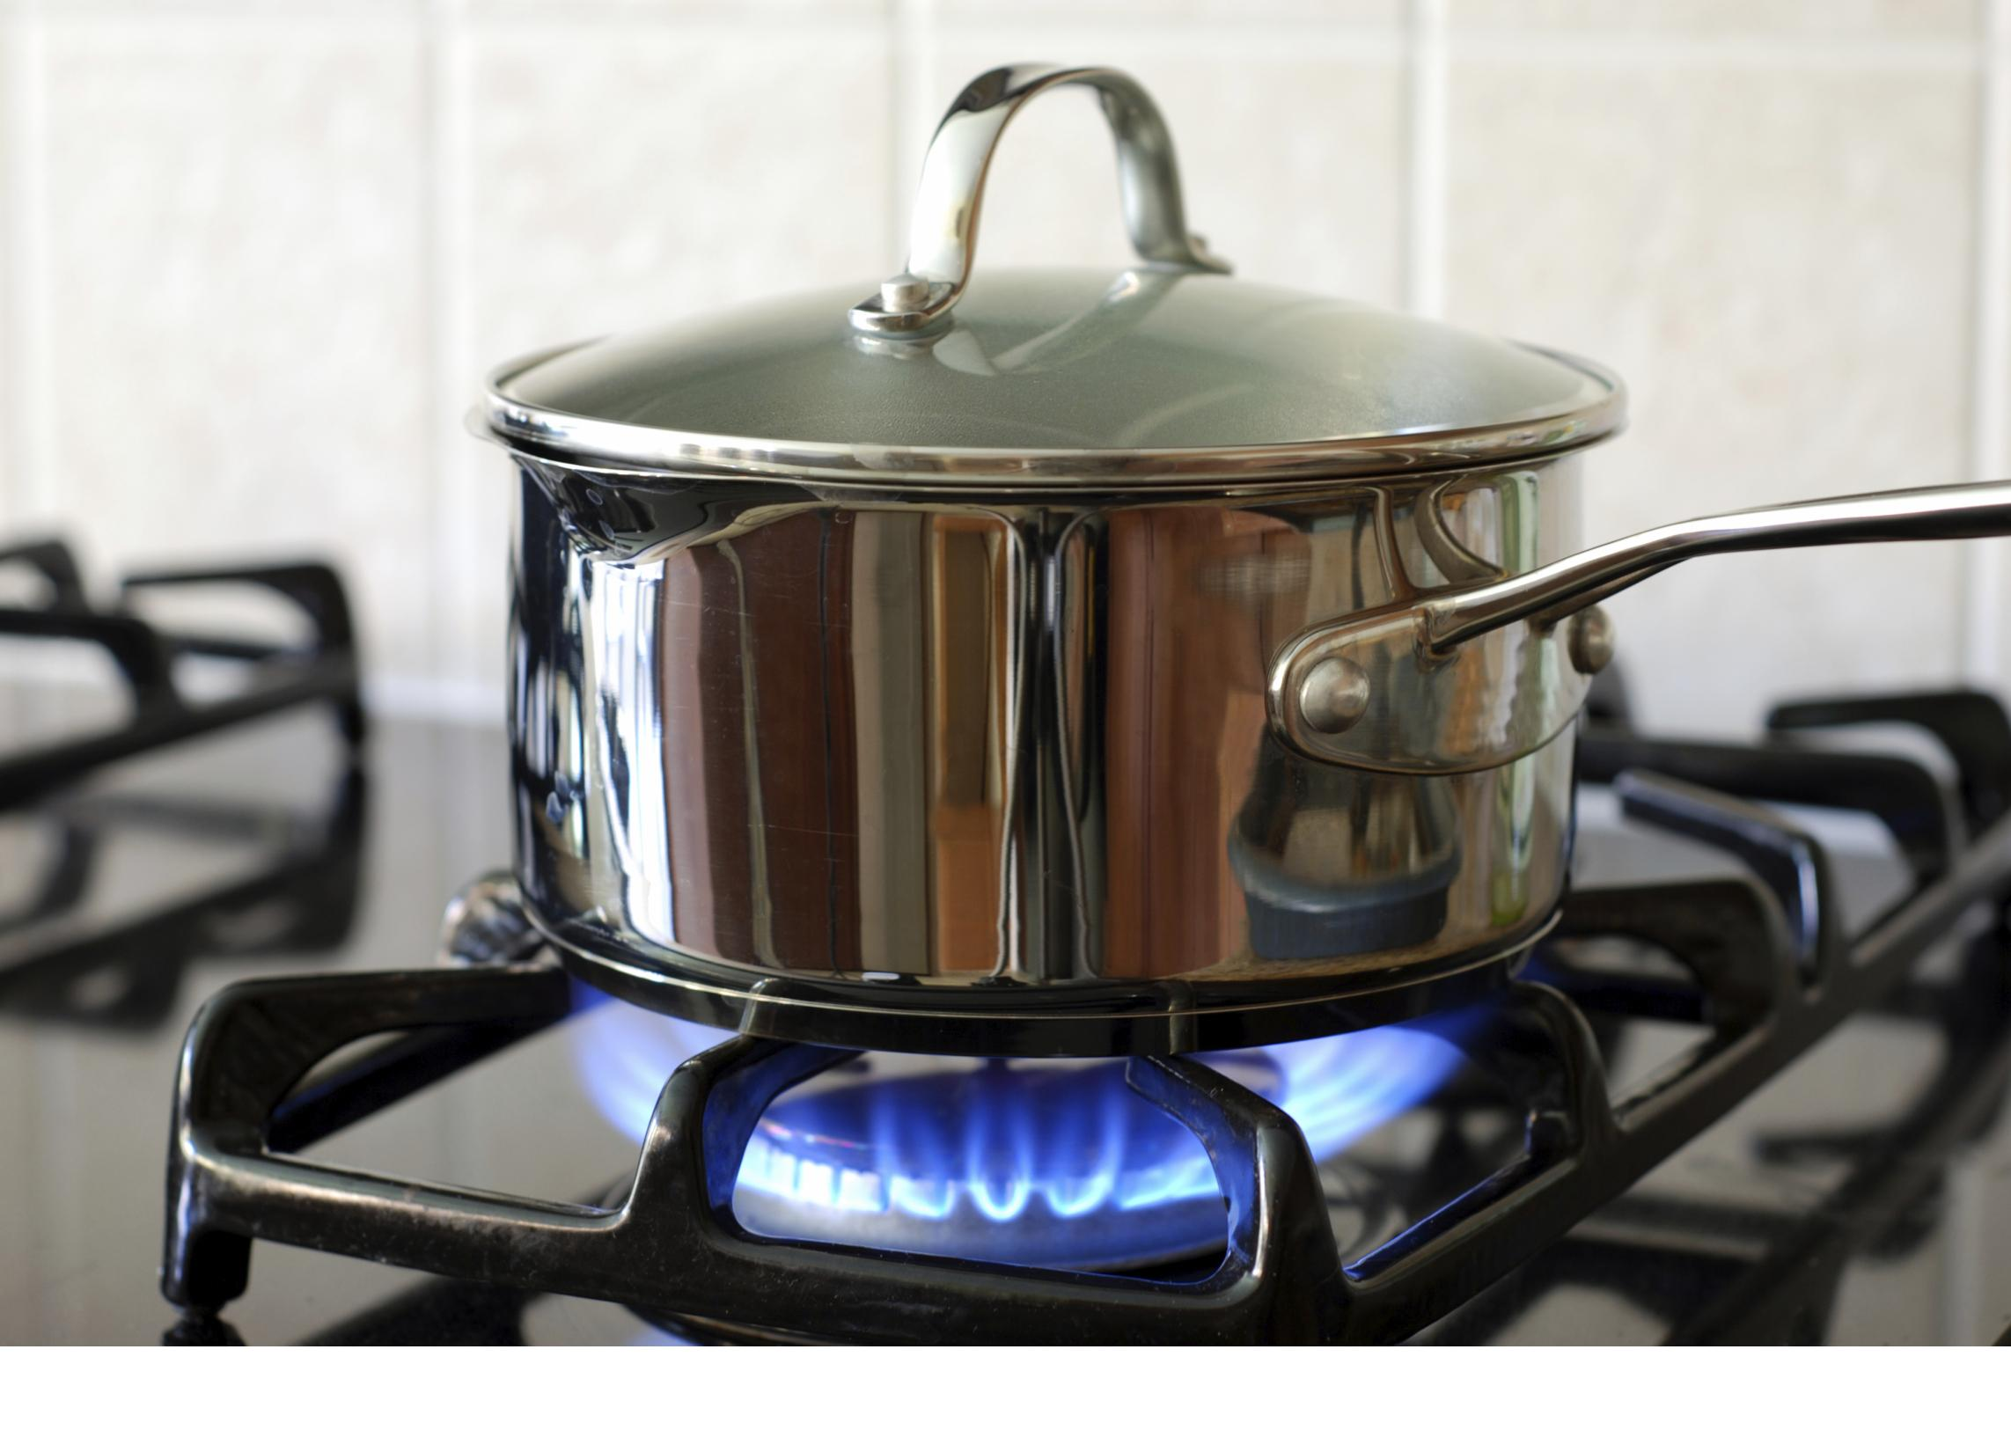
Gas
Delivery Application System
Done: Denyse Marembo - 24442

Slide 2

CONTENTS
01
Project Requirements
02
Project Plan
03
Project Scope
04
User Documentation
05
Database Schema
06
Technical Documentation

Slide 3

Home Gas Delivery App
01
This is web application that helps people to order gases online and delivered them at their home without going to market which can be time consuming. This application provides numbers of features to help the seller track and manages their stocks, orders and payments have made.

Slide 4
What are the features of the Home Gas Delivery System
Gas Management: the application allows seller to store and manage the fuel information.
Cylinder Management: the application allows seller to store and manage the cylinder that contains gas information and their stock and costs
Customer Order Management: application allows customers to make order online by themselves and be able to pay after ordering.
Reporting: application allows seller to view the performance of their business

Slide 5
Project Scope
The Scope of the project is to develop Home Gas Delivery System that will help customers to order gas online and be delivered. The application also provide features of tracking business perfomance.
Resources
The following resources will be needed to complete the project:
Java
Spring Boot
MySql
Thymeleaf
Bootstrap

Slide 6
USER DOCUMENTATION
ADMIN:
To register your Login into this system you will need to provide the email and password, you used when you were registered. You have to be autheticated and authorized in order to use admin navigation
NAVIGATION
The HOME-GAS-delivery application on admin side is dived into different sections:
DashBoard: the dashboard is for showing how your business is operating.
Fuel: the fuel section is for managing your gas types you will sell, you can add, delete, view and edit
Cylinder: The cylinder section is for managing the stock you have and total cost you invested, you can add,view,edit and delete.
Payment: The payment section is for viewing how many customers have ordered and already paid their orders
USER(CUSTOMER):
To order your gas, you have to be on our web sites, it is user friendly.
User can order through click to links that directs to order form . once you finished ordering you may choose to pay your order and payment confirmation will be done once you received email.
To login use : denysemarembo@gmail.com
Password:Marembo@12

Slide 7
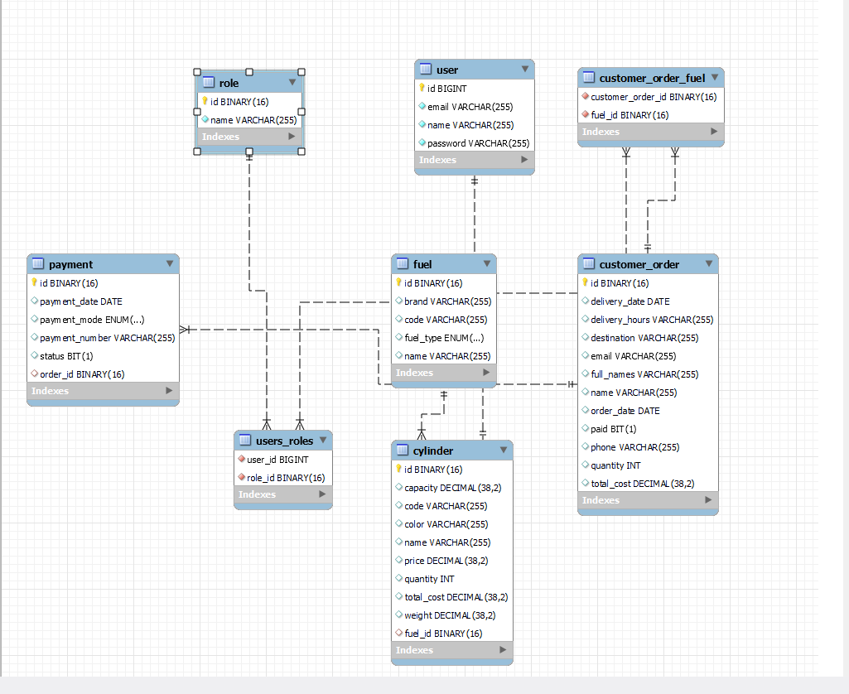
Database Schema

Slide 8
Other functionality of application
Home Gas Application has Authentication and Authorization by using spring security
CRUD(Create, Read, Update, Delete) operations on fuel and cylinder
Form Validation: validate users inputs
Search and Filtering: search and Filter

Slide 9
Technical Documentation
Architecture The Home Gas Delivery application is a web application that is implemented using the Spring Boot framework.
The Spring Boot framework provides a number of features that make it easy to develop and deploy web applications, including:
•Autoconfiguration: The Spring Boot framework automatically configures many of the dependencies that are needed for a web application. This makes it easy to get started with development.
•Starters: The Spring Boot framework provides a number of starters that make it easy to add specific features to a web application. For example, there are starters for adding a database, adding security, and adding a web server.
•Dependency management: The Spring Boot framework manages the dependencies for a web application. This makes it easy to keep the dependencies up to date and to avoid conflicts between dependencies.

Slide 10
Technical Documentation
Libraries and frameworks
The following libraries and frameworks are used in the Home Gas application:
•Spring Boot: The Spring Boot framework is used to develop and deploy the Home Gasapplication.
•Spring Data JPA: The Spring Data JPA framework is used to access the data in the
MySQL database.
•Thymeleaf: The Thymeleaf template engine is used to render the HTML pages for
the CRM application.
•Bootstrap: The Bootstrap CSS framework is used to style the HTML pages for the
Home Gas application
The Home Gas application is implemented using the following technologies:
• Java: The Home Gas application is written in Java. Java is a popular programming language that is used to develop a wide variety of applications.
• Spring Boot: The Spring Boot framework is used to develop and deploy the Home Gas application.
• MySQL: The MySQL database is used to store the data for the Home Gas application .
• Spring Data JPA: The Spring Data JPA framework is used to access the data in the MySQL database.
• Thymeleaf: The Thymeleaf template engine is used to render the HTML pages for the Home Gas application.
• Bootstrap: The Bootstrap CSS framework is used to style the HTML pages for the Home Gas application.

Slide 11
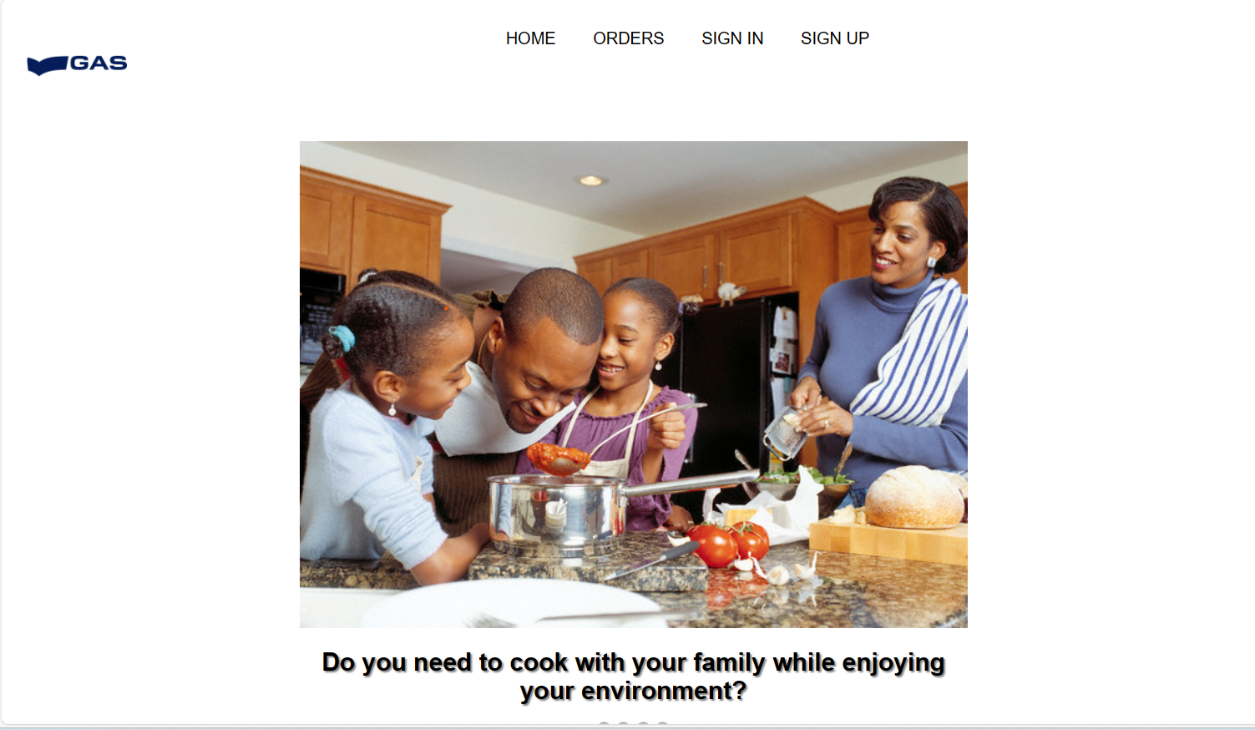
Home Page

Slide 12
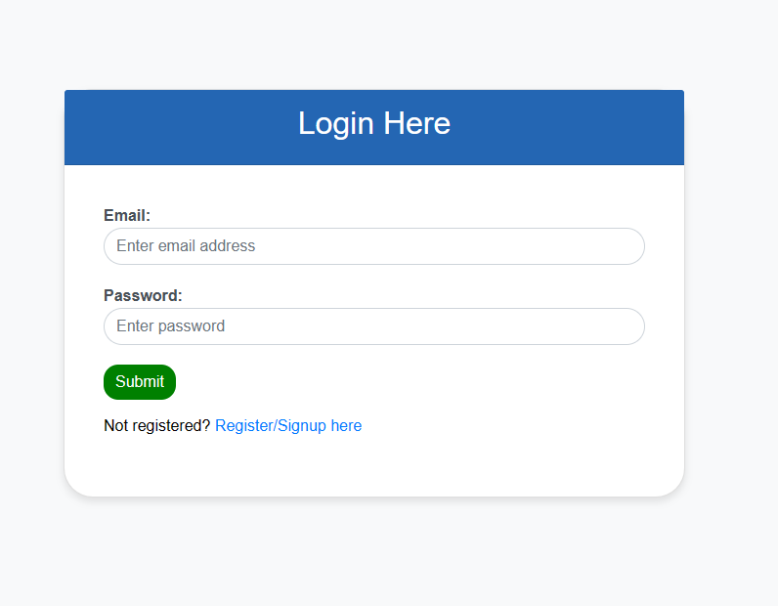
Login Page

Slide 13
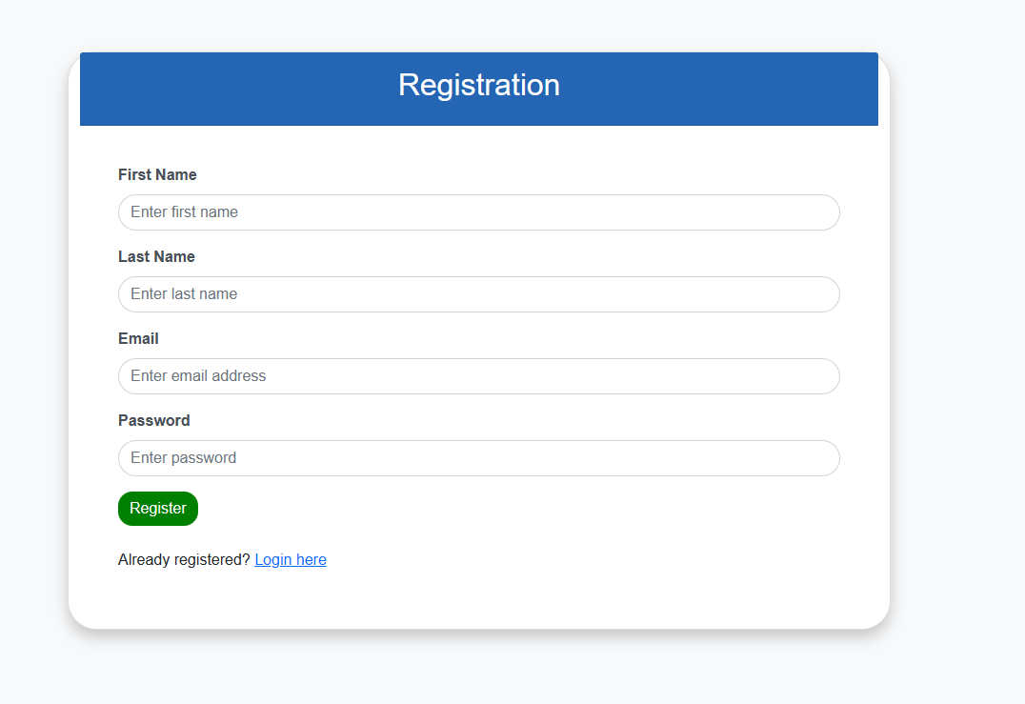
Registration Form

Slide 14
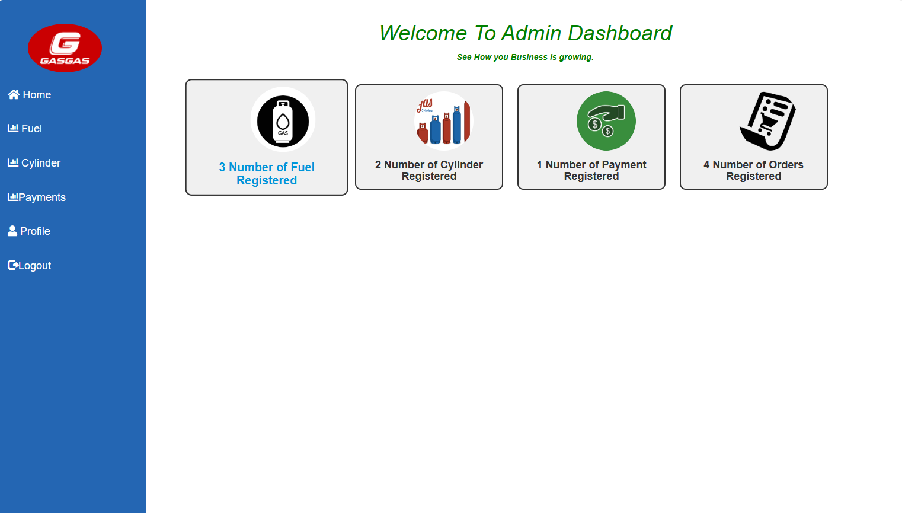
DashBoard

Slide 15
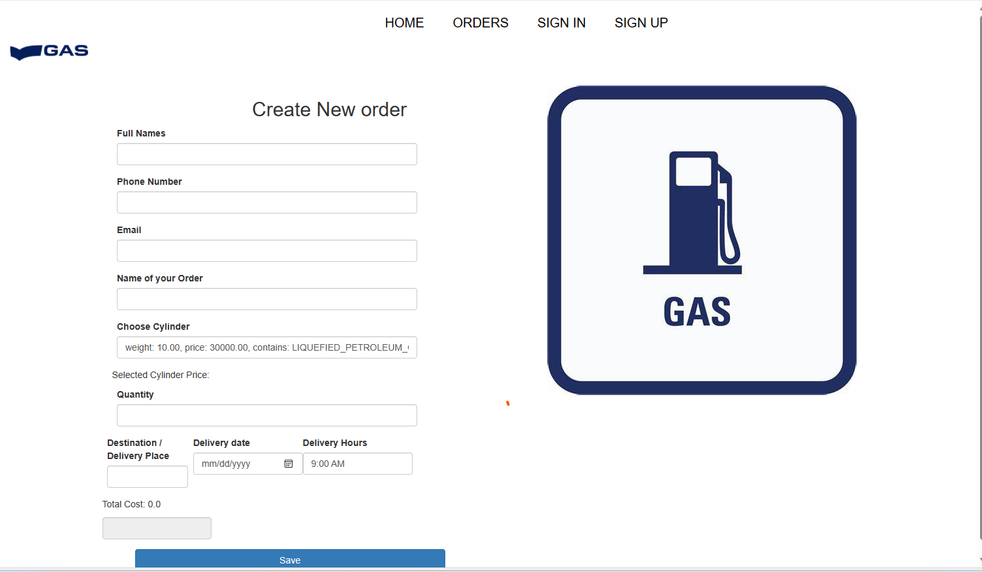
Customer order form

Slide 16
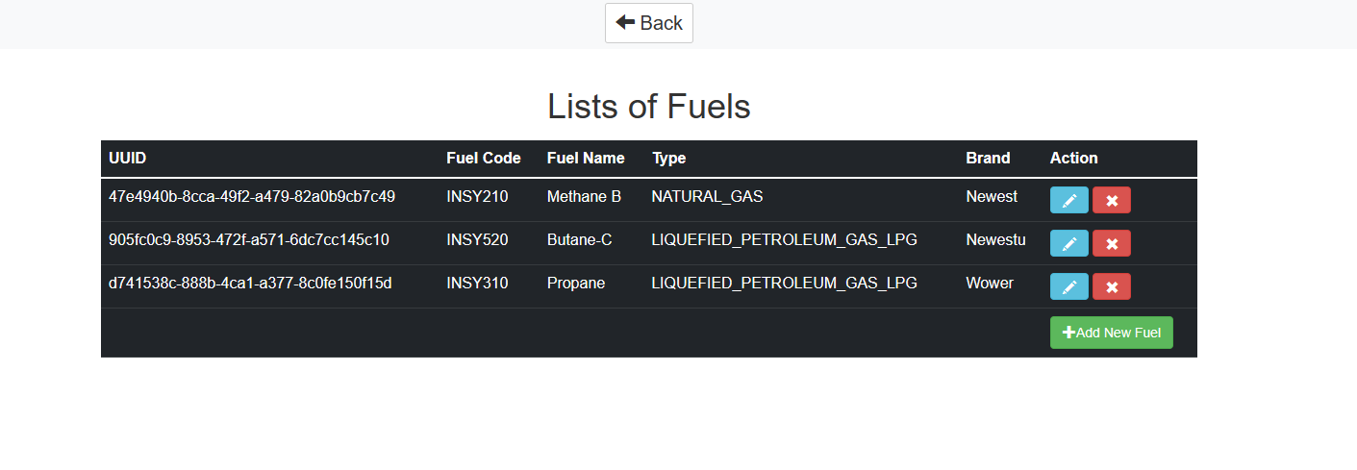
Tables

Slide 17
THANKS

