Slide 1
Unemployment and Labour Market Exclusion in South Africa
Who is hit hardest by unemployment, and where should the support go first?
Socioeconomic Development and Household Well-being (SDHSA) | Presentation
Denzel Takunda Muranganwa | Goitsemang Baloyi | Noliyolo Mamello Khotseng
Business Intelligence 381

Slide 2
One national rate hides who is affected, so DEL cannot target support
Business problem and the five objectives we set in Milestone 1
Client: Department of Employment and Labour and provincial development departments.
Problem: Official rate 31.9% to 33.5% in 2024, about 8.2 million unemployed, but very uneven across groups and places.
Question: How well can demographic, regional and education indicators predict unemployment risk, and which matter most?
Method: CRISP-DM, from business understanding to a deployed tool.
Objective | Outcome
1 Groups by age and gender | Met
2 Provinces vs national | Met
3 Education and unemployment | Met
4 Sectors, formal/informal | Not modelled, employed-only fields
5 Clear reporting for users | Dashboard and app built
< 0.1 pt
170,377
AUC 0.787
our rate vs Stats SA, every quarter
person-quarter records
80% recall at 0.20
BIN381 Milestone 4 | Unemployment and Labour Market Exclusion in South Africa
2 / 10

Slide 3
We tested the join, it failed, so we built two parallel tracks
Data sources and integration
11 files inspected, 4 used. Household files on dwellings, services, energy, connectivity and transport excluded: no link to labour status.
Track A: D11 only. Four 2024 quarters, ages 15 to 64. Feeds the models, the weighted analysis and the dashboard.
Track B: D01 + D02 + D03. Inner join: 45,326 rows before, 45,322 after. First quarter only. Descriptive context.
Why separate: 0 of 45,326 person keys in D01 appear in D11, although 938 of 1,037 area codes overlap. Merging would invent data.
Source | Raw rows | Cleaned | Removed
D01 | 70,440 | 45,326 | 25,114
D02 | 70,462 | 70,440 | 22
D03 | 70,460 | 70,440 | 20
D11 (Track A) | 170,432 | 170,377 | 55
Track A status mix: Employed 38.4%, Unemployed 18.8%, Other inactive 34.9%, Discouraged 7.9%.
A join that returns zero matches is a finding, not a failure.
BIN381 Milestone 4 | Unemployment and Labour Market Exclusion in South Africa
3 / 10

Slide 4
Each cleaning decision was checked: problem, treatment, effect, verification
Data cleaning and preprocessing
Problem | What we did in R | Check
18-digit IDs lost digits when read as numbers | Read IDs as text; key = household + person + year + quarter | Zero duplicate keys
1.8e308 used for "not applicable" (up to 87% of some columns) | Recode all values above 1e300 to missing | Count of sentinels is 0
33 spellings of 9 provinces | Trim and standardise before encoding | 9 province dummies
Outcome-derived and employed-only fields (occupation, industry, earnings, hours, informal) | Dropped before modelling, with identifiers and weights | Leakage list; recipe fitted on training data only
Only 18.8% of records unemployed | Stratified 70/30 split (seed 2026); thresholds tuned, nothing discarded | Class share equal in train and test
BIN381 Milestone 4 | Unemployment and Labour Market Exclusion in South Africa
4 / 10

Slide 5
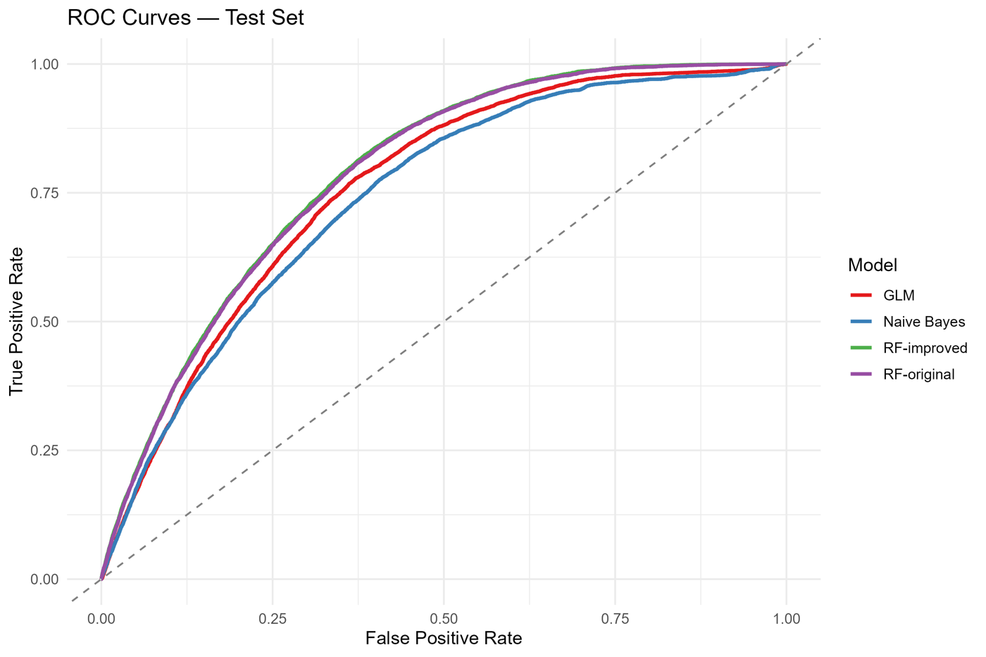
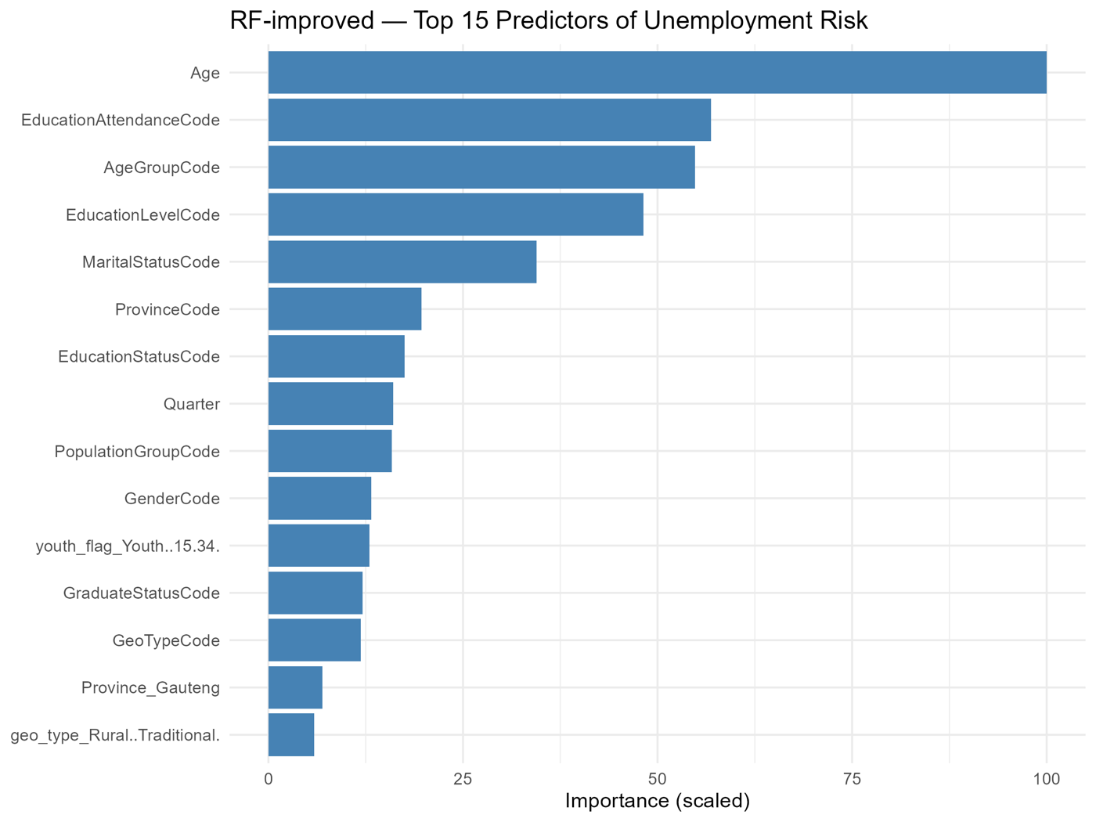
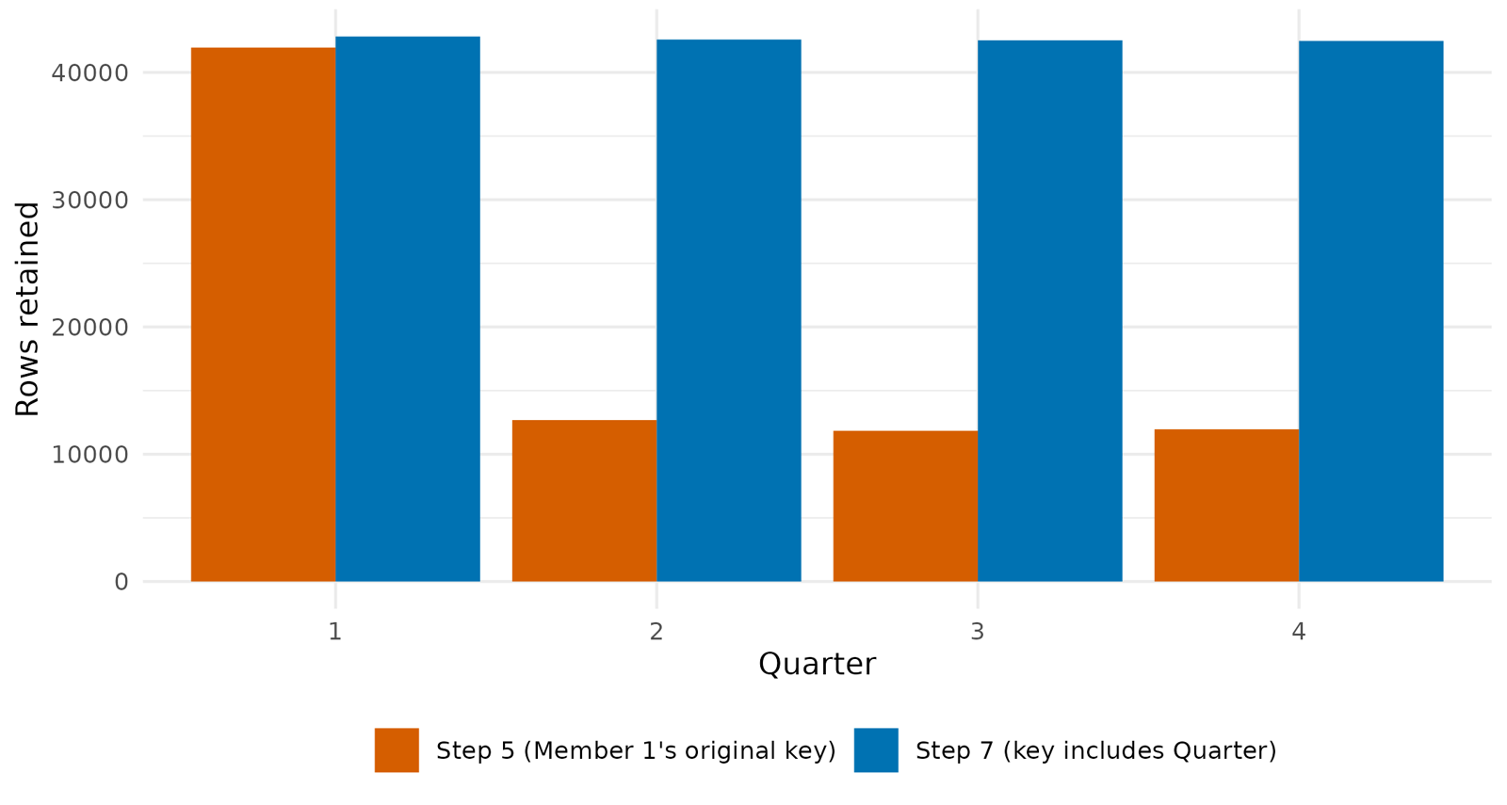
We followed CRISP-DM and compared three models, judged on more than accuracy
Analysis and modelling methodology
Task: is a person unemployed (1) or not (0)? 18.8% are.
Models: logistic regression, Naive Bayes, random forest (500 trees, 5-fold CV).
Split: 70/30 stratified, seed 2026.
Weights: used for every headline rate, not as model inputs.
Metrics: recall, precision, specificity, balanced accuracy, AUC.
Leakage: outcome-derived fields removed before training.
BIN381 Milestone 4 | Unemployment and Labour Market Exclusion in South Africa
5 / 10

Slide 6
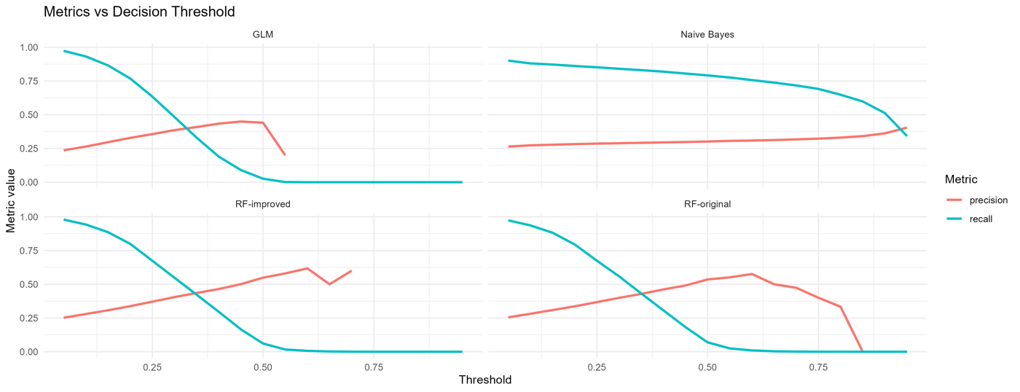
Youth, women and rural traditional areas are hit hardest; the model finds 80%
Key findings (weighted, 2024) and model evaluation (test set, n = 51,114)
45.6%
49% | 42%
40.0%
32.6%
youth rate vs 23.0% for adults
young women | young men
North West, highest province
of the unemployed live in Gauteng
Model | AUC | Recall | Precision | Spec.
Logistic (0.50) | 0.759 | 0.026 | 0.441 | 0.992
Naive Bayes (0.50) | 0.741 | 0.792 | 0.302 | 0.575
Random forest (0.50) | 0.787 | 0.061 | 0.549 | 0.988
Random forest (0.20) | 0.787 | 0.800 | 0.338 | 0.636
Matches Stats SA within 0.1 point each quarter. At 0.20, 4 in 5 unemployed people are found, but only 1 in 3 flags is correct: a screening aid, not a verdict.
BIN381 Milestone 4 | Unemployment and Labour Market Exclusion in South Africa
6 / 10

Slide 7
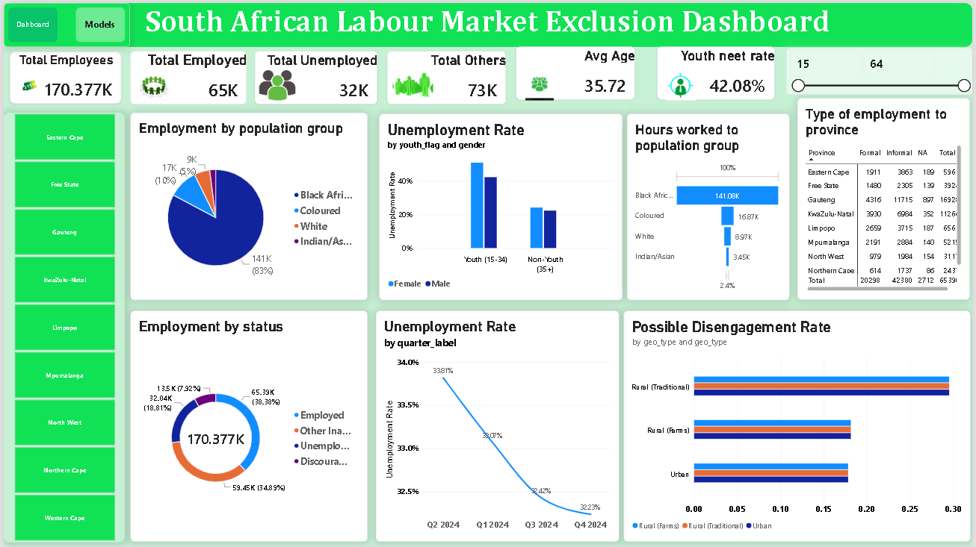
Power BI: one page that answers who, where and when
Dashboard demonstration
KPIs: records, employed, unemployed, others, average age 35.7, youth NEET 42.1%.
Filters: province buttons and an age slider update every chart.
Charts: status mix, population group, youth by gender, quarterly trend, disengagement by area.
Read with care: figures are sample counts; weighted national rate is 32.6% (sample 32.9%).
BIN381 Milestone 4 | Unemployment and Labour Market Exclusion in South Africa
7 / 10

Slide 8
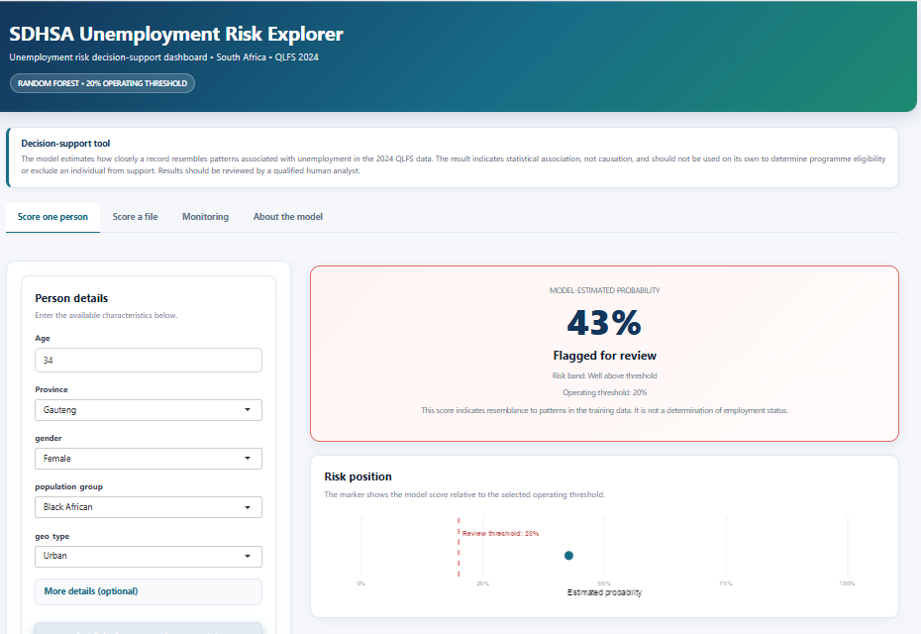
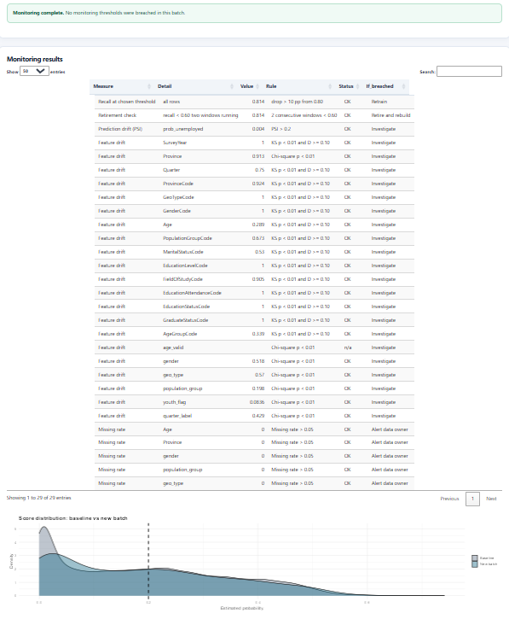
R/Shiny: score a person or a file, then monitor the model
Deployment demonstration
Score: one person or a CSV; every input validated first.
Result: probability, flag at 0.20, banner: not a determination.
Monitor: score drift (PSI), feature drift, missing data, recall, run log.
Tests: 29-row upload all OK; 500-row log PSI 0.004, recall 0.814.
BIN381 Milestone 4 | Unemployment and Labour Market Exclusion in South Africa
8 / 10

Slide 9
Recommendations, ethics and limitations
All three members
Recommendations
Ethics: recall by group
Limitations
Young people first: 59.5% of the unemployed, young women 49%.
Use rates and headcounts together: North West and Eastern Cape for intensity, Gauteng and KwaZulu-Natal for volume.
Bridge school to work: 66% of the unemployed hold matric.
Screen, then review by hand; expect 2 in 3 flags to be wrong.
Group | Recall
Black African | 83%
Coloured | 62%
Indian/Asian | 37%
White | 36%
Youth | 35+ | 91% | 64%
One year of data; random split, no future-quarter test.
Associations, not causes.
Formal/informal coding unverified.
Dashboard shows sample counts, no user testing yet.
Quarter used as a predictor.
No login; no automatic retraining.
Black African 83%, White 36%: a 46-point gap.
Gender gap 0.2 points.
Advisory use only; gaps shown in the app; no thresholds by race.
BIN381 Milestone 4 | Unemployment and Labour Market Exclusion in South Africa
9 / 10

Slide 10
Conclusion and future work
Member 3
Who: young people, women, rural traditional areas.
Where: highest rates in North West, Eastern Cape, Free State; most people in Gauteng and KwaZulu-Natal.
How we know: weighted rates match Stats SA within 0.1 point.
Model: finds 80% of unemployed people at 0.20, with uneven performance across groups, so it is decision support only.
Handover: repository, run order, monitoring and retirement rules, ethics report and AI log.
Future work
More QLFS waves; test on a held-out future quarter.
Weighted measures and sorted quarters on the dashboard.
Resolve the formal/informal coding to study sectors.
Group-aware retraining for low-recall groups.
Usability test with DEL analysts; add login and a plumber API.
BIN381 Milestone 4 | Unemployment and Labour Market Exclusion in South Africa
10 / 10

