Slide 1
Deep Q-network
이경택

Slide 2
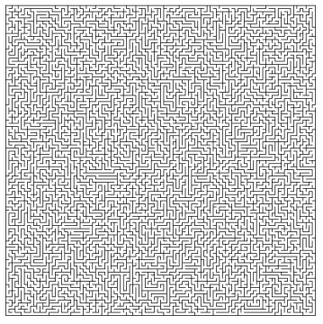
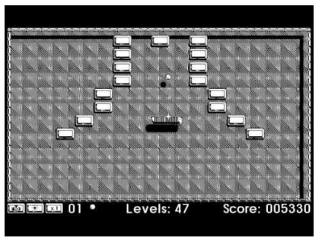
Q-network
1
ISD lab
Q-Table을 현실에 적용하기엔 무리가 있음
100 x 100 image
80 x 80 image x 2 color

Slide 3
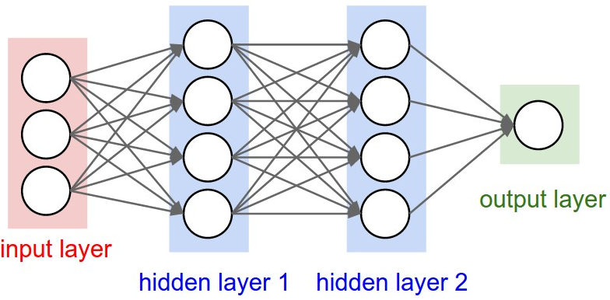
Q-network
1
ISD lab
Neural network로 Q-function Approximation
Q value
LEFT : 0.3
State (S)
RIGHT : 0.1
UP : 0.3
DOWN : 0.9

Slide 4
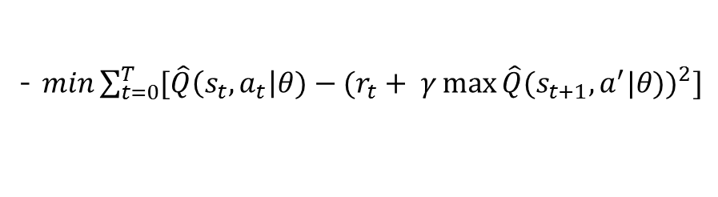





Q-network
1
ISD lab
Approximate $Q^{∗}$function using $θ$ $\hat{Q}\left(s, a\right|θ) \sim Q^{∗}$(s,a)
s
$Ws \left( \hat{Q}\left(s, a\right|θ\right)$ )
W
- $cost\left(W\right)={( Ws −y)}^{2}$
- $y=r+ γ\max{Q(s^{′})}$
$$Q^{∗}$$
- $min\sum_{t=0}^{T}{[{\hat{Q}\left(s_{t}, a_{t}\right|θ)−(r_{t}+ γ\max{\hat{Q}{(s}_{t+1}, a^{′}|θ))}}^{2}]}$
$$a^{′}$$

Slide 5

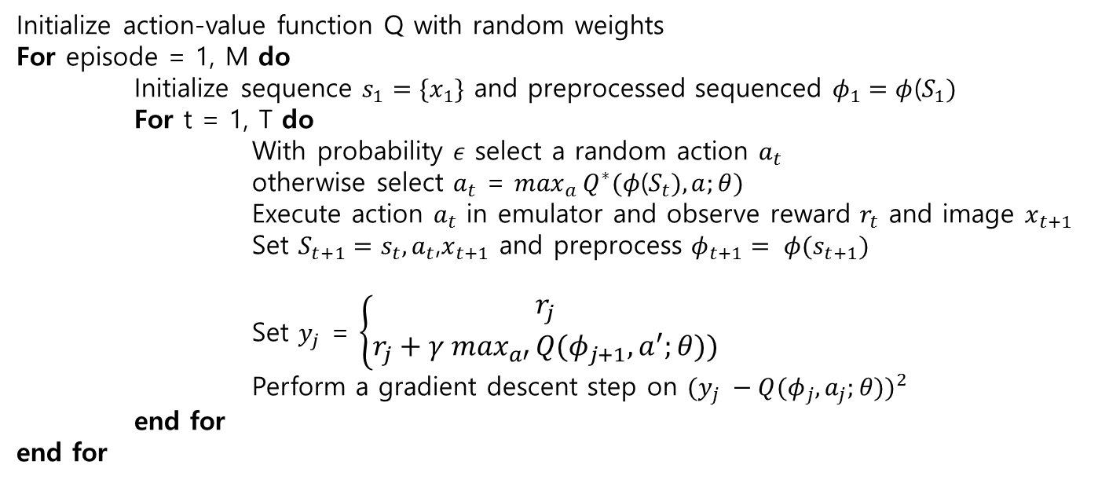
Q-network
1
ISD lab
Algorithm
Initialize action-value function Q with random weights
For episode = 1, M do
Initialize sequence $s_{1}=\{x_{1}\}$ and preprocessed sequenced $φ_{1}=φ$($S_{1})$
For t = 1, T do
With probability $ε$ select a random action $a_{t}$
otherwise select $a_{t}$ = $\max_{a}{Q^{∗}(φ\text{(}S_{t}),a;θ)}$
Execute action $a_{t}$ in emulator and observe reward $r_{t}$ and image $x_{t+1}$
Set $S_{t+1}=s_{t},a_{t}$,$x_{t+1}$ and preprocess $φ_{t+1}= φ(s_{t+1})$
Set $y_{j}$ = $\left\{\begin{aligned}r_{j} \\ r_{j}+γ \max_{a′}{Q{(φ}_{j+1}, a^{′};θ))}\end{aligned}\right.$
Perform a gradient descent step on ${(y_{j} −Q{(φ}_{j},a_{j};θ))}^{2}$
end for
end for
for terminal $φ_{j+1}$
for non-terminal $φ_{j+1}$

Slide 6
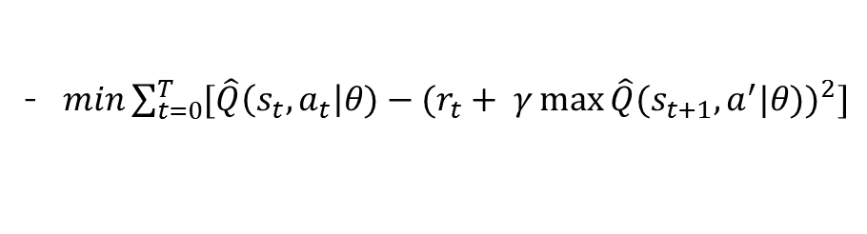
Q-network
1
ISD lab
단점
- $min\sum_{t=0}^{T}{[{\hat{Q}\left(s_{t}, a_{t}\right|θ)−(r_{t}+ γ\max{\hat{Q}{(s}_{t+1}, a^{′}|θ))}}^{2}]}$
수렴하지 않을 수 있음
Correlations between samples Non-stationary target

Slide 7
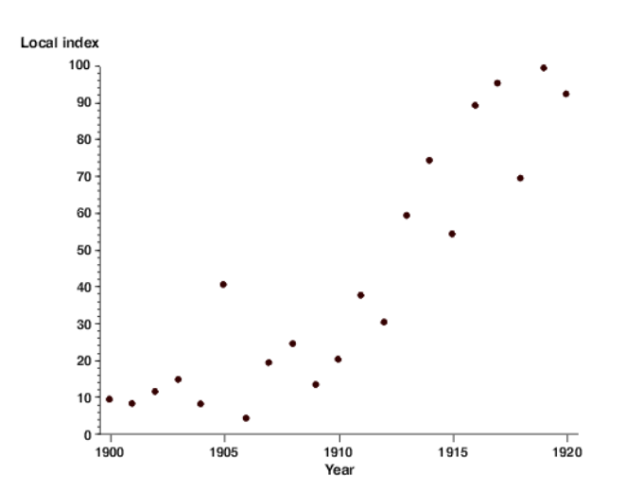
Q-network
1
ISD lab
단점
Correlations between samples
(t-1 시점의 state와 t시점의 state는 유사할 것)
best

Slide 8


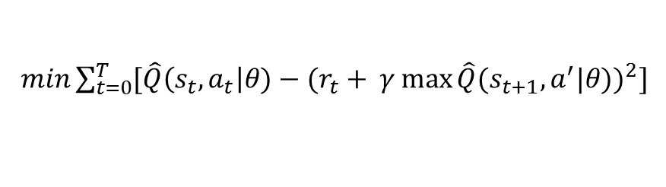
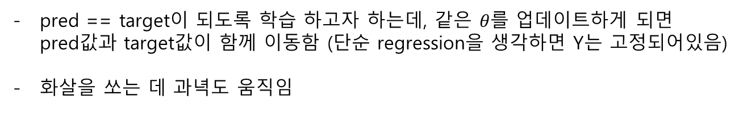


Q-network
1
ISD lab
단점
Non-stationary target
$min\sum_{t=0}^{T}{[{\hat{Q}\left(s_{t}, a_{t}\right|θ)−(r_{t}+ γ\max{\hat{Q}{(s}_{t+1}, a^{′}|θ))}}^{2}]}$
$$θ$$
pred
target
$$\hat{Y}=\hat{Q}\left(s_{t}, a_{t}\right|θ)$$
$$Y= r_{t}+γmax\hat{Q}{(s}_{t+1}, a^{′}|θ)$$
$$a^{′}$$
pred == target이 되도록 학습 하고자 하는데, 같은 $θ를$ 업데이트하게 되면 pred값과 target값이 함께 이동함 (단순 regression을 생각하면 Y는 고정되어있음)
화살을 쏘는 데 과녁도 움직임

Slide 9
Q-network
1
ISD lab
Q-network 단점에 대한 Solution
Go Deep
Capture and replay - correlation between samples
Separate networks : create a target network - Non-stationary targets

Slide 10
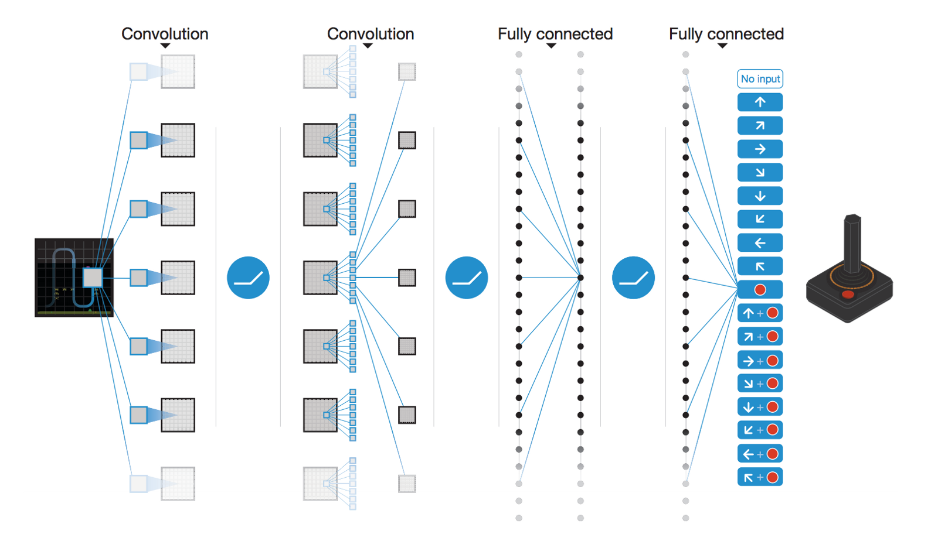
DQN (Deep Q-Network)
2
ISD lab
Go deep
Deep 하게 학습시킴으로써 더 학습이 잘 되도록

Slide 11
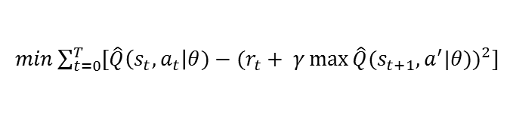
DQN (Deep Q-Network)
2
ISD lab
Capture and replay
episode1
s1, a1, r2, s2
s2, a2, r3, s3
s3, a3, r4, s4
s4, a4, r5, s5
…
st, at, rt+1, st+1
episode2
capture
$min\sum_{t=0}^{T}{[{\hat{Q}\left(s_{t}, a_{t}\right|θ)−(r_{t}+ γ\max{\hat{Q}{(s}_{t+1}, a^{′}|θ))}}^{2}]}$
episodeN
random sample & replay
기존 : Epsiode1(step1) -> backpropagation,
Epsiode1(step2) -> backpropagation …
DQN : epsiode1 -> episode2 -> episodeN
-> random sample -> backpropagation …

Slide 12

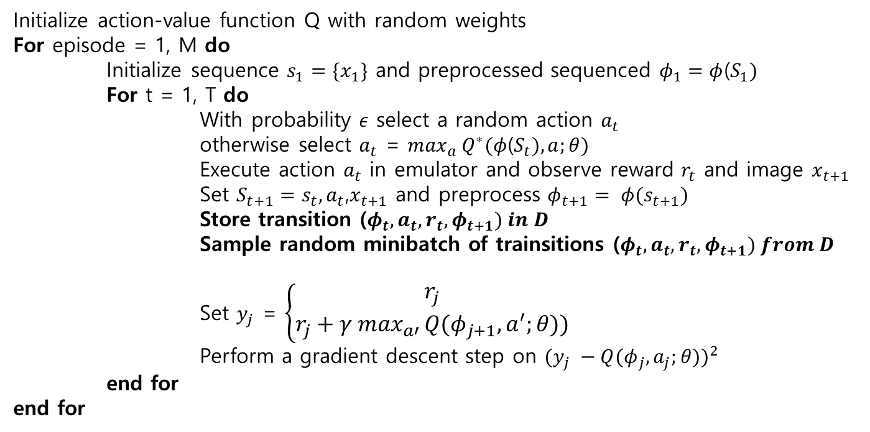
DQN (Deep Q-Network)
2
ISD lab
Capture and replay
Initialize action-value function Q with random weights
For episode = 1, M do
Initialize sequence $s_{1}=\{x_{1}\}$ and preprocessed sequenced $φ_{1}=φ$($S_{1})$
For t = 1, T do
With probability $ε$ select a random action $a_{t}$
otherwise select $a_{t}$ = $\max_{a}{Q^{∗}(φ\text{(}S_{t}),a;θ)}$
Execute action $a_{t}$ in emulator and observe reward $r_{t}$ and image $x_{t+1}$
Set $S_{t+1}=s_{t},a_{t}$,$x_{t+1}$ and preprocess $φ_{t+1}= φ(s_{t+1})$
Store transition ($φ_{t}, a_{t},r_{t},φ_{t+1}) in D$
Sample random minibatch of trainsitions ($φ_{t}, a_{t},r_{t},φ_{t+1}) from D$
Set $y_{j}$ = $\left\{\begin{aligned}r_{j} \\ r_{j}+γ \max_{a′}{Q{(φ}_{j+1}, a^{′};θ))}\end{aligned}\right.$
Perform a gradient descent step on ${(y_{j} −Q{(φ}_{j},a_{j};θ))}^{2}$
end for
end for
for terminal $φ_{j+1}$
for non-terminal $φ_{j+1}$

Slide 13

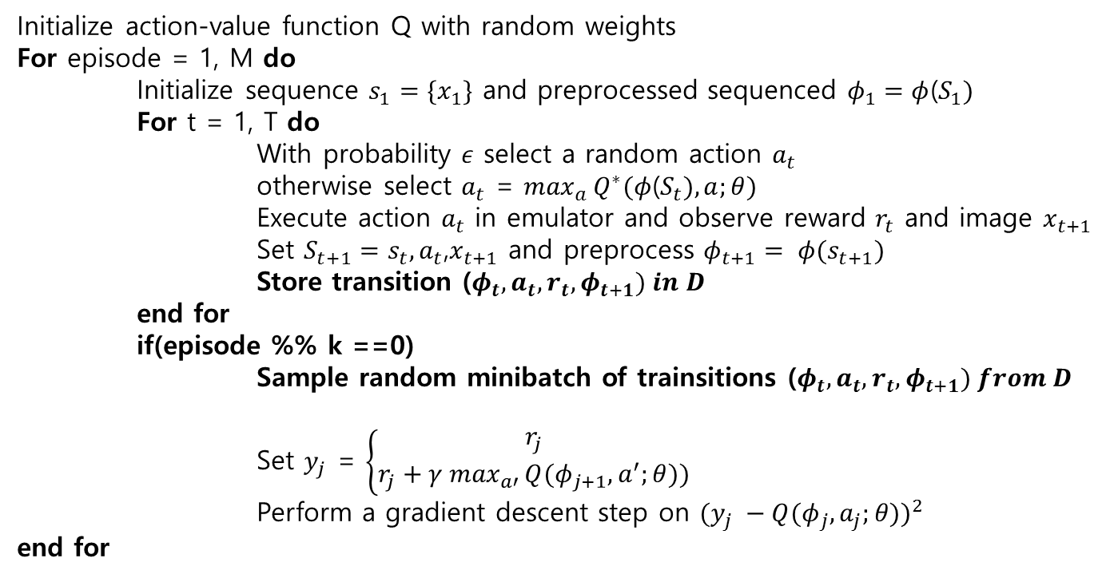
DQN (Deep Q-Network)
2
ISD lab
Capture and replay
Initialize action-value function Q with random weights
For episode = 1, M do
Initialize sequence $s_{1}=\{x_{1}\}$ and preprocessed sequenced $φ_{1}=φ$($S_{1})$
For t = 1, T do
With probability $ε$ select a random action $a_{t}$
otherwise select $a_{t}$ = $\max_{a}{Q^{∗}(φ\text{(}S_{t}),a;θ)}$
Execute action $a_{t}$ in emulator and observe reward $r_{t}$ and image $x_{t+1}$
Set $S_{t+1}=s_{t},a_{t}$,$x_{t+1}$ and preprocess $φ_{t+1}= φ(s_{t+1})$
Store transition ($φ_{t}, a_{t},r_{t},φ_{t+1}) in D$
end for
if(episode %% k ==0)
Sample random minibatch of trainsitions ($φ_{t}, a_{t},r_{t},φ_{t+1}) from D$
Set $y_{j}$ = $\left\{\begin{aligned}r_{j} \\ r_{j}+γ \max_{a′}{Q{(φ}_{j+1}, a^{′};θ))}\end{aligned}\right.$
Perform a gradient descent step on ${(y_{j} −Q{(φ}_{j},a_{j};θ))}^{2}$
end for
for terminal $φ_{j+1}$
for non-terminal $φ_{j+1}$

Slide 14
DQN (Deep Q-Network)
2
ISD lab
Capture and replay

Slide 15


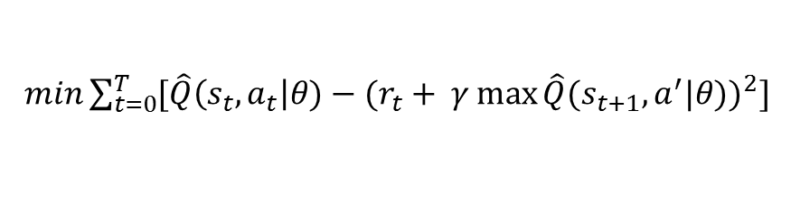
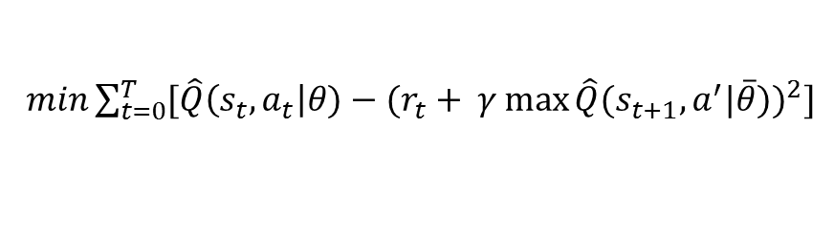


DQN (Deep Q-Network)
2
ISD lab
Separate networks : create a target network
$min\sum_{t=0}^{T}{[{\hat{Q}\left(s_{t}, a_{t}\right|θ)−(r_{t}+ γ\max{\hat{Q}{(s}_{t+1}, a^{′}|θ))}}^{2}]}$
$$θ$$
$min\sum_{t=0}^{T}{[{\hat{Q}\left(s_{t}, a_{t}\right|θ)−(r_{t}+ γ\max{\hat{Q}{(s}_{t+1}, a^{′}|\overline{θ}))}}^{2}]}$
$$θ$$
pred
target
$$\hat{Y}=\hat{Q}\left(s_{t}, a_{t}\right|θ)$$
$$Y= r_{t}+γmax\hat{Q}{(s}_{t+1}, a^{′}|\overline{θ})$$
$$a^{′}$$
Y를 고정시키고 q-network를 update 시킨 후 일정 step 이후, q-network를
target network로 복사
* Human-level control through deep reinforcement learning(2015)

Slide 16

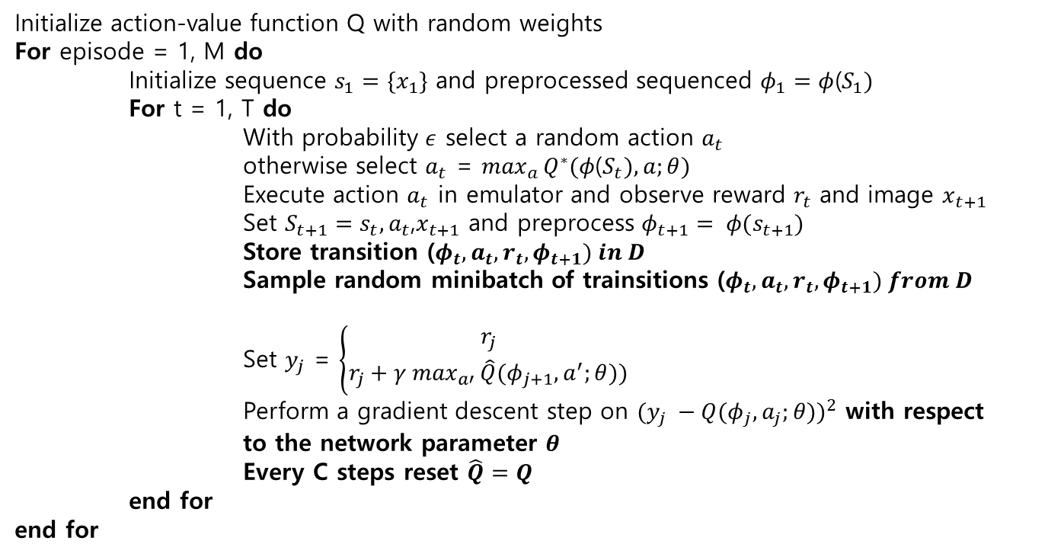
DQN (Deep Q-Network)
2
ISD lab
Separate networks : create a target network
Initialize action-value function Q with random weights
For episode = 1, M do
Initialize sequence $s_{1}=\{x_{1}\}$ and preprocessed sequenced $φ_{1}=φ$($S_{1})$
For t = 1, T do
With probability $ε$ select a random action $a_{t}$
otherwise select $a_{t}$ = $\max_{a}{Q^{∗}(φ\text{(}S_{t}),a;θ)}$
Execute action $a_{t}$ in emulator and observe reward $r_{t}$ and image $x_{t+1}$
Set $S_{t+1}=s_{t},a_{t}$,$x_{t+1}$ and preprocess $φ_{t+1}= φ(s_{t+1})$
Store transition ($φ_{t}, a_{t},r_{t},φ_{t+1}) in D$
Sample random minibatch of trainsitions ($φ_{t}, a_{t},r_{t},φ_{t+1}) from D$
Set $y_{j}$ = $\left\{\begin{aligned}r_{j} \\ r_{j}+γ \max_{a′}{\hat{Q}{(φ}_{j+1}, a^{′};θ))}\end{aligned}\right.$
Perform a gradient descent step on ${(y_{j} −Q{(φ}_{j},a_{j};θ))}^{2}$ with respect to the network parameter $θ$
Every C steps reset $\hat{Q}=Q$
end for
end for
for terminal $φ_{j+1}$
for non-terminal $φ_{j+1}$

Slide 17

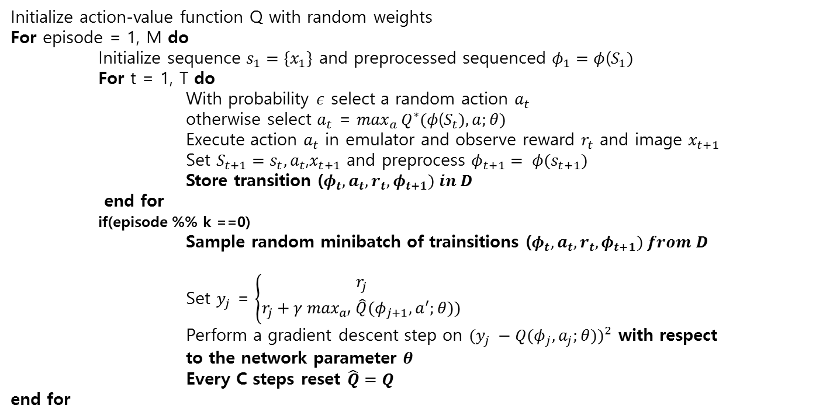
DQN (Deep Q-Network)
2
ISD lab
Separate networks : create a target network
Initialize action-value function Q with random weights
For episode = 1, M do
Initialize sequence $s_{1}=\{x_{1}\}$ and preprocessed sequenced $φ_{1}=φ$($S_{1})$
For t = 1, T do
With probability $ε$ select a random action $a_{t}$
otherwise select $a_{t}$ = $\max_{a}{Q^{∗}(φ\text{(}S_{t}),a;θ)}$
Execute action $a_{t}$ in emulator and observe reward $r_{t}$ and image $x_{t+1}$
Set $S_{t+1}=s_{t},a_{t}$,$x_{t+1}$ and preprocess $φ_{t+1}= φ(s_{t+1})$
Store transition ($φ_{t}, a_{t},r_{t},φ_{t+1}) in D$
end for
if(episode %% k ==0)
Sample random minibatch of trainsitions ($φ_{t}, a_{t},r_{t},φ_{t+1}) from D$
Set $y_{j}$ = $\left\{\begin{aligned}r_{j} \\ r_{j}+γ \max_{a′}{\hat{Q}{(φ}_{j+1}, a^{′};θ))}\end{aligned}\right.$
Perform a gradient descent step on ${(y_{j} −Q{(φ}_{j},a_{j};θ))}^{2}$ with respect to the network parameter $θ$
Every C steps reset $\hat{Q}=Q$
end for
for terminal $φ_{j+1}$
for non-terminal $φ_{j+1}$

Slide 18
감사합니다.

