Slide 1
Introduction to Response Assertion
Emp id-6162

Slide 2
What is an Assertion?
Assertion help verifies that your server under test returns the expected results

Slide 3
Response Assertion
The response assertion lets you add pattern strings to be compared against various fields of the server response

Slide 4
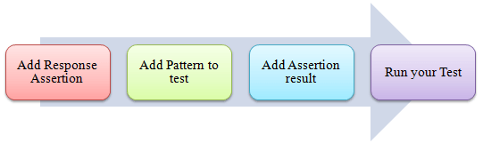
Steps to use Response Assertion

Slide 5
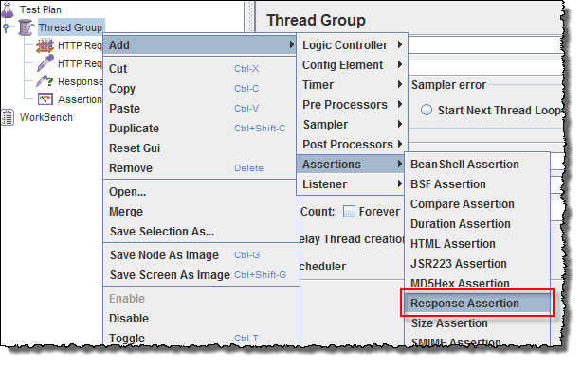
Add Response Assertion

Slide 6
Add Pattern to test
404
200
302

Slide 7
Thank You
This work is licensed under a Creative Commons Attribution-ShareAlike 3.0 Unported License. It makes use of the works of Kelly Loves Whales and Nick Merritt.

