Slide 1

What you learn ?
Python OOP
Python OOP | Method Overloading and Method Overriding
Python Polymorphism | Constructor
Inheritance | Encapsulation & Data Abstraction
Python OOP

Slide 2
Python OOP
Python is a multi-paradigm programming language. Meaning, it supports different programming approach.
One of the popular approach to solve a programming problem is by creating objects. This is known as Object-Oriented Programming (OOP).
Class
Object
Method
Inheritance .
Encapsulation
Polymorphism
Data Abstraction
Python OOP

Slide 3
Python OOP - Class and Object
A class is a blueprint for the object.
class ClassName:
<statement-1>
.
.
<statement-N>
The object is an entity that has state and behavior. It may be any real-world object like tree,fruit etc.
Everything in Python is an object, and almost everything has attributes and methods. All functions have a built-in attribute
objName = ClassConstructor()
Python OOP

Slide 4
Python OOP - Method and Inheritance
Methods are functions defined inside the body of a class. They are used to define the behaviors of an object.
def MethodName(Argument1,Argument2):
Inheritance provides code reusability to the program because we can use an existing class to create a new class instead of creating it from scratch. In inheritance, the child class acquires the properties and can access all the data members and functions defined in the parent class. A child class can also provide its specific implementation to the functions of the parent class.
class derived-class(base class1):
Python OOP

Slide 5
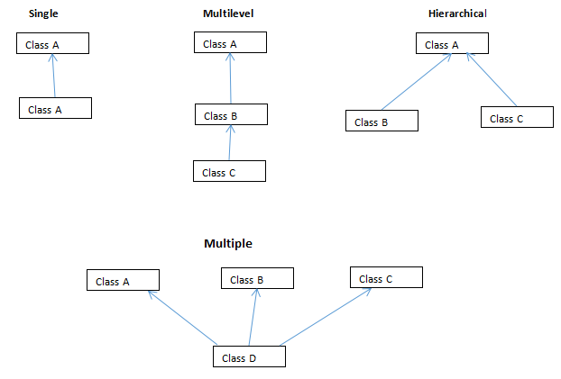
Python OOP - Inheritance Types
Python OOP

Slide 6
Python OOP – Encapsulation & Data Abstraction
Using OOP in Python, we can restrict access to methods and variables. This prevent data from direct modification which is called encapsulation
we can also perform data hiding by adding the double underscore (___) as a prefix to the attribute which is to be hidden. After this, the attribute will not be visible outside of the class through the object.
Python OOP - Polymorphism
Polymorphism is an ability (in OOP) to use common interface for multiple form (data types).
Python OOP

Slide 7
Operator Overloading in Python
Python operators work for built-in classes. But same operator behaves differently with different types. For example, the + operator will, perform arithmetic addition on two numbers, merge two lists and concatenate two strings.
Oerator Overloading allows same operator to have different meaning according to the context is called operator overloading
Python OOP

Slide 8
Python Constructor
A constructor is a special type of method (function) which is used to initialize the instance members of the class.
There are two types of Constructors.
1) Parameterized Constructor
2) Non-parameterized Constructor
Constructor definition is executed when we create the object of this class.
In python, the method __init__ simulates the constructor of the class. This method is called when the class is instantiated.
Python OOP

Slide 9
Python Access Modifiers
In most of the object-oriented languages access modifiers are used to limit the access to the variables and functions of a class.
Python makes the use of underscores to specify the access modifier for a specific data member and member function in a class.
Access modifiers play an important role to protect the data from unauthorized access as well as protecting it from getting manipulated. When inheritance is implemented there is a huge risk for the data to get destroyed(manipulated) due to transfer of unwanted data from the parent class to the child class. Therefore, it is very important to provide the right access modifiers for different data members and member functions depending upon the requirements.
Python OOP

Slide 10
Python Self
self represents the instance of the class. By using the “self” keyword we can access the attributes and methods of the class in python. It binds the attributes with the given arguments
class Cat:
def __init__(self, name, age):
self.name = name
self.age = age
def info(self):
print(f"I am a cat. My name is {self.name}. I am {self.age} years old.")
def make_sound(self):
print("Meow")
Python OOP

Slide 11
THANKS
Python OOP

