Slide 1

What you learn ?
Python Data Structure
What is Data Structure | DS Container and Algorithms
Stack Queue | Linked List –Single & Double
Sorting Algorithm
Python Data Structure

Slide 2
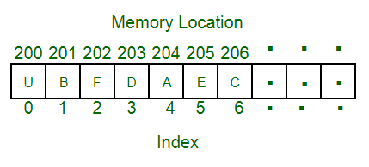
Data Structure
A data structure is a particular way of organizing data in a computer so that it can be used effectively.
Array
For example, we can store a list of items having the same data-type using the array data structure.
Python Data Structure

Slide 3
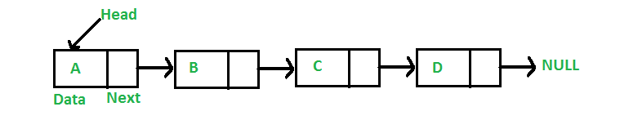
Linked List Data Structure
linked list consists of nodes where each node contains a data field and a reference(link) to the next node in the list.
linked list elements are not stored at a contiguous location; the elements are linked using pointers.
Python Data Structure

Slide 4
Why Linked List?
Arrays can be used to store linear data of similar types, but arrays have the following limitations.
1) The size of the arrays is fixed: So we must know the upper limit on the number of elements in advance. Also, generally, the allocated memory is equal to the upper limit irrespective of the usage.
2) Inserting a new element in an array of elements is expensive because the room has to be created for the new elements and to create room existing elements have to be shifted. For example, in a system, if we maintain a sorted list of IDs in an array id[]. id[] = [1000, 1010, 1050, 2000, 2040]. And if we want to insert a new ID 1005, then to maintain the sorted order, we have to move all the elements after 1000 (excluding 1000). Deletion is also expensive with arrays until unless some special techniques are used. For example, to delete 1010 in id[], everything after 1010 has to be moved.
Python Data Structure

Slide 5
Types of Linked List
Single Link List
A singly linked list is a type of linked list that is unidirectional, that is,
it can be traversed in only one direction from head to the last node (tail).
A single node contains data and a pointer to the next node which helps in maintaining the
structure of the list.
Double Link List
Doubly linked list is a type of linked list in which each node apart from storing its data has
two links. The first link points to the previous node in the list and the second link points to
the next node in the list.
Python Data Structure

Slide 6
Data Structure
Python Data Structure

Slide 7
Data Structure
Python Data Structure

Slide 8
Data Structure
Python Data Structure

Slide 9
Data Structure
Python Data Structure

Slide 10
Data Structure
Python Data Structure

Slide 11
THANKS
Python Data Structure

