Slide 1
Operating Systems Lab Part 1: Threads

Slide 2
4.4BSD like scheduler

Slide 3
Outline of Advanced Scheduler
Main Goal
Implement 4.4 BSD scheduler MLFQ like scheduler without the queues.
Give priority to the processes with interactive nature.
Priority based scheduler
Use “equation”.
Files to modify
threads/thread.*
devices/timer.c

Slide 4
nice
Nice value
Represents the ‘niceness’ of a thread.
If a thread is nicer, it is willing to give up some of its CPU time.
Value (from -20 to 20)
Nice (0) : not influence on priority. (initial value)
Nice (positive) : decrease priority.
Nice (negative) : increase priority.
Function
thread_get_nice()
thread_set_nice(int new_nice)

Slide 5
Priority
Priority
From 0 (PRI_MIN) to 63 (PRI_MAX)
The larger the number, the higher the priority.
It initialized when thread is created (default: 31)

Slide 6
Priority
priority = PRI_MAX – (recent_cpu / 4) – (nice * 2)
Philosophy
If the thread is nicer, lower the priority.
If the thread have been using lots of CPU recently, lower the priority.
For all threads, priority is recalculated once in every fourth clock tick.
The result is truncated to its nearest integer.

Slide 7
CPU usage
Update the cpu usage
recent_cpu
Increase the recent_cpu of the currently running process by 1 in every timer interrupt.
Decay recent_cpu by decay factor in every second.
recent_cpu = decay * recent_cpu
Adjust recent_cpu by nice in every second.
recent_cpu = recent_cpu + nice
Putting them together,
recent_cpu = decay * recent_cpu + nice

Slide 8
Decay factor
In SVR3
decay = ½
In BSD4.4
In heavy load, decay is nearly 1.
In light load, decay is 0.
decay = (2*load_average)/ (2*load_average + 1)

Slide 9
load _average
load_average
load_avg = (59/60)*load_avg + (1/60)*ready_threads
At booting, load_avg is initially set to 0.
ready_threads: the number of threads in ready_list and threads in executing at the time of update. (except idle thread)

Slide 10
In summary,
In every fourth tick, recompute the priority of all threads
priority = PRI_MAX – (recent_cpu / 4) – (nice * 2)
In every clock tick, increase the running thread’s recent_cpu by one.
In every second, update every thread’s recent_cpu
recent_cpu = decay * recent_cpu + nice, where
decay = (2*load_average)/ (2*load_average + 1)
and
load_avg = (59/60)*load_avg + (1/60)*ready_threads

Slide 11
Priority = PRI_MAX – (recent_cpu/4) – (nice*2)
recent_cpu = (2*load_avg)/(2*load_avg+1)*recent_cpu + nice
load_avg = (59/60)*load_avg + (1/60)*ready_threads
nice = 0,
load_avg = 0
Sec | Tick | P1 |  | P2 |  | P3
 |  | Priority | recent_cpu | Priority | recent_cpu | Priority | recent_cpu
0 | 0 | 63 | 0 | 63 | 0 | 63 | 0
 | 1 | 63 | 1 | 63 | 0 | 63 | 0
 | 2 | 63 | 2 | 63 | 0 | 63 | 0
 | 3 | 63 | 3 | 63 | 0 | 63 | 0
 | 4 | 62 | 4 | 63 | 0 | 63 | 0
 | 5 | 62 | 4 | 63 | 1 | 63 | 0
 | 6 | 62 | 4 | 63 | 2 | 63 | 0
 | 7 | 62 | 4 | 63 | 3 | 63 | 0
1 | 8 | 63 | 0 | 62 | 4 | 63 | 0
 | 9 | 63 | 0 | 62 | 4 | 63 | 1
 | 10 | 63 | 0 | 62 | 4 | 63 | 2
 | 11 | 63 | 0 | 62 | 4 | 63 | 3
 | 12 | 63 | 0 | 63 | 0 | 62 | 4
 | 13 | 63 | 1 | 63 | 0 | 62 | 4
 | 14 | 63 | 2 | 63 | 0 | 62 | 4
 | 15 | 63 | 3 | 63 | 0 | 62 | 4
Priority
=PRI_MAX(63)–(4/4)–(0*2)
=62
Running
Priority recalculate
Recent CPU recalculate

Slide 12
Implement fixed point arithmetic
Inside kernel, you can do only integer arithmetic.
Kernel does not save floating point register when switching the context.
We need to implement fixed point arithmetic using integer arithmetic.
priority, nice, ready_threads value is integer, and recent_cpu, load_avg value is real number.
Implement the fixed-pint arithmetic using 17.14 fixed-point number representation.
Decimal point is 14 right-most bits.
Integer is 17 next bits to the left.
Last of left 1bit is sign bit.
31
30
13
0
Integer (17bits)
Point (14bits)
Sign bit

Slide 13
Operations to implement
n : integer x, y : fixed-point numbers f : 1 in 17.14 format
31
30
13
0
f
0
00000000000000001
00000000000000
Sign bit
Convert n to fixed point: | n * f
Convert x to integer (rounding toward zero): | x / f
Convert x to integer (rounding to nearest): | (x + f / 2) / f if x >= 0, (x - f / 2) / f if x <= 0.
Add x and y: | x + y
Subtract y from x: | x - y
Add x and n: | x + n * f
Subtract n from x: | x - n * f
Multiply x by y: | ((int64_t) x) * y / f
Multiply x by n: | x * n
Divide x by y: | ((int64_t) x) * f / y
Divide x by n: | x / n

Slide 14
Examples
Convert n to fixed point: n * f: shift n by 14 bits to the left.
Convert x to integer: shift x by 14 to the right.

Slide 15
Implementation
Each thread maintains
nice and recent_cpu
Add nice, recent_cpu to thread structure.
Functions to be added
The function that calculate priority using recent_cpu and nice.
The function that calculate recent_cpu.
The function that calculate load_avg.
The function that increase recent_cpu by 1.
The function that recalculate priority and recent_cpu of all threads.
Multiple ready queues vs. single ready queue
You can use single in implementing BSD scheduler.
If you use multiple ready queues, you will get 10 extra mark for 100 mark.

Slide 16
Functions to modify
static void init_thread(struct thread *t, const char *name, int priority)
Initialize nice, recent_cpu
void thread_set_priority(int new_priority)
Disable the priority setting when using the advanced scheduler.
static void timer_interrupt(struct intr frame *args UNUSED)
Recalculate load_avg, recent_cpu of all threads, priority every 1 sec.
Recalculate priority of all threads every 4th tick.

Slide 17
Functions to modify
void lock_acquire(struct lock *lock)
Forbid the priority donation when using the advanced scheduler.
void lock_release(struct lock *lock)
Forbid the priority donation when using the advanced scheduler.

Slide 18
Functions to modify
void thread_set_nice(int nice UNUSED)
Set nice value of the current thread.
int thread_get_nice(void)
Return nice value of the current thread.
int thread_get_load_avg(void)
Return load_avg multiplied by 100
timer_ticks() % TIMER_FREQ == 0
int thread_get_recent_cpu(void)
Rerturn recent_cpu multiplied by 100

Slide 19
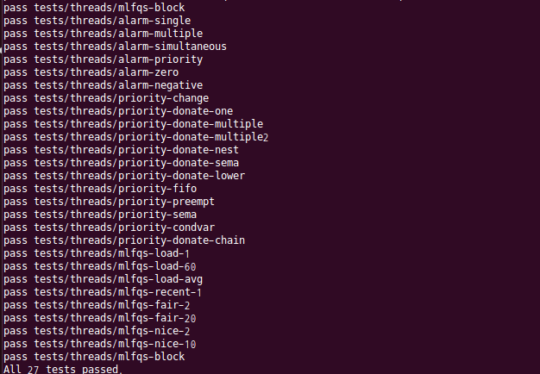
Result
$ make check

