Slide 1

IB DIPLOMA PROGRAMME · ECONOMICS
Economic Growth
Macroeconomics · Standard & Higher Level
An interactive study deck — diagrams, worked examples, exercises and real exam practice, built to give you a solid understanding fast.
Diagrams
Exercises
Exam practice
▶ Tip: run this in Slide Show mode — click to reveal answers and watch the diagrams shift.
Notes:
Welcome. Today's topic is economic growth - one of the main macroeconomic objectives. By the end you should be able to define, draw, explain, evaluate and calculate growth (SL and HL). Tip: run this in Slide Show mode - the exercises reveal their answers on click.

Slide 2





HOW TO USE THIS DECK
What you will master
Define & measure growth Real GDP, real GDP per capita, and why "real" matters.
1
Show growth on diagrams The PPC and the AD–AS model (short run vs long run).
2
Explain the causes More factors of production and better productivity.
3
Evaluate the consequences Living standards, inequality, the environment & sustainability.
4
Apply & sit the exam Growth-rate calculations plus Paper 1 exam-style questions.
5
Economic Growth · IB Economics · Macroeconomics
2
Notes:
Quick roadmap of the five things we will master. Emphasise that diagrams and evaluation earn the most marks in the exam. Point out the 'Your turn' slides where students try a question before the answer is revealed.

Slide 3
SECTION
01
The Big Picture
What economic growth is — and how we measure it.
Economic Growth · IB Economics · Macroeconomics
3
Notes:
Section 1: the big picture - what economic growth means and how we measure it.

Slide 4

01 · THE BIG PICTURE
What is economic growth?
Economic growth = an increase in the real output (real GDP) of an economy over a period of time.
Key terms
Real GDP — output valued at constant (base-year) prices.
Nominal GDP — output at current prices (inflation-distorted).
GDP per capita — GDP ÷ population.
Rate of growth — annual % change in real GDP.
Measured as the % change in real GDP from one year to the next.
Real GDP per capita (real GDP ÷ population) better reflects average living standards.
“Real” strips out inflation, so we compare volumes of output, not just higher prices.
It is one of the key macroeconomic objectives, alongside low unemployment, low inflation and equity.
Economic Growth · IB Economics · Macroeconomics
4
Notes:
Core definition: an increase in REAL GDP over time. Stress two words: 'real' (adjusted for inflation) and 'per capita' (better for living standards). Remind them growth is one of the macroeconomic objectives.

Slide 5




01 · THE BIG PICTURE
Real vs nominal GDP
Nominal GDP
Real GDP
Measured at current (this year’s) prices.
Rises when prices rise — even if no extra goods are made.
Can overstate real progress during inflation.
Measured at constant (base-year) prices.
Strips out inflation — shows the true change in volume.
The correct measure of economic growth.
Convert: Real GDP = ( Nominal GDP ÷ GDP deflator ) × 100
GO FURTHER increase your knowledge
Read about the difference between the GDP deflator and the CPI, and why economists prefer chained/real measures for comparisons over time.
Economic Growth · IB Economics · Macroeconomics
5
Notes:
Contrast the two. Nominal GDP uses current prices, so inflation can inflate it. Real GDP uses constant prices, so it shows the true change in volume - that is what we mean by growth. Example: if prices rise but output is flat, nominal rises but real does not.

Slide 6


01 · THE BIG PICTURE
Actual vs potential growth
Actual growth
Potential growth
A real increase in output happening now.
Uses up spare / idle capacity (e.g. re-employing workers).
Often cyclical — the short-run upswing of the business cycle.
Closes a negative output gap.
An increase in the economy’s productive capacity.
The maximum it can sustainably produce at full employment.
Long-run — more or better factors of production.
Shifts the frontier (PPC / LRAS) outward.
Link: closing an output gap = actual growth · expanding the capacity ceiling = potential growth.
Economic Growth · IB Economics · Macroeconomics
6
Notes:
The key distinction for the whole topic. Actual growth = using spare capacity now (short run, closes an output gap). Potential growth = expanding capacity (long run, shifts the frontier). We draw both on the next slides.

Slide 7
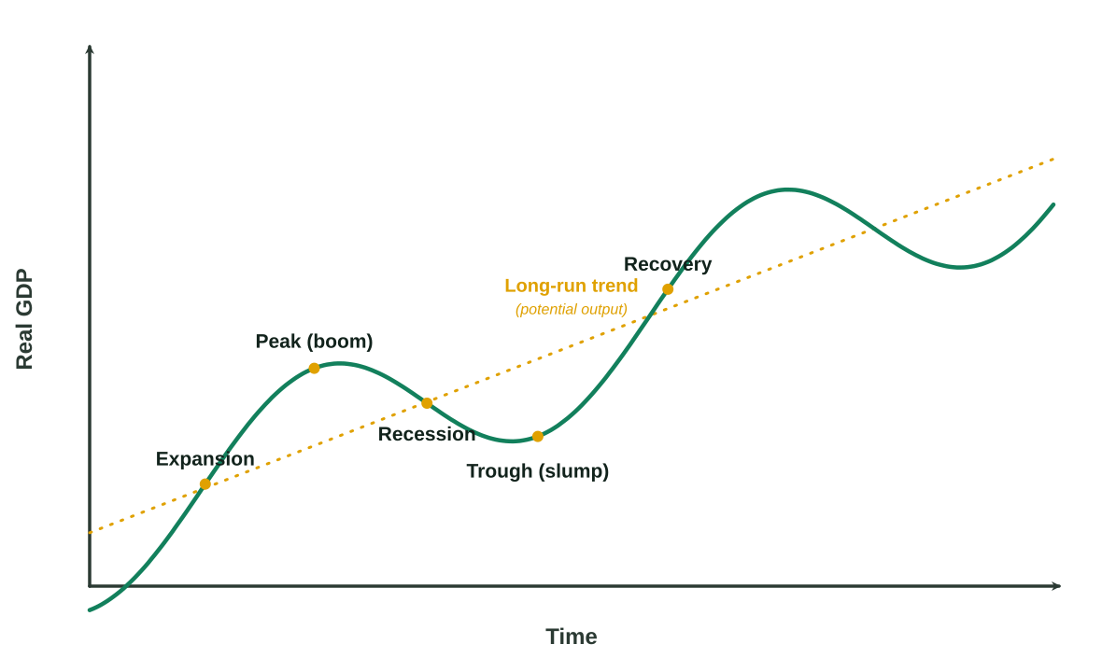
01 · THE BIG PICTURE
Growth & the business cycle
Growth is the upward long-run trend in real GDP.
The business cycle is the short-run fluctuation around that trend.
Boom → recession → trough → recovery, then repeat.
Recession = two consecutive quarters of negative real GDP growth.
GO FURTHER increase your knowledge
Explore output gaps (positive vs negative) and leading economic indicators used to forecast the cycle.
Economic Growth · IB Economics · Macroeconomics
7
Notes:
Growth is the long-run upward trend; the business cycle is the short-run wobble around it. Name the phases (boom, recession, trough, recovery). Define a recession: two consecutive quarters of negative real GDP growth.

Slide 8
SECTION
02
Show It on a Diagram
Modelling growth with the PPC and AD–AS.
Economic Growth · IB Economics · Macroeconomics
8
Notes:
Section 2: let's put growth on diagrams - the PPC and the AD-AS model.

Slide 9
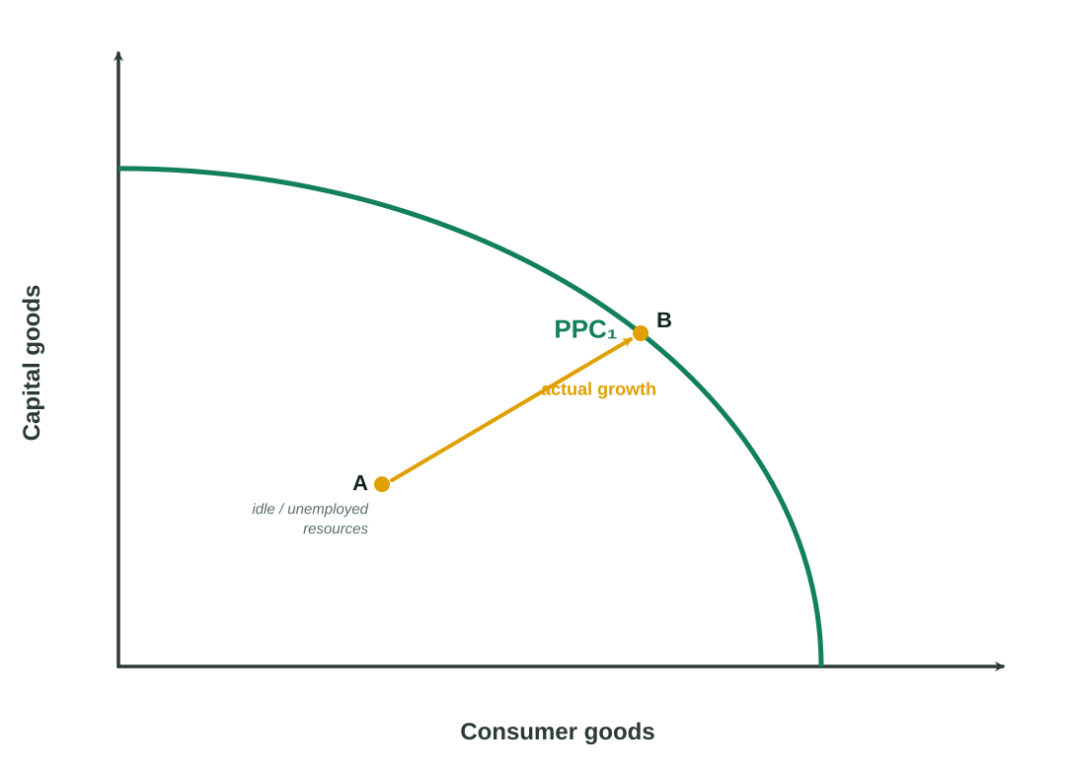
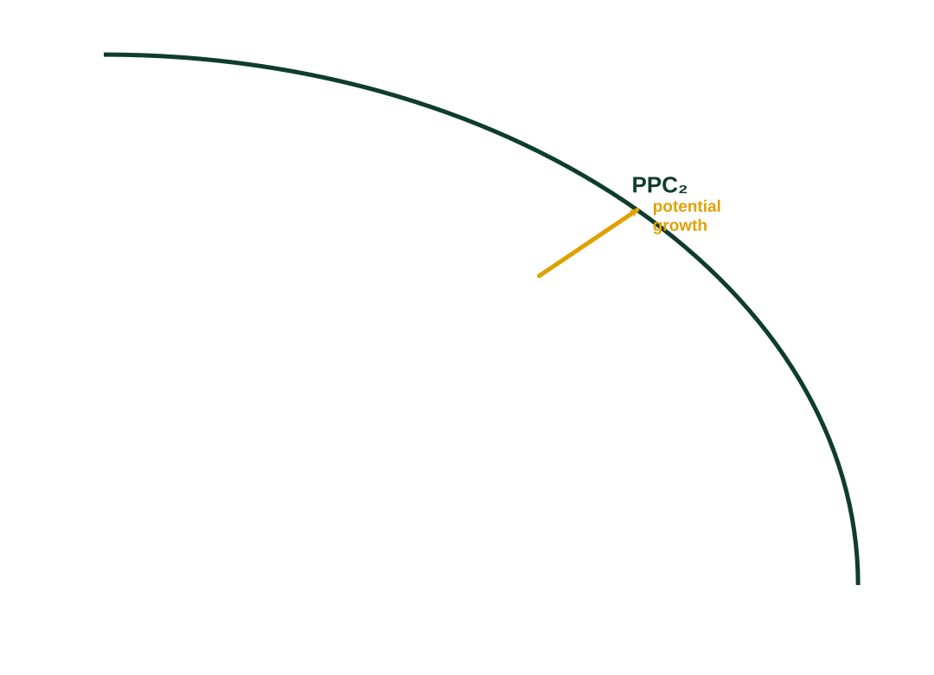


02 · DIAGRAMS
▶ Click to reveal
Growth on the PPC
Actual growth
Move from a point inside the PPC (A) onto the curve (B) — using previously idle resources. The curve does not shift.
Potential growth
The whole PPC shifts outward (PPC₁ → PPC₂) — more or better factors of production raise capacity.
Economic Growth · IB Economics · Macroeconomics
9
Notes:
Start with the base PPC. Actual growth = moving from a point inside (A) onto the curve (B) using idle resources. CLICK to reveal potential growth = the whole curve shifting outward. One line to remember: inside-to-curve = actual; whole-curve-out = potential.

Slide 10
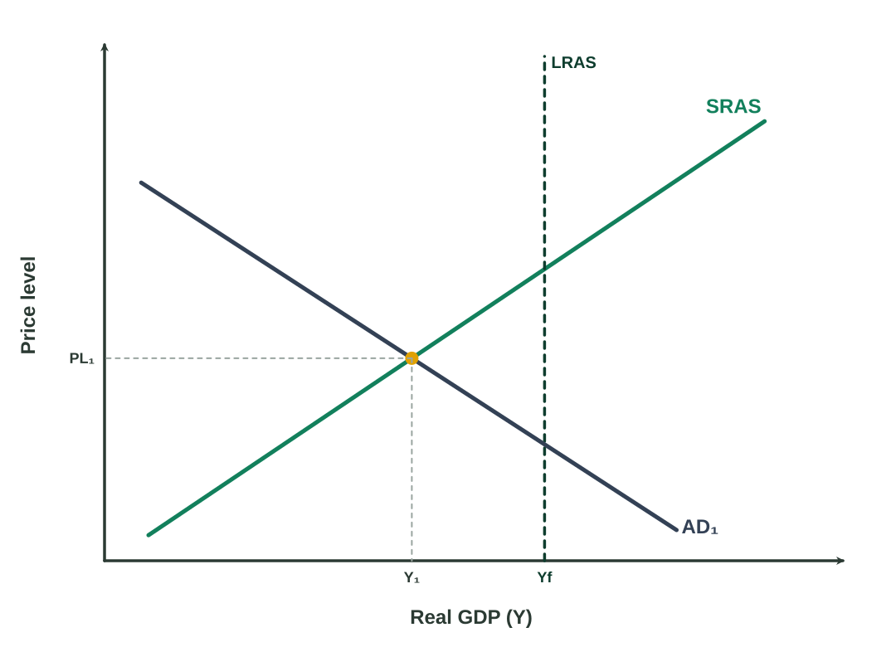
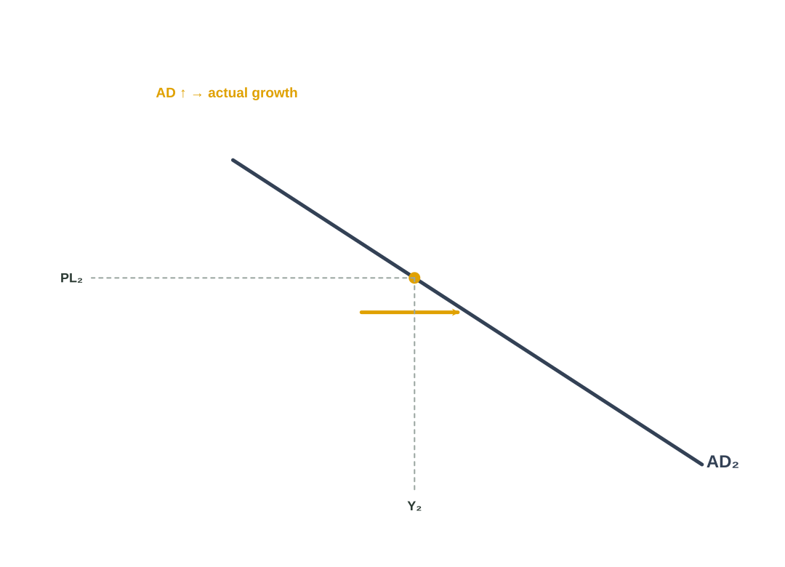
02 · DIAGRAMS
▶ Click to reveal
AD–AS: actual (short-run) growth
A rise in aggregate demand (AD₁ → AD₂) raises real GDP in the short run.
Drivers: consumption (C), investment (I), government (G) or net exports (X−M).
But note: the price level also rises (PL₁ → PL₂) — inflation risk as you near full capacity (Yf).
GO FURTHER increase your knowledge
This is demand-side growth. Compare it with supply-side (LRAS) growth on the next slide.
Economic Growth · IB Economics · Macroeconomics
10
Notes:
Show equilibrium below full capacity. CLICK to shift AD to the right - real GDP rises (actual growth), but so does the price level (inflation risk near full capacity). This is demand-side growth.

Slide 11
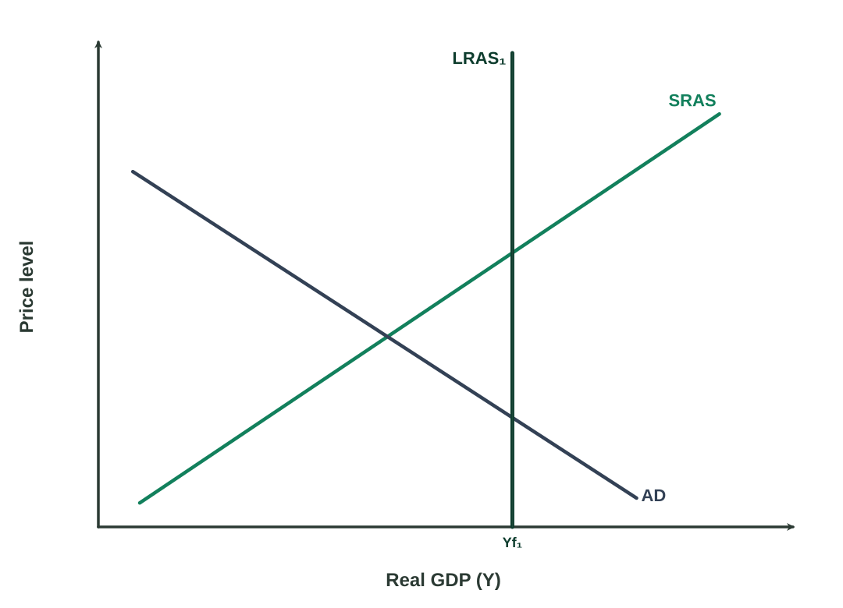
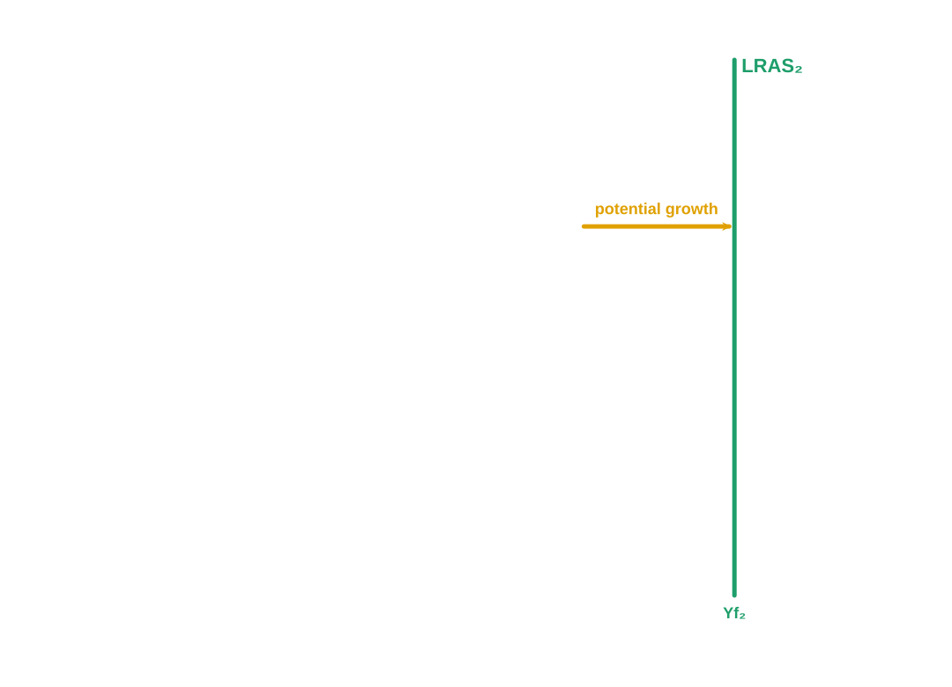
02 · DIAGRAMS
▶ Click to reveal
AD–AS: potential (long-run) growth
Potential growth = a rightward shift of LRAS (LRAS₁ → LRAS₂).
Caused by more / better factors of production and higher productivity.
Full-capacity output rises with no inflationary pressure — this is sustainable growth.
GO FURTHER increase your knowledge
Compare the Monetarist/New-Classical vertical LRAS with the Keynesian AS model, where the vertical (full-employment) section shifts right.
Economic Growth · IB Economics · Macroeconomics
11
Notes:
CLICK to shift LRAS to the right = potential growth. Capacity rises with no inflationary pressure, so it is sustainable. For stronger students, mention the Keynesian AS version where the vertical section shifts right.

Slide 12


02 · DIAGRAMS
▶ Click to reveal
Your turn: read the diagram
Question. A government reopens idle factories, putting unemployed workers back to work. (a) Is this actual or potential growth? (b) How is it shown on a PPC?
Model answer
(a) Actual growth.
Spare capacity is being used — the economy moves toward its existing frontier, it does not expand it.
(b) A movement from a point inside the PPC to a point on the curve.
The PPC itself does not shift (that would be potential growth).
Economic Growth · IB Economics · Macroeconomics
12
Notes:
Let students attempt this first. Read the question, pause, then CLICK to reveal the model answer. Reinforce: reopening idle factories = actual growth = a movement inside-to-curve, with no shift of the PPC.

Slide 13
SECTION
03
What Causes Growth?
The engines behind more — and better — output.
Economic Growth · IB Economics · Macroeconomics
13
Notes:
Section 3: what actually causes growth? Two big buckets - more factors, and better factors.

Slide 14




03 · CAUSES
Cause 1 — more factors of production
Increasing the QUANTITY of resources shifts the PPC / LRAS outward.
Land
Labour
New natural resources — e.g. discovering oil, gas or mineral reserves.
A larger workforce — population growth, immigration, higher participation.
Capital
Enterprise
Investment in machines, factories and infrastructure.
More entrepreneurs combining resources and taking risks.
Economic Growth · IB Economics · Macroeconomics
14
Notes:
More factors of production: land, labour, capital, enterprise. Each shifts the PPC/LRAS outward. Give a quick real example for each (e.g. a new oil field, immigration).

Slide 15



03 · CAUSES
Cause 2 — more productive factors
Improving the QUALITY of resources raises productivity (output per worker) — the engine of long-run growth.
Human capital
Technology
Education, training and better health raise worker productivity.
Innovation and automation let the same inputs produce more.
Institutions
Investment (key)
Property rights, rule of law and stability encourage investment.
Raises both the quantity AND quality of capital — a double driver.
Economic Growth · IB Economics · Macroeconomics
15
Notes:
Better, more productive factors: human capital, technology, institutions, and investment (which raises both quantity and quality). Productivity - output per worker - is the real long-run engine.

Slide 16
03 · CAUSES
▶ Click to reveal
Your turn: sort the cause
Is each a QUANTITY of factors or a QUALITY / productivity improvement? (Answers appear on click.)
1. A baby-boom generation enters the workforce
Quantity — Labour
2. A national free-vaccination programme
Quality — Human capital
3. New AI software raises output per worker
Quality — Technology
4. A large new oil field is discovered
Quantity — Land
5. A government vocational-training scheme
Quality — Human capital
6. Net inward migration of workers
Quantity — Labour
Economic Growth · IB Economics · Macroeconomics
16
Notes:
Classification exercise. Read each item, let students call 'quantity' or 'quality', then CLICK to reveal. Watch-outs: training and health = quality; more workers or new land = quantity.

Slide 17
SECTION
04
Consequences
Benefits, costs, and the evaluation examiners love.
Economic Growth · IB Economics · Macroeconomics
17
Notes:
Section 4: consequences - the benefits, the costs, and the evaluation examiners reward.

Slide 18




04 · CONSEQUENCES
Benefits of economic growth
Higher living standards
Lower unemployment
Higher average real incomes let households consume more.
Growing firms hire more workers as output expands.
More tax revenue
Less absolute poverty
Funds public services and can reduce government debt.
Rising incomes can lift people out of poverty — if shared.
Also: stronger business & consumer confidence, encouraging further investment.
Economic Growth · IB Economics · Macroeconomics
18
Notes:
Quick run-through of the benefits: higher incomes and living standards, lower unemployment, more tax revenue, less poverty. Students usually know these, so keep it brisk.

Slide 19




04 · CONSEQUENCES
Costs & risks of growth
Demand-pull inflation
Environmental damage
If AD-driven near capacity, the price level rises.
Pollution, carbon emissions and depletion of resources.
Rising inequality
May be unsustainable
The gains may go mostly to owners of capital and skilled workers.
Fast growth today can undermine the resources of tomorrow.
Also: structural unemployment as “creative destruction” makes some industries obsolete.
Economic Growth · IB Economics · Macroeconomics
19
Notes:
The flip side: demand-pull inflation, environmental damage, rising inequality, and sustainability concerns. This sets up the evaluation on the next slide.

Slide 20


04 · CONSEQUENCES
Evaluation: is growth always good?
Top marks come from judgement — “it depends on…”
How it is achieved
Who gains
Environmental cost
Context & type
AD-led growth risks inflation; LRAS-led (supply-side) growth is more sustainable.
If growth mainly benefits the top, inequality can worsen despite a bigger economy.
“Dirty” growth harms welfare; green growth aims to decouple output from emissions.
A little growth means more in a low-income country than in a rich one.
Exam tip: always weigh benefits against costs, use a real-world example, then give a supported final judgement.
Economic Growth · IB Economics · Macroeconomics
20
Notes:
The single most important exam skill. Growth is not automatically good - it depends on how it is achieved, who gains, the environmental cost, and the country's context. Drill the exam tip: weigh both sides, use an example, give a judgement.

Slide 21
04 · CONSEQUENCES
Growth vs development
Economic growth
Economic development
Quantitative: simply more real output (GDP). A necessary means, but narrow — it says nothing about how people actually live.
Multidimensional: incomes + health + education + freedoms & choices. Growth can enable it, but is not sufficient on its own.
GO FURTHER increase your knowledge
Read about: GDP vs the HDI · sustainable development (meeting today’s needs without harming future generations) · “green growth” and decoupling growth from carbon emissions.
Economic Growth · IB Economics · Macroeconomics
21
Notes:
Growth = more output (quantitative). Development = broader wellbeing - incomes plus health, education and freedoms. Growth can enable development but is not the same thing.

Slide 22
SECTION
05
Crunch the Numbers
The quantitative skills the exam rewards.
Economic Growth · IB Economics · Macroeconomics
22
Notes:
Section 5: the numbers - the calculation skills the exam expects.

Slide 23


05 · QUANTITATIVE SKILLS
Calculating economic growth
Rate of economic growth
%Δ = [ (GDP₂ − GDP₁) ÷ GDP₁ ] × 100
The annual percentage change in real GDP.
Real GDP from nominal
Real GDP = ( Nominal GDP ÷ deflator ) × 100
Removes the effect of inflation.
Real GDP per capita
= Real GDP ÷ Population
Best proxy for average living standards.
Economic Growth · IB Economics · Macroeconomics
23
Notes:
Three formulas. The growth-rate formula is the one most tested. Show the deflator conversion and the per-capita formula quickly.

Slide 24
05 · QUANTITATIVE SKILLS
▶ Click to reveal
Worked example
Problem. Real GDP is $500bn in Year 1 and $530bn in Year 2. (a) Find the growth rate. (b) If population rose 2%, what happened to real GDP per capita?
(a) Growth rate
(b) Real GDP per capita
= (530 − 500) ÷ 500 × 100
= 30 ÷ 500 × 100
= 6%
Approx. %Δ per capita ≈ %Δ GDP − %Δ population
≈ 6% − 2% = +4%
Living standards rose — output grew faster than population.
Tip: the subtraction rule is an approximation — fine for small percentages.
Economic Growth · IB Economics · Macroeconomics
24
Notes:
Do part (a) live: 30/500 x 100 = 6%. CLICK to reveal. Then part (b): per-capita growth is about 6% - 2% = 4%. Emphasise that the subtraction shortcut works for small percentages, and that living standards rose.

Slide 25

SECTION
06
Exam Zone
Quick-fire quiz and Paper 1 practice.
Economic Growth · IB Economics · Macroeconomics
25
Notes:
Section 6: exam zone - let's test it.

Slide 26
06 · EXAM ZONE
▶ Click to reveal
Quick-fire quiz
✓ B) real GDP over time
1. Economic growth is best defined as an increase in…
A) nominal GDP B) real GDP over time C) the money supply
✓ C) potential (long-run) growth
2. An outward shift of the PPC represents…
A) actual growth B) inflation C) potential (long-run) growth
✓ B) environmental degradation
3. Which is most likely a cost of rapid growth?
A) lower tax revenue B) environmental degradation C) lower prices
Economic Growth · IB Economics · Macroeconomics
26
Notes:
Ask each question, let students answer, then CLICK to reveal the correct option. A quick, fun recap of the key definitions and the PPC point.

Slide 27
06 · EXAM ZONE
Paper 1 — exam-style questions
10 marks
Part (a)
15 marks
Part (b)
“Explain how investment can increase an economy’s rate of economic growth.”
“Evaluate the view that economic growth always improves living standards.”
Define economic growth & investment.
Use a diagram: LRAS (or PPC) shifting right.
Explain the chain: investment → more/better capital → productivity → capacity.
One real-world example.
Benefits: incomes, jobs, tax revenue, poverty.
Against: inequality, inflation, environment, sustainability.
“Depends on” how growth is achieved & shared.
Real-world example + a supported judgement.
Command terms: “Explain” = give reasons with theory + diagram. “Evaluate” = weigh both sides and judge.
Economic Growth · IB Economics · Macroeconomics
27
Notes:
Show how to structure Paper 1 answers. (a) 'Explain' = theory + a diagram + a chain of reasoning + a real example. (b) 'Evaluate' = both sides + a supported judgement. Point out the command terms.

Slide 28
RECAP
Key terms glossary
Economic growth — increase in real GDP over time.
Real GDP — output at constant (base-year) prices.
Nominal GDP — output at current prices.
GDP per capita — GDP ÷ population.
Actual growth — using spare capacity (inside → onto PPC).
Potential growth — rise in capacity (PPC / LRAS shifts out).
PPC — max combinations of goods with full resources.
Aggregate demand — C + I + G + (X − M).
LRAS — output at full employment (potential).
Productivity — output per unit of input (per worker).
Recession — two quarters of negative real growth.
Sustainable growth — without harming future generations.
Economic Growth · IB Economics · Macroeconomics
28
Notes:
A recap of every key term - great for revision. Tell students to cover the right-hand column and test themselves on the definitions.

Slide 29


WRAP-UP
Key takeaways & where to go next
Take these away
Go further
Growth = rising real GDP; per-capita real GDP tracks living standards.
Actual growth uses spare capacity; potential growth expands it.
Show it with the PPC (shift out) and AD–AS (AD vs LRAS).
Causes = more factors + higher productivity (investment & tech are key).
Always evaluate: growth has real costs, so it is not automatically “good”.
Output gaps & the Keynesian multiplier (HL).
Monetarist vs Keynesian AS models.
Endogenous vs exogenous growth theory.
GDP vs HDI — growth vs development.
Green growth, decoupling & the Kuznets curve.
A real data-response on one country’s growth.
Economic Growth · IB Economics · Macroeconomics
29
Notes:
Five takeaways - especially: always evaluate. Point to the 'go further' list for anyone who wants to push beyond the syllabus (HL multiplier, endogenous growth, HDI, green growth).

Slide 30
ECONOMIC GROWTH · IB ECONOMICS
You’ve got this.
Define it · draw it · explain it · evaluate it · calculate it.
Big picture
Diagrams
Causes
Consequences
Numbers
Exam
Made for IB Economics revision — good luck in the exam!
Notes:
Wrap up with the five verbs: define it, draw it, explain it, evaluate it, calculate it. Invite questions. Good luck in the exam!

