Slide 1


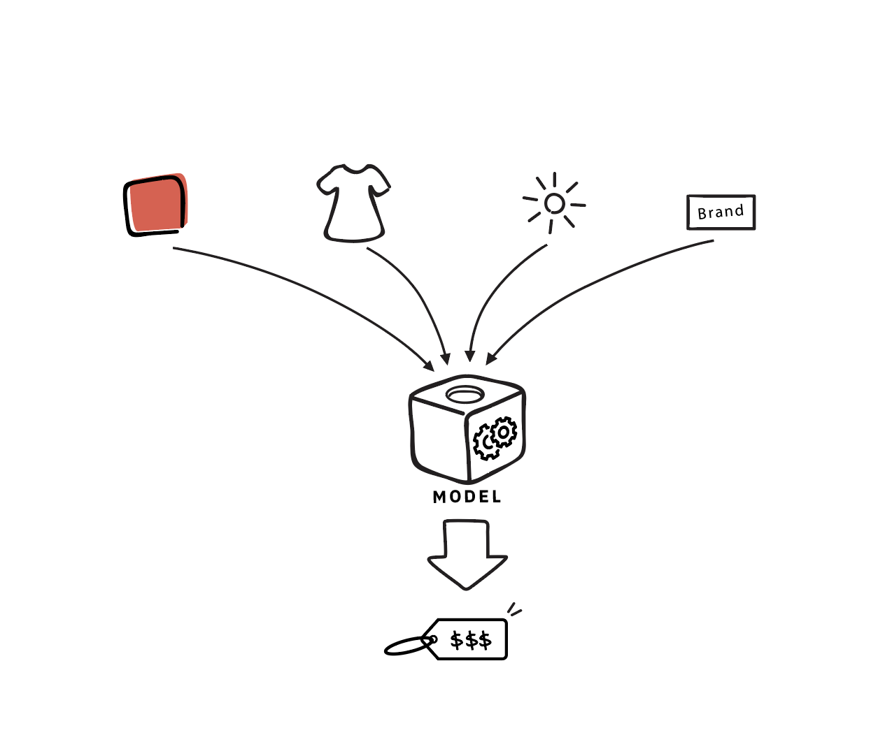
STUDENT PLACEMENT PREDICTION
Guide: Prof.

Slide 2

Our Team
Division :- ET-A Batch :- 2 Group No. :- 5
Name | Roll No. | Gr. No.
Geetai Charde | A-60 | 12020007
Nishit chaudhari | A-64 | 11910054
Abhijeet Chine | A-67 | 12020187
Chinmay Deotale | A-71 | 11910759

Slide 3

METHODOLOGY
UNDERSTANDING PROBLEM STATEMENT :
IMPORT LIBRARIES AND DATASET :
PERFORM EXPLORATORY DATA ANALYSIS
PERFORM DATA VISUALIZATION
CREATE TRAINING AND TESTING DATASET
TRAIN AND EVALUATE USING DIFFERENT MODELS
a) Logistic Regression Model
b) Naive Bayes Classifier
c) Support Vector Machine

Slide 4

UNDERSTANDING PROBLEM STATEMENT :
Placements hold great importance for students to build a strong foundation for the professional career ahead as well as a good placement record gives a competitive edge to a college/university in the education market.
To develop a placement predictor as a part of making a placement management system at college level which predicts the chances of students getting placed and helps in uplifting their skills before the recruitment process starts.
A placement predictor is to be designed to calculate the possibility of a student being placed in a company, subject to the criterion of the company.
The placement predictor takes many parameters which can be used to assess the skill level of the student. While some parameters are taken from the university level, others are obtained from tests conducted in the placement management system itself.
Combining these data points, the predictor is to accurately predict if the student will or will not be placed in a company. Data from past students are used for training the predictor.

Slide 5


Libraries Used

Slide 6
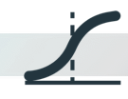
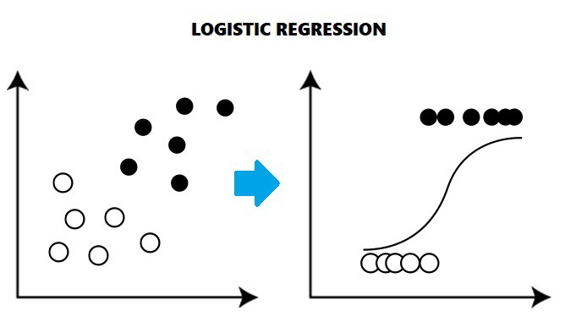
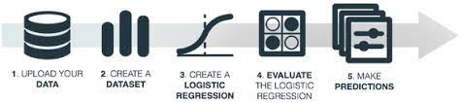
Logistic Regression
The goal of this technique is given a new data point, and predict the class from which the data point is likely to have originated. Input features can be quantitative or qualitative.
The function is defined as logistic(x)=1/(1+exp(-x))

Slide 7
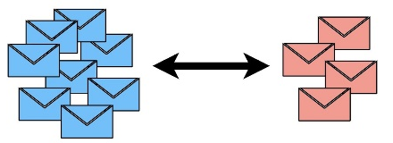
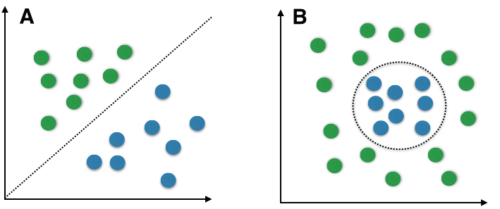
Naïve Baiyes Classifier
The naive Bayes Algorithm is one of the popular classification machine learning algorithms that helps to classify the data based upon the conditional probability values computation.
It implements the Bayes theorem for the computation and used class levels represented as feature values or vectors of predictors for classification. Naive Bayes Algorithm is a fast algorithm for classification problems.
This algorithm is a good fit for real-time prediction, multi-class prediction, recommendation system, text classification, and sentiment analysis use cases.
Naive Bayes Algorithm can be built using Gaussian, Multinomial and Bernoulli distribution.

Slide 8

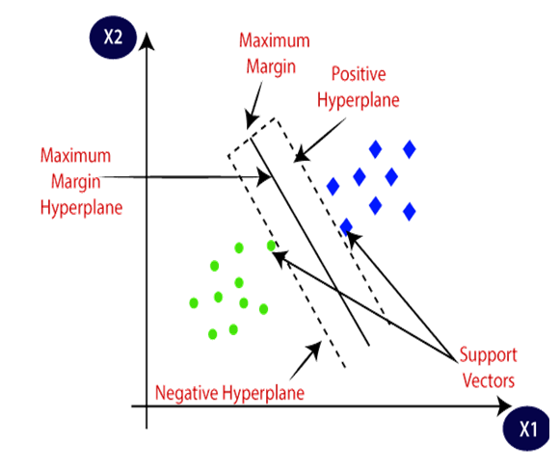
Support Vector Machine
A support vector machine (SVM) is machine learning algorithm that analyzes data for classification and regression analysis.
SVM is a supervised learning method that looks at data and sorts it into one of two categories. An SVM outputs a map of the sorted data with the margins between the two as far apart as possible.
SVMs are used in text categorization, image classification, handwriting recognition and in the sciences.
A support vector machine is also known as a support vector network (SVN).

Slide 9

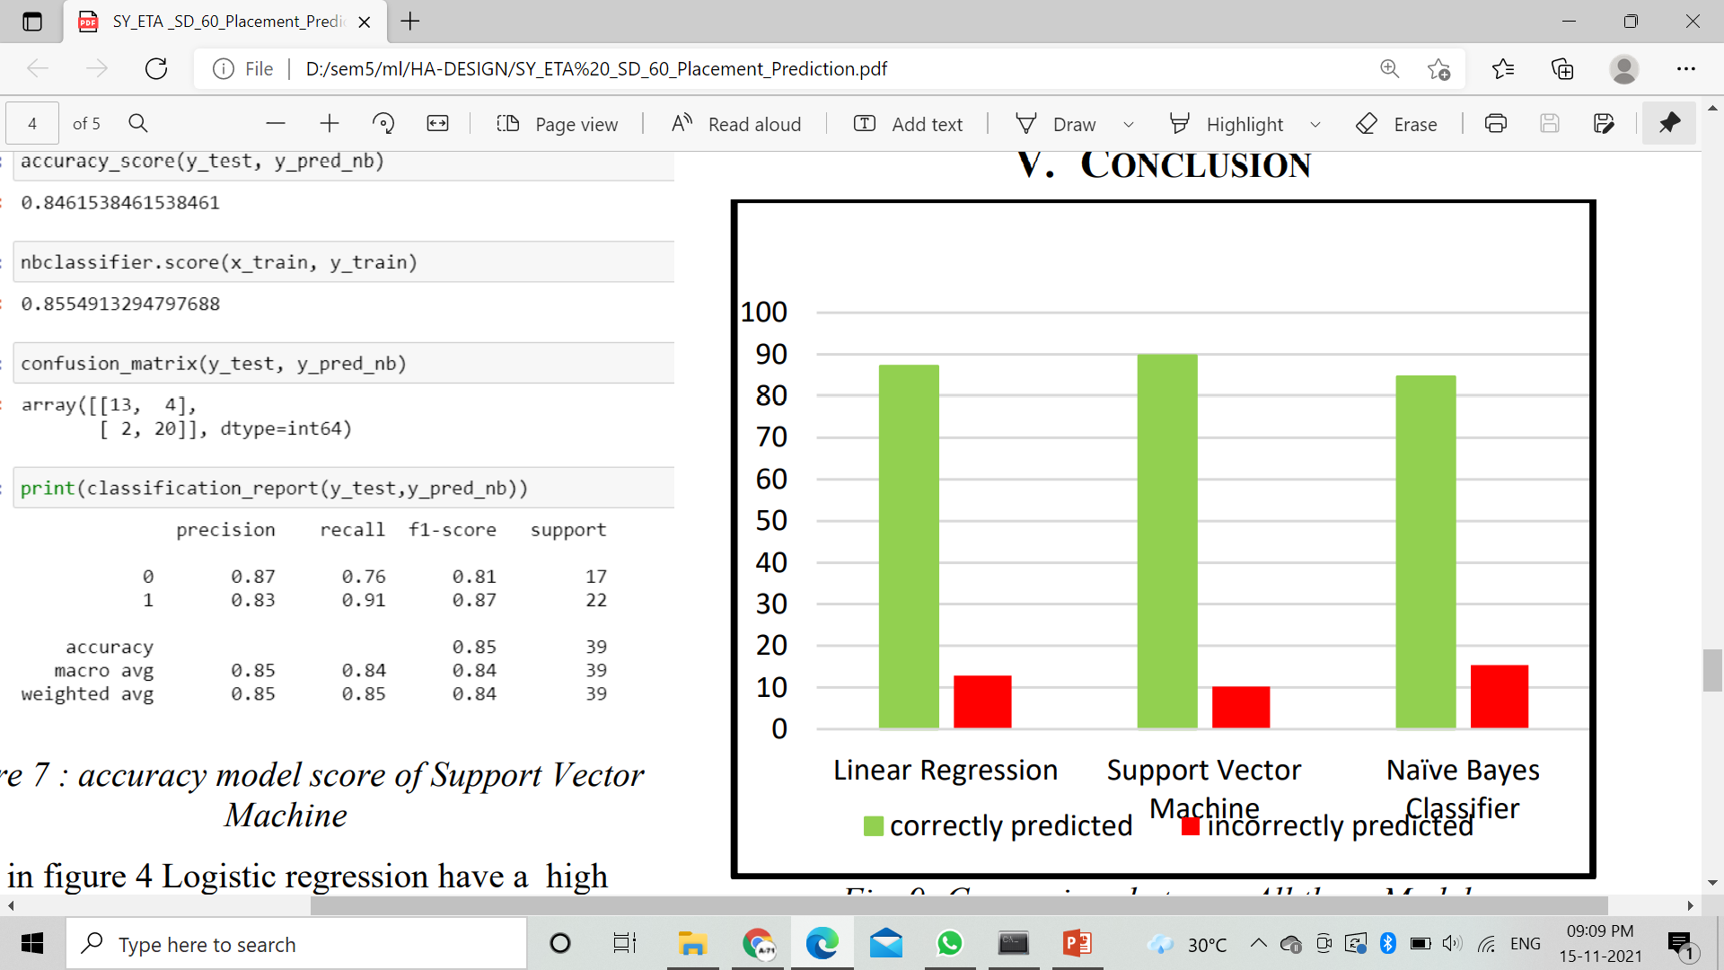
RESULTS
We conclude that Logistic Regression works better with better accuracy but difference in scores is highest among three
Gaussian Naive Bayes was less accurate but the difference in known and unknown data was lesser
But, SVM gave better accuracy with least difference in score. So, Our final model would use SVM for Student Placement Prediction.

Slide 10
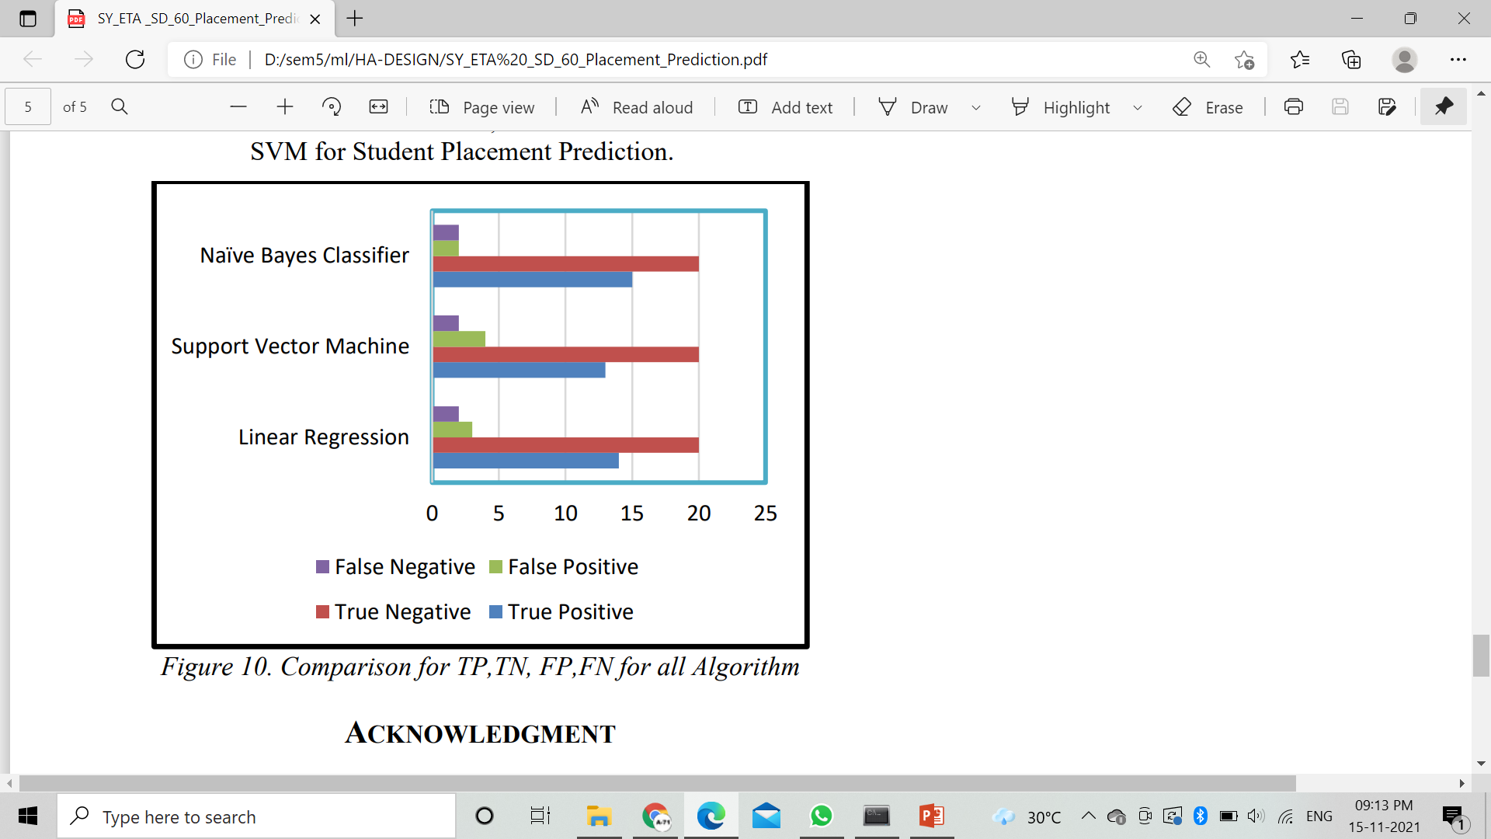
RESULTS

Slide 11


